Slide 1
The essential oils of thyme, sage and peppermint against strawberry anthracnose
Armina Morkeliūnė^{1,}*, Neringa Rasiukevičiūtė¹, and Alma Valiuškaitė¹
¹ Laboratory of Plant Protection, Institute of Horticulture, Lithuanian Research Centre for Agriculture and Forestry, LT-54333 Babtai, Kaunas district., Lithuania
* Corresponding author: armina.morkeliune@lammc.lt

Slide 2
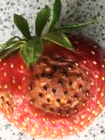
Abstract: Strawberry Colletotrichum spp. is a significant strawberry pathogen with yield losses of up to 50 %, due to agrometeorological conditions change its spread in a temperate climate is growing. The demand for alternative measures for biological protection is growing because of the increasing pathogens resistance and pesticides harm for human and environment. The findings of antimicrobial activities, low toxicity and biodegradability of essential oils (EO) make them suitable for biological protection against pathogens. This study aims to evaluate the inhibition of Colletotrichum spp. by thyme, sage and peppermint EO in vitro and on detached strawberry leaves. Thyme EO inhibited Colletotrichum spp. completely above 200 μL L⁻¹ concentration in vitro.
Our findings could potentially help to manage Colletotrichum spp.; however, the detached strawberry leaves assay showed that EO efficacy was relatively low on tested concentrations and should be increased.
Keywords: biocontrol, inhibition, Mentha piperita, Salvia officinalis, Thymus vulgaris

Slide 3
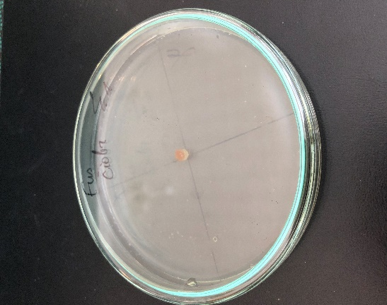
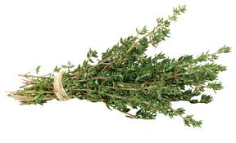
T. vulgaris EO
Results and Discussion
Thyme EO totally inhibited Colletotrichum spp. mycelial growth in vitro above 200 μL L⁻¹. In an investigation conducted by Duduk et al. [34], thyme EO showed good antifungal efficacy against C. acutatum on strawberry fruit.
Figure 1. Inhibition (%) of Colletotrichum spp. mycelial growth by thyme (T. vulgaris) EO at 4 days after inoculation (4 DAI). Results are presented as means (n = 4). The same letter indicates no significant differences between treatments (p < 0.05).

Slide 4
S. officinalis EO
Antifungal activity of sage EO against Colletotrichum spp. achieved highest effect 88.14% at 1800 μL L⁻¹. These results were comparable to the Yilmaz et al. [40] investigation, there sage EO resulted slight inhibition on mycelial growth of C. gloeosporioides.
In our research peppermint EO highest antifungal activity reached at 1600 μL L⁻¹ (88%). In comparison, Oliveira et al. [35] reported, that 5 μL/mL peppermint EO resulted in 100% MGI on all tested Colletotrichum stains.
Figure 2. Inhibition (%) of Colletotrichum spp. mycelial growth by sage (S. officinalis) EO at 4 days after inoculation (4 DAI). Results are presented as means (n = 4). The same letter indicates no significant differences between treatments (p < 0.05).
M. piperita EO
Figure 3. Inhibition (%) of Colletotrichum spp. mycelial growth by peppermint (M. piperita) EO at 4 days after inoculation (4 DAI). Results are presented as means (n = 4). The same letter indicates no significant differences between treatments (p < 0.05).

Slide 5
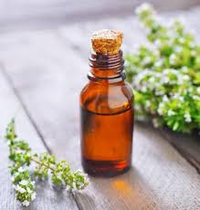
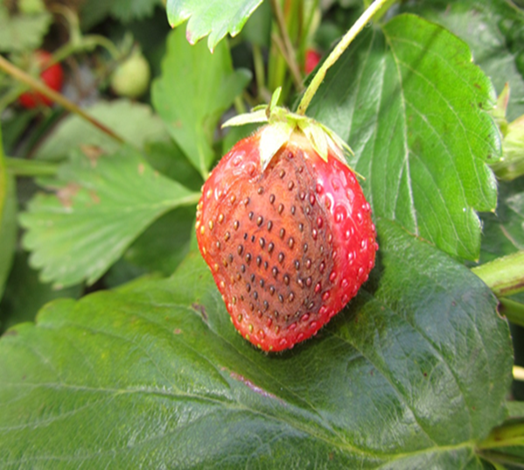
EO result on detached strawberry leaves assay showed less positive effect of reducing spread of anthracnose. 1000 μL L⁻¹ concentration of peppermint EO (15.8%) and 800 μL L⁻¹ concentration of thyme (5.3%) reduced the infection on strawberry leaves at 4 DAI, compared to inoculated control.
In the future research, a higher concentration of these EO should be investigated for higher effectiveness. The effect of plant EOs as volatile compounds on the surface of strawberry leaves may induced a stressful environment [11,33].
Treatments | Disease severity (%) | Disease reduction (%)
Inoculated control | 79.2±0.2 | n.a.*
Thymus vulgaris 800 μl/ L | 75±0.3 | 5.3
Salvia officinalis 1000 | 80.6±0.2 | 0
Mentha piperita 1000 μl/L | 66.7±0.2 | 15.8
Table 1. The disease severity and reduction of anthracnose regarding strawberry cultivar ‘Deluxe’ by different essential oils concentrations at 4 days after inoculation. Means n=18

Slide 6
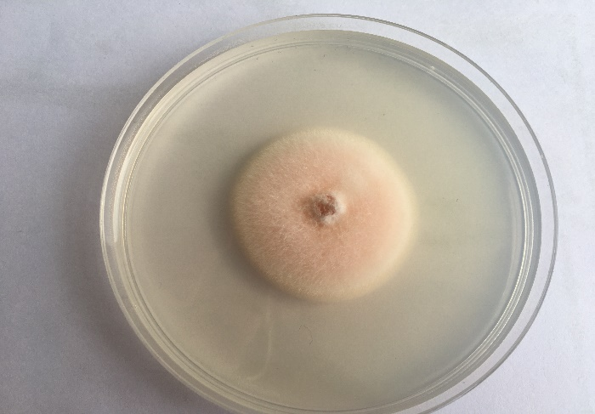
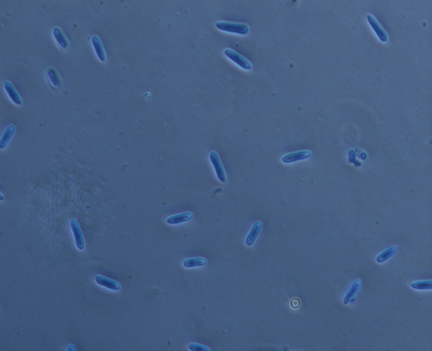
Conclusions
Thyme EO, showed total inhibition against Colletotrichum spp. in vitro. Peppermint and sage EOs showed significant antifungal activity at highest concentrations.
Infection of anthracnose on detached strawberry leaves was slightly reduced by application of thyme EO and more suppressed by peppermint EO at tested concentration. Sage EO did no influence the spread of Colletotrichum spp. on detached strawberry leaves.
The detached strawberry leaves assay showed that the investigated essential oils were not equally effective and needed further investigations with higher concentrations.

Slide 7
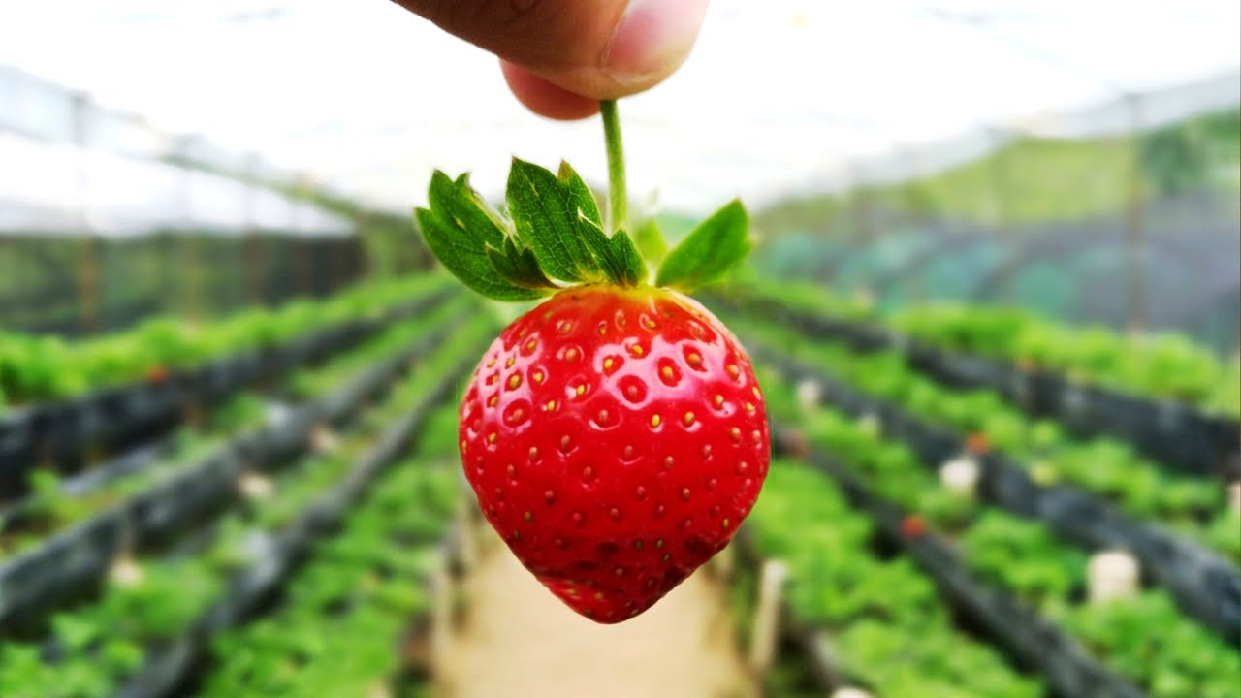
Thank you for attention!

