Slide 1
PROTEIN-PROTEIN INTERACTION BETWEEN GLYOXALASE II AND SPECIFIC REDOX DEPENDENT PROTEINS THROUGH
S-GLUTATHIONYLATION MODIFICATION.
Laura Cianfrugliaª, Cristina Minnelli^{b}, Andrea Scirè^{b}, Tatiana Armeniª
ªDepartment of Clinical Sciences, Section of Biochemistry, Biology and Physics, Polytechnic University of Marche, Ancona, Italy
_{b}Department of Life and Environmental Sciences, Polytechnic University of Marche, Ancona, Italy

Slide 2
Background
S-glutathionylation involves the reversible formation of a mix disulphide-bridge between specific cysteine and a molecule of glutathione, the major non-protein antioxidant compound in the cell. Mechanism of glutathionylation can be spontaneous or catalyzed. Glyoxalase II (Glo2) enzyme was studied as a new potential candidate to promote S-glutathionylation. To demonstrate its active involvement in protein glutathionylation were used Actin, Cytochrome c (CYT-C); Malate Dehydrogenase (MDH) and Glyceraldehyde 3-phosphate dehydrogenase (GAPDH) purified proteins, which are known to be glutathionylated, for in vitro experiments. This work shows active involvement of cytosolic Glo2 for in vitro protein S-glutathionylation, suggesting a new mechanism of protein-SSG formation.

Slide 3
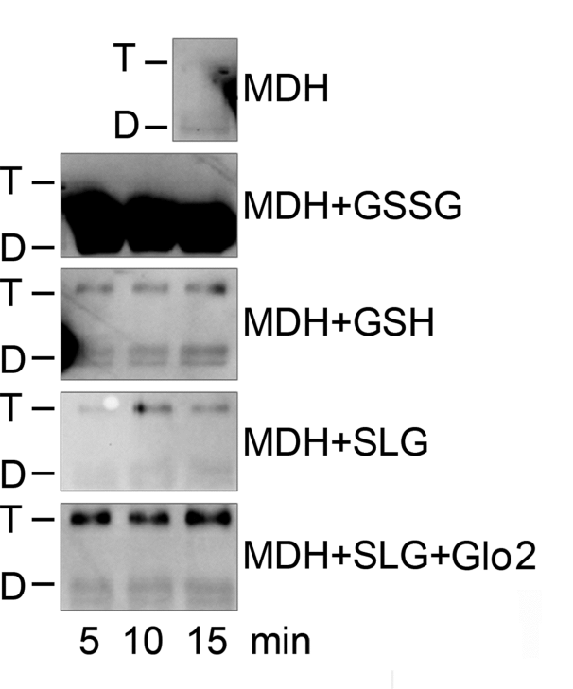
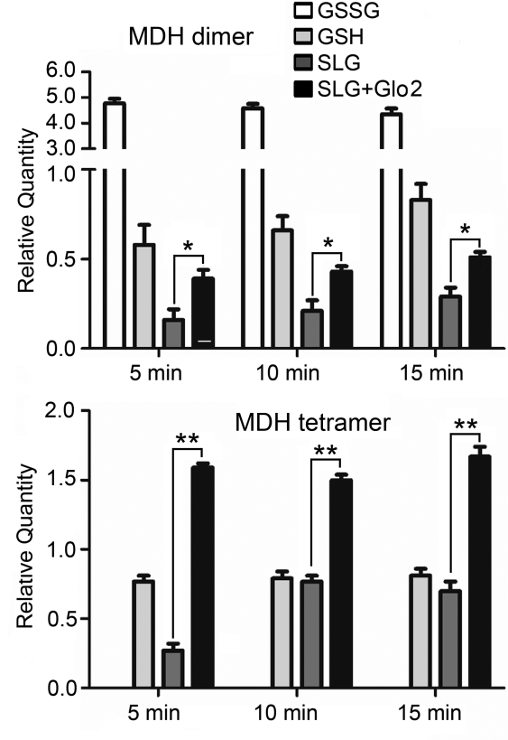
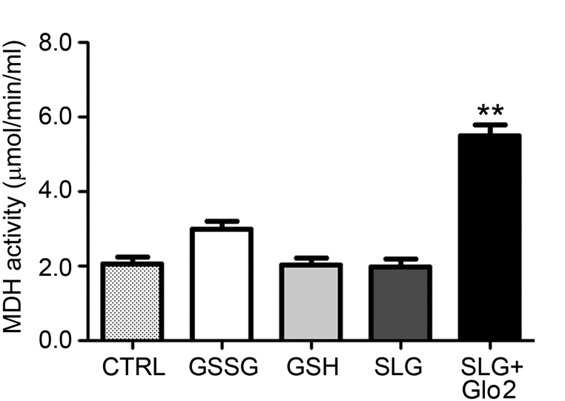
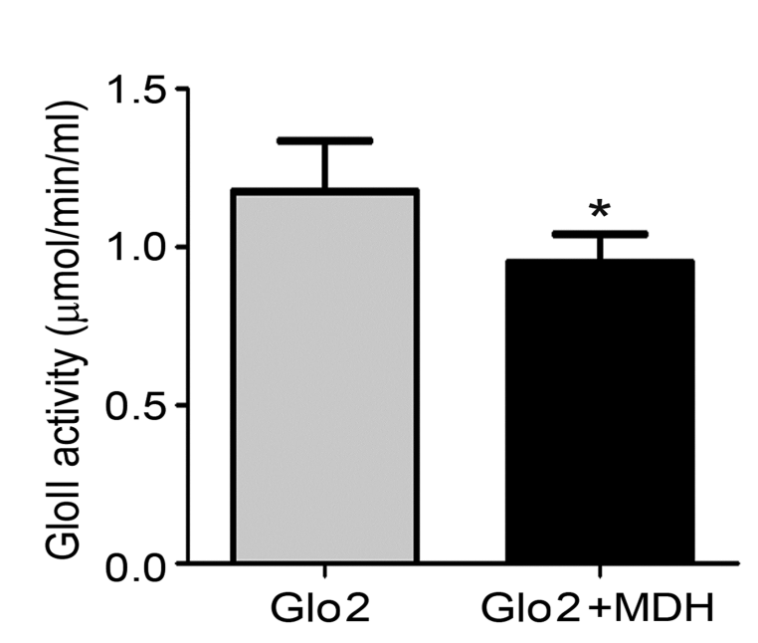
Glyoxalase 2 promotes S-glutathionylation
and tetramerization of malate dehydrogenase…
Mitochondrial enzyme MDH, showed a strong glutathionylation signal when incubated with Glo2 plus SLG, in particular Glo2 plus SLG is able to promote tetrameric conformation.
MDH activity significantly increase in the presence of Glo2 plus SLG. Glo2 activity, instead, decrease in presence of MDH.

Slide 5
CONCLUSION:
This study shows that Glo2, through a specific interaction of its catalytic site with the target proteins, is able to perform a rapid and specific protein S-glutathionylation using its natural substrate SLG.

Slide 6
EXPERIMENTAL PROCEDURE:
Recombinant human cytosolic Glo2 was prepared by heterologous expression in Escherichia coli from a human adult liver cDNA library. Actin, MDH, Cyt C and GAPDH, were used to test in vitro S-glutathionylation by immunoblot with anti-GSH antibody. P value were calculated by Student’s test.
Data were reported as mean SD, where n=3. P* value of < 0,05 was considered significant
P** < 0,01and < 0,001 was highly significant.
REFERENCES:
Galeazzi R, Laudadio E, Falconi E, Massaccesi L, Ercolani L, Mobbili G, Minnelli C, Scirè A, Cianfruglia L, Armeni T. (2018) Protein-protein interactions of human glyoxalase II: findings of a reliable docking protocol. Org Biomol Chem.
Ercolani L., Scirè A., Galeazzi R., Massaccesi L., Cianfruglia L., Amici A., Piva F., Urbanelli L., Emiliani C., Principato G., Armeni T. (2016) A possible S-glutathionylation of specific proteins by Glyoxalase II: an in-vitro and in silico study. Cell Biochem Function
Armeni T, Cianfruglia L, Piva F, Urbanelli L, Caniglia M, Pugnaloni A, Principato G. S-D-Lactoylglutathione can be an alternative supply of mitochondrial glutathione. Free Radic Biol Med. 2014 Vol. 67:451-9.

