Slide 1
High-fat diet promotes a pro-inflammatory environment in testis and inhibits antioxidant defenses in the progeny
Luís Crisóstomo¹, Romeu A. Videira², Ivana Jarak³, Kristina Starčević⁴, Tomislav Mašek⁵, Luís P. Rato⁶, João F. Raposo^{7,8}, Pedro F. Oliveira⁹, Marco G. Alves^{1,}*
¹Department of Microscopy, Laboratory of Cell Biology, and Unit for Multidisciplinary Research in Biomedicine (UMIB), Institute of Biomedical Sciences Abel Salazar (ICBAS), University of Porto, Portugal;
²REQUINTE/LAQV, Laboratory of Pharmacognosy, Faculty of Pharmacy, University of Porto, Porto, Portugal;
³Department of Pharmaceutical Technology, Faculty of Pharmacy, University of Coimbra, Portugal;
⁴Department of Chemistry and Biochemistry, University of Zagreb, Faculty of Veterinary Medicine, Zagreb, Croatia;
⁵Department of Animal Nutrition and Dietetics, University of Zagreb, Faculty of Veterinary Medicine, Zagreb, Croatia; ⁶Health School of the Polytechnic Institute of Guarda, Guarda, Portugal;
⁷NOVA Medical School – New University Lisbon, Lisbon, Portugal;
⁸APDP – Diabetes Portugal, Lisbon, Portugal;
⁹QOPNA & LAQV, Department of Chemistry, University of Aveiro, Aveiro, Portugal
* Corresponding author: alvesmarc@gmail.com

Slide 2
Abstract: The adoption of high-fat diets (HFD) is a major contributor to the increasing prevalence of obesity worldwide. Herein we study the impact of HFD from early age in testicular physiology and sperm parameters in two generations of mice, with a focus on testicular oxidative status. Mice of the diet-challenged generation (F0; n=36) were randomly fed after weaning with standard chow (CTRL) or high-fat diet (HFD) for 200 days or transient high-fat diet (HFDt) (60 days of HFD+140 days of standard chow). The offspring generation (F1; n=36) was obtained by mating with normoponderal females with 120 days post-weaning and fed with chow diet. Mice fed with HFD for a lifetime have impaired insulin tolerance, a trait inherited by their sons. The sons of mice fed HFD inherited decreased catalase activity, displayed lower activities of mitochondrial complexes I and IV. Similar to their progenitos, the sons of HFD mice had a higher prevalence of pinhead and bent neck defects, than the sons of CTRL. The adoption of HFD impairs testicular antioxidant defenses and mitochondrial function in the progeny, which is detrimental to sperm morphology.
Keywords: high-fat diet; pro-inflammatory state; intergenerational effects; antioxidant defenses; testis

Slide 3
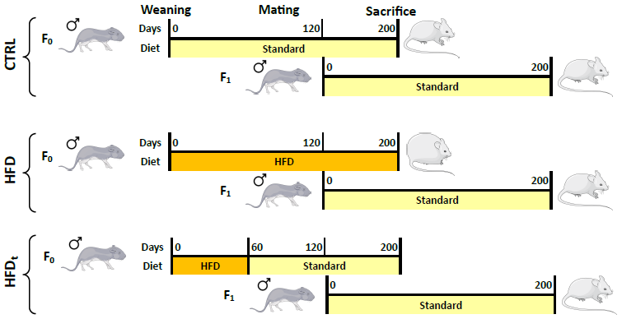
Methods
Biometric monitoring
Glucose homeostasis
GC-MS Lipidomics
Sperm parameters
Oxidative Stress and Mitochondrial activity
NMR-based Metabolomics

Slide 4
Results
The offspring of HFD-fed mice display abnormal insulin tolerance
ipITT - F0 Generation
ipITT - F1 Generation
Two-way ANOVA corrected by Šidak’s method. Significance was considered when p < 0.05. * p < 0.05; ** p < 0.01; *** p < 0.001. * CTRL vs. HFD; # HFD vs. HFDt.

Slide 5
Results
The adoption of HFD inhibits testicular antioxidant defences even in offspring
Univariate ANOVA corrected by Tukey’s HSD. Significance was considered when p < 0.05. * p < 0.05; ** p < 0.01; *** p < 0.001. * vs. CTRL; # vs. HFD.

Slide 6
Results
Testicular mitochondrial defects are only detected in offspring of HFD-fed mice
Univariate ANOVA corrected by Tukey’s HSD. Significance was considered when p < 0.05. * p < 0.05; ** p < 0.01; *** p < 0.001. * vs. CTRL; # vs. HFD.

Slide 7
Results
Paternal HFD causes intergenerational sperm defects
F0 Generation
F1 Generation
Pearson’s Chi-square and z-test for collumn proportions corrected by Bonferroni’s method. Significance was considered when p < 0.05. * p < 0.05; ** p < 0.01; *** p < 0.001. * vs. CTRL; # vs. HFD.

Slide 8
Discussion
Acquired traits of metabolic syndrome are inherited by the offspring;
Tissue-specific traits (e.g. catalase activity) may be inherited;
Some effects of paternal exposure (to HFD) are just observable in the offspring – Intergenerational effects
Despite the inhibition of AntiOx defenses and abnormal Mt. Activity, there is no evidence of oxidative stress in the sons of HFD mice;
However, the sons of HFD mice have higher prevalence of sperm head and neck defects (lipid peroxidation of sperm cells’ membranes?);
The father’s nutritional status at conception may be crucial for the health outcomes of the progeny.
Conclusions
The adoption of HFD causes intergenerational signatures in testis, which are associated with lower sperm quality.

Slide 9
Supplementary Materials
Links:
Crisóstomo, L.; Rato, L.; Jarak, I.; Silva, B.M.; Raposo, J.F.; Batterham, R.L.; Oliveira, P.F.; Alves, M.G. A switch from high-fat to normal diet does not restore sperm quality but prevents metabolic syndrome. Reproduction 2019, 158, 377–387, doi:10.1530/REP-19-0259.
Crisóstomo, L.; Videira, R.A.; Jarak, I.; Starčević, K.; Mašek, T.; Rato, L.P.; Raposo, J.F.; Batterham, R.L.; Oliveira, P.F.; Alves, M.G. Diet during early life defines testicular lipid content and sperm quality in adulthood. American Journal of Physiology-Endocrinology and Metabolism 2020, (article in press), doi:10.1152/ajpendo.00235.2020.
Sertoli Cell & Gamete Biology lab
UMIB - Unit for Multidisciplinary Research in Biomedicine

Slide 10
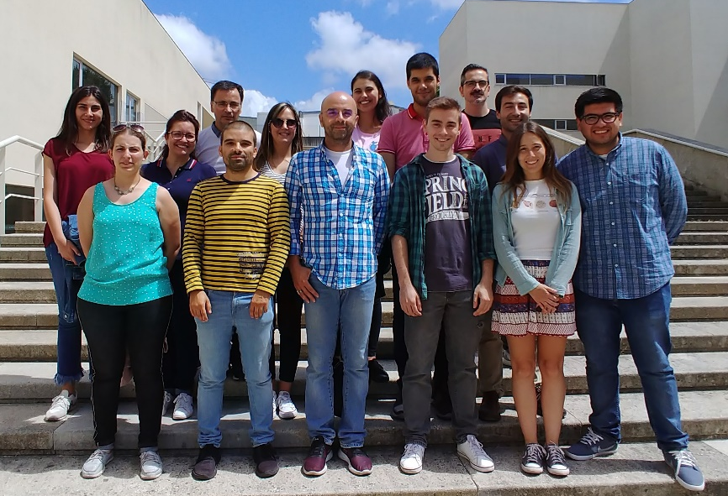
Acknowledgments
SFRH/BD/128584/2017 - Luís Crisóstomo
PTDC/MEC-AND/28691/2017 - PI: Marco G. Alves
IFCT2015 - Pedro F. Oliveira and Marco G. Alves
PTDC/BIM-MET/4712/2014 - PI: Marco G. Alves
Sertoli Cell and Gamete Biology Lab
GIFT research grant 2019 - Marco G. Alves
Albert Renold Grant – Luís Crisóstomo
UID/Multi/00215/2019 and FEDER funds through POCI/COMPETE 2020 - UMIB

