Slide 1
Antmicrobial Activity and Composition of Different Cultivars of Honeysuckle Berry Lonicera caerulea L.
Aistė Pažereckaitė¹, Ina Jasutienė¹, Antanas Šarkinas¹, Laima Česonienė²
¹Kaunas University of Technology. Radvilėnų str. 19, Kaunas, Lithuania
²Vytautas Magnus University Botanical Garden. Ž. E. Žilibero 4, Kaunas, Lithuania.
ina.jasutiene@ktu.lt

Slide 2
Introduction
The edible blue honeysuckle berries comes from Russia and in recent years has been considerably planted in some European countries, Lithuania is among them. Honeysuckle berries not require special care during cultivation: they have high resistance to cold, different soil acidities, pests and various diseases. The berries are rich in an ascorbic acid and phenolic contents, which have nutritional and health promoting properties for humans. By the way, berries chemical composition and properties depends on the cultivars, enviroment and climate.
The aim of this work was comparative study of composition and antimicrobial properties in 11 cultivars of honeysuckle berries.

Slide 3
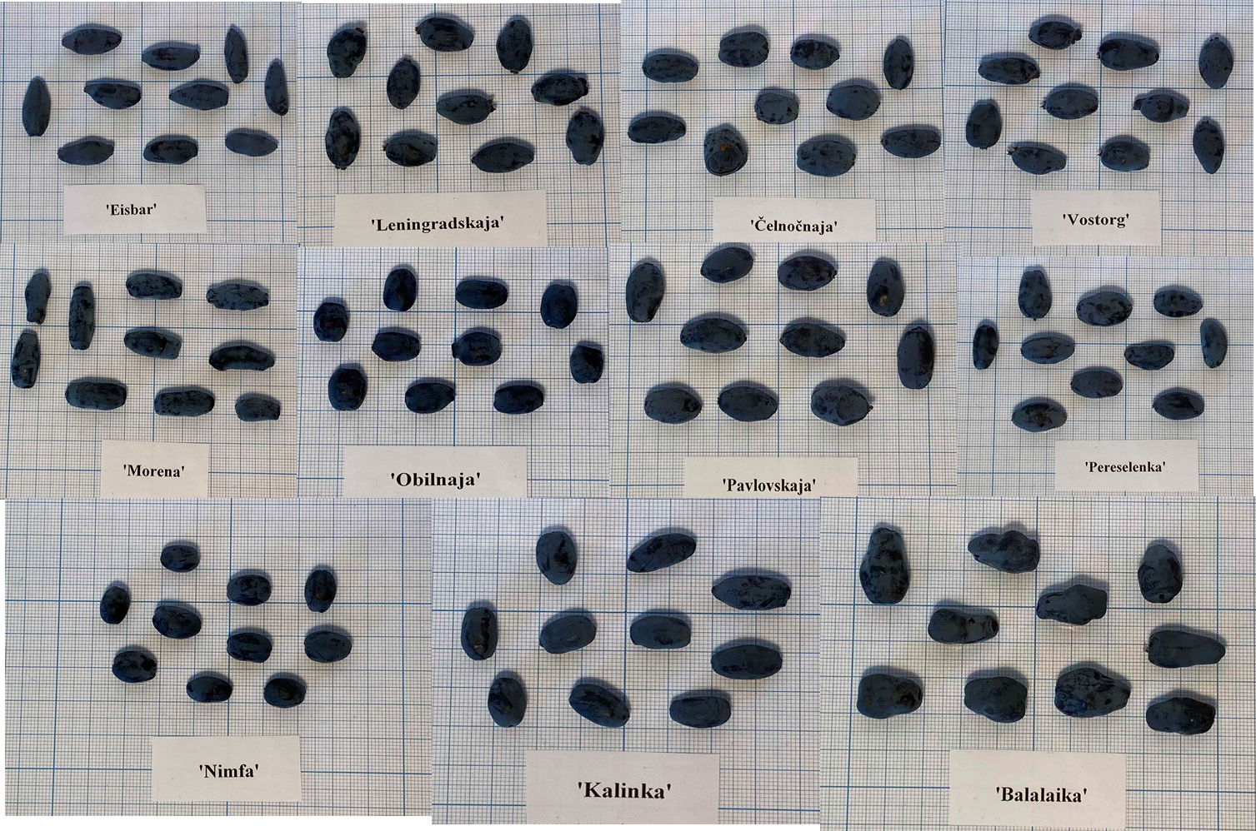
Objective
Berries of 11 Lonicera caerulea L. cultivars were grown in collection of Vytautas Magnus University Botanical Garden and collected at maturation stage.

Slide 4
Materials and Methods
The dry matter content was determined using moisture analyzer MB 64M.
pH was determined directly by pH-meter Denver Instrument Company, USA.
Total soluble solids were determined by refractometer ATAGO RX-5000CX, Japan.
Color CIE L*a*b* characteristics was evaluated by chroma meter CR-410 (Konica minolta).
Total anthocyanin content : the absorption of 1:10 diluted ethanolic extract was measured on a spectrophotometer Genesys-5 (Thermo Spectronic, Rochester, USA) at 535 nm. The concentration of anthocyanins was determined from the calibration curve, which was constructed by measuring the absorption of cyanidin-3-glucoside (MW 449.4, ε=26.900) reference solution.

Slide 5
Materials and Methods
Total phenolics content, expressed as gallic acid, was determined by Folin-Ciocalteu method. Results were expressed in mg of gallic acid equivalents.
Vitamin C content was determined by HPLC method after extraction with oxalic acid solution (10 g / L). Shimadzu Prominence series (Shimadzu corp., Kyoto Japan) HPLC system with Atlantis dC18 5mm 4.6 × 150 mm column (Waters, Ireland) was used for separation and quantification.
Determination of saccharides: an aqueous extract was used for HPLC separation. The YMC-Pack Polyamine II 250 × 4.6 mm, 5 μm (YMC Co., Ltd., Japan) column was used with a temperature of 28 ºC. Detection was performed using an Evaporative Light Scattering Detector ELSD-LTII (Shimadzu Corp., Japan). Calibration curves of fructose, glucose and sucrose were used for the quantification.

Slide 6
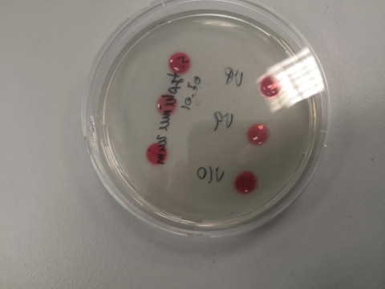
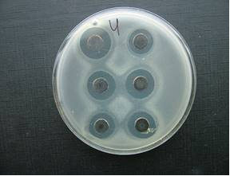
Materials and Methods
Antimicrobial Test
Undesirable in food products the yeasts and bacteria were used in the test cultures. The antimicrobial properties were evaluated by the agar well diffusion method.
Bacteria were grown in peptone-soy bouillon. Yeasts were grown on a slant potato dextrose agar.
Eight-millimeter diameter wells were pushed in the agar and filled with 50 µl of sample. The plates were incubated overnight at 37°C. After incubation the inhibition zones were measured and the effect was calculated as a mean of three replicate tests.

Slide 7
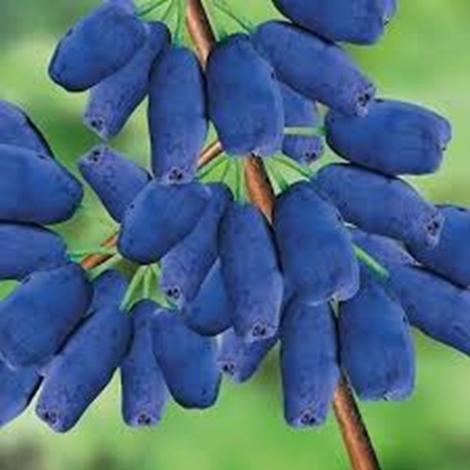
Results

Slide 8
pH, Soluble Solids and Dry Matter Amount of Honeysuckle Berries
Cultivar | pH | Soluble solids, Brix | Dry matter, %
‘Eisbar‘ | 3.13 | 12.10 ± 0.021 | 15.41 ± 0.332
‘Leningradskaja‘ | 3.37 | 13.01 ± 0.021 | 14.35 ± 0.262
‘Čelnočnaja‘ | 3.04 | 11.03 ± 0.007 | 11.70 ± 1.414
‘Vostorg‘ | 3.17 | 11.03 ± 0.017 | 17.36 ± 1.252
‘Morena‘ | 2.99 | 12.45 ± 0.044 | 16.34 ± 0.184
‘Obilnaja‘ | 3.04 | 12.10 ± 0.014 | 13.93 ± 0.078
‘Pavlovskaja‘ | 3.02 | 10.57 ± 0.028 | 15.03 ± 0.987
‘Pereselenka‘ | 3.01 | 10.32 ± 0.028 | 13.40 ± 0.658
‘Nimfa‘ | 3.14 | 10.32 ± 0.106 | 18.49 ± 1.853
‘Kalinka‘ | 2.99 | 10.07 ± 0.402 | 15.72 ± 1.181
‘Balalaika‘ | 3.37 | 16.09 ± 0.078 | 18.41 ± 0.262

Slide 9
Qualitative and Quantitative Composition of Saccharides

Slide 10
Content of Ascorbic Acid

Slide 11
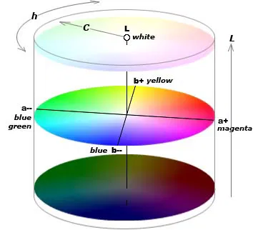
CIE L*a*b* Colour Characteristics
Cultivar | L* | a* | b* | C | h
‘Eisbar‘ | 25.68±0.113 | 10.23±0.332 | 2.83±0.085 | 10.61±0.343 | 0.27±0.001
‘Leningradskaja‘ | 25.53±0.127 | 6.85±0.035 | 1.36±0.057 | 6.98±0.046 | 0.20±0.007
‘Čelnočnaja‘ | 25.76±0.085 | 10.28±0.028 | 3.06±0.014 | 10.73±0.031 | 0.29±0.001
‘Vostorg‘ | 24.73±0.601 | 9.09±0.064 | 2.34±0.085 | 9.38±0.040 | 0.25±0.010
‘Morena‘ | 23.99±0.092 | 6.91±0.021 | 1.39±0.014 | 7.04±0.024 | 0.20±0.001
‘Obilnaja‘ | 23.61±0.764 | 8.30±0.120 | 1.81±0.007 | 8.49±0,119 | 0.21±0.002
‘Pavlovskaja‘ | 25.91±0.580 | 10.22±0.361 | 3.15±0.163 | 10.69±0.393 | 0.30±0.005
‘Pereselenka‘ | 28.22±1.011 | 13.15±0,389 | 5.33±0.163 | 14.18±0.422 | 0.38±0.000
‘Nimfa‘ | 23.34±1.874 | 8.58±1.138 | 2.19±0.29 | 8.85±1.175 | 0.25±0.001
‘Kalinka‘ | 26.44±0.134 | 8.30±0.049 | 2.23±0.057 | 8.59±0.062 | 0.26±0.001
‘Balalaika‘ | 24.41±0.163 | 6.79±0.042 | 1.23±0.064 | 6.90±0.030 | 0.18±0.001

Slide 12
Total Phenolic Compounds and Anthocyanins

Slide 13
Antimicrobial Activity of Aqueous Extract
Inhibition zone in mm, including the 8 mm hole. If inhibition zone wasn't observed, results is presented as 0.
Cultivar | C. freundii | E. coli | E. feacalis | S. typhimurium | L. monocytogenes | S. aureus | P. aeruginosa | B. subtillis | C. albicans | S. cerevisea
‘Eisbar’ | 0 | 8.50±0.00 | 9.00±0.00 | 0 | 9.00±0.00 | 9.00±0.00 | 9.00±0.00 | 10.00±0.00 | 0 | 0
‘Leningradskaja’ | 0 | 8.50±0.00 | 8.75±0.35 | 0 | 9.00±0.00 | 9.00±0.00 | 8.75±0.35 | 10.50±0.71 | 0 | 0
‘Čelnočnaja’ | 9.00±0.00 | 8.50±0.00 | 8.75±0.36 | 0 | 9.00±0.00 | 9.00±0.00 | 9.00±0.00 | 10.50±0.01 | 0 | 0
‘Vostorg’ | 0 | 8.50±0.00 | 8.5±0.00 | 0 | 9.00±0.00 | 8.50±0.71 | 8.75±0.35 | 10.00±0.00 | 0 | 0
‘Morena’ | 9.00±0.000 | 8.50±0.00 | 8.5±0.00 | 0 | 9.00±0.00 | 8.25±0.35 | 9.00±0.00 | 11.00±1.41 | 0 | 0
‘Obilnaja’ | 9.00±0.00 | 8.75±0.35 | 8.75±0.35 | 0 | 9.00±0.00 | 0 | 8.75±0.35 | 10.50±0.71 | 0 | 0
‘Pavlovskaja’ | 8.50±0.00 | 8.50±0.00 | 8.50±0.00 | 0 | 9.00±0.00 | 8.50±0.71 | 8.75±0.35 | 9.50±0.71 | 0 | 0
‘Pereselenka’ | 9.00±0.00 | 8.25±0.35 | 8.25±0.35 | 0 | 9.00±0.00 | 8.00±0.00 | 9.00±0.00 | 11.00±1.14 | 0 | 0
‘Nimfa’ | 9.00±0.00 | 8.75±0.35 | 8.75±0.35 | 0 | 10.00±0.00 | 9.00±0.00 | 8.50±0.71 | 11.00±0.00 | 0 | 0
‘Kalinka’ | 8.50±0.00 | 8.50±0.00 | 8.50±0.00 | 9.00±0.00 | 8.50±0.707 | 8.00±0.00 | 8.25±0.35 | 10.50±2.12 | 0 | 0
‘Balalaika’ | 8.50±0.00 | 0 | 8.50±0.00 | 8.50±0.00 | 9.00±0.00 | 8.25±0.35 | 8.75±0.35 | 10.00±.0.00 | 0 | 0

Slide 14
Antimicrobial Activity of Ethanolic Extract
Inhibition zone in mm, including the 8 mm hole. If inhibition zone wasn't observed, results is presented as 0.
Cultivar | C. freundii | E. coli | E. feacalis | S. typhimurium | L. monocytogenes | S. aureus | P. aeruginosa | B. subtillis | C. albicans | S. cerevisea
’Eisbar’ | 14.00±0,00 | 0 | 13.67±0.58 | 14.00±0.00 | 11.00±0.00 | 14.33±0.57 | 10.00±0.000 | 10.00±0.000 | 0 | 0
‘Leningradskaja’ | 15.00±1.00 | 0 | 14.00±0.00 | 12.67±0.58 | 13.00±0.00 | 13.33±0.57 | 10.00±0.00 | 11.33±0.58 | 0 | 0
‘Čelnočnaja’ | 15.33±0.58 | 13.67±0.57 | 15.00±0.00 | 15.00±0.00 | 14.00±0.00 | 15.00±0.00 | 9.00±0.00 | 13.00±0.00 | 0 | 0
‘Vostorg’ | 13.67±0.58 | 11.67±0.58 | 13.33±0.58 | 14.00±0.00 | 14.00±1.00 | 12.67±1.53 | 9.33±0.58 | 11.33±0.58 | 0 | 0
‘Morena’ | 13.00±0.00 | 10.33±0.58 | 14.33±0.58 | 15.67±0.58 | 9.33±0.58 | 13.00±0.00 | 9.00±0.00 | 10.00±0.00 | 0 | 0
‘Obilnaja’ | 17.00±0.00 | 13.00±0.00 | 15.00±0.00 | 14.67±0.58 | 13.67±0.58 | 15.33±1.16 | 10.33±0.58 | 11.00±0.00 | 0 | 0
‘Pavlovskaja’ | 15.67±0.58 | 14.00±0.00 | 12.33±0.58 | 16.67±1.16 | 12.67±0.58 | 14.33±0.58 | 10.67±0.58 | 9.00±0.00 | 0 | 0
‘Pereselenka’ | 16.00±0.00 | 9.33±0.58 | 13.00±0.00 | 14.00±0.00 | 12.00±0.00 | 12.00±0.00 | 9.33±0.58 | 10.67±0.58 | 0 | 0
‘Nimfa’ | 9.33±0.58 | 9.00±0.00 | 13.00±0.00 | 14.33±0.58 | 11.33±1.15 | 14.67±0.58 | 9.33±0.58 | 11.00±0.00 | 0 | 0
‘Kalinka’ | 12.33±1.53 | 13.67±1.53 | 13.00±0.00 | 16.00±0.00 | 12.00±0.00 | 16.00±0.00 | 10.00±1.00 | 11.00±0.00 | 0 | 0
‘Balalaika’ | 16.33±1.16 | 9.00±0.00 | 13.00±0.00 | 15.00±0.00 | 9.33±0.58 | 14.00±0.00 | 9.00±0.00 | 9.33±0.58 | 0 | 0

Slide 15
Conclutions
Results showed that, cultivars ‘Pereselenka’ (141 mg/100g) and ‘Pavlovskaja’ (114mg/100g) had the highest content of ascorbic acid.
The maximum glucose and fructose content was detected in ‘Leningradskaja’ and ‘Balalaika’ cultivars.
The cultivars ‘Morena‘ had the highest anthocyanins (781mg/100g) and total phenolic compounds (799mg/100g), the lowest anthocyanins (282 mg/100g) and TPC (300 mg/100g) content was detected in ‘Vostorg‘ cultivars.
Bacterial tests have identified antimicrobial properties of honeysuckle berries against undesirable in food products bacteria but without affecting Candida and Saccharomyces cerevisiae yeast.
Results indicate that, due to the amount of bioactive substances and beneficial health properties, honeysuckle berries are valuable component to the diet.

Slide 16
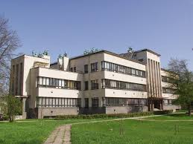
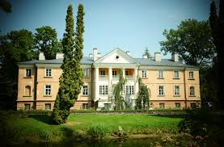
Thanks for attention!

