Slide 1
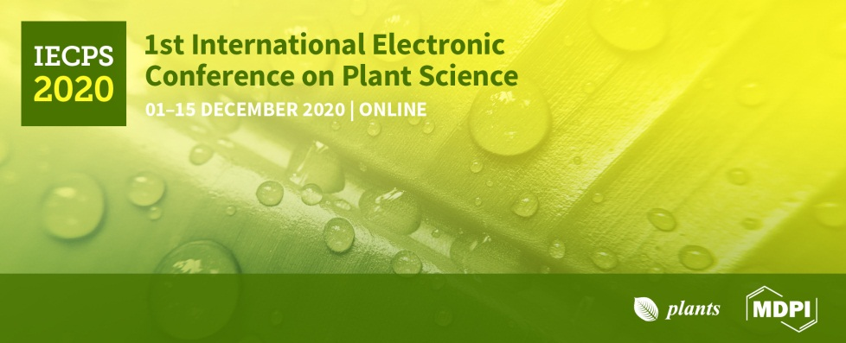
Session: Plant Protection, Response to stress and Climate Change
Plant molecular responses to salt stress
Loredana F. Ciarmiello*, Petronia Carillo, Pasqualina Woodrow
Università della Campania Luigi Vanvitelli, Dipartimento di Scienze e Tecnologie Ambientali, Biologiche e Farmaceutiche

Slide 2
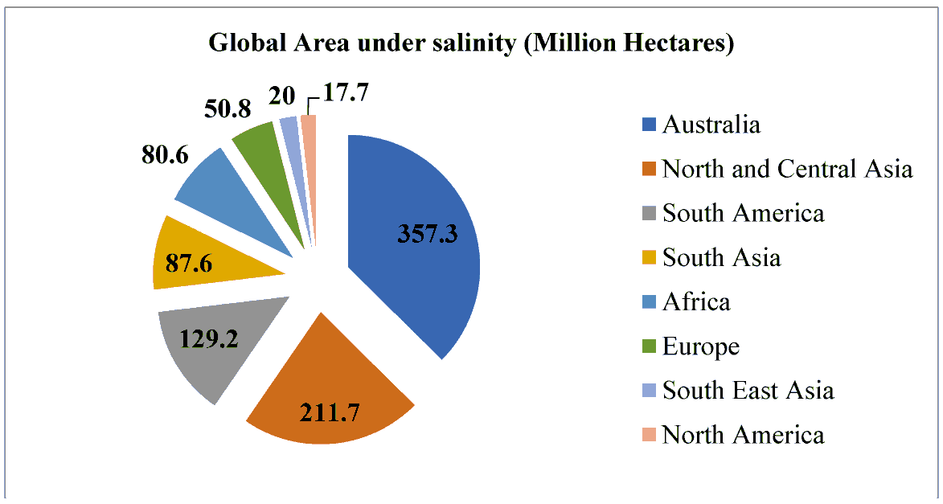
SALT STRESS EFFECT ON AGRICULTURAL
It decreases the production potential of up to 46 million ha/year and is estimated that it caused an annual loss in agricultural productivity with a lost of about US$ 31 million. Excess salt concentrations takes up to 1.5 million ha/year of farmland out of production (FAO, 2019).
Total : 444 M ha
Source : FAO database

Slide 3
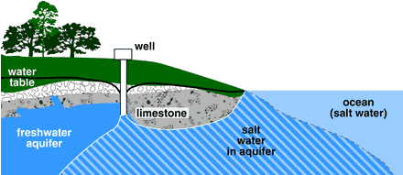
SEAWATER INTRUSION
In the Mediterranean basin, one of the process that most contribute to soil salinity is seawater intrusion into freshwater and the irrigation with brackish water (Maggio et al., 2011).
This is ulterior enhanced by secondary salt, that is accumulated in irrigated soils as water evaporates.

Slide 4
SOIL SALINIZATION AND SODIFICATION EFFECT
major soil degradation processes
decrease of water quality
decrease of soil biodiversity
Soil erosion

Slide 5
SALT STRESS EFFECT AND PLANT RESPONSES
Consequences | Plant Responses
High NaCl concentrations affect plant physiology and metabolism at different levels: water deficit, ion toxicity, nutrient imbalance, and oxidative stress (Vinocur et al., 2005; Ciarmiello et al., 2011) | Plants adopt two main responses: a rapid protective ones together with a long term adaptation response. During initial exposure to high salt concentrations, plants attempt water stress, which in turn reduces leaf expansion. During long-term exposure to salinity, plants attempt ionic stress, which can lead to premature senescence of adult leaves, and thus a reduction in the photosynthetic area available to growth support (Cramer & Nowak, 1992)
Salinity induces in plants three stress pathways: ionic stress, osmotic stress, and secondary stresses, especially oxidative stress and nutritional disorders (Yang and Guo 2018).

Slide 6
MANIFESTATION OF SALT STRESS
Morphological Symptoms
White leaf tip followed by tip burning (salinity)
Leaf browning and death (sodicity)
Stunted plant growth
Low tillering
Spikelet sterility
Low harvest index
Low yield
Change in flowering time
Leaf rolling
Poor root growth

Slide 7
MANIFESTATION OF SALT STRESS
Physiological & Biochemical
High Na⁺ transport to shoot
Preferential accumulation of Na ⁺ in older leaves
High Cl⁻ uptake
Lower K⁺ uptake
Lower fresh and dry weight of shoot and roots
Low P and Zn uptake
Increase of non-toxic organic compatible solutes
Increase in Polyamine levels

Slide 8
HOW TO MANAGE THE SALT-AFFECTED AREAS ?
1. Environment modifying approach:
Change the environment for the normal growth of plants
2. Crop based approach:
Select or develop crop variety which can withstand the salt stress

Slide 9
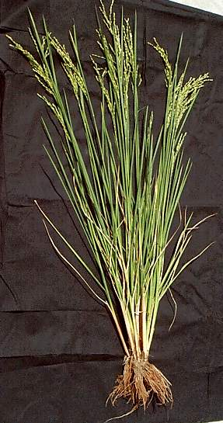
PREDOMINANT SALT-TOLERANCE MECHANISMS OPERATING IN PLANT
4. Sequestration of the toxic ions to vacuole or cell wall – cell level compartmentation
3. Excretion of salt through salt glands, salt-hairs or bladders – in most halophytes
2. Transporting the toxic ions to stem, leaf sheath or older leaves – plant level compartmentation
1. Restricting the entry of toxic ions at root level - Exclusion
Na⁺ Cl⁻

Slide 10
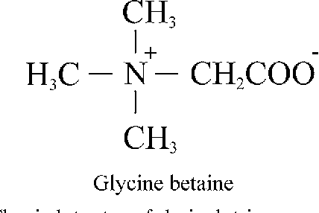
ADAPT MECHANISM TO SALINITY
Ions partitioning in the vacuole;
Synthesis and accumulation of osmolytes in the cytosol.
(Annunziata et al. 2017).
Glycine betaine plays an important role in osmoregulation, in fact, it is one of the main nitrogen-containing compatible osmolytes found in Poaceae (Annunziata et al., 2019).

Slide 11
EFFECT OF EXOGENOUS GB UNDER SALT STRESS
Crop | Effect of exogenous GB under salt stress | Reference
Glycine max | Reduced lipid peroxidation (MDA content), increased proline content of seedlings, increased CAT and APX enzyme activity, reduced ROS level, reduced NaC/KC ratio | Malekzadeh, 2015
Lolium perenne | Higher shoot and root fresh weight, lower decline of RWC and Chl, reduced electrolyte leakage and MDA content, increased GB content, SOD, CAT and APX activity, reduced NaC/KC ratio in leaves and stems | Hu et al., 2012
Oryza sativa | Improved height, fresh weight and dry weight in plant, enhanced total chlorophyll and proline content, reduced MDA content | Yao et al., 2016
Triticum aestivum | Higher endogenous GB levels, improved leaf water and osmotic potential, reduced NaC and increased KC and Ca2C, improved growth, enhanced activities of SOD, CAT, and POD | Raza et al., 2007
Triticum aestivum | Alleviated inhibition of photosynthesis | Rajasekaran et al., 1997
Vigna unguiculata | Salt stress Increased total soluble sugar concentration and antioxidative enzymes (POD and PAL), increment of proline | Manaf, 2016

Slide 12
PLANTS ADAPTIVE MECHANISMS AND SIGNALLING PATHWAYS SURING SALT STRESS
The Ca2+/salt overly sensitive (SOS) cascade. Under salt stress, the SOS pathway is activated by a calcium and SCaBP8 is phosphorylated by SOS2. This latter act on vacuolar H+-ATPase and Na+/H+ exchanger. Vacuolar partitioning of Na+ is mediated by the vacuolar Na+/H+ antiporter (NHX). SOS1 sodium transport requires a proton gradient created by H+-ATPase. SOS2 enhance gene expression.
SOS4 encodes a pyridoxal (PL) kinase involved in pyridoxal-5-phosphate (PLP) biosynthesis, which is associate with AKT1, a potassium channel. SOS5, a putative cell surface adhesion protein, is involved in cell expansion process.
SOS = salt overly sensitive; H+- ATPase = vacuolar type ATPase; NHX = vacuolar Na+/H+ antiporter.

Slide 13
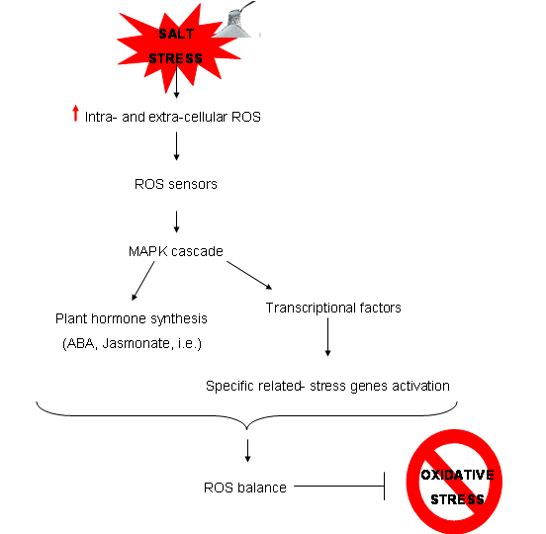
PLANTS ADAPTIVE MECHANISMS AND SIGNALLING PATHWAYS SURING SALT STRESS
ROS signal transduction pathway under saltinity stress

Slide 14
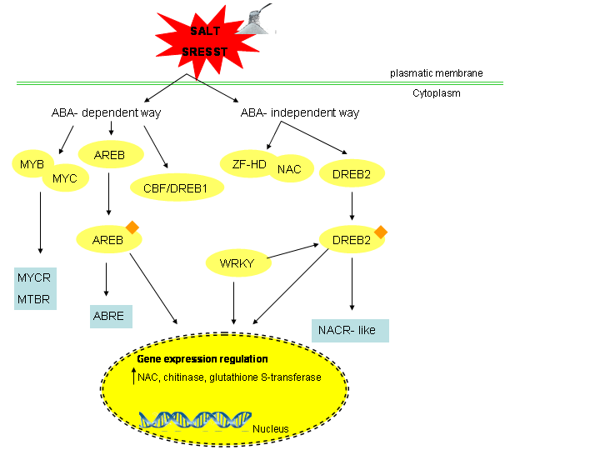
GENE REGULATION AND TRANSCRIPTIONAL FACTOR IN SALINITY STRESS
Transcriptional network of salt stress responses. Transcription factors are shown in ovals. The small rhombuses correspond to post-translational modifications. Sky-blue boxes represent the cis-elements present in stress-responsive genes.
DREBs, WRKYs and ABREs TFs bind to stress-related cis-regulatory elements in the promoter of regulated NAC genes and influence their transcription.

Slide 15
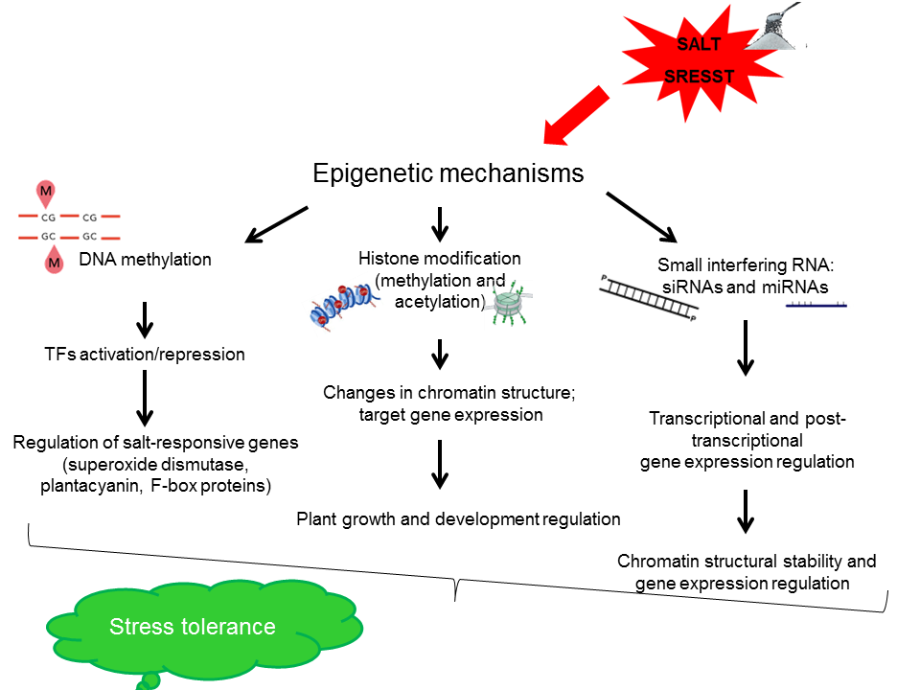
EPIGENETIC REGULATION

Slide 16
CONCLUSIONS AND PERSPECTIVES
Many genetic loci linked to plant salt tolerance have been identified and cloned. However, many factors have not been studied in sufficient detail, and other areas require further elucidation, such as Na+ signal perception, salt-triggered developmental regulation and the molecular markers for breeding salt-resistance crops, epigenetic regulation of plant salt stress responses.
Although significant research advances have been made to our understanding of plant salt-tolerance mechanisms in recent years, more studies are required to expand our knowledge, such as the elucidation of salt stress perception and the identification of key components of the salt stress response and development of efficient strategies to improve crop salt tolerance.
The further characterization and in particular functional analysis of transcriptional factors, genes as well as elements with key role in epigenetic control such as siRNA and miRNA, could help to explain the complex salinity stress regulatory pathways. The ability of TFs and small RNA to induce or repress the expression of stress-responsive genes may be a useful key point to develop improved crop plants resistant or tolerant to salt stress.

