Slide 1
Oral raft forming in situ gelling system for site specific delivery of calcium
UNDER THE GUIDANCE OF DR(PROF) H.N.SHIVAKUMAR PROFESSOR AND
HEAD OF THE DEPARTMENT (DEPT OF PHARMACEUTICS) KLEU’S COLLEGE OF PHARMACY, BENGALURU
Presented by
MANASA.MOGANTI

Slide 2
Contents
Introduction
Need for the study
Justification for the study
Methodology
Results and discussion
Optimization
In vivo X-ray imaging studies
Conclusion
References

Slide 3
INTRODUCTION
Limitations of current oral conventional drug delivery systems of calcium
The release of the drug is hindered by the fluctuation in gastric emptying time.
The variation in pH in different segments of the gastro-intestinal tract.
Difficulty of localizing an oral delivery system in a selected region of the GI tract.
Resulting in side effects like constipation & bloating of the stomach.

Slide 4
GASTRORETENTIVE DRUG DELIVERY SYSTEM
Gastro-retentive drug delivery system (GRDDS) is an approach that has been used to resolve the bioavailability issues arising from poor absorption of nutrients or drugs that are absorbed only from a specific absorption window in the upper part of gastrointestinal (GI) tract.
These systems are designed to be well retained in the upper part of the GI tract and release the drug in a sustained manner.
The floating raft system (GFRS) is a novel GRDDS that would be well retained in the stomach by virtue of floating and bioadhesive properties.
Biopolymers like sodium alginate, pectin and numerous others have been used to develop in situ gels as they offer advantages in development in terms of low cost, availability, biodegradation and freedom from toxicity and sustainability.

Slide 5
need for the study
Oral calcium is the First line therapy for calcium deficiency.
Approx. 75-100 % of Indians were Calcium deficient.
Higher demand for sensitive group like children, pregnant & PMS women, elderly patients.

Slide 6
Justification for the study
Calcium is primarily absorbed in the duodenum as a result of the presence of active absorption sites in the upper GI tract.
Its solubility in acidic environment which enhances oral bioavailability makes it an ideal candidate for gastroretentive drug delivery system.
We propose to undertake the “Oral raft forming in situ gelling system for site specific delivery of calcium”

Slide 7
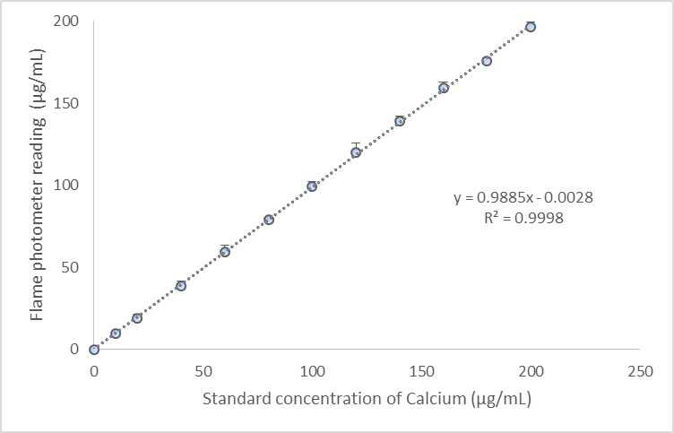
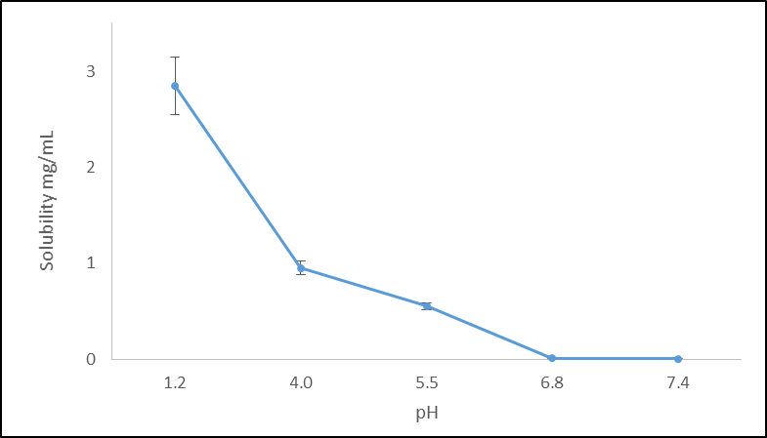
methodology
Conc. Range: 10-200 µg/mL
Media: 0.1 N HCl
Instrument used: Flame photometer (Model – 128, Systronics)
Fig 1: Calibration curve of Calcium carbonate in pH 1.2.
Buffers used:
0.1 N HCl
pH 4.0 Acetate buffer
pH 5.5 Acetate buffer
pH 6.8 Phosphate buffer
pH 7.4 Phosphate buffer
Fig 2: pH solubility profile of Calcium carbonate

Slide 8
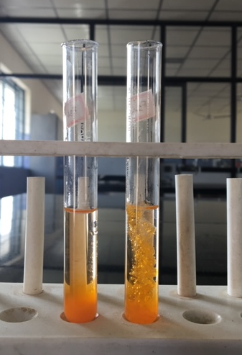
Based on the Pourability and gelling properties on contact with the acidic environment the polymers and natural gums were screened during the preliminary trials.
Screening of the polymers for good gelation – The different viscosity grades of Sodium alginate, Hydroxypropyl methylcellulose like HPMC K4M, HPMC K15M, HPMC K100M.
Screening of the gums for controlled release – Xanthan gum, Guar gum, Karaya gum and Gellan gum.
Selected polymers for formulating Raft forming solutions –
a)Sodium alginate
b)HPMC K100 M
c)Xanthan gum

Slide 9
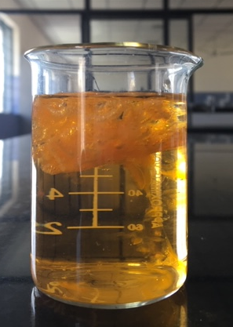
Preliminary studies
The following conclusion were drawn from the results of preliminary studies:
when lower amounts of the polymer (X1: HPMC K100M) and higher amount of gum (X2: Xanthan gum) resulted in non pourable thick viscous solution
when higher amounts of the polymer and lower amount of gum resulted bilayer tablets with increased floating lag times.
The range of polymer to gum ratio was known to significantly affect the buoyancy lag times and dissolution of the raft forming solution.

Slide 10
A simple lattice design was employed to elucidate the influence of the factors namely the proportion of HPMC K100 M (X1) and Xanthan gum (X2) on the buoyancy lag time (Y1), percent release at the end of 1 hr (Y2) and percent release at the end of 6 hr (Y3).
Table 1: Independent variables with experimental ranges as per simplex lattice mixture design
Independent variables | Low value (%) | High value (%)
X1 : Fraction of HPMC K100 M (% w/w) | 50 | 90
X2 : Fraction of Xanthan gum (%w/w) | 10 | 50
Dependent variables | Constraints
Y1: Buoyancy lag time (sec) | Minimize
Y2: Drug release at 1st hr (%) | Minimize
Y3: Drug release at the end of 6th hr (%) | Maximize

Slide 11
Table 2: Formulation variables for the in situ gelling raft formulations and their observed responses
Run | X1: HPMC K 100 M (% w/w) | X2: Xanthan gum (% w/w) | Y1:Buoyancy lag time (sec) | Y2:% Release at 1 hr | Y3:% Release at 6 hr
F1 | 70 | 30 | 15.55 ± 3.51 | 21.78 ± 2.47 | 83.50 ± 1.20
F2 | 50 | 50 | 4.52 ± 2.78 | 16.15 ± 3.46 | 68.65 ± 0.97
F3 | 50 | 50 | 4.58 ± 0.49 | 14.51 ± 3.06 | 65.50 ± 1.98
F4 | 60 | 40 | 10.46 ± 0.20 | 25.12 ± 1.80 | 82.90 ± 1.13
F5 | 80 | 20 | 34.43 ± 2.39 | 27.34 ± 2.01 | 87.07 ± 0.85
F6 | 90 | 10 | 56.17 ± 3.62 | 58.56 ± 2.64 | 80.33 ± 1.68
F7 | 90 | 10 | 50.74 ± 0.44 | 56.54 ± 3.60 | 79.30 ± 0.04
F8 | 70 | 30 | 13.46 ± 0.57 | 19.54 ± 3.30 | 85.69 ± 2.44
Each data point represents mean ± S.D (n=3)

Slide 12
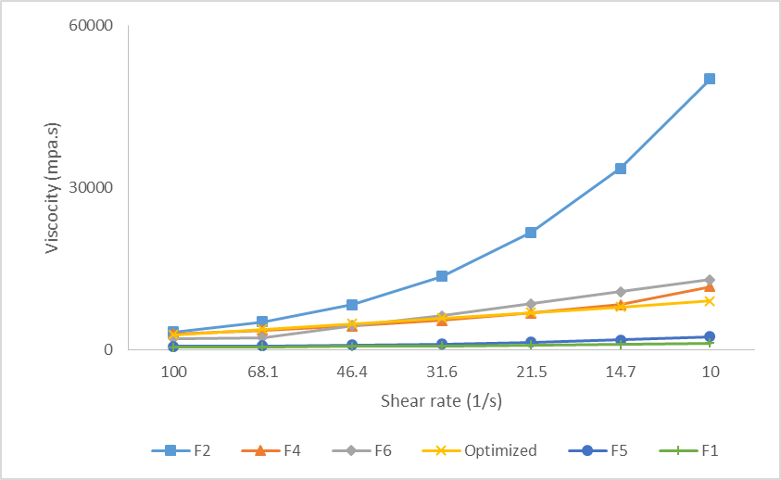
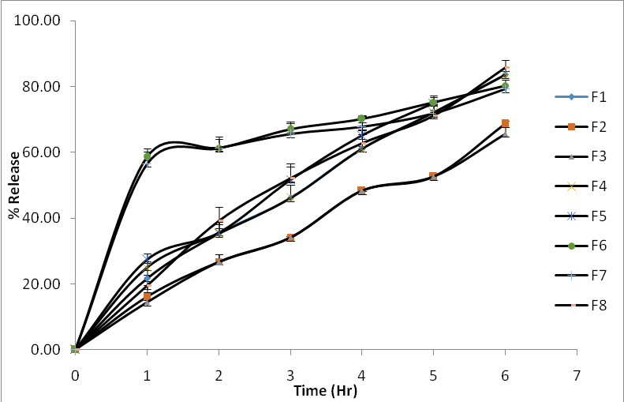
Figure 1: Overlay of Viscosity Curve (Viscosity versus Shear rate)
Figure 6: Comparative cumulative amount of Calcium carbonate release from in situ gelling raft formulation batches F1-F8

Slide 13
Data Analysis of the D-Optimal Mixture Design
The design expert® v-10 software was used to systematically analyse the experimental data obtained and generate mathematical models that define the relationship between the proportions of the two components (X1 and X2) and the three responses namely buoyancy lag time (BLT), Rel_{1h} and Rel_{6h}.
Table 3: Summary of ANNOVA for the response parameters of the Model formulations of in situ gelling raft formulation prepared as per simplex lattice design
Response | F-value | p-value | R² | Adj R² | % C.V.
Y1 | 395.04 | <0.0001 | 0.9850 | 0.9825 | 4.69
Y2 | 269.11 | <0.0001 | 0.9951 | 0.9914 | 5.44
Y3 | 52.54 | 0.0015 | 0.9546 | 0.9364 | 2.54
Regression equations of the fitted model containing only the significant terms:
Log BLT = + 0.05*X1 – 0.01*X2
Rel_{1h} = + 1.36*X1 – 8.94*X2 + 0.16*X1X2
Rel_{6h} = + 0.67*X1 - 0.92*X2 + 0.03*X1X2

Slide 14
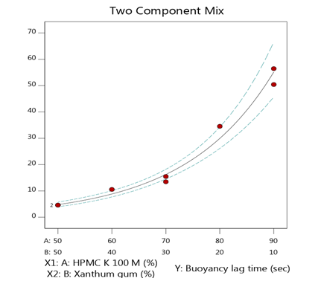
Buoyancy Lag time (Y1)
Log BLT = + 0.05*X1 – 0.01*X2
the effect of HPMC K100 M (X1) was found to have a positive effect on the BLT, this indicates that HPMC facilitated ﬂuid movement into the liquid raft formulation through its swelling action, followed by expanding the surface of the raft gel.
Xanthan gum (X2) was found to have a negative influence on the BLT, this implies low BLT are invariably associated with high levels of xanthan gum
Fig 3: Two component mix for BLT

Slide 15
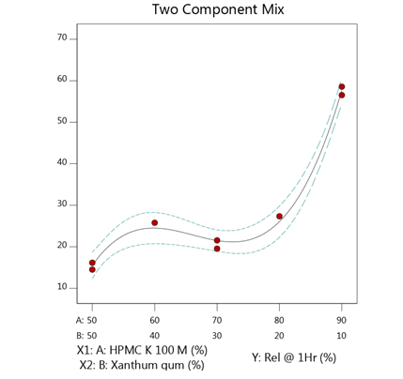
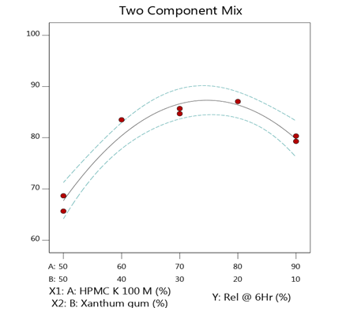
Release at 1h (Y2)
Rel_{1h} = + 1.36*X1 – 8.94*X2 + 0.16*X1X2
the burst effect from the raft formulations could be minimized by using high levels of xanthan gum, could result in formation of more compact gel that would prevent the penetration of the dissolution media and therefore the burst effect.
Fig 4: Two component mix for Release at 1h
Release at 6h
Rel_{6h} = + 0.67*X1 - 0.92*X2 + 0.03*X1X2
amount of Xanthan gum (X2) had a high negative coefficient (-0.92) that implies the factor was found to have the considerable influence on the release at 6h. Xanthan gum on coming in contact with aqueous medium forms a very viscous strong gel network.
Fig 5: Two component mix for Release at 6h

Slide 16
Optimization
A numerical optimization technique using the desirability approach was employed to develop new GRFS formulations with the desired responses.
Table 4: Composition of the optimized formulations and comparison of experimental values of the response parameters with the predicted values.
Factor | Optimized level (D-0.757)
X1:HPMC K 100 M | 65.88
X2:Xanthangum | 34.13
Response | Predicted value | Observed value | % Residual Error
Y1:BLT | 12.52 | 10.90 | 14.86
Y2:Release at 1Hr | 22.95 | 20.74 | -10.65
Y3:Release at 6Hr | 84.82 | 87.25 | -2.78
Each data point represents mean ± S.D (n=3)

Slide 17
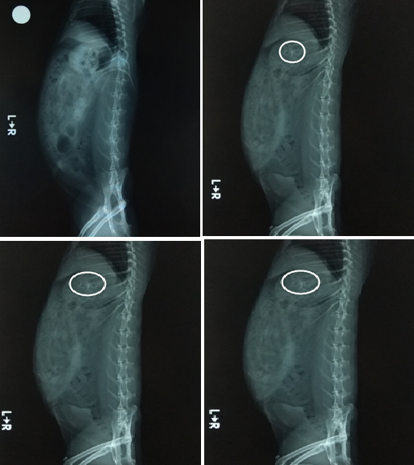
In vivo X-ray Imaging Studies :
Study Title : In vivo X-ray Imaging Studies for different formulations in rabbit model.
Test Facility : Invivo Biosciences.
Study Number : IE-52.
Species & Strain : Rabbit & New Zealand white.
Avg. weight of animals : 2–2.5 kg.
No. of groups : 2 (4 animals per group)
Group 1 (optimized batch of raft forming solution containing barium sulphate as a marker).
Group 2 (conventional suspension (Calcimax plus) containing the same marker).
Housing conditions : Standard laboratory conditions at 25±2°C and 55±5% RH with standard diet and tap water ad libitum.
X-ray machine : Skanray Model (Microskan DR).
Time intervals : 0, 2, 4 and 6h.

Slide 18
Conclusion
The studies collectively proved that bilayer gastroretentive tablets possessing floating properties would be highly promising drug delivery platform for nutrients and therapeutic agents with absorption window in the upper part of the gastrointestinal tract.

Slide 19
references
Nagaraju B, Ramu B, Saibaba SV, Rajkamal B. Formulation and evaluation of floating bioadhesive Doxofylline tablets. International Journal of Drug Delivery. 2016;8:134-141.
El-Zahaby SA, Kassem AA, El-Kamel AH. Formulation and in vitro evaluation of size expanding gastro-retentive systems of levofloxacin hemihydrate. Int J Pharm.2014;464:10–18.
Lifang Y, Chao Q, Kaisheng C, Chunli Z, Hui C, Jianping Z,Wei H, Qiang Z. Gastro-floating tablets of cephalexin: Preparation and in vitro/in vivo evaluation. International Journal of Pharmaceutics.2013;452:241– 248.
Anil Kumar AR, Chandra Sekhara Rao G, Prabhakar Reddy V. Formulation and Evaluation of Swellable and Floating Gastroretentive Ciprofloxacin Hydrochloride Tablets. AAPS PharmSciTech.2009;10(1)

Slide 20
THANK YOU

