Slide 1
Preparation of Magnetic-Fluorescent Bifunctional Microrods as a Drug Delivery System via One-step Electrospraying
Title of the Presentation
Junwei Xu ^{1,2}, Ping Li ^{1,2 ,}*, and Yubo Fan ^{2,3 ,}*
¹ School of Biological Science and Medical Engineering, BUAA, Beijing, China;
² Beijing Advanced Innovation Centre for Biomedical Engineering, BUAA, Beijing, China;
³ School of Medical Science and Engineering, BUAA, Beijing, China.
* Corresponding author: liping@buaa.edu.cn; yubofan@buaa.edu.cn

Slide 2
Abstract:
☞ Magnetic-fluorescent bifunctional drug delivery system which possesses magnetic targeting and fluorescent tracing capabilities, effectively improves the delivery efficiency of drugs.
☞ With the in-depth study of the properties of non-spherical microparticles, it is found that the shape of the microparticles also plays a key role in drug delivery.
☞ Because of the unique shape, rod-like microparticles have exhibited great drug molecule metabolic dynamics and excellent anti-tumor effects during the process of treatment.
☞ In this study, Fe₃O₄/NaYF₄:Eu³⁺/PLGA magnetic- fluorescent bifunctional microrods were prepared via one-step electrospraying.
Keywords:
♢ One-step electrospraying; ♢ Microrods;
♢ Drug delivery system; ♢ A549 cells；
♢ Magnetic-fluorescent bifunctional

Slide 3
Content
1. Background
2. Materials & Methods
3. Results & Discussion
4. Conclusions

Slide 4
Drug delivery system
Magnetic-fluorescent
Shape influence
Background

Slide 5
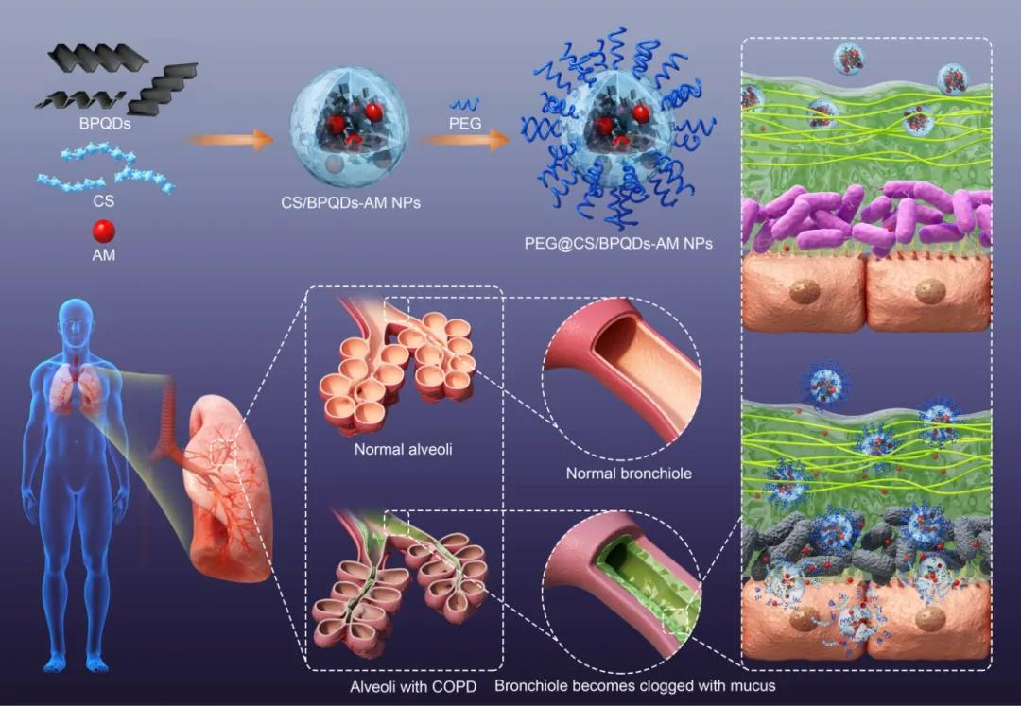
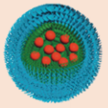
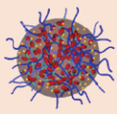
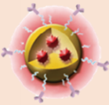
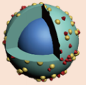
Drug delivery system
In order to improve the efficiency of drug utilization, drug delivery system (DDS) was proposed and used for delivering and then releasing the drugs to the lesion as well as reducing the toxicity of drugs.
Chen H.B., et al. Sci. China Chem. 2018,61:1503
Yu X.F., et al. Angew. Chem. Int. Edit. 2020, 59: 20568

Slide 6
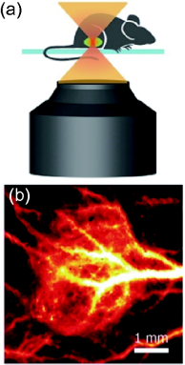
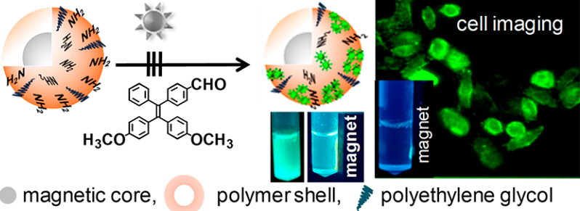
Magnetic-fluorescent
With the development of DDS, researchers paid more attention to the delivery targeting efficiency of DDS, especially that with magnetic targeting and fluorescence tracer.
Zhang M., et al. PNAS, 2018,115:6590
With magnetic targeting and fluorescent labeling functions, the DDS could realize the integration of diagnosis and treatment such as biological imaging and drug delivery.
Mandal K., et al. Appl. Nano Mater. 2019, 2, 3292

Slide 7
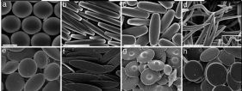
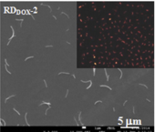
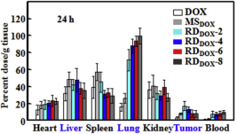
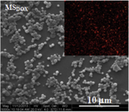
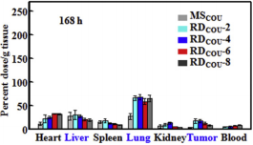
Shape influence
The regulation in the morphology, size, and surface composition of the carrier also affects the therapeutic effect of the DDS.
Lu Y., et al. Adv. Mater., 2001,13:271
With the large specific surface area, high drug-loading capacity, long circulation time and high cell uptake efficiency, the rod-shaped DDS has a better effect than the spherical DDS in the
treatment of cancer and other diseases
Zhang H., et al. J Control. Release, 2016,244:52

Slide 8
Preparation
Characterization
Materials
& Methods

Slide 9
Materials & Methods
Figure 1. Schematic illustration of the preparation of the Fe₃O₄/NaYF₄:Eu³⁺/PLGA magnetic-fluorescent bifunctional microrods.

Slide 10
Characterization
SEM: Morphology
Fe₃O₄/NaYF₄:Eu³⁺/
PLGA microrods
Infrared analysis
Thermal stabilities
Magnetic property
Hydrophobicity
Fluorescent property
Cytotoxicity
Entrapment efficiency
Drug-loading capacity
DOX-loaded
Anti-cancer cell efficiency
Fe₃O₄/NaYF₄:Eu³⁺/
PLGA microspheres

Slide 11
Morphology
Composition
Magnetic property
Fluorescent property
Hydrophobicity
Cytotoxicity
Drug loading capacity
Anti-cancer cell efficiency
Results
& Discussion

Slide 12
Morphology
Fe₃O₄/NaYF₄: Eu³⁺/PLGA microrod possessed uniform rod shape.
Figure 2. SEM images of Fe₃O₄/NaYF₄: Eu³⁺/PLGA microrods at different magnifications, (a) ×5000, (b) ×10000; (c) length distribution and
(d) diameter distribution of Fe₃O₄/NaYF₄: Eu³⁺/PLGA microrods.

Slide 13
Composition
Infrared analysis and thermal stabilities
Figure 3. (a) FTIR spectra of PLGA and Fe₃O₄/NaYF₄:Eu³⁺/PLGA microrods; (b) TG curve of PLGA and Fe₃O₄/NaYF₄: Eu³⁺/PLGA microrods.

Slide 14
Magnetic property
The saturation magnetizations of the pure Fe₃O₄ MNPs and Fe₃O₄/NaYF₄:Eu³⁺/PLGA microrods were 67.4 and 4.6 emu/g, respectively.
Fe₃O₄/NaYF₄:Eu³⁺/PLGA microrods still exhibited great magnetic properties.
Figure 4. Hysteresis loop of (a) pure Fe₃O₄ MNPs and (b) Fe₃O₄/NaYF₄:Eu³⁺/PLGA microrods. (c) Optical microscope images of Fe₃O₄/NaYF₄:Eu³⁺/PLGA microrods.

Slide 15
Fluorescent property
The intensity of emission spectra and the fluorescence photograph suggested the excellent luminescent property of Fe₃O₄/NaYF₄:Eu³⁺/PLGA microrods which would be a good candidate for bioimaging and drug tracer.
Figure 4. Emission spectra of (d) pure NaYF₄:Eu³⁺ NPs and (e) Fe₃O₄/NaYF₄:Eu³⁺/PLGA microrods. (f) Fluorescent photograph of the Fe₃O₄/NaYF₄:Eu³⁺/PLGA microrods.

Slide 16
Hydrophobicity
The microrods exhibited a smaller contact angle of approximately 9.7 °than the microspheres, which suggested that microrods were more hydrophilic than microspheres.
Figure 5. Images of water droplets on (a) Fe₃O₄/NaYF₄:Eu³⁺/PLGA microrods and (b) Fe₃O₄/NaYF₄:Eu³⁺/PLGA microspheres; (c) contact angles and of Fe₃O₄/NaYF₄:Eu³⁺/PLGA microrods and microspheres, n=3.

Slide 17
Cytotoxicity
No significant cytotoxicity to HUVECs and A549 cells !
Figure 6. (a) Fluorescence images of HUVECs and A549 cells (stained with AO) cultured with microrods or microspheres at the concentration of 1 mg/mL for 5 d, scale bar: 100 μm. In vitro cell relative viabilities of (b) HUVECs and (c) A549 cells co-cultured with Fe₃O₄/NaYF₄:Eu³⁺/PLGA microrods or microspheres at the concentration of 1 mg/mL for 1 d, 3 d and 5 d, n=3.

Slide 18
Drug loading capacity
The entrapment efficiency and drug-loading capacity of DOX loaded Fe₃O₄/NaYF₄:Eu³⁺/PLGA microrods were 9.153±0.506% and 0.907±0.050%, higher than 8.368±0.259% and 0.830±0.025% of DOX loaded Fe₃O₄/NaYF₄:Eu³⁺/PLGA microspheres.
The high drug loading capacity might due to the larger specific surface area in comparasion with microspheres.
Figure 7. The calculated EE and LC of DOX loaded Fe₃O₄/NaYF₄:Eu³⁺/PLGA microrods and microspheres, n=3.

Slide 19
Anti-cancer cell efficiency
The drug-loading Fe₃O₄/NaYF₄:Eu³⁺/PLGA microrods had stronger killing effects to cancer cells in comparison with microsheres.
Figure 8. (a) In vitro A549 cell relative viabilities normalized to the untreated control after co-cultured with DOX loaded Fe₃O₄/NaYF₄:Eu³⁺/PLGA microrods or microspheres at different concentrations of 0.1, 0.2, 0.5, 1.0, 2.0 or 5.0 mg/mL for 48 h, n=3. (C) In vitro A549 cell relative viabilities normalized to the untreated control at the concentration of 1.0 mg/mL for 12, 24, 48 and 72 h, n=3.

Slide 20
Conclusions
Acknowledgments
Conclusions

Slide 21
Conclusions
☺ The Fe₃O₄/NaYF₄:Eu³⁺/PLGA microrods showed a good rod.
☺ The microrods had outstanding magnetic and fluorescent properties.
☺ Compared with microspheres, microrods had better hydrophilic property.
☺ there was no obvious cytotoxicity of Fe₃O₄/NaYF₄:Eu³⁺/PLGA microrods.
☺ Microrods had a higher entrapment efficiency and drug-loading.
☺ Compared with microspheres, microrods had stronger killing effects to cancer cells (after loading DOX).
In short, this rod-shaped drug carrier, Fe₃O₄/NaYF₄:Eu³⁺/PLGA microrods, with magnetic-fluorescent bifunctional have a good prospect in the field of drug delivery.

Slide 22
Acknowledgments
This study was supported by funds from National Natural Science Foundation of China (NSFC) Research Grants (61871014, 52071008, 11827803, 11421202), and it was also supported by Beijing Natural Science Foundation (7191006).
Prof. Y.B. Fan
Beijing Advanced Innovation Centre for Biomedical Engineering
Beihang University
Beijing 100191, P. R. China
E-mail: yubofan@buaa.edu.cn
Prof. P. Li
School of Biological Science and Medical Engineering
Beihang University
Beijing 100191, P. R. China
E-mail: liping@buaa.edu.cn

Slide 23
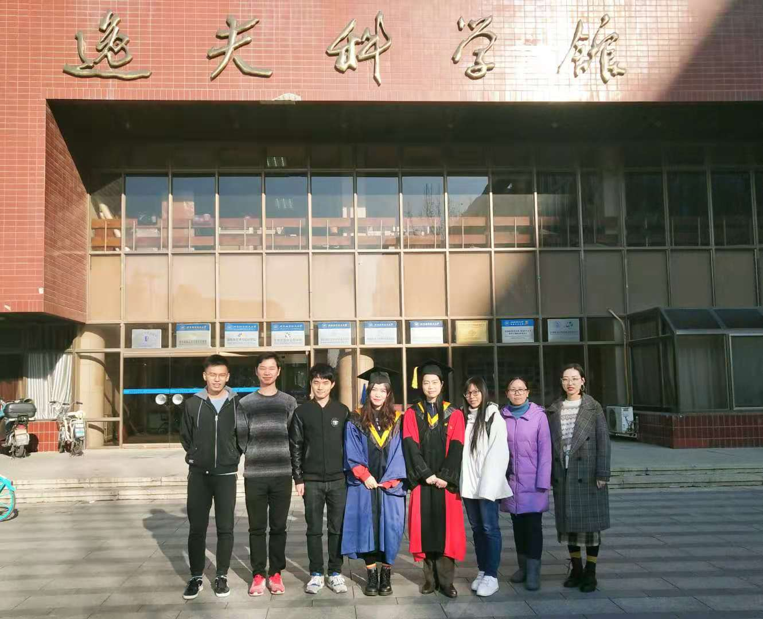
Our group~

Slide 24
Thanks!

