Slide 1
Reorientation of methods applied to plant protection as an effect of climate change

Slide 2
Abstract
The paper provides an overview of the agricultural economy in terms of agricultural development, especially in the area of ​​plant protection, taking into account the effects of climate change. Environmental protection and sustainable management of natural resources, prioritizing an action behavior regarding vulnerabilities regarding the types of fertilizers used, favors the reorientation of methods applied to plant protection in order to protect the biosphere are part of the soil-plant-air-water equation. Climate change involves the reduction of greenhouse gas emissions and the adaptation of agricultural systems. The risks of using excessive fungicides in plant protection.
Plant-soil interdependence in agricultural practice is also highlighted in the paper. One of the main objectives in the field of agriculture is to maintain a low level of greenhouse gas emissions from the agricultural sector.
The role of research and studies has shown an important factor in reducing the carbon footprint per tonne of food produced from organic farming compared to conventional farming, mainly due to the abandonment of the use of chemical fertilizers and pesticides. The aim of the following research is to collect data and information on the most efficient management models that will create the premises for the production of production models that will respond in the future to the challenges of climate change, especially from the perspective of reducing greenhouse gases, depending the application of a plant protection system in response to climate change and the pressure of diseases and pests. During the research we tried to highlight aspects that, in our opinion, are important for the development of the agricultural sector as part of the economy.

Slide 3




Keywords: : water, plant, environment, plant protection
water,

Slide 4
Introduction
Most agricultural soils contain too little natural nitrogen available to meet growing requirements during the growing season. As a result, it is necessary to supplement the nitrogen naturally contained in the soil every year. Applying the right amount of nitrogen at the right time is the basic requirement for good fertilizer management. Nitrogen requirements vary considerably in different crops and within the same crop, the level of harvest being possible to be reached in a certain conjuncture of climatic and technological factors. Due to the specific behavior of nitrogen in the soil, fertilization with this nutrient and also techniques cultivation that influences its dynamics in the soil must be carried out in a way that minimizes losses with percolating water, thus reducing the risk of nitrate contamination of groundwater and surface water (Tecimen, 2017; Joshi & Chilwal, 2018; Işık, & Kırkpınar, 2020). The 1991 Nitrates Directive is one of the first EU legislation to control pollution and improve water quality. Although nitrogen is a vital nutrient that contributes to the growth of plants and crops, high concentrations of nitrogen are harmful to humans and nature. Agricultural use of nitrates in organic and chemical fertilizers is a major source of water pollution in Europe. Consumption of mineral fertilizers first fell sharply in the early 1990 and stabilized over the last four years in the EU-15, but in all 27 Member States nitrate consumption increased by 6%. In general, animal husbandry remains the main cause of over 50% of total nitrogen discharges into surface waters activities related to livestock and fertilizer management release nitrogen oxide (N2 O) and methane (CH4), greenhouse gases with a global warming potential of 310 and 21 times higher than CO2, respectively.

Slide 5
In the analysis we highlighted products that contain active substances, phytoprotective agents or synergistic agents, in the form in which they are presented to the user and which are intended for: - protection of plants or plant products against all harmful organisms or prevention of these organisms; - the exercise of an action on the vital processes of plants, other than a nutritional action; - ensuring the preservation of plant products, insofar as these substances or products are not subject to other legal regulations on preservatives; - destruction of parts of plants, stopping or preventing unwanted plant growth. Thus we found that products (chemicals) that are used to control diseases in agricultural crops are growing in agricultural areas highlighted especially fungicides.
The amount of fungicides sold in solid form in 2018 increased compared to the previous year by 5.7%. The distribution, in total fungicides, on macroregions is as follows: macroregion three (34.2%), macroregion one (26.3%), macroregion four (22.0%), macroregion two (17.5%). The largest quantities of fungicides in solid form were sold in the development regions of Centru (20.6%), Sud-Muntenia (17.6%) and Bucharest-Ilfov (16.6%). For products sold in liquid form, the amount of fungicides decreased by 3.0% compared to 2017.
The largest amount of fungicides was sold in macro-region three (49.2%), followed by macro-region one (26.6%), macro-region two (15.7%) and macro-region four (8.5%). By development regions, the South-Muntenia region occupies the first place (27.7%), followed by the Bucharest-Ilfov (21.5%) and Center (19.3%) regions. Thus, in determining the increase in consumption, the different climatic conditions of the regions were analyzed as possible increases in consumption and the critical level of losses by non-compliance with agricultural practices in the application of plant protection products.

Slide 6
The use of pesticides plays
The use of pesticides plays an important role in agricultural production, ensuring less damage to weeds and crop pests and a consistent yield. However, their use can have negative effects on the environment on water quality, on terrestrial and aquatic biodiversity (persistence and toxic effects on non-target species, etc.).
The Sustainable Use Directive promotes the use of integrated pest management and alternative approaches and techniques, such as non-chemical alternatives to pesticides. Integrated Pest Management (IPM) is a strategy that promotes safer and more sustainable pesticide management.
IPM strategies evolve due to new emerging pests and climate change and involve crop rotation, hygiene measures to prevent the spread of pests, protection and improvement of beneficial organisms, using appropriate cultivation, cultivation or seed techniques. Farmers need to implement IPM and give preference to non-chemical methods if they ensure satisfactory pest control. The main goal is to reduce pesticide dependence in agriculture.
Environmental contamination due to pesticides can result from drift by spraying, volatilization, surface runoff and loss of subsoil by leaching / flow. The persistence of pesticides in the environment differs greatly and is dependent on factors such as their susceptibility to attack by microorganisms and enzymes, soil temperature and water content.

Slide 7
In the last decade, much has been done in the agricultural sector to limit the negative effects of pesticides. Organic farming is growing year by year and now covers 7.5% of the EU AU. Four million farmers have been trained in the safe use of pesticides, and the number of EU-approved non-chemicals or low-risk substances has doubled since 2009.
The abandonment of agricultural land has far-reaching effects on ecosystem services, such as increased carbon storage, lower soil erosion, better water quality, and loss of traditional cultural landscapes. These effects often result in a decline in biodiversity. Also, the lack of appropriate knowledge, as a result of problems with the farm consulting system, results in often inadequate agricultural practices, with a negative influence on biodiversity.
Even the relatively low yields of feed production, largely determined by improper pasture management, lead to erosion and loss of biodiversity.In the context of climate change, there is a need for a new activity in the agricultural field, which means using natural resources and good practice models to provide observation systems, information management understanding, modeling and analysis of environmental phenomena for evaluation, exploitation and management. natural resources (water soil, climate).

Slide 8
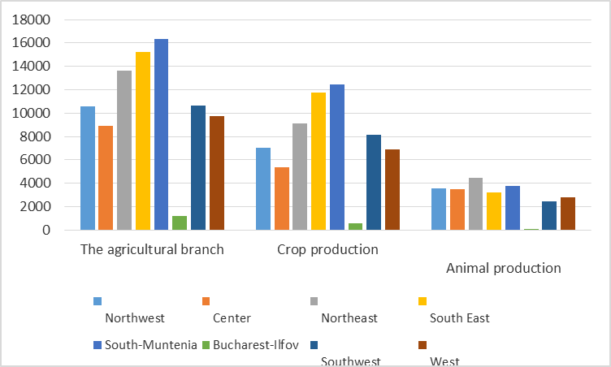
The value of the production of the agricultural branch by development regions, in 2018
 | Northwest | Center | Northeast | South East | South-Muntenia | Bucharest-Ilfov | Southwest | West
The agricultural branch | 10561 | 8930 | 13652 | 15256 | 16336 | 1196 | 10656 | 9762
Crop production | 7015 | 5348 | 9092 | 11724 | 12428 | 606 | 8141 | 6862
Animal production | 3523 | 3509 | 4475 | 3239 | 3775 | 110 | 2453 | 2819

Slide 9
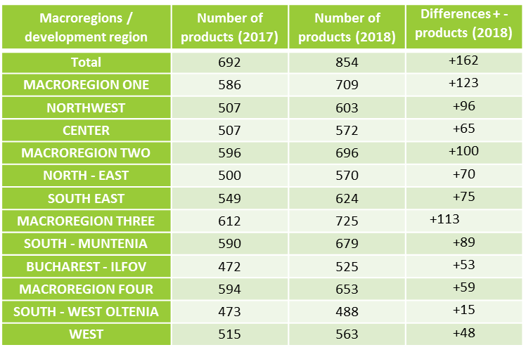
Plant protection products placed on the market (2017-2018) by development regions

Slide 10
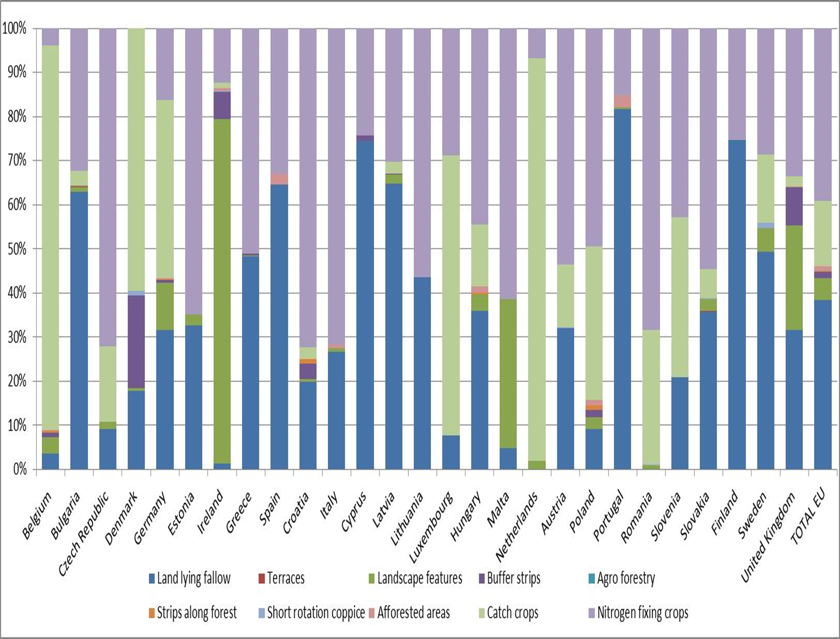
Source: Member States’ uptake data, 2015 (EU-27, data not available for France)
Figure 3 — Spatial distribution of main EFA type categories for each NUTS 3 region

Slide 11
Discussions
The 2013 reform of the common agricultural policy (CAP) introduced an ecological ("greening") direct payment scheme. It should be noted that the aim was to further improve the sustainable management of agricultural-related natural resources through payments for climate-friendly and environmentally friendly agricultural practices. Therefore, in addition to crop diversification and the maintenance of permanent pastures, greening requires farmers to reserve 5% of their arable land for areas of ecological interest (ZIE). Many valuable habitats and the biodiversity they maintain are based on agricultural systems. However, efforts to protect this biodiversity are not recognized as they are not reflected in farmers' prices for their products. Although biodiversity depends on the existence of appropriate management practices, these practices have changed over time due to competitive pressures, leading to increasing specialization and intensification of production in certain areas and the abandonment of soil cultivation in certain areas. others.
All this has put pressure on biodiversity, had detrimental effects on soil, water and climate, and also jeopardized the long-term productive potential of the agricultural sector. Thus, as a priority in these conditions of "chaos" amplified by climate change, there is a need once again for the resettlement of efforts in the systematization of agricultural production processes. And where can we start except from the reorientation of the techniques of using plant protection products. In fact, this issue will not expire until good practices are intertwined in good faith in the correct use of fertilizers, self-control is needed to avoid unwanted consequences of pollution and destabilization of the biosphere largely affected by climate today.

Slide 12
References
[1] Andrei, T., Bourbonnais, R. (2008): Econometrics, Bucharest, Economic Publishing House, p. 111- 123;
[2] Andrei, T., Stancu, S., James, AI, et al. (2008): Introduction to econometrics using Eviews, Bucharest, Economic Publishing House, pp. 66-82;
[3] Appiah, K., Du, J., & Poku, J. (2018). Causal relationship between agricultural production and carbon dioxide emissions in selected emerging economies. Environmental Science and Pollution Research, 25(25), 24764-24777.
[4]www.insse.ro European Commission (2017). EU agricultural outlook: Arable land area to continue its decline. Available online: https://ec.europa.eu/info/news/eu-agricultural-outlook-arable-land-area-continue-its-decline_en (accessed on 15 July 2020).
[5] Gavrila V. (2013). Soil management in sustainable development context. Lucrări Științifice Management Agricol, 15(2), 161.
[6] Huang J., Chen Y., Pan J., Liu W., Yang G., Xiao X., Zhou L. (2019). Carbon footprint of different agricultural systems in China estimated by different evaluation metrics. Journal of Cleaner Production, Vol. 225, pp. 939-948.
[6] Hutchinson J.J., Campbell C.A., Desjardins R.L. (2007). Some perspectives on carbon sequestration in agriculture in Agricultural and Forest Meteorology 142: 288.
[7] INSSE General Agricultural Census (2010). Selection of tables with the main indicators, at national level at the level of macro-regions, development regions and counties. Available online: https://insse.ro/cms/files/RGA2010/Rezultate%20definitive%20RGA%202010/rezultate%20definitive%20RGA%202010.html (accessed on 19 March 2020).

