Slide 1
On augmenting growth, photosynthesis, enzymatic activities and nutrient contents of Brassica juncea (L.) by application of plant growth regulators
PRESENTED
BY
SHAISTUL ISLAM
Research Scholar
Dept. of Botany
Aligarh Muslim University
Aligarh, India

Slide 2
INTRODUCTION
Brassica juncea L. is a herbaceous plant commonly known as Indian mustard, belonging to the family Brassicaceae.
It is the second most edible oil seed crop and contributes about 30% of the total oilseed production in India.
B. juncea L. is one of the richest source of of unsaturated fatty acids like oleic acid, linoleic acid and linolenic acid
Efforts have been made from time to time to raise its cultivation, growth and productivity.

Slide 3
PLANT GROWTH REGULATORS
Plant growth regulators (PGRs) are a group of organic compounds that mediate plant growth, development and yield.
Among PGRs, Auxins, Gibberellins, Cytokinins, Abscisic acid, Ethylene, Salicylic acid, Jasmonates, Triacontanol and Brassinosteroids are supposed important as far as growth and development is concerned.
PGRs are also known for having a prominent impact on plant metabolism and playing a vital role in the stimulation of plant defense response mechanisms against myriad conditions.

Slide 4
OBJECTIVE
To explore the effect of leaf-applied nine PGRs on growth, photosynthetic attributes, enzyme activities and nutrient contents of mustard

Slide 5
EXPERIMENTAL SET UP

Slide 6
The experiment was conducted in a completely randomized design in the net house of Botany Department, Aligarh Muslim University, Aligarh
Authenticate seeds of mustard were procured from the Indian Agriculture Research Institute, New Delhi, India
The seeds were surface sterilized and were sown in earthen pots filled with soil and farmyard manure
Plants were sprayed with a uniform concentration at 5 µM each of nine PGRs at 50 and 70 days after sowing (DAS)
The plants were harvested to assess various growth, physio-biochemical parameters at 80 DAS

Slide 7
The following parameters were studied at 80 DAS
Growth parameters
Physiological parameters
Shoot length
Root length
Root fresh mass
Shoot fresh mass
Root dry mass
Shoot dry mass
Leaf area
Chlorophyll content
Net photosynthetic rate
Relative water content
Biochemical analysis
Carbonic anhydrase
Nitrate reductase
Nitrogen content
Phosphorous content
Potassium content

Slide 8
RESULTS

Slide 9
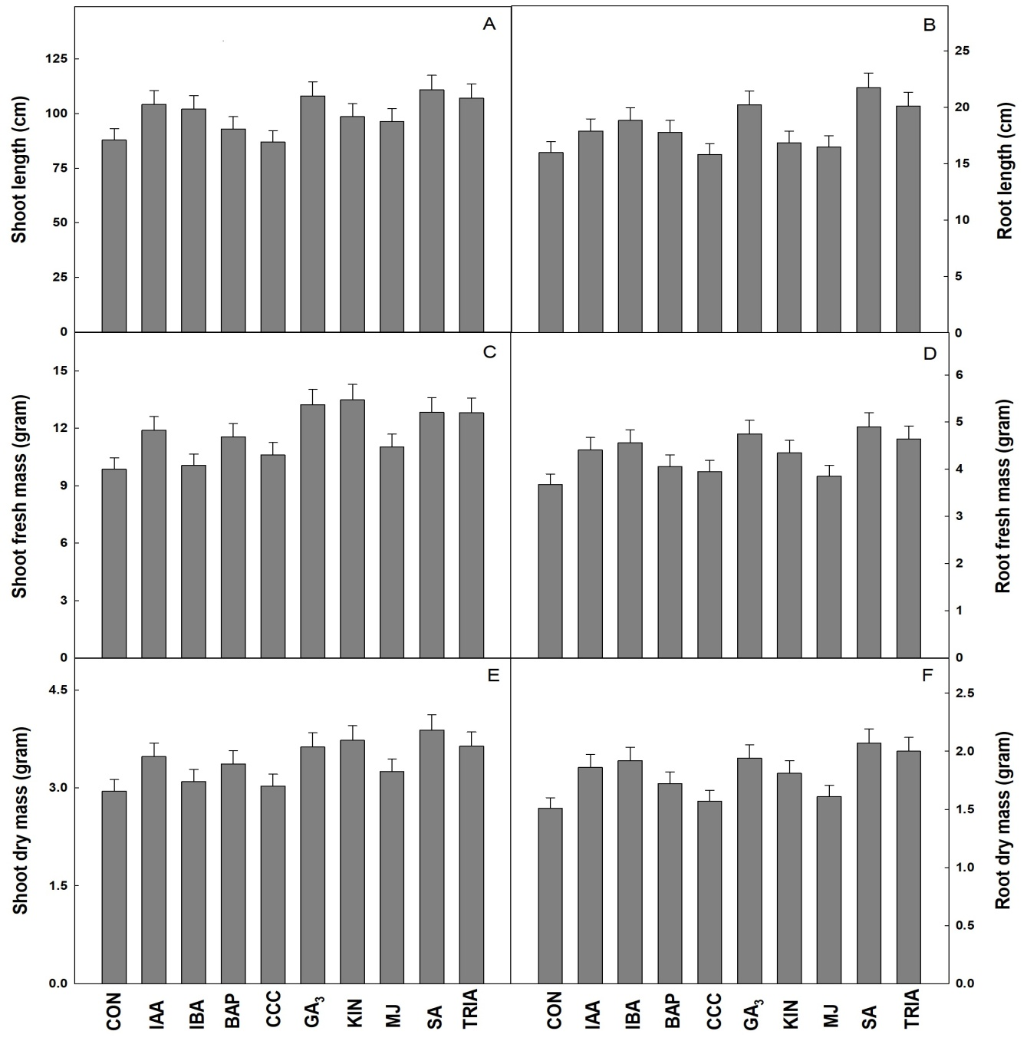
Fig. 1 Effect of leaf applied PGRs on (A) Shoot length per plant, (B) Root length per plant, (C) Shoot fresh mass per plant, (D) Root fresh mass per plant, (E) Shoot dry mass per plant, (F) Root dry mass per plant in Brassica juncea (L.).

Slide 10
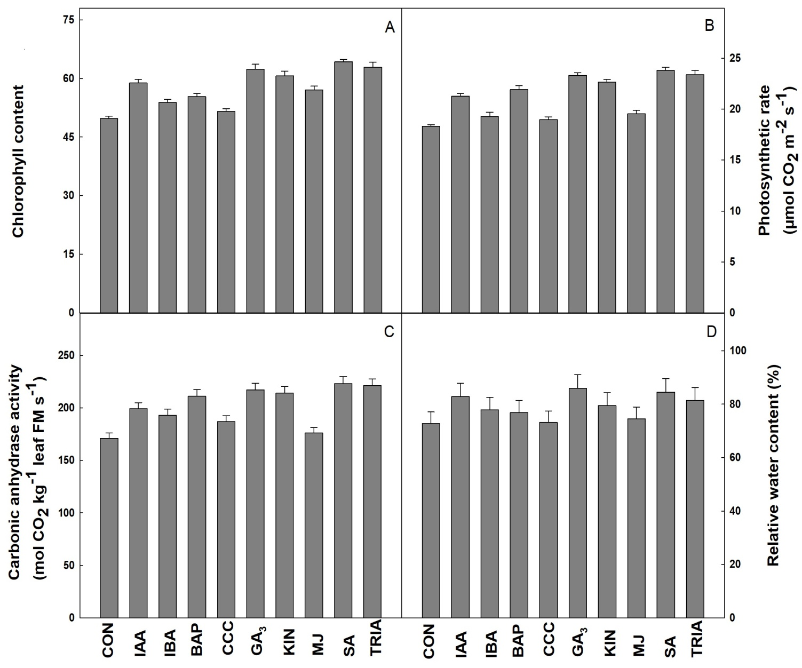
Fig. 2 Effect leaf applied PGRs on (A) Chlorophyll content (B) Net photosynthetic rate (C) Carbonic anhydrase activity and (D) Relative water content in Brassica juncea (L.).

Slide 11
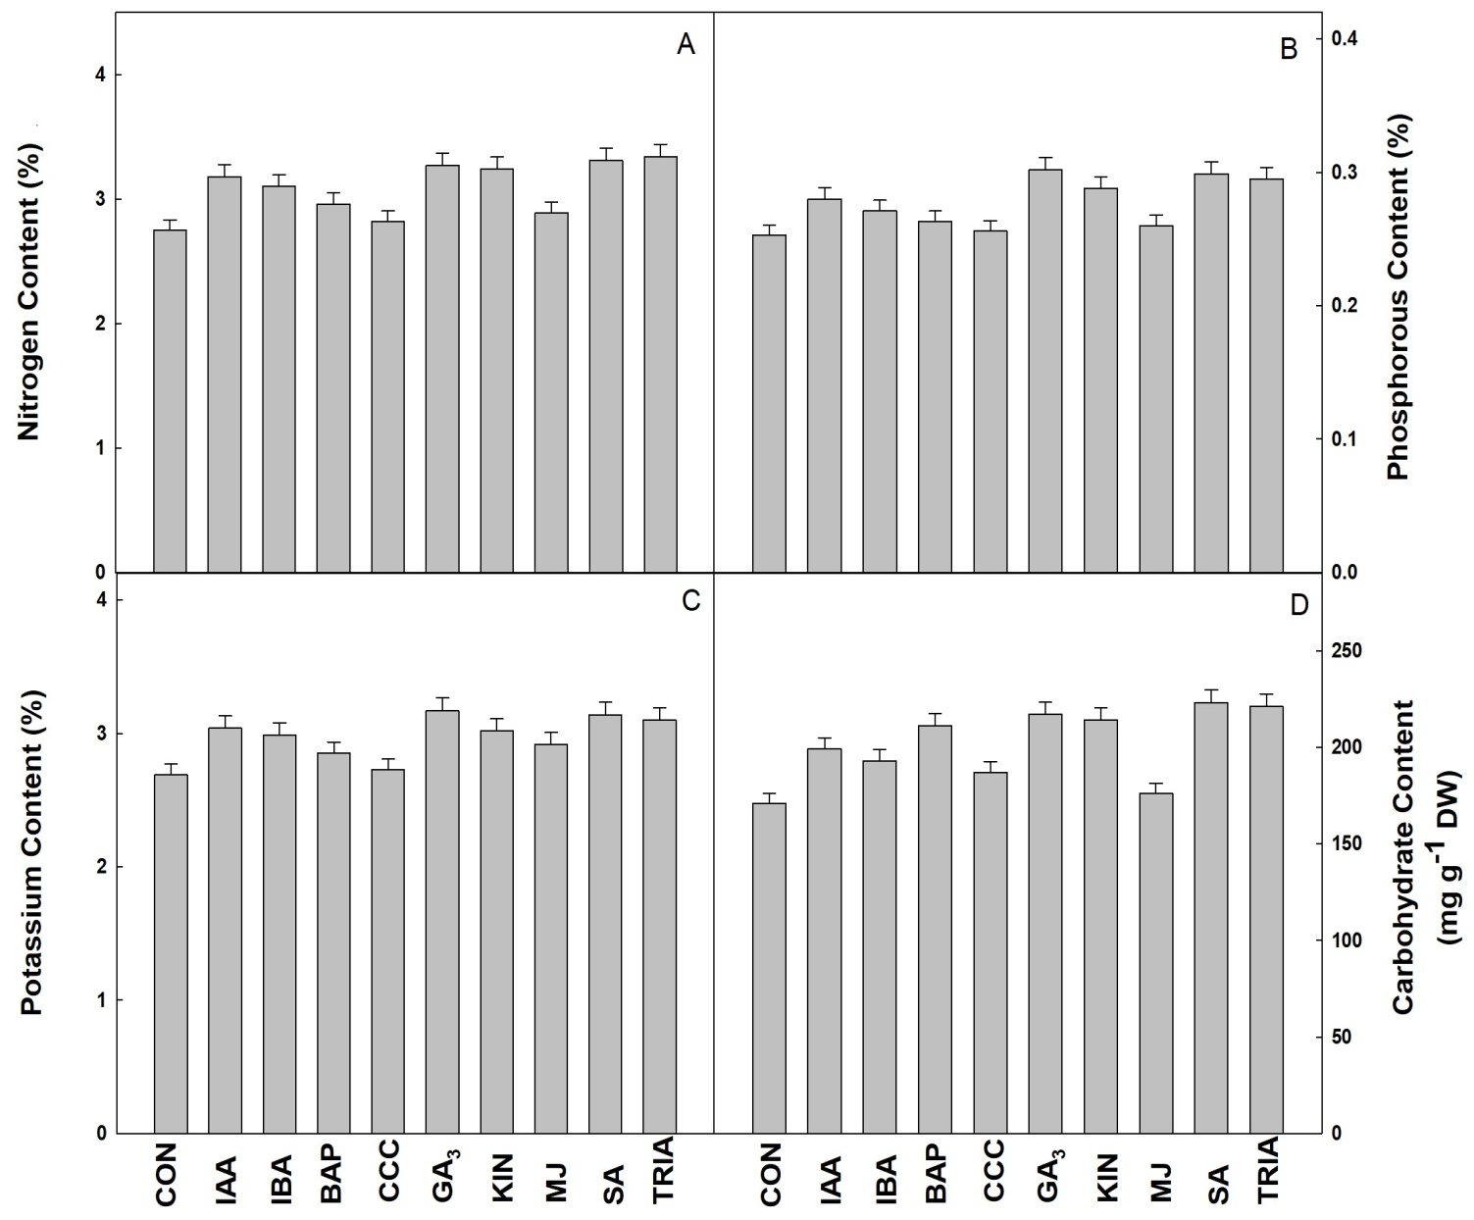
Fig. 3 Effect leaf applied PGRs on (A) Nitrogen content (B) Phosphorous content (C) Potassium content and (D) Carbohydrate content in Brassica juncea (L.).

Slide 12
conclusion

Slide 13
Foliar spray of PGRs improved the growth, photosynthesis, enzyme activities and leaf nutrient contents of mustard plant.
Application of SA, GA₃ and TRIA in that order was found comparatively more pronounced and improved the most of the parameters studied.
Further, the technique of foliar feeding of PGRs may safely be adopted for improving the growth, photosynthesis and yield of mustard.

