Slide 1
Title of the Presentation
Sub-100 nm chitosan-triphosphate-DNA nanoparticles for delivery of DNA vaccines
Renato Nunes ^{1,2}*, Ângela Sousa¹, Aiva Simaite ², Ahmed Aido² and Matej Buzgo²
¹ CICS- UBI – Health Sciences Research Center, University of Beira Interior, Avenida Infante D Henrique, 6200-506, Covilhã, Portugal; angela@fcsaude
² InoCure s.r.o, R&D Lab, Prumyslová 1960, 250 88 Celákovice, Czechia; aiva@inocure.cz
* Corresponding author: renato.nunes@ubi.pt

Slide 2
Abstract: Intramuscular delivery is one of the main route for DNA vaccines administration. However, it requires large amounts of the DNA administered and external stimulation to encourage the internalization of the DNA. In this work we consider routes for less invasive administration route, and develop drug delivery systems (DDS) for intranasal administration. Chitosan polyplexes using sodium tripolyphosphate (TPP) as a crosslinker were prepared using the ionic gelation method. Our method allowed preparation of nanoparticles with the size bellow 50nm that is at least two times lower than previously reported. Moreover, despite small size, we obtained DNA encapsulation efficiencies about 70%. Parameters that may affect the encapsulation efficiency were investigated, including different chitosan-TPP ratios and concentrations of DNA. We found that encapsulation efficiency of DNA inside the particles increases with the increasing TPP-chitosan ratio. Moreover, increasing the DNA concentration also leads to a higher encapsulation efficiency. Small (<50nm) chitosan nanoparticles hold enormous potential as DNA carriers through physiological barriers and subsequent internalization
Keywords: chitosan; DNA vaccines; tripolyphosphate;
nanoparticles; ionic gelation

Slide 3
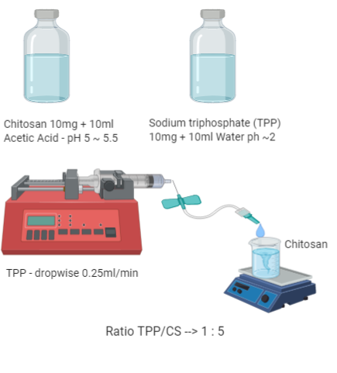
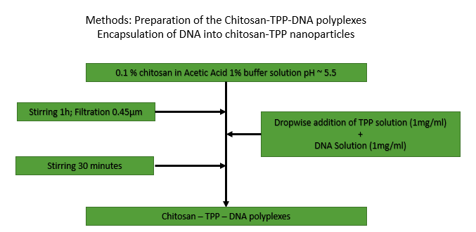
Methods
Ionotropic gelation:
Chitosan → polymer
Sodium tripolyphosphate (TPP) → crosslinker
(a)
(b)
Figure 1. (a) Schematic illustration of chitosan-TPP nanoparticles (b) Flow chart of the nanoparticle with DNA preparation First solutions with optimized concentrations were prepared. Then TPP with DNA was added to chitosan solution dropwise while stirring.
Dropwise addition of TPP into CS solution
Particles with and without DNA
Negative and Positive control

Slide 4
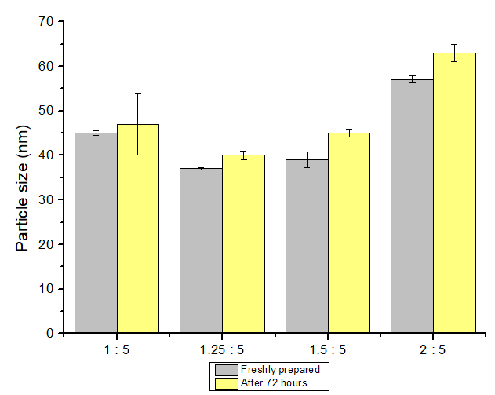
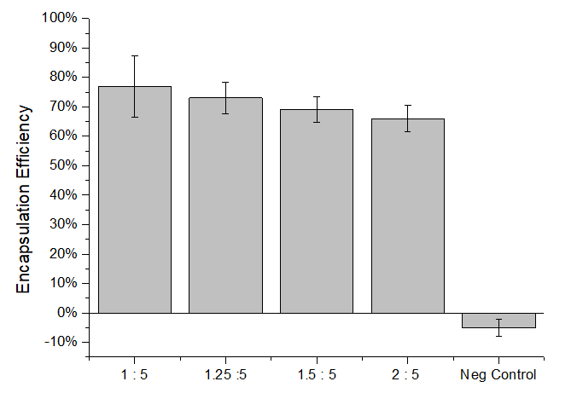
Results and Discussion
Table 1. Average particle size, PDI and encapsulation efficiency of chitosan-TPP-DNA polyplexes with different TPP/CS ratios
TPP/CS Ratio | Z-Average Size (nm) | Polydispersibily index (PDI) | Z - Average Size after 72h (nm) | (PDI) after 72h | Encapsulation efficiency (%)
1 : 5 | 45 ± 0.5 | 0.55 ± 0.01 | 47 ± 6.9 | 0.51 ± 0.006 | 77 ± 10
1.25 : 5 | 37 ± 0.3 | 0.50 ± 0.03 | 40 ± 0.9 | 0.48 ± 0.004 | 73 ± 5
1.5 : 5 | 39 ± 1.7 | 0.46 ± 0.04 | 45 ± 0.9 | 0.40 ± 0.009 | 69 ± 4
2 : 5 | 57 ± 0.8 | 0.50 ± 0.02 | 63 ± 1.9 | 0.46 ± 0.010 | 66 ± 4
Small particles → below 70 nm
Hight TPP/CS ratio → small increase in size
No significant increase after 72h
No interference of blank particles in dEE
Good efficiency of encapsulation
Increasing TPP/CS ratio → small decrease in E.E. (10%)

Slide 5
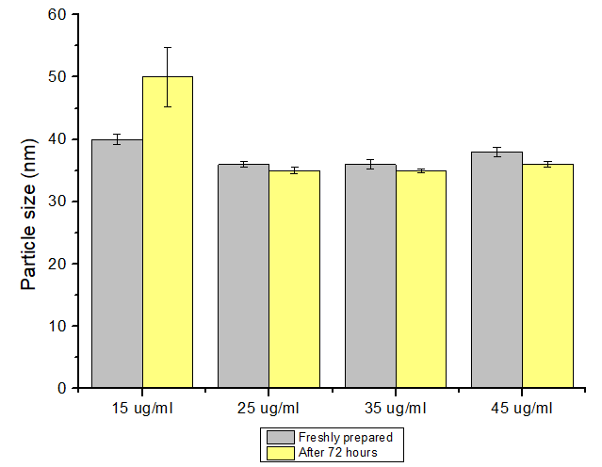
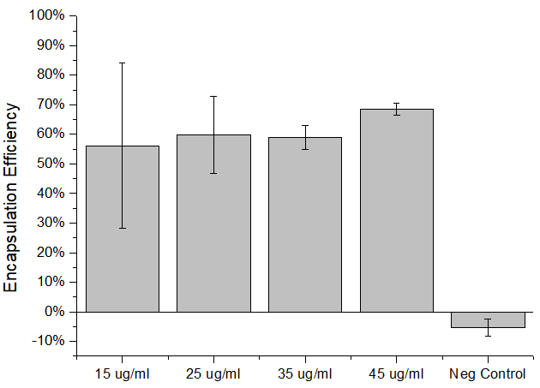
Results and Discussion
Table 2. Average particle size, PDI and encapsulation efficiency of chitosan-TPP-DNA polyplexes with different DNA concentrations
DNA Concentration (μg/ml) | Z-Average Size (nm) | Polydispersibily index (PDI) | Z - Average Size after 72h (nm) | (PDI) after 72h | Encapsulation efficiency (%)
15 ± 5 | 40 ± 0.8 | 0.59 ± 0.01 | 50 ± 4.8 | 0.39 ± 0.26 | 56 ± 28
25 ± 5 | 35 ± 0.5 | 0.48 ± 0.05 | 35 ± 0.5 | 0.53 ± 0.006 | 60 ± 13
35 ± 5 | 36 ± 0.8 | 0.47 ± 0.05 | 35 ± 0.3 | 0.56 ± 0.006 | 59 ± 4
45 ± 5 | 38 ± 0.7 | 0.47 ± 0.04 | 36 ± 0.4 | 0.55 ± 0.01 | 69 ± 2
Small particles → below 50 nm
Changing DNA concentration → no difference in size
Small increase about 10nm in the sample with 15 μg/mL after 72h
Good efficiency of encapsulation
Increasing DNA concentration → Increase in E.E.

Slide 6
Conclusions
Ionic gelation of CS/TPP nanoparticles →promising delivery system for nucleic acids
Nanocarriers below 100nm in size → Efficient internalization of NPs by relevant cells
High quantities of DNA can be encapsulated using TPP/CS nanoparticles
Delivery of DNA vaccines demands → high quantity of DNA to achieve the effective immunization and therapeutic effects

Slide 7
Acknowledgments
R.N. has received support from the Erasmus+ traineeship programme for his research activities at InoCure s.r.o. The project was supported by TACR project number FW01010445.

