Slide 1
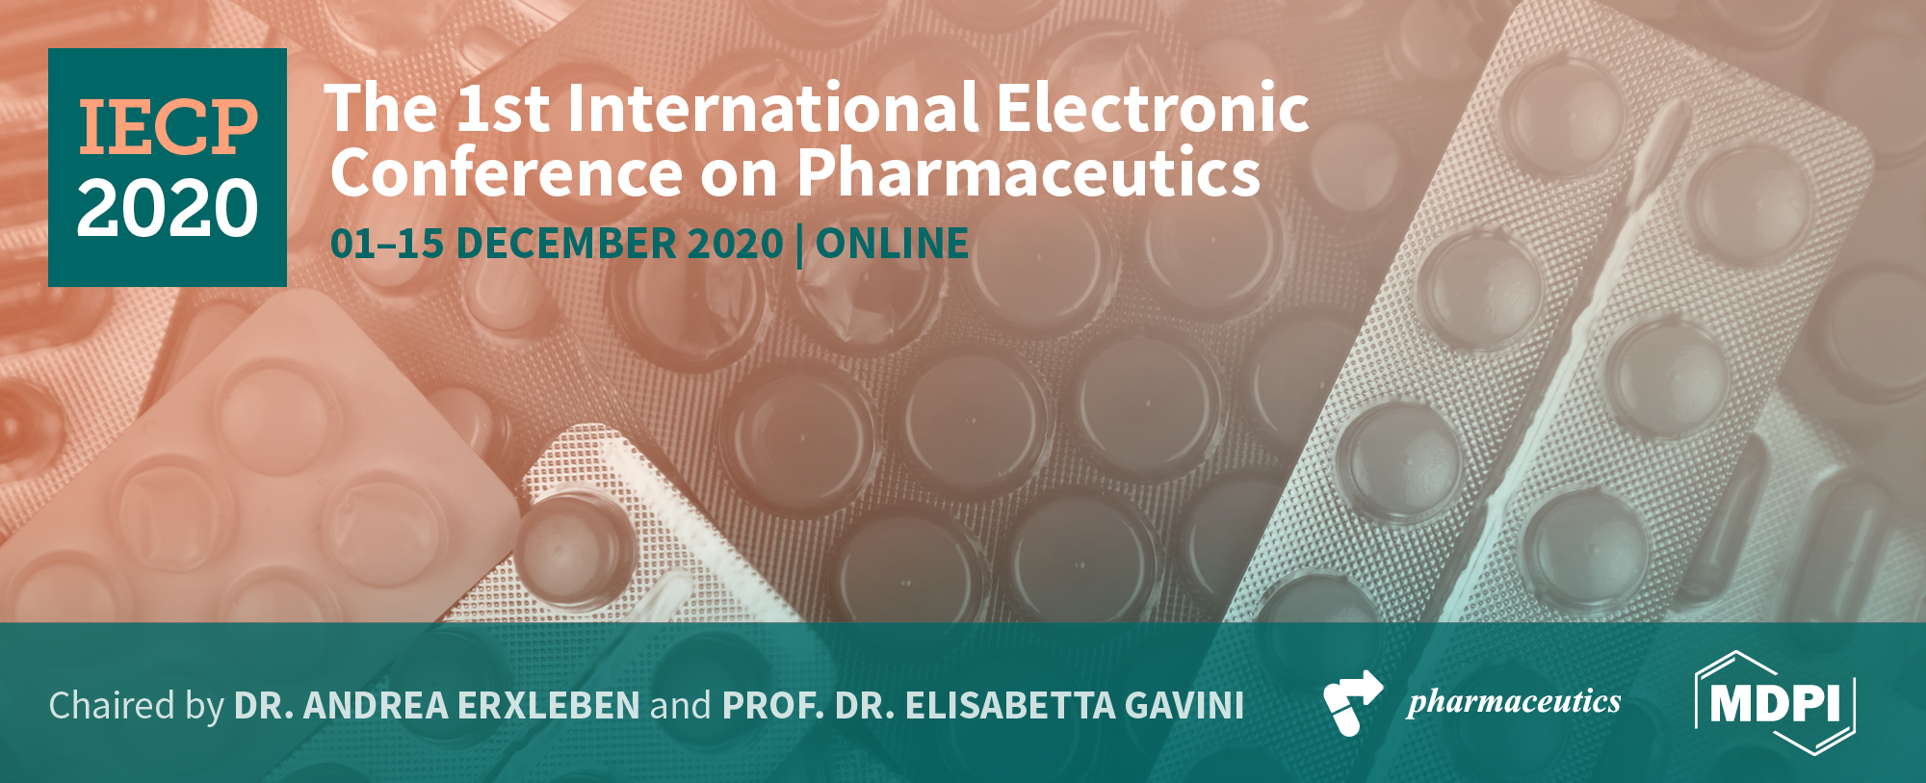


Synthesis of Peptaibolin, an antimicrobial peptide
Ana R.M. Ribeiro¹, Helena P. Felgueiras^{2*}, Susana P. G. Costa¹, Silvia M. M. A. Pereira-Lima¹*
¹Chemistry Research Centre (CQ), University of Minho, Portugal
²Centre for Textile Science and Technology (2C2T), University of Minho, Portugal
* Corresponding author: helena.felgueiras@2c2t.uminho.pt ; silviap@quimica.uminho.pt

Slide 2

Abstract: To tackle one of the biggest global health problems, the resistance of microorganisms to antibiotics, a collective effort in the search for more effective agents against bacteria was required. Peptides with antimicrobial activity have been rasing much attention as a promising alternative for antibiotics. Peptaibols, for instance, are a family of antimicrobial peptides (AMPs) with great biomedical potential, in which the Peptaibolin can be highlighted. Indeed, this peptide has gained relevance due to its small amino acids content, only four, and its acetyl group and a phenylalaninol residue (Phol) at the N-terminal and C-terminal, respectively. Here, we report the synthesis of Peptaibolin through Solid Phase Peptide Synthesis assisted by Microwave heating (MW-SPPS), in a pre-loaded Phe-Wang resin. Starting from a loading of 0.51 mmol/g, two syntheses were made, using two different combinations of coupling reagents. The best option was DIC/Oxima achieving a yield of 50.0%. Proton Nuclear Magnetic Resonance (1H NMR) studies confirmed the peptide structure, while the High Performance Liquid Chromatography (HPLC) technique verified the peptide purity. The peptide solubility was examined against several combinations of solvents. Peptaibolin was not soluble in water, only in organic solvents or in the combination of both. Antimicrobial testing has been conducted using both Gram-positive (Staphylococcus aureus and Staphylococcus epidermidis) and Gram-negative bacteria (Escherichia coli and Pseudomonas aeruginosa). Minimum inhibitory concentration studies demonstrated the resistance of bacteria to the peptide action and the peptide instability in bacterial growth conditions.
Keywords: antimicrobial peptides; peptide synthesis; solid-phase approach; bacteria resistance

Slide 3
Introduction
Peptaibolin
DIC/HOBt
DIC/Oxime
Study of Properties :
Yeld according to coupling reagents combination;
Purity;
Solubility;
Antimicrobial activity.
Figure 1- Scheme of the SPPS method using a pre-loaded Fmoc-Phe-Wang resin. All the coupling and deprotecting cycles were performed with assisted heating by microwave.

Slide 4
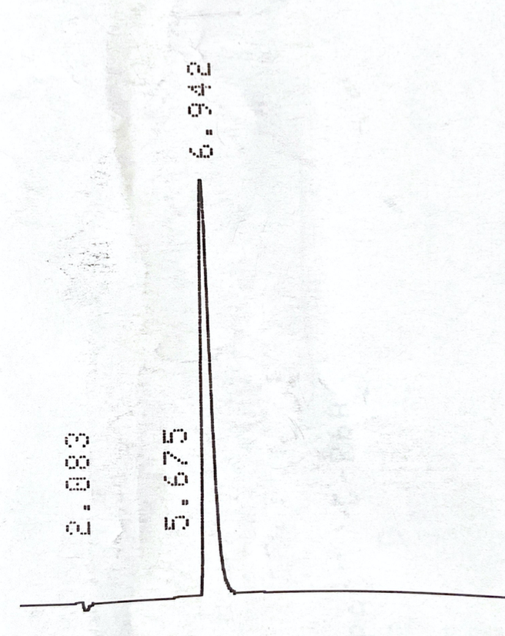
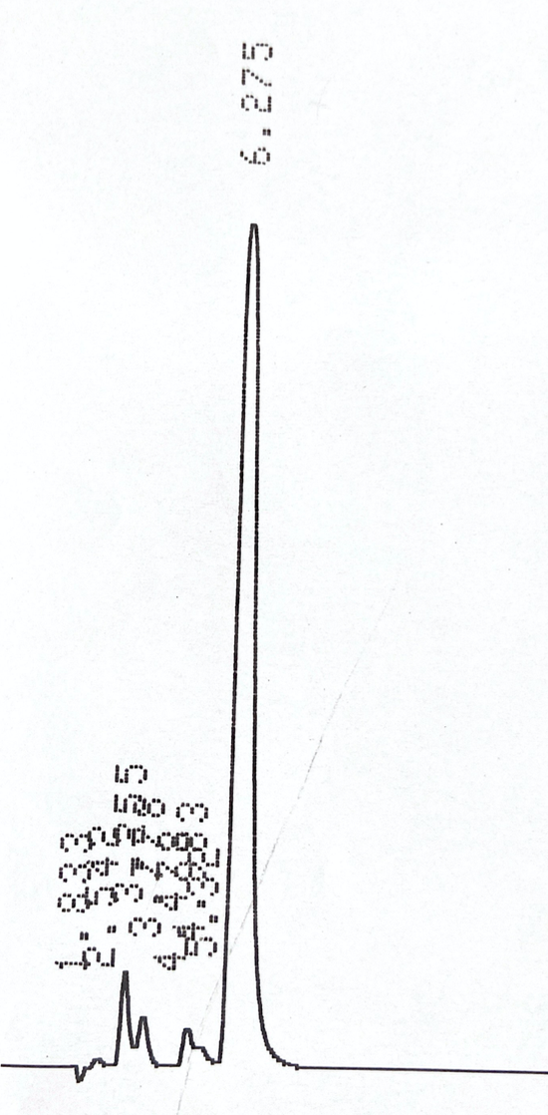
Results and Discussion- Synthesis of Peptaibolin by MW-SPPS on Wang resin
Peptaibolin was synthesized according to the MW-SPPS method where each amino acid is sequentially coupled with the aid of a combination of coupling reagents.
Two combinations were tested: DIC/HOBt (most common on peptide synthesis) and DIC/Oxime.
Structural confirmation: Proton Nuclear Magnetic Resonance (¹H-NMR) studies;
Purity confirmation: High Performance Liquid Chromatography (HPLC)
a)
b)
Table 1. Comparison between the two coupling reagent combinations in terms of obtained mass, reaction yield and retention time purity.
Coupling Reagents | Mass (g) | Yeld (%) | Retention Time (min)
DIC/HOBt | 0,1222 | 40,6 | 6,232
DIC/Oxima | 0,1520 | 50,0 | 6,942
DIC/Oxime coupling reagents had a higher yield as well as a higher purity
Figure 2- Analytical HPLC of Peptaibolin in a) DIC / Oxima and b) DIC / HOBt.

Slide 5
Results and Discussion-Evaluation of Solubility Properties of Peptaibolin
Performed only on the peptide synthetized with DIC/Oxime, mostly because of the highest amount of mass and yield
Solvents Tested (V_{T}= 1 mL)
10% DMSO/H₂O
ACN/H₂O
Acetic Acid/H₂O
NaCl/H₂O
PBS
10% HCL /H₂O
100% HCL
100% H₂O
10% CDCl₃
Soluble
Only with large amounts of ACN
Peptide precipitacion
Does not dissolve
Partially soluble
Peptaibolin was not soluble in water, requiring the addition of other types of organic solvents or even the dissolution of the peptide in a total volume of organic solvents

Slide 6
Results and Discussion-Antibacterial Assessment
Peptide dissolved in 10% DMSO/H₂O for the antimicrobial tests.
Tests were performed on: Staphylococcus aureus, Staphylococcus epidermidis, Escherichia coli and Pseudomonas aeruginosa.
After 24 h of incubation, precipitates were detected in the most Peptaibolin concentrated wells.
Bacterial growth detected in all tested bacteria
MIC studies demonstrated the resistance of bacteria to the peptide action and the peptide instability in bacterial growth conditions

Slide 7
Conclusions
DIC/Oxima combination, in addition to maintaining the characteristics of Peptaibolin, provides better yields with the same level of purity comparing to DIC/HOBt.
Peptaibolin is only soluble in organic solvents or in organic solvents in combination with H₂O, making it unsuitable for biomedical applications as AMP.
Minimum inhibitory concentration studies on Staphylococcus aureus, Staphylococcus epidermidis, Escherichia coli and Pseudomonas aeruginosa demonstrated the resistance of bacteria to the peptide action and the peptide instability in bacterial growth conditions.

Slide 8
Acknowledgments
The authors acknowledge Fundação para a Ciência e Tecnologia - FCT (Portugal) for funding through CQUM (UID/QUI/00686/2020) and project PTDC/QUI-COL/28052/2017. The NMR spectrometer Bruker Avance III 400 is part of the National NMR Network and was purchased within the framework of the National Program for Scientific Re-equipment, contract REDE/1517/RMN/2005 with funds from POCI 2010 (FEDER) and FCT. Authors also acknowledge FCT for funding the project PEPTEX with reference PTDC/CTM‐TEX/28074/2017 (POCI‐01‐0145‐FEDER‐028074). They acknowledge project UID/CTM/00264/2020 of Centre for Textile Science and Technology (2C2T), funded by national funds through FCT/MCTES.

