Slide 1
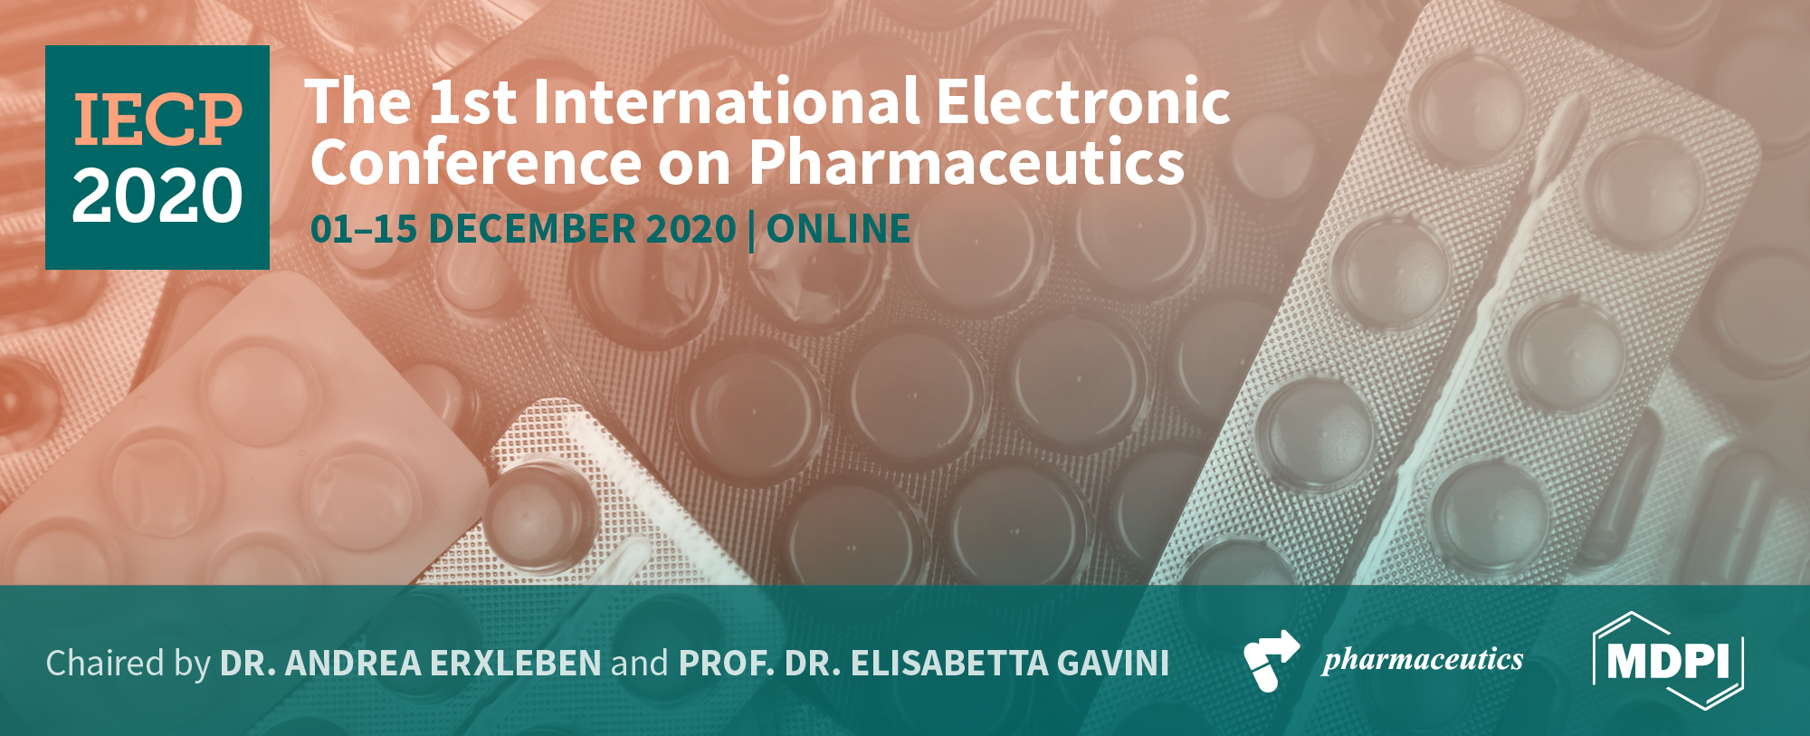


Application of the quality-by-design (QbD) approach to improve the nose-to-brain delivery of diazepam-loaded nanostructured lipid carriers (NLC)
Cláudia Pina Costa^{1,}*, Sara Cunha¹, Andreia Peixoto², João Nuno Moreira^{3,4},
José Manuel Sousa Lobo¹ and Ana Catarina Silva^{1,5}
¹ UCIBIO/REQUIMTE, MEDTECH, Laboratory of Pharmaceutical Technology, Department of Drug Sciences, Faculty of Pharmacy, University of Porto;
² LAQV/REQUIMTE, Department of Chemistry and Biochemistry, Faculty of Sciences, University of Porto;
³ CNC - Center for Neuroscience and Cell Biology, Center for Innovative Biomedicine and Biotechnology (CIBB), University of Coimbra, Faculty of Medicine (Pólo I), Coimbra, Portugal;
⁴ UC - University of Coimbra, CIBB, Faculty of Pharmacy, Pólo das Ciências da Saúde, Coimbra, Portugal.
⁵ FP-ENAS (UFP Energy, Environment and Health Research Unit), CEBIMED (Biomedical Research Centre), Faculty of Health Sciences, University Fernando Pessoa, Porto, Portugal.
* Corresponding author: claudiaspinacosta@gmail.com

Slide 2

Abstract: The intranasal administration of nanostructured lipid carriers (NLC) has been suggested as a promising strategy to improve the fast treatment of epilepsy. This route allows drug passage directly from the nose to the brain, avoiding the need of bypassing the blood brain barrier. In addition, the quality-by-design (QbD) approach is a useful tool for the optimization of manufacturing variables, resulting in effective and safe pharmaceutical formulations. The aim of this work was to use the QbD approach to optimize a NLC formulation for the nose-to-brain delivery of diazepam. The studies began with the screening of excipients and the assessment of lipid-drug compatibility. The central composite design was used to evaluate the effects of critical material attributes (CMAs) (ratio of solid and liquid lipids and amount of emulsifiers) on the CQAs of the NLC formulation (particle size, polydispersity index (PDI), zeta potential (ZP) and encapsulation efficiency (EE)). The results showed that the most adequate ratios of lipids and emulsifiers were 6.65:2.85 and 4.2:0.3 (%, w/w), with values of 84.92 nm, 0.18, -18.20 mV and 95.48% for particle size, PDI, ZP and EE, respectively. This formulation was selected for further studies related to the optimization of critical process parameters (CPPs).
Keywords: Epilepsy; nose-to-brain delivery; intranasal delivery; nanostructured lipid carriers, quality-by-design.

Slide 3
Methods
Diazepam-loaded NLC formulation
Based on the screening of excipients (solid and liquid lipids and emulsifiers), compatibility between solid and liquid lipids and drug-lipid solubility.
Precirol® 5 ATO and Cetiol® V were selected as the solid lipid (SL) and liquid lipid (LL), respectively.
Tween 80® (E1) and sodium deoxycholate (E2) were selected as emulsifiers.
A 0.50% of drug concentration was selected to prepare the final NLC formulation.

Slide 4
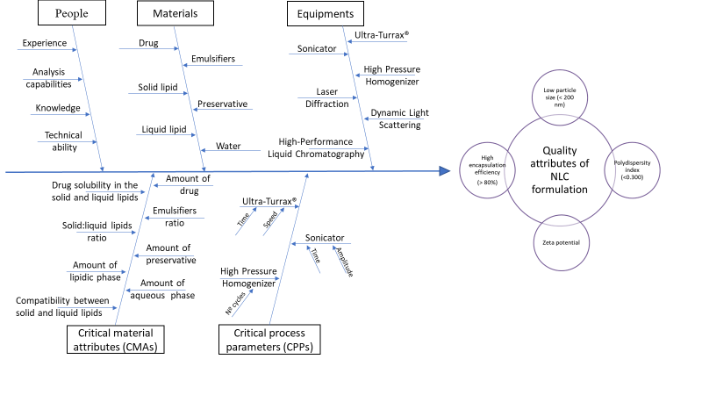
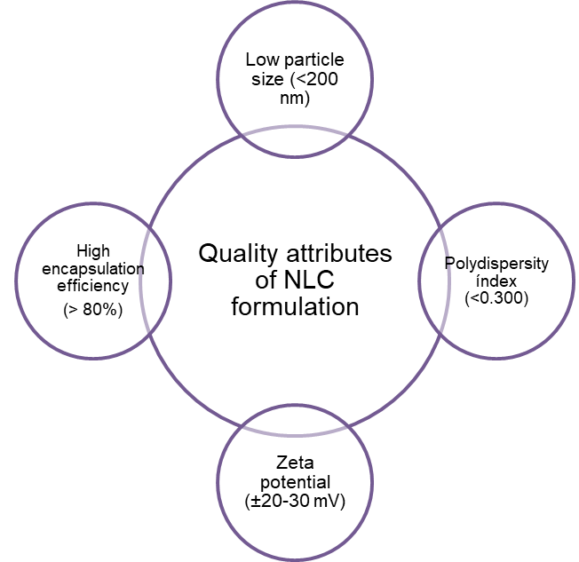
Methods
Quality-by-design approach
Effect of the CMAs and CPPs on the CQAs
Figure 1. Ishikawa diagram showing the effects of critical material attributes (CMAs) and critical process parameters (CPPs) on critical quality attributes (CQAs), for the optimization of a NLC formulation.

Slide 5
Results
Diazepam-loaded NLC formulation
Table 1. Composition of diazepam-loaded nanostructured lipid carriers (NLC) formulation.
Composition | (w/w)%
Precirol® 5 ATO | 6.65
Cetiol® V | 2.85
Diazepam | 0.50
Tween 80® | 4.20
Sodium deoxycholate | 0.30
Benzalkonium chloride | 0.02
Ultrapure water | q.s. 100.00

Slide 6
Results
Quality-by-design approach
Central composite design (CCD)
Table 2. Effect of the critical material attributes (CMAs) on the critical quality attributes (CQAs) of the diazepam-loaded NLC.
CMAs: critical material attributes; D(50): 50% of particles with size equal or lower to the given value; D(90): 90% of particles with size equal or lower to the given value; EE: encapsulation efficiency; PDI: polydispersity index; ZP: zeta potential; Z-Ave: mean particle size.

Slide 7
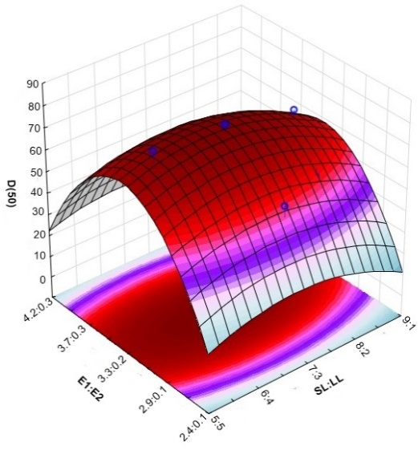
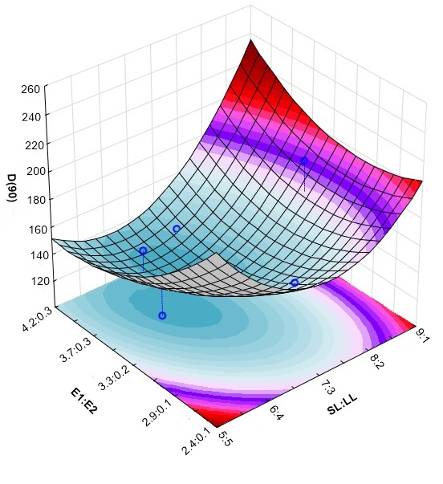


Results
Quality-by-design approach
Figure 2. The 3-D surface plots portraying the effect of the ratio between the solid and liquid lipids (SL: LL) and the two emulsifiers (E1: E2) on the size (D(50): 50% of particles with size equal or lower to the given value, D(90): 90% of particles with size equal or lower to the given value).

Slide 8
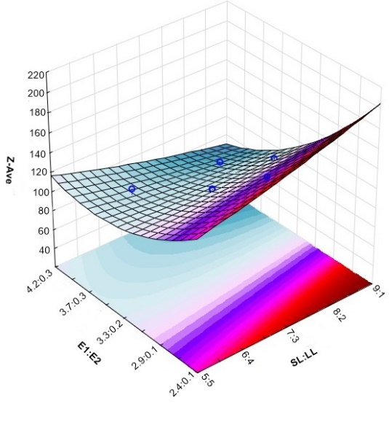
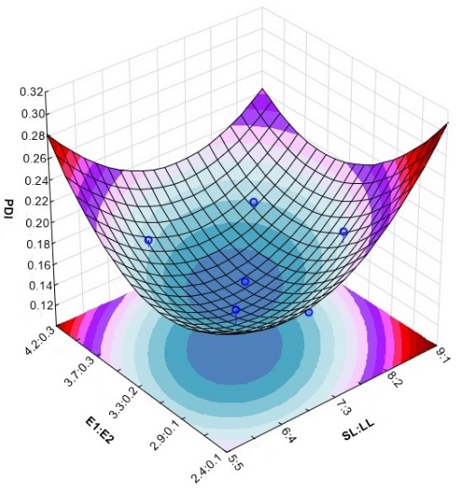


Results
Quality-by-design approach
Figure 3. The 3-D surface plots portraying the effect of the ratio between the solid and liquid lipids (SL: LL) and the two emulsifiers (E1:E2) on the mean particle size (Z-Ave) and polydispersity index (PDI).

Slide 9
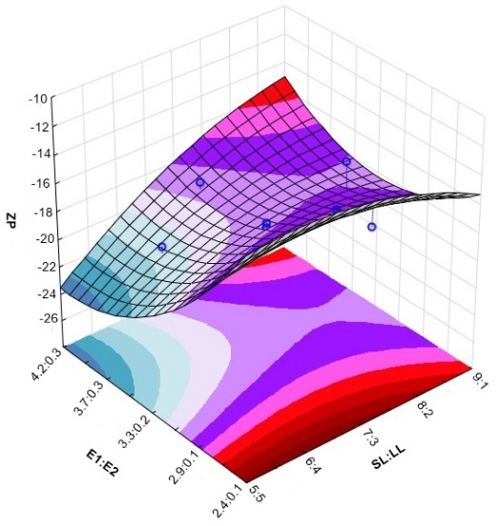
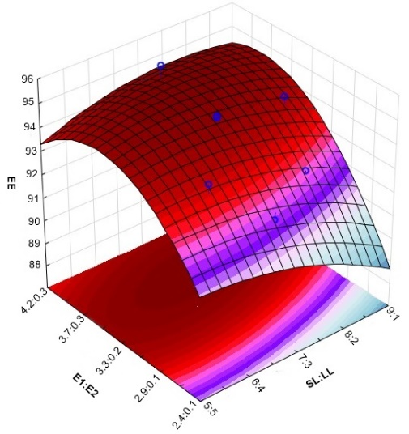


Results
Quality-by-design approach
Figure 4. The 3-D surface plots portraying the effect of the ratio between the solid and liquid lipids (SL: LL) and the two emulsifiers (E1:E2) on the zeta potential (ZP) and encapsulation efficiency (EE).

Slide 10
Discussion
The most adequate ratios of lipids and emulsifiers were 6.65:2.85 and 4.2:0.3 (%, w/w), presenting values of 84.92 nm, 0.178, -18.20 mV and 95.48% for particle size, PDI, ZP and EE, respectively.
The values are in accordance with the requisites of intranasal delivery of NLC, presenting a particle size less than 200 nm, a polydispersity index less than 0.3, a zeta potential close to -20 mV and an encapsulation efficiency higher than 80%.

Slide 11
Conclusions
Optimizing NLC formulations is critical to achieve a reproducible quality of pharmaceutical products, in terms of efficacy and safety.
QbD approach is a useful tool for the development of lipid nanoparticles, such NLC.
The formulation with the best CQAs was selected for further optimization related to the selection of the best CPPs using the same design of experiment, which will be tested in vitro and in vivo in the future.

Slide 12



Acknowledgments
This work was supported by Fundação para a Ciência e a Tecnologia (FCT), Portugal (SFRH/BD/136177/2018) and by the Applied Molecular Biosciences Unit-UCIBIO which is financed by national funds from FCT/MCTES (UIDMulti/04378/2019).

