Slide 1
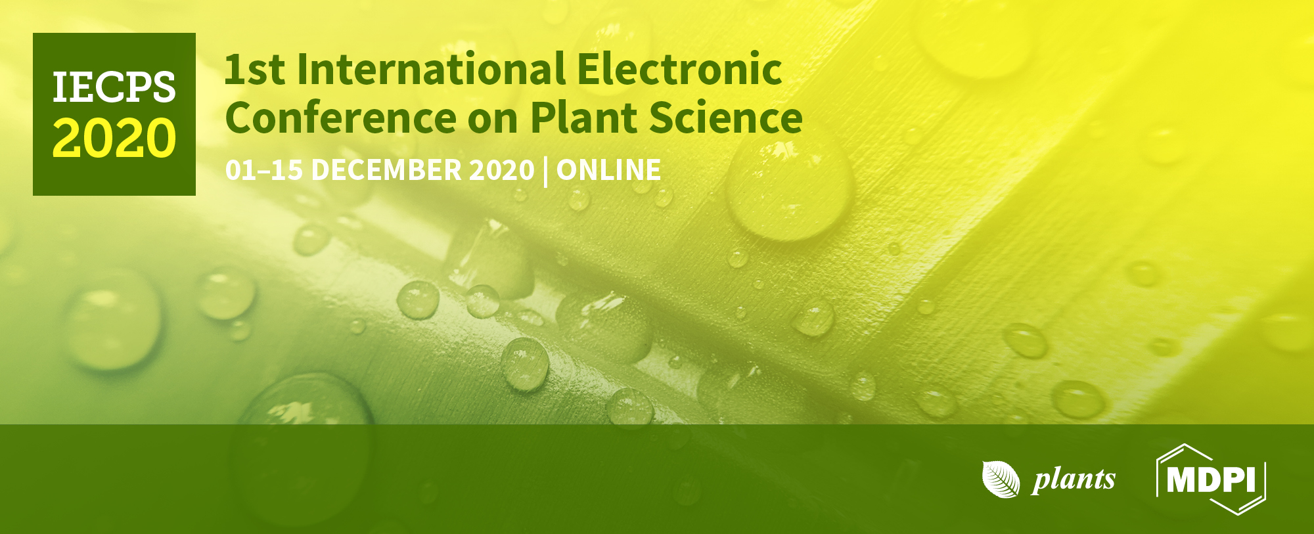
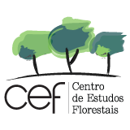
Increase of calcium in ‘Rocha’ pear (Pyrus communis L.) for development of functional foods
Cláudia Campos Pessoa^{1,2,}*, Ana Coelho^{1,2}, Ana Marques^{1,2}, Inês Luís^{1,2}, Diana Daccak^{1,2}, Maria Manuela Silva^{2,3}, José Ramalho^{2,4}, Manuela Simões^{1,2}, Fernando Reboredo^{1,2}, Maria Pessoa^{1,2}, Paulo Legoinha^{1,2}, Paula Scotti-Campos^{2,5}, Isabel Pais^{2,5} and Fernando Lidon^{1,2}
¹Earth Sciences Department, Faculdade de Ciências e Tecnologia, Universidade Nova de Lisboa, Caparica, Portugal;
²GeoBioTec Research Center, Faculdade de Ciências e Tecnologia, Universidade Nova de Lisboa, Caparica, Portugal;
³ESEAG / Grupo Universidade Lusófona, Lisboa, Portugal;
⁴PlantStress & Biodiversity Lab, Centro de Estudos Florestais, Instituto Superior Agronomia, Universidade de Lisboa, Oeiras, Portugal;
⁵INIAV, Instituto Nacional de Investigação Agrária e Veterinária, Oeiras, Portugal.
* Corresponding author: c.pessoa@campus.fct.unl.pt

Slide 2
Abstract: The food industry will face determinant challenges in the future, namely feeding a growing population, set to reach up to 9 billion people by 2050, while maintaining food quality, in the meads of resource limitations and sustainable use. In this outlook, minimizing mineral deficits in human diet can prevent health diseases. Calcium is one of the most abundant minerals in human organisms, performing both structural and signaling functions, being its deficits associated to the development of osteoporosis and other pathologies. To minimize this issue, foliar spraying of edible plants can increase the amount of minerals, triggering additional value in unprocessed food products. Following this assumption at an orchard of Rocha pears located in the West region of Portugal, seven foliar sprays were carried out with calcium chloride (4 % corresponds to the exclusive use of CaCl₂ 4 kg ha⁻¹; 8 % corresponds to the use of CaCl₂ 4 kg ha⁻¹ (for the first three sprays) and CaCl₂ 8 kg ha⁻¹ (for the four remaining sprays)). At harvest, calcium levels increased about 12.2 - 38.3 %, whereas significant differences in physicochemical parameters occurred only in malic acid and total soluble solids. In conclusion, calcium levels increased in fruits after foliar spraying, but quality parameters only revealed minor changes, enabling the production of biofortified Rocha pears.
Keywords: Biofortification; Calcium; Pyrus communis L.

Slide 3
Results and Discussion
Treatments | Ca contents (%_{Dw}) |  | Diameter (mm) |  | Dry weight (%) |  | Total Soluble Solids (°Brix) |  | Malic acid (g/L)
 | Mean | S.E. | Mean | S.E. | Mean | S.E. | Mean | S.E. | Mean | S.E.
Ctr | 0.107b | ±0.010 | 63.3a | ±1.9 | 12.9a | 0.6 | 9.9b | ±0.1 | 1.53a | ±0.02
4 % | 0.120ab | ±0.003 | 63.5a | ±1.9 | 14.4a | 0.4 | 11.6a | ±0.6 | 1.41ab | ±0.07
8 % | 0.148a | ±0.008 | 65.0a | ±1.1 | 12.7a | 0.4 | 11.1ab | ±0.2 | 1.32b | ±0.06
Colorimetric Parameters (CieLab)
L |  | a* |  | b*
Mean | S.E. | Mean | S.E. | Mean | S.E.
68.6a | ±0.8 | -16.7a | ±0.6 | 44.8a | ±0.5
70.3a | ±1.0 | -17.4a | ±0.6 | 45.3a | ±0.5
67.6a | ±0.6 | -17.6a | ±0.6 | 43.0a | ±0.4
In the pre-harvest phase, CaCl₂ foliar sprays increased Ca content in all pulverized fruits, and an increase of concentration in the later sprays resulted in higher Ca values. Additionally, regarding physicochemical characteristics, chemical parameters were more affected than morphometric and colorimetric.
Conclusions
Foliar sprays of CaCl₂ (8 kg ha⁻¹) increase Ca content in Rocha pear fruits. From the physicochemical parameters analized, only chemical parameters had minor changes. Morphological and colorimetric aspects of fruits were not affected, allowing commercialization to the consumer, storage or further processing by agro-industry to obtain new products with added value. Accordingly, agronomic biofortification of Rocha pear can be used to enrich Ca content, allowing its prophylactic consumption to face osteoporosis and other physiological diseases triggered by Ca malnutrition.

Slide 4
Acknowledgments
The authors thanks to Tiago Peralta (Ribamaior – Produção e Comércio de Frutas Lda) for technical assistance in the orchards as well as to project PDR2020-101-030734 – for the financial support. We also thanks to the Research centers (GeoBioTec) UIDB/04035/2020, and (CEF) UIDB/00239/2020 for support facilities.

