Slide 1
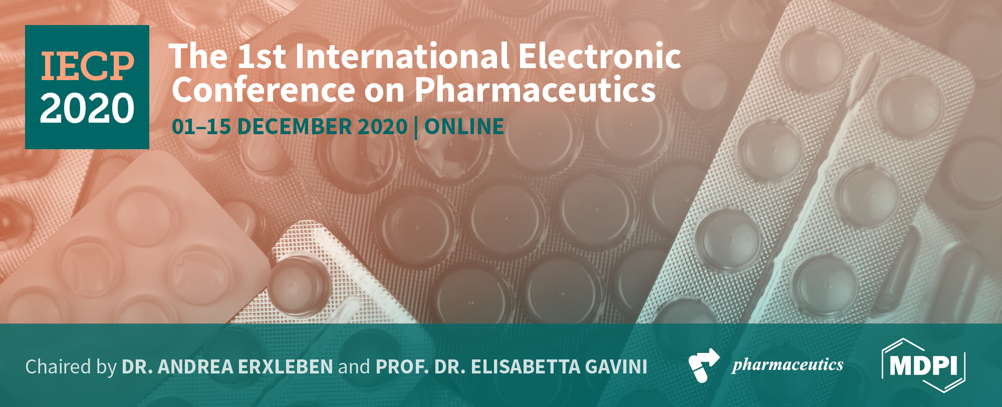

NANOTECHNOLOGICAL STRATEGIES FOR ADMINISTRATION OF POORLY SOLUBLE NEUROACTIVE DRUGS
Elisabetta Esposito¹*, Maddalena Sguizzato¹, Markus Drechsler², Paolo Mariani³, Viviana Trezza⁴, Rita Cortesi¹ and Claudio Nastruzzi¹
1: Department of Chemical and Pharmaceutical Sciences, University of Ferrara, Italy; ese@unife.it; sgzmdl@unife.it; crt@unife.it; nas@unife.it
2: Bavarian Polymer Institute (BPI) Keylab “Electron and Optical Microscopy” University of Bayreuth, D-95440 Bayreuth, Germany; markus.drechsler@uni-bayreuth.de
3: Department of Life and Environmental Sciences, Polytechnic University of Marche, I-60131 Ancona, Italy; p.mariani@staff.univpm.it
4: Department of Science, Roma Tre University, 00146 Rome, Italy; viviana.trezza@uniroma3.it
*Correspondence: ese@unife.it; Tel.: +39-0532-455230

Slide 2
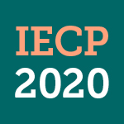
Abstract: Many neuroactive drugs are characterized by poor solubility, hampering their therapeutic potential and clinical research studies. For instance, the lipophilic molecules dimethylfumarate, retinyl palmitate, progesterone and URB597 can be employed in the treatment of relapsing remitting multiple, early brain injury, learning deficits and/or traumatic brain injuries. In this study the possibility to encapsulate these drugs in lipid nanoparticles is investigated. Solid lipid nanoparticles and nanostructured lipid carriers have been produced by melt and ultrasonication of stearic triglyceride or a mixture of stearic triglyceride and caprylic/capric triglycerides. Mean diameters and morphology of lipid particles were studied by photon correlation spectroscopy, cryo-transmission electron microscopy and x-ray diffraction, while encapsulation efficiency and in vitro drug release have been determined by HPLC. A behavioral study was conducted in rats to study the capability of lipid nanoparticles containing URB597 to alter behaviors relevant to psychiatric disorders after intranasal administration. The nanoparticle surface has been modified by polysorbate 80, in order to obtain “stealth” nanoparticles. The nanoencapsulation strategy allowed to increase drug solubility with respect to unphysiological solvent or solvent mixtures usually employed for animal and clinical studies. In particular, retinyl palmitate solubility in nanostructured lipid carriers has been increased up to 8-fold. Moreover rat behavioral effects observed by nanoencapsulated URB597 administered intranasally suggest the therapeutic potential of this non-invasive route to treat social dysfunctions, such as autism.
Keywords and abbreviations: solid lipid nanoparticles (SLN);
nanostructured lipid carriers (NLC); URB597; dimethyl fumarate (DMF);
retynil palmitate (RP); progesterone (PRG).

Slide 3
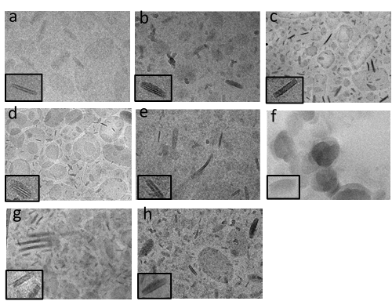
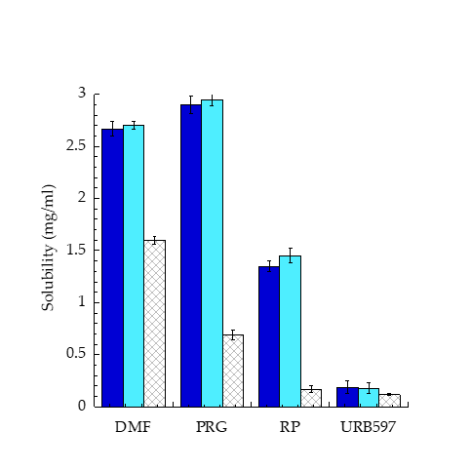
Results and Discussion
Four neuroactive drugs have been considered: DMF and PRG employed to treat early or traumatic brain injuries; RP for multiple sclerosis and URB597 for animal models of anxiety, depression, and autism spectrum disorders were studied. All drugs are poor soluble in water and slight soluble in ethanol (log P: 0.72, 11.62, 3.87 and 4.03 for DMF, RP, PRG and URB597 respectively). Since the use of ethanol solutions can induce acute intravenous toxicity in animals and behavioral effects in humans by inhalation, lipid nanoparticles were designed as alternative strategies to administer the drugs. Mean diameters measured 130-262 nm, dispersity was < 0.3, indicating homogeneous size distribution, both for SLN and NLC. The X-ray analysis suggested a lamellar morphology with an expanded packing of nanoparticle matrix occurring in the presence of miglyol, characterized by a liquid consistency, in the case of NLC.
Figure 1. Cryo-TEM edge-on-viewed images of SLN (a-d) and NLC (e-h) containing different drugs, namely DMF (a, e), RP (b, f), PRG (c, g), URB597 (d, h). Bar corresponds to 150 nm.
The shape of nanoparticles was in general discoid, both for SLN and NLC, they appear as low electron density ellipses when viewed from the top and electron-dense rods when edge-on viewed (Fig. 1)
The solubility of drugs in SLN and NLC was compared to solubility in PEG 400/P80/saline, a standard vehicle often used in clinical and preclinical studies. As summarized in Figure 2, nanoparticles increased the solubility of drugs with respect to PEG400/P80/saline, particularly in the case of RP and PRG. Indeed RP solubility in SLN and NLC increased 8/8.5-fold with respect to PEG400/P80/saline, while PRG solubility underwent a 4.3/4.3-fold increase in SLN and NLC respectively. URB597 solubility was the lowest, passing from 0.12 mg/ml in PEG 400/P80/saline to 0.18 mg/ml upon nano-encapsulation (1.5-fold increase).
Figure 2. Comparative analysis of drug solubility in SLN (blue), NLC (light blue) and PEG 400/P80/saline 5:5:90 (v/v/v) (criss-cross).

Slide 4
The potential of SLN/P80 as delivery systems of URB597 was investigated with respect to a drug solution in PEG 400/P80/saline and a drug suspension in poloxamer 188 (2.5% w/w), taken as controls. To this aim, the in vitro drug release profiles from SLN/P80-URB597 was determined by a dialysis method. As reported in Figure 3, the URB597 release kinetic from SLN/P80 was almost superposable to that from PEG 400/P80/ saline, while, as expected, the release of URB597 in the suspension form was reduced, especially in the slower phase, occurring 3 h after starting the experiment.
Figure 3. In vitro release kinetics of URB597 from SLN/P80-URB597 (blue circles), poloxamer 188 (2.5% w/w) (white circle) and PEG 400/P80/water 5:5:90 (v/v/v) (pink square). Experiments were performed by dialysis method. Data are the mean of 6 experiments ± S.D.
Conclusions
The present study suggests the suitability of lipid nanoparticles for solubilization and administration of poorly soluble drugs, avoiding unphysiological solvents or solvent mixtures. Notably, lipid nanoparticles enable to 4- and 8-fold increase RP and PRG solubility with respect to PEG400/P80/saline, usually employed for in vivo preclinical studies. Moreover, SLN/P80-URB597 administered by i.n. route appears a not- invasive effective strategy to treat social dysfunctions.

Slide 5
Acknowledgments
This study was funded his work was funded by "FIRB 2010. Fondo per gli Investimenti della Ricerca di Base" from the Ministry of the University and Research of Italy (code RBFR10XKHS) and by Unife FIR2018

