Slide 1
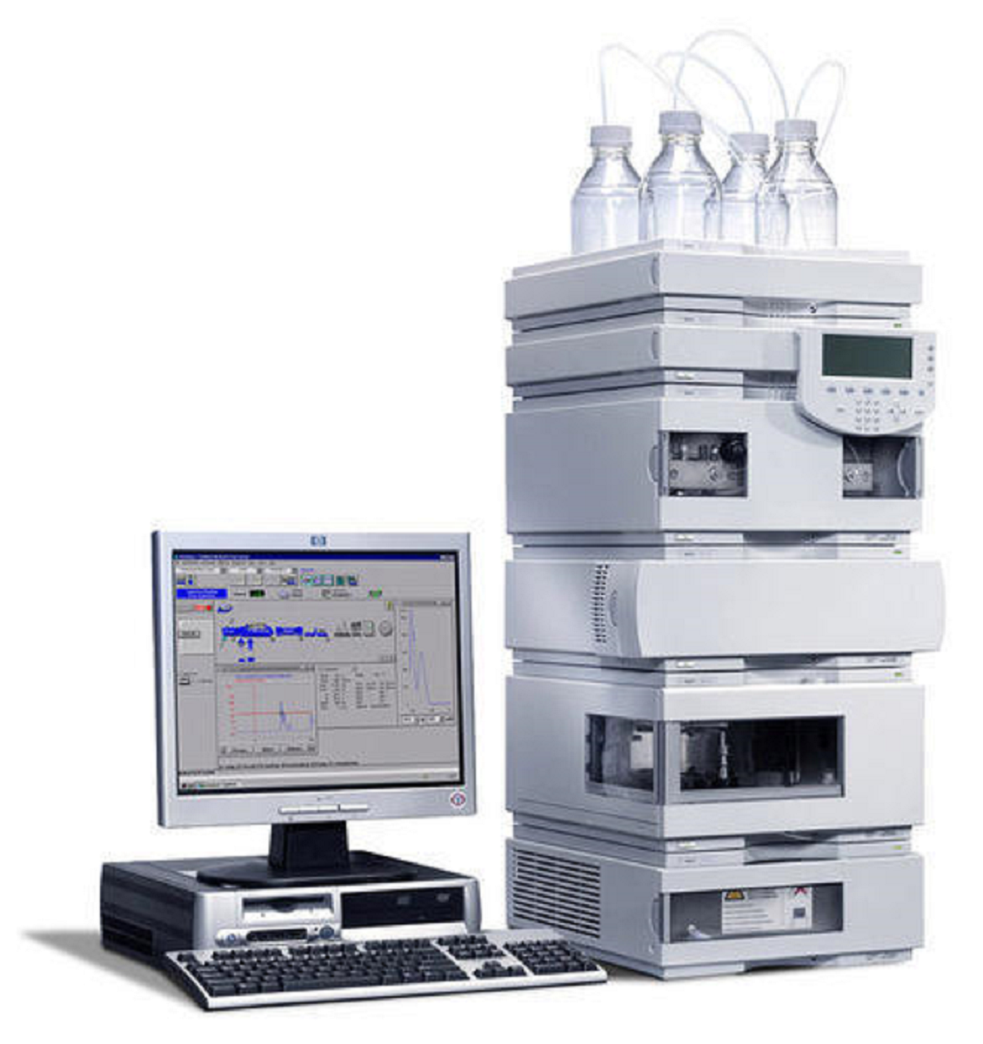
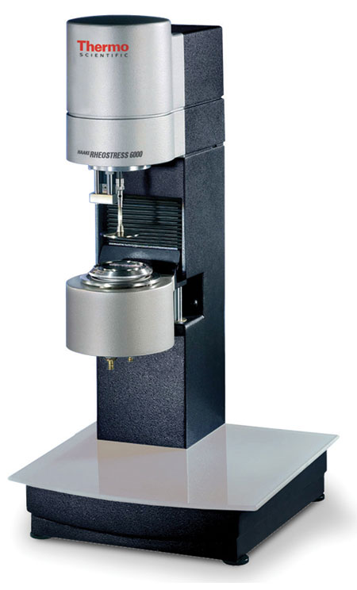
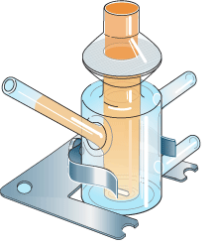
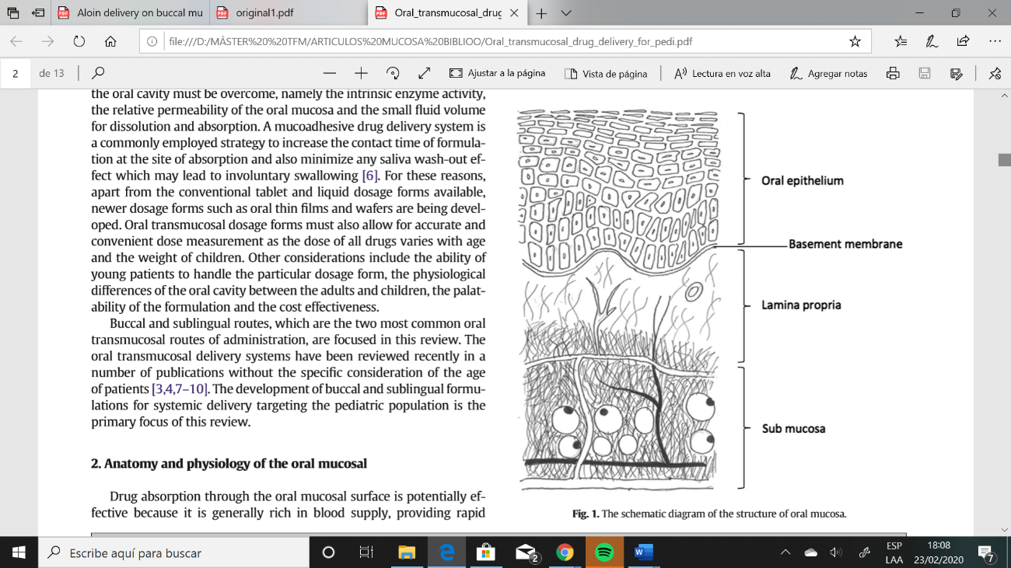
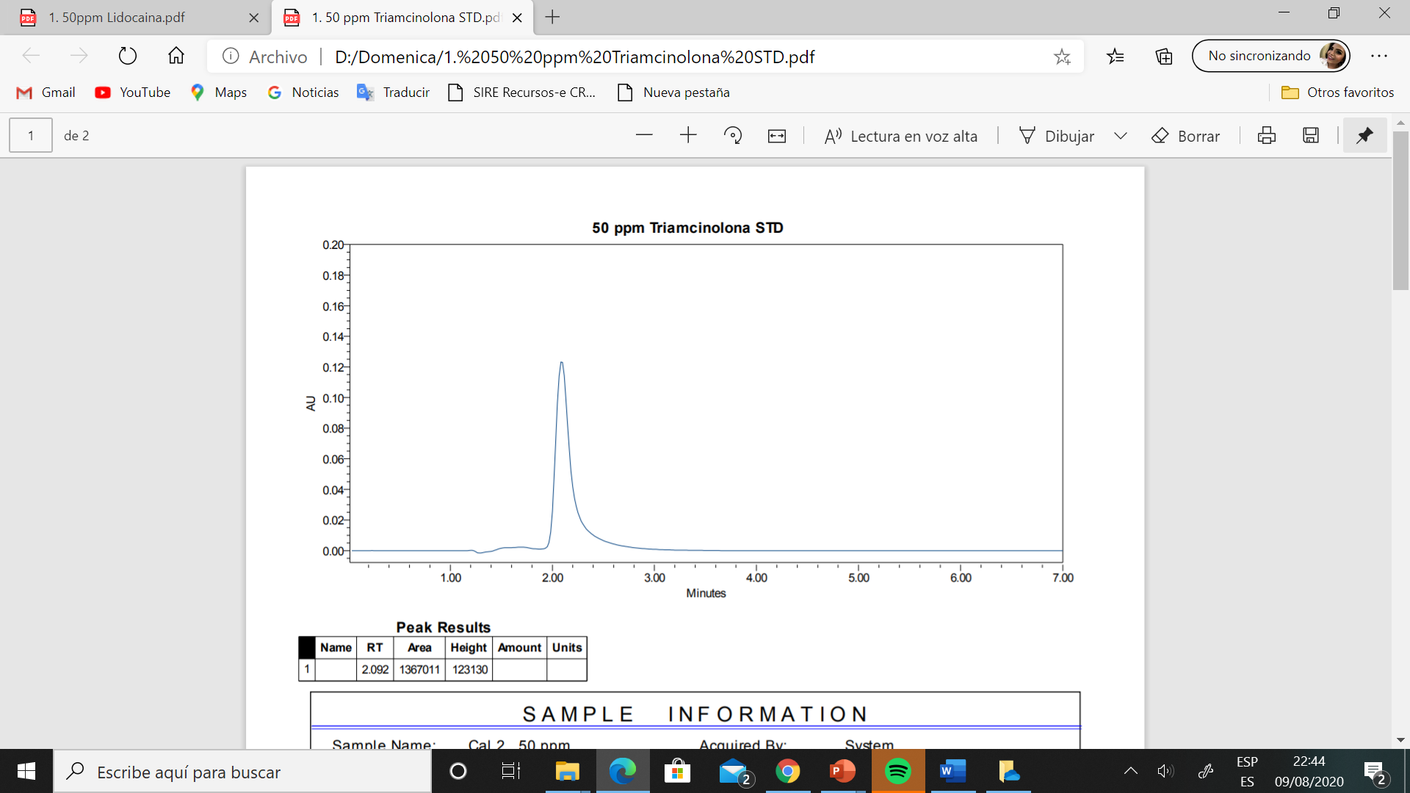
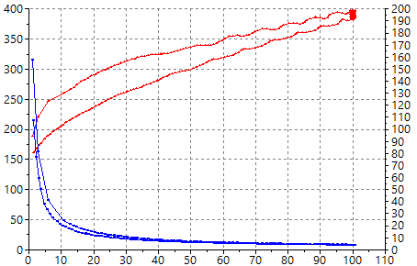
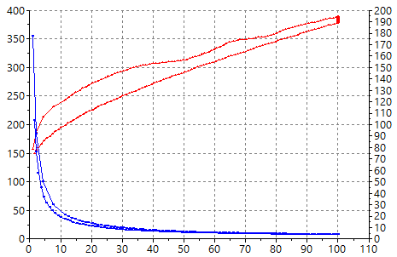
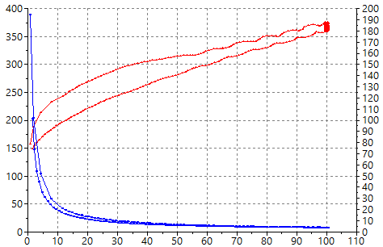
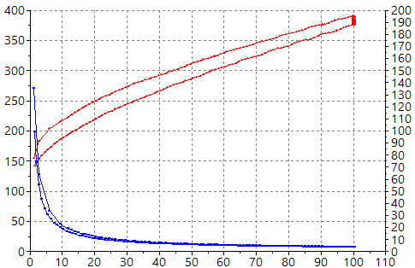




Galenic and biopharmaceutical study of triamcinolone acetonide and lidocaine hydrochloride semisolid formulations for buccal administration
Marta Márquez Valls ¹, Alejandra Martínez Labrador ¹, Lyda Halbaut Bellowa ¹, Doménica Bravo Torres ¹,
Paulo Sarango-Granda ¹, David Limón Magaña ¹, Ana Calpena-Campmany ¹*
¹ Department of Pharmacy, Pharmaceutical Technology, and Physical Chemistry, Faculty of Pharmacy and Food Sciences, University of Barcelona, Av. Joan XXIII 29-31, 08028 Barcelona, Spain
* Correspondence: anacalpena@ub.edu
INTRODUCTION
MATERIALS AND METHODS
The mouth is affected by localized and, also systemic diseases such as diabetes, AIDS and leukemia. The main problems that manifest in the mouth are various types of sores, such as canker sores and lichen planus, pathologies that present inflammation and pain [1]. The present work revolves around 4 semisolid formulations for administration in the buccal mucosa with the aim of treating painful processes symptomatically in this cavity. These formulations have one or two Active Pharmaceutical Ingredients (APIs), triamcinolone acetonide (TA) and lidocaine hydrochloride (LIDO). The formulations contain as well, Orabase® as an excipient, which is a protective adhesive vehicle, hydrophobic and anhydrous, used to retain or facilitate the application of APIs in buccal mucosa [2]. TA is a synthetic glucocorticosteroid with immunosuppressive and anti-inflammatory activity [3] and lidocaine hydrochloride is a local anesthetic that blocks sodium ion channels.
Analytical method validation
HPLC system consisting of a Waters 1525 pump and a UV-VIS 2487 detector.
Column: Supercosil LC-ABZ (15cm; 4.6mm and 5 µm)
Mobile phase: MeOH: H₂O (50:50 v/v).
Flow: 1 ml / min.
Injection vol.: 10 μL
Wavelength ʎ: 232 nm.
Parameters of validation
Linearity, range, accuracy, precision, limits of quantification and detection.
Rheological properties
Thermo Scientific Haake Rheostress 1 rheometer with a cone (C60/2º) – plate.
Ascendant shear velocity: 0 to 100 s⁻¹ for 3 min.
Constant velocity: 100 s⁻¹ during 1 min. Descendant section: from 100 s⁻¹ to 0 s⁻¹ for 3 min.
Mathematical model adjusted
Newton, Bingham, Casson, Ostwald, Herschel-Bulkley and Cross.
AIM
The aim of this research was the determination of the physical and biopharmaceutical properties of the semisolid formulations and stablish if there are differences between them.
Release studies
Franz-type diffusion cells
Membrane: Nylon (NY41, 41 μm).
Receptor fluid: ACN: Ammonium acetate (10:90 v/v): Transcutol.
Temperature: 37 ºC.
Permeation and retention studies
Franz-type diffusion cells
Membrane: Porcine sublingual and buccal mucosa.
Dermatomized mucosa: 700 μm thickness
Receptor fluid: ACN: Ammonium acetate (10:90 v/v): Transcutol.
Temperature: 37 ºC.
TEST FORMULATIONS
Table 1. Composition of the four different formulations.
Composition | TA 0.05% | TA 0.05% + LIDO | TA 0.1% | TA 0.1% + LIDO
TA | 0.05% | 0.05% | 0.1% | 0.1%
LIDO | - | 2% | - | 2%
Liquid paraffin | 5% | 5% | 5% | 5%
Orabase® | Q.S | Q.S | Q.S | Q.S
RESULTS
Validation of the analytical method
Rheological properties
Release, permeation and retention studies
❐ LINEAR (Ratios area vs. concentration)
PRECISE (Coefficient of variation %)
❐ EXACT (Relative error %)
The formulations show a shear thinning and
apparent thixotropic behavior
Cumulative released amount of TA (µg) – time (hours) obtained corresponds to a Boltzmann sigmoidal trend with a r² = 0.99
Cross equation: $τ= \dot{ɣ}·\frac{η_{∞}+\left( η_{0}− η_{∞}\right)}{1+{\left(\frac{\dot{ɣ}}{ɣ_{0}}\right)}^{n} }$
0.05% TA
0.05% TA + LIDO
a)
b)
Cumulative release amount: 76.2h
TA 0.1% + LIDO: 1154.33 µg
TA 0.1%: 609.11 µg
TA 0.05% + LIDO: 546.33 µg
TA 0.05%: 190.78 µg
η (Pa s)
τ (Pa)
τ (Pa)
η (Pa s)
·
·
c)
γ (s⁻¹)
γ (s⁻¹)
Figure 3. Release kinetics of the formulations.
0.1% TA
d)
0.1% TA + LIDO
τ (Pa)
Figure 1. Triamcinolone acetonnido chromatogram, 50 µg/ml.
τ (Pa)
η (Pa s)
η (Pa s)
·
·
γ (s⁻¹)
γ (s⁻¹)
The range for Triamcinolone acetonide:
3.125 - 100 µg/ml.
Figure 2. Rheological behavior of formulations. (A) TA 0.05%; (B) TA 0.05% + LIDO;
(C) TA 0.1%; and (D) TA 0.1% + LIDO
Table 1. Viscosity of the different formulations at 100 s⁻¹.
Figure 4. Sublingual permeation kinetics of TA for the different formulations.
Figure 5. Buccal permeation kinetics of TA for the different formulations.
CONCLUSIONS
Formulation | Viscosity (mPa·s) at 100 s⁻¹
TA 0.05% | 3890 ± 39.80
TA 0.05% + LIDO | 3833 ± 27.95
TA 0.1% | 3662 ± 42.33
TA 0.1% + LIDO | 3819 ± 39.77
Based on the obtained results, the treatment with TA and lidocaine hydrochloride can be useful to treat painful processes in the buccal mucosa, such as sores. Nevertheless, this treatment should be used punctually due to the existence of permeation processes for TA. Future studies would be useful to characterize the release and permeation processes for lidocaine hydrochloride, and it would be interesting to assess the stability of these topical formulations.
REFERENCES
Figure 6. Buccal retained amount of TA for each formulation.
1. Álvarez, M. Tratamiento de las enfermedades de la cavidad bucal. OFFARM. 2003, 22 (9), 80-86.
2. Acofarma. Fichas de información técnica: excipiente acofar adhesivo oral [Internet]. [accessed on 17/09/2019]. Available online: https://formulasmagistrales.acofarma.com/idb/descarga/3/f9b97fcbceaef2bf.pdf
3. National Center for Biotechnology Information. PubChem Database. Triamcinolone acetonide [Internet]. [accessed on 14/09/2019 Sep 14]. Available online: https://pubchem.ncbi.nlm.nih.gov/compound/6436#section=Pharmacology-and-Biochemistry

