Slide 1
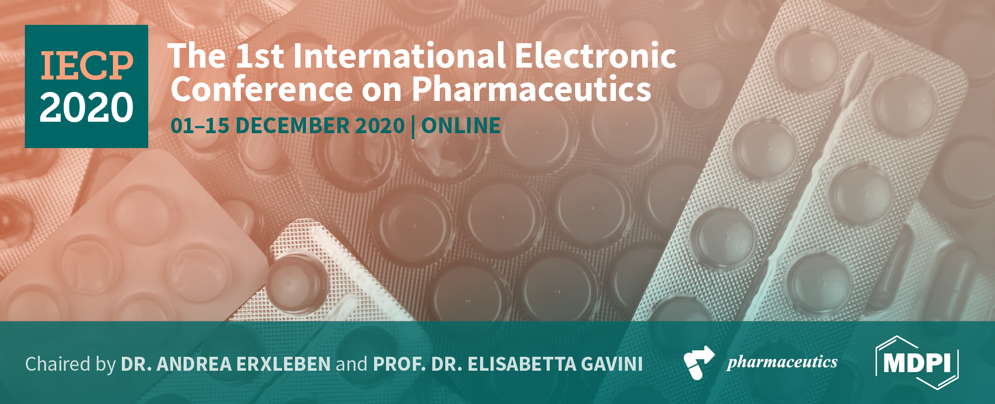


Development of anti-TNFR antibody-conjugated nanoparticles
Ahmed Aido ^{1,2,}*, Harald Wajant ² , Matej Buzgo¹ and Aiva Simaite ¹
¹ InoCure s.r.o, R&d Lab, Prumyslová 1960, 250 88 Celákovice, Czech Republic; aiva@inocure.cz;
² Division of Molecular Internal Medicine, Department of Internal Medicine II, University Hospital Würzburg, Auverahaus, Grombühlstrasse 12, 97080 Würzburg, Germany; harald.wajant@mail.uni-wuerzburg.de.
* Corresponding author: ahmed@inocure.cz; Tel.: +49-174-913-6442

Slide 2

Abstract: Immunotherapy is considered as a new pillar of cancer treatment. However, the application of some promising immunotherapeutic antibodies, such as antibodies against certain immune-stimulatory receptors of the TNF receptor superfamily (TNFRs) including CD40, 41BB, CD27 and anti-fibroblast growth factor-inducible 14 (anti-Fn14) are limited due to their low bioactivity. It has been previously shown that the bioactivity of such anti-TNFR antibodies could be improved by crosslinking or attachment to the plasma membrane by interaction with Fcγ receptors (FcγR). Both result in proximity of multiple antibody-bound TNFR molecules what allows activation of proinflammatory signaling pathways. In this work, we have grafted antibodies on gold nanoparticles to simulate the “activating” effect of FcγR-bound and thus plasma membrane-presented anti-TNFR antibodies. We have developed and optimized the method for the preparation of gold nanoparticles, their functionalization with poly-ethylene glycol (PEG) linkers, and grafting of antibodies on the surface. We showed here that antibodies, including the anti-Fn14 antibody PDL192, can be successfully attached to nanoparticles without affecting antigen binding. We hypothesize that conjugation of monoclonal anti-TNFR antibodies to the inorganic nanoparticles is a promising technique to boost the efficacy of these immunotherapeutic antibodies.
Keywords: Nanoparticles; Surface modification; Drug-delivery, agonistic anti TNFRSF receptor (TNFR) antibody

Slide 3
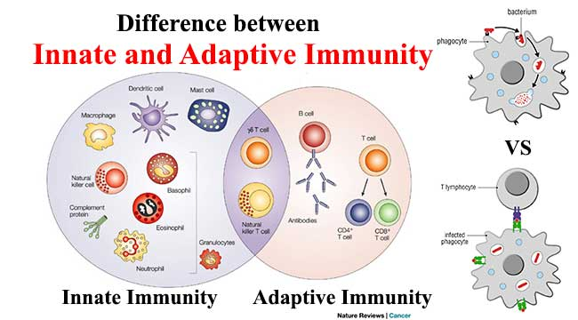
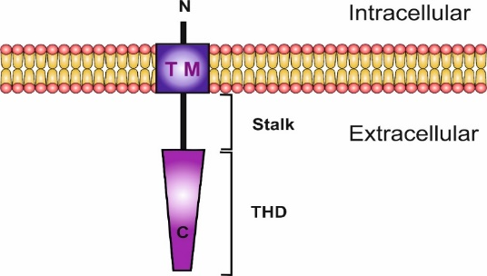
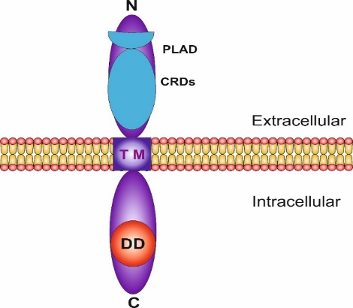
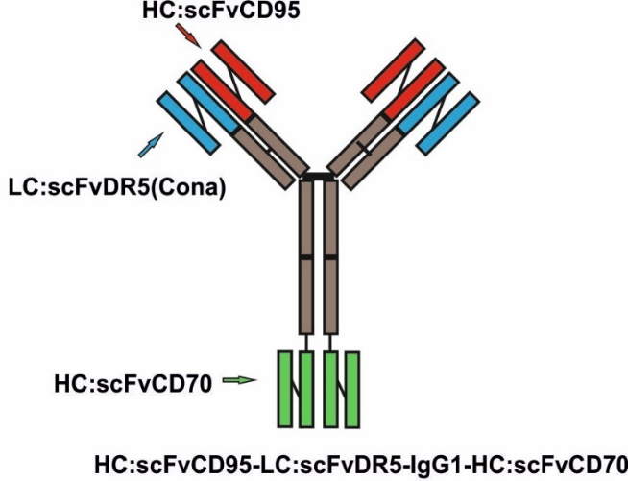
Introduction and keywords
1. Addaptive and Innative Immunoresponse
2. TNFSF ligand and TNFRSF receptors
3. Single chaine variable domaine scFv as an anchoring domain
Domain architecture of the TNF ligand
Domain architecture of a TNFRSF death receptor

Slide 4
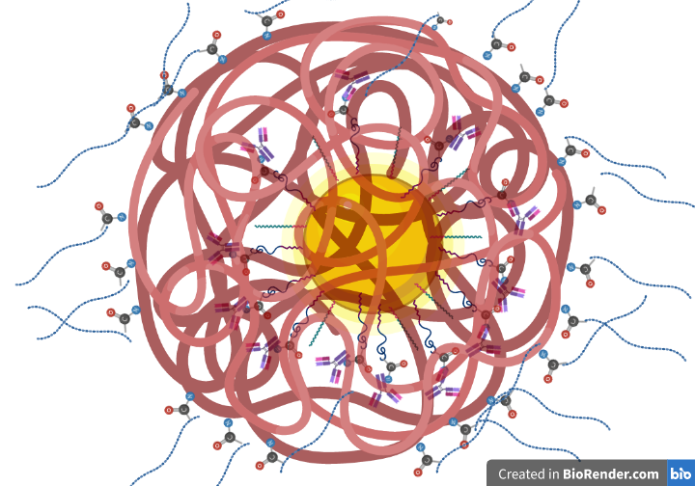
Aim of the work
1. Immobilizing the bio molecules.
To enhance the activity of the antibody
2. Encapsulation of the bio molecules:
To enable release-on-demand (cleavable peptides, etc.)
To eliminate systemic side effect

Slide 5
Results and Discussion
Optimized protocol of synthesis and C-AuNPs ca. 86 nm .
Reduction of Au+ (HAuCl4) with Trisodium citrate.
1. The size of the particles can be controlled by the concentration of Auric salt or Trisodium citrate.
2. Longer boiling duration increases the concentration with the same size.

Slide 6
Results and Discussion
AuNPs Colloid's stability can preserved by functionalization with carboxyl-PEG.
The size of AuNPs increases after the PEGylation.

Slide 7
Results and Discussion
AuNPs Colloid's stability can preserved by functionalization with carboxyl-PEG.
The negative charge on the surface of the particles increases after the PEGylation.
Sample structure | Particles Size | ζ potential
Trisodium citrate - AuNPs | 60.19 nm | -14 mv
mPEG-AuNPs | 80.45 nm | -7 mv
HOOC-PEG-AuNPs | 86.5 nm | -20 mv

Slide 8
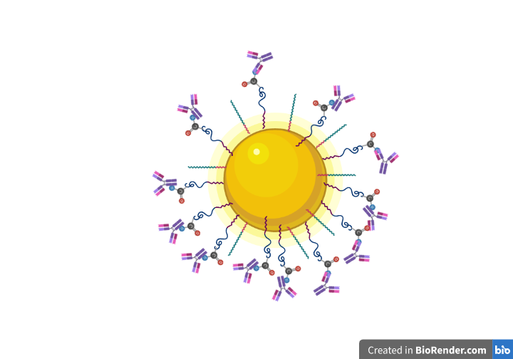
Results and Discussion
Grafting the carboxyl-modified AuNPs with the protein of interest
Using EDC/NHS Covalent Coupling Procedure
The size of the AuNPs has been slightly increases after the grafting

Slide 9
Results and Discussion
C-AuNPs can be coupled with different types of therapeutic antibodies without affecting their activity.
Using EDC/NHS Covalent Coupling Procedure

Slide 10
Results and Discussion
The max grafting capacity on AuNPs (25mg/ml-60nm) is around 250 (μg/ml)

Slide 11
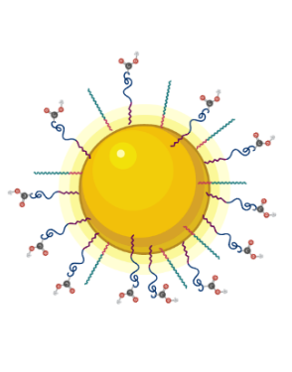
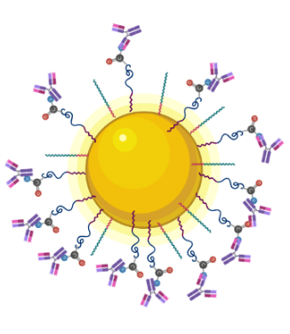

Conclusions
Gold nanoparticles of diameter ca. 60 nm have been synthesized by sodium citrate reduction of gold chloride.
Functionalization with COOH-PEG-SH stabilize the colloidal solution of the gold nanoparticles and help to cross link them with antibodies.
The carboxyl-modified gold nanoparticles can be coupled with the antibodies of interest using the EDC/NHS coupling procedure without affecting their activity. Our future work will focus on the in vitro assays to compare the activity of the conjugated antibodies and their soluble variants.

Slide 12


Acknowledgments
Grant Agreement number: 813871 — I-DireCT — H2020-MSCA-ITN-2018
This is a part of project which has received funding from the European Union’s Horizon 2020 research and innovation programme under the Marie Sklodowska-Curie grant agreement No 813871.

