Slide 1

A Novel Intensification Strategy for Wet Media Milling of Drug Suspensions: Bead Mixtures
Gulenay Guner, Manisha Kannan, Matthew Berrios, Nathaniel Parker, and Ecevit Bilgili*
Otto H. York Department of Chemical and Materials Engineering New Jersey Institute of Technology, Newark, NJ, United States
* Corresponding author: bilgece@njit.edu; Tel.: +1-973-596-2998

Slide 2
Motivation
Delivery of poorly water-soluble drugs remains a significant challenge (Kipp, 2004; Lipinski, 2002)
  Up to 80-90% of drugs in pipeline are poorly water-soluble (Chawla and Bansal, 2007; Shah et al., 2006)
  Require some form of bioavailability enhancement (Brough and Williams III, 2013)
Available approaches to enhance the bioavailability:
Nanocomposites (Singh et al. 2011; Tanaka et al. 2012; Tuomela et al. 2014)
Amorphous solid dispersions (Forster et al. 2001; Hancock and Parks, 2000; Knopp et al. 2016)
Noyes-Whitney equation

Slide 3
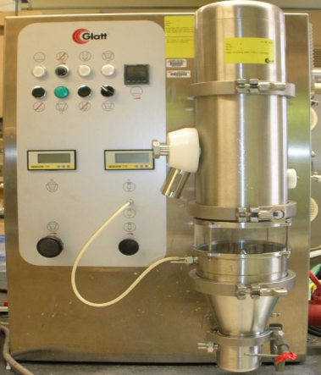
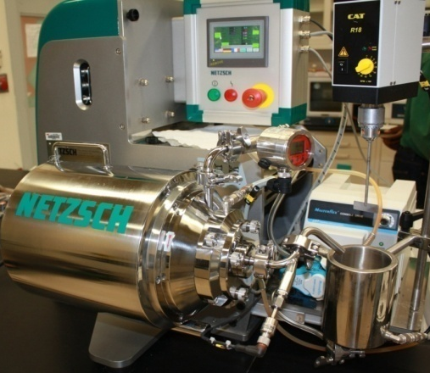
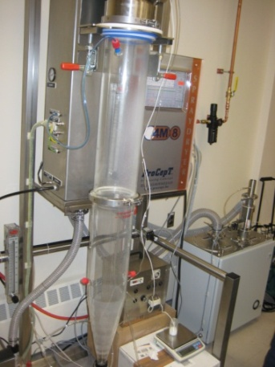
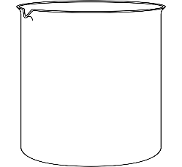
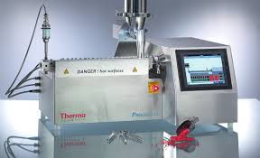
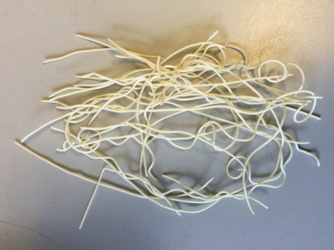
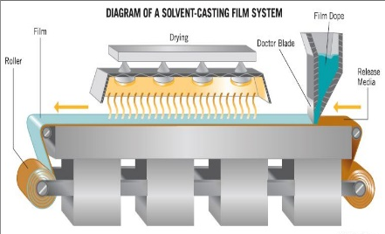
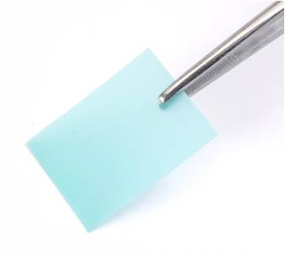


Platform Approach: Nanocomposites Containing Drug Nanoparticles
Fluidized bed coating/drying
Core-shell nanocomposite
Shell
Drug
Polymer
Wet stirred media milling
Pharmatose
( Core)
Spray drying
Matrix type nanocomposite
Water
Suspension
Co-rotating twin-screw extruder
Noodle shape extrudates
Film-casting for strip film
Drug strip films

Slide 4
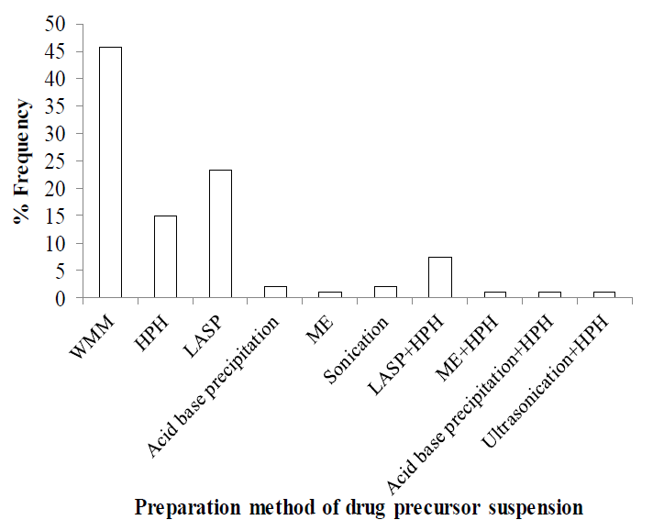
Wet Stirred Media Milling
Advantages:
  Production of high drug-loaded, stable suspensions
  Robust
  Reproducible
  Solvent-free
  Environmentally benign
Disadvantages:
  Possible nanoparticle aggregation-growth
  High energy consumption
  Long operating hours
  Contamination by the beads
Bhakay et al., (2018), Pharmaceutics, 10(3), 86.

Slide 5
Wet Stirred Media Milling of Drugs
Purpose: Produce stable nanoparticle suspensions of BCS class II drugs
Mode of operation: Suspension is recirculated through the milling chamber
Mechanism of Action: Repetitive compression of drug particles captured between colliding beads (media)
Formulation: BCS class II drug and stabilizers (polymers and surfactants)

Slide 6
Previous Studies on Wet Stirred Media Milling: Process Optimization
Afolabi et al. (2014) studied the impact of process parameters
Li et al. (2017) studied the impact of Zirconia (YSZ) bead sizes and produced sub-100 nm nanoparticles (2015)
Parker et al. (2020) studied the impact of crosslinked polystyrene (CPS) and YSZ beads
A possible synergistic effect of CPS-YSZ bead mixture was not studied

Slide 7
Experimental
Materials
  Fenofibrate (drug): 10%
  Hydroxypropyl cellulose: 7.5%
  Sodium dodecyl sulfate: 0.05%
  400 µm cross-linked polystyrene (CPS) beads and yttrium-stabilized zirconia (YSZ) (100:0-0:100)
Equipment
  Netzsch MicroCer wet stirred media mill
  Beckmann Coulter LS 230 for PSD
  Brookfield Rheometer
CPS:YSZ=100:0
CPS:YSZ=75:25
CPS:YSZ=50:50
CPS:YSZ=25:75
CPS:YSZ=0:100

Slide 8
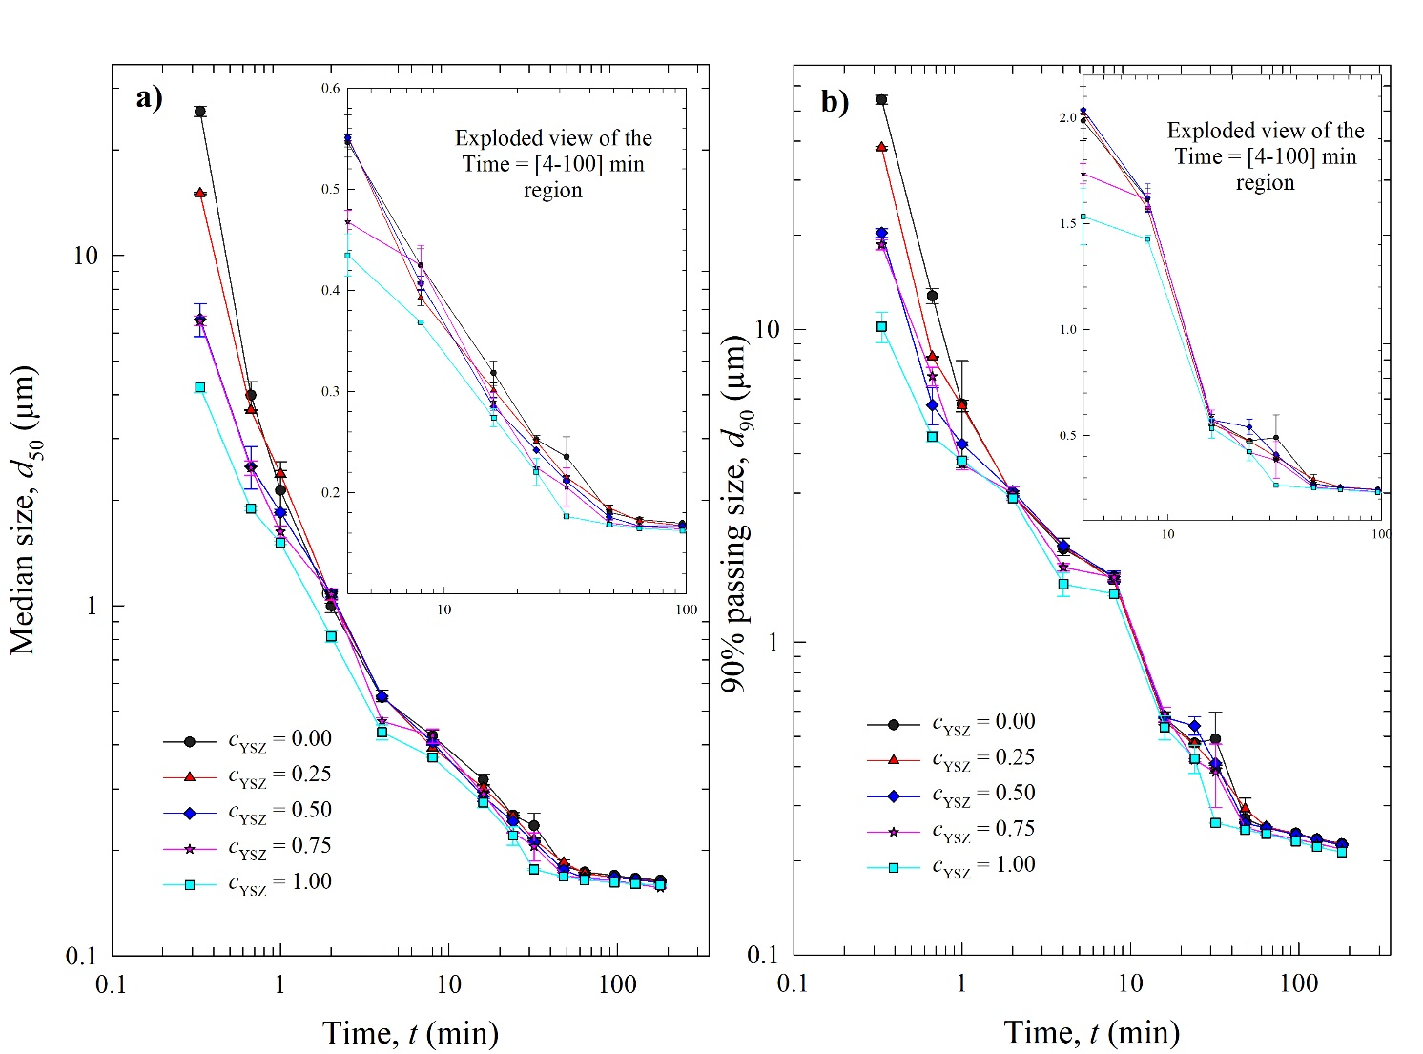
Wet Media Milling with Bead Mixtures
Initial drug particle size:
  d₅₀ = 25.58 ± 0.06 µm
  d₉₀ = 49.32 ± 0.016 µm
FNB nanosuspensions with d₅₀ < 165 nm were produced within 180 min using CPS and YSZ beads and their mixtures
Well-stabilized suspensions: Monotonic decrease of particle size and no particle growth over 7 days (not shown for brevity)
Apparent grinding limit: ~ d₅₀ = 160 nm

Slide 9
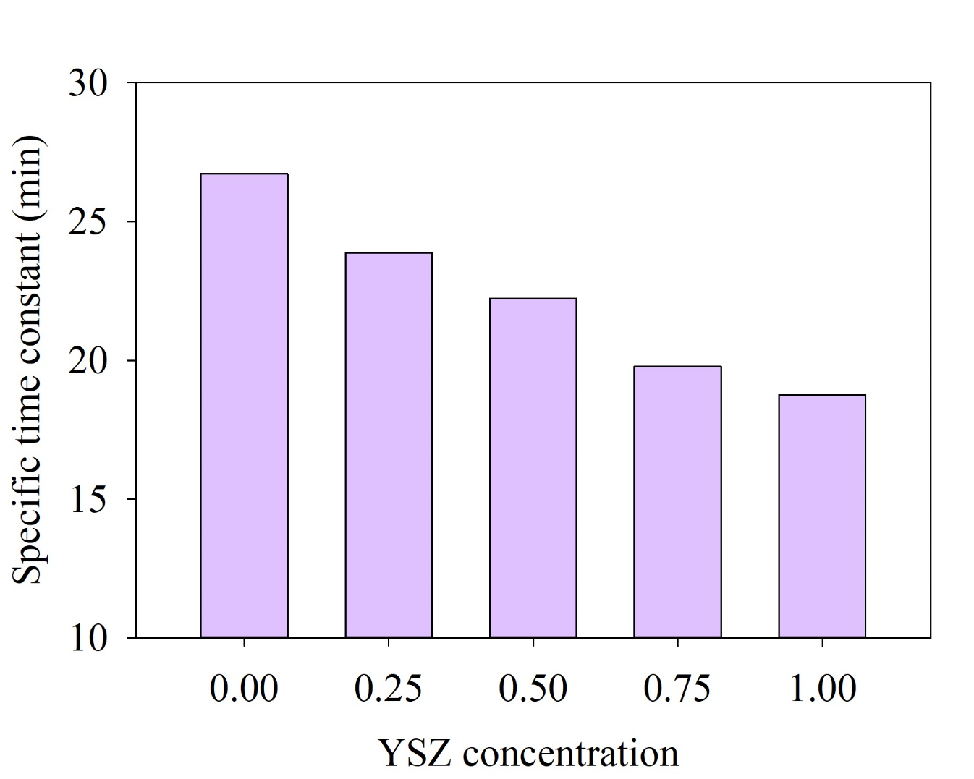
Specific time constant
Time required for d50 to reach 0.25 µm
Faster breakage at higher YSZ concentration in the bead mixture
The increase in the rate decreases for cYSZ>0.5

Slide 10
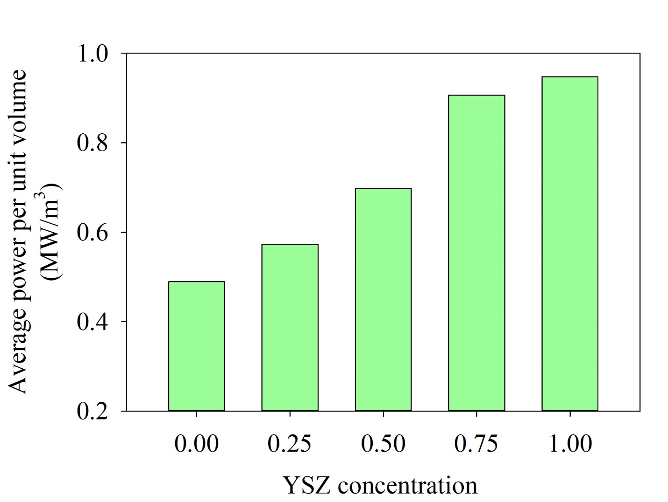
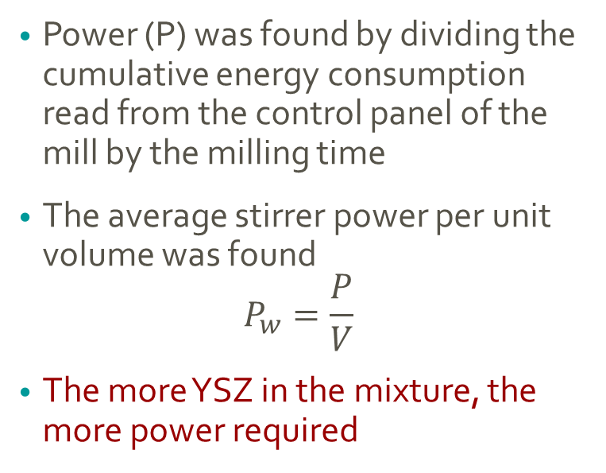
Power
Power (P) was found by dividing the cumulative energy consumption read from the control panel of the mill by the milling time
The average stirrer power per unit volume was found
$$P_{w}=\frac{P}{V}$$
The more YSZ in the mixture, the more power required

Slide 11
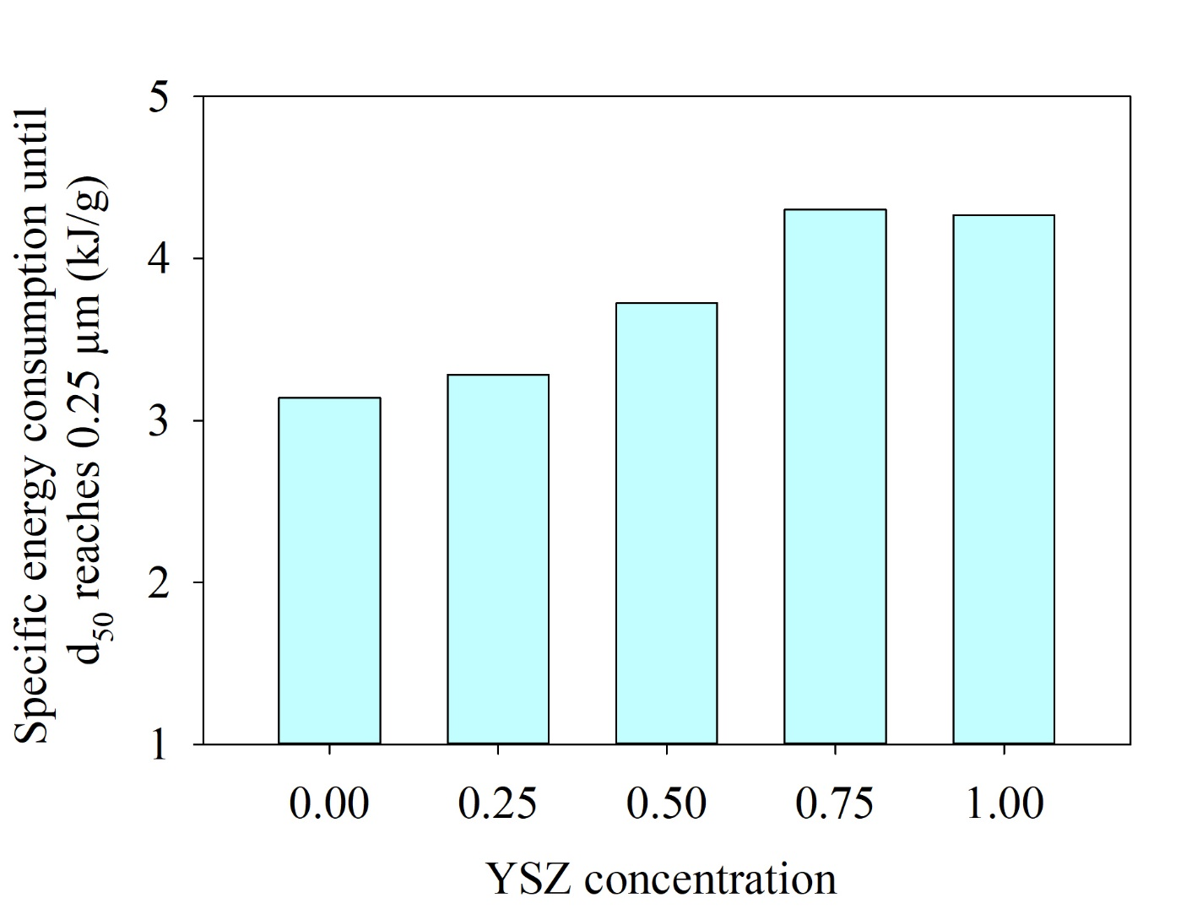
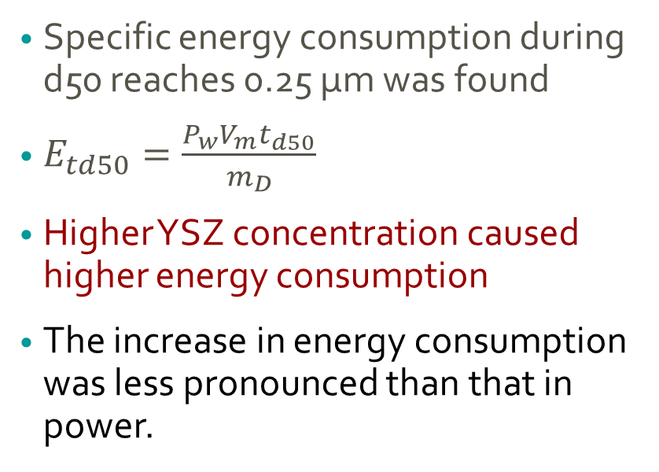
Energy consumption
Specific energy consumption during d50 reaches 0.25 µm was found
$E_{td50}=\frac{P_{w}V_{m}t_{d50}}{m_{D}}$
Higher YSZ concentration caused higher energy consumption
The increase in energy consumption was less pronounced than that in power.

Slide 12
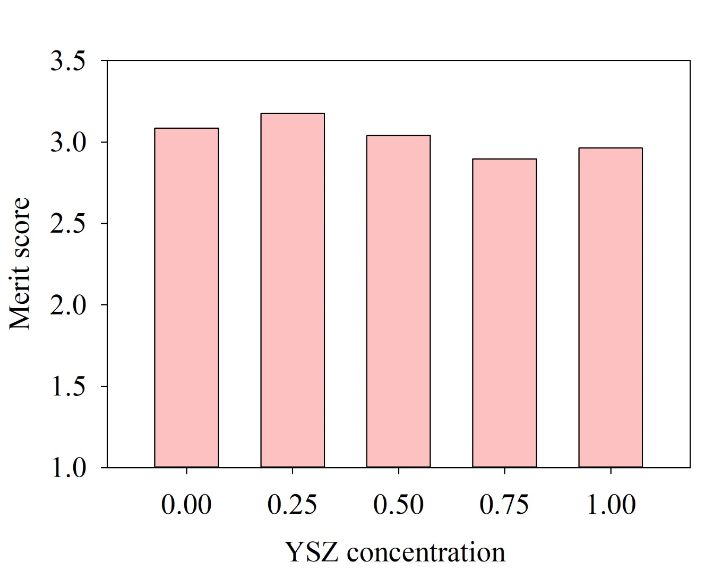
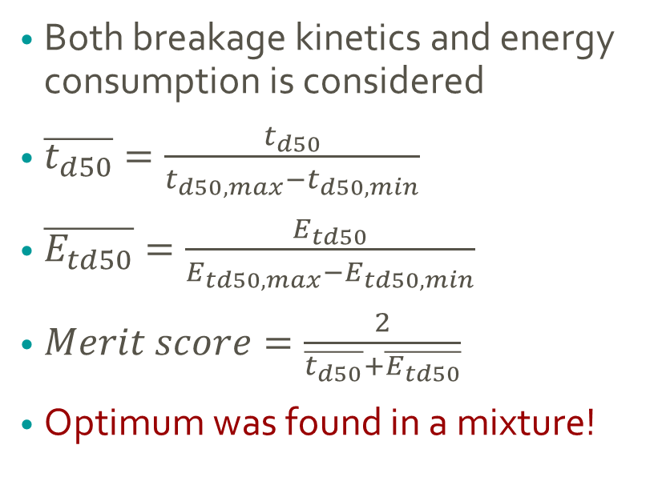
Merit Score for an Optimum Process
Both breakage kinetics and energy consumption is considered
$\overline{t_{d50}}=\frac{t_{d50}}{t_{d50,max}−t_{d50,min}}$
$\overline{E_{td50}}=\frac{E_{td50}}{E_{td50,max}−E_{td50,min}}$
$Merit score=\frac{2}{\overline{t_{d50}}+\overline{E_{td50}}}$
Optimum was found in a mixture!

Slide 13
Conclusions
CPS beads are favorable for energy efficiency (lower utility costs)
YSZ beads are favorable for fast production (reduced cycle time)
When the process is designed to reduce both, mixture of beads appears to enable optimization.
Different operating conditions will be studied in future work.

Slide 14
References
1. Lipinski C. Poor aqueous solubility—an industry wide problem in drug discovery. Am Pharm Rev. 2002;5(3):82-85.
2. Kesisoglou F, Panmai S, Wu Y. Nanosizing — Oral formulation development and biopharmaceutical evaluation. Advanced Drug Delivery Reviews. 2007;59(7):631-644.
3. Bhakay A, Merwade M, Bilgili E, Dave RN. Novel aspects of wet milling for the production of microsuspensions and nanosuspensions of poorly water-soluble drugs. Drug Development and Industrial Pharmacy. 2011;37(8):963-976.
4. Malamatari M, Taylor KMG, Malamataris S, Douroumis D, Kachrimanis K. Pharmaceutical nanocrystals: production by wet milling and applications. Drug Discovery Today. 2018;23(3):534-547.
5. Chen H, Khemtong C, Yang X, Chang X, Gao J. Nanonization strategies for poorly water-soluble drugs. Drug Discovery Today. 2011;16(7):354-360.
6. Mohammad IS, Hu H, Yin L, He W. Drug nanocrystals: Fabrication methods and promising therapeutic applications. International Journal of Pharmaceutics. 2019;562:187-202.
7. Bhakay A, Rahman M, Dave RN, Bilgili E. Bioavailability Enhancement of Poorly Water-Soluble Drugs via Nanocomposites: Formulation⁻Processing Aspects and Challenges. Pharmaceutics. 2018;10(3):86.
8. Li M, Azad M, Davé R, Bilgili E. Nanomilling of Drugs for Bioavailability Enhancement: A Holistic Formulation-Process Perspective. In.Pharmaceutics; 2016. p. 17.
9. Peltonen L. Design Space and QbD Approach for Production of Drug Nanocrystals by Wet Media Milling Techniques. Pharmaceutics. 2018;10(3):104.
10. Li M, Yaragudi N, Afolabi A, Dave R, Bilgili E. Sub-100nm drug particle suspensions prepared via wet milling with low bead contamination through novel process intensification. Chemical Engineering Science. 2015;130:207-220.
11. Kawatra SK. Advances in comminution. Littleton, Colorado: Society for Mining, Metallurgy, and Exploration; 2006.

Slide 15
References
12. Afolabi A, Akinlabi O, Bilgili E. Impact of process parameters on the breakage kinetics of poorly water-soluble drugs during wet stirred media milling: A microhydrodynamic view. European Journal of Pharmaceutical Sciences. 2014;51:75-86.
13. Bilgili E, Capece M, Afolabi A. Modeling of milling processes via DEM, PBM, and microhydrodynamics. In: Pandey P, Bharadwaj R, editors. Predictive Modeling of Pharmaceutical Unit Operations: Woodhead Publishing; 2017. p. 159-203.
14. Li M, Alvarez P, Bilgili E. A microhydrodynamic rationale for selection of bead size in preparation of drug nanosuspensions via wet stirred media milling. International Journal of Pharmaceutics. 2017;524(1):178-192.
15. Parker N, Rahman M, Bilgili E. Impact of media material and process parameters on breakage kinetics–energy consumption during wet media milling of drugs. European Journal of Pharmaceutics and Biopharmaceutics. 2020;153:52-67.
16. Rahman M, Arevalo F, Coelho A, Bilgili E. Hybrid nanocrystal–amorphous solid dispersions (HyNASDs) as alternative to ASDs for enhanced release of BCS Class II drugs. European Journal of Pharmaceutics and Biopharmaceutics. 2019;145:12-26.
17. Rahman M, Ahmad S, Tarabokija J, Bilgili E. Roles of surfactant and polymer in drug release from spray-dried hybrid nanocrystal-amorphous solid dispersions (HyNASDs). Powder Technology. 2020;361:663-678.
18. Jamzad S, Fassihi R. Role of surfactant and pH on dissolution properties of fenofibrate and glipizide—A technical note. AAPS PharmSciTech. 2006;7(2):17-22.
19. Azad M, Afolabi A, Bhakay A, Leonardi J, Davé R, Bilgili E. Enhanced physical stabilization of fenofibrate nanosuspensions via wet co-milling with a superdisintegrant and an adsorbing polymer. European Journal of Pharmaceutics and Biopharmaceutics. 2015;94:372-385.
20. Bilgili E, Li M, Afolabi A. Is the combination of cellulosic polymers and anionic surfactants a good strategy for ensuring physical stability of BCS Class II drug nanosuspensions? Pharmaceutical Development and Technology. 2016;21(4):499-510.
21. Knieke C, Azad MA, Davé RN, Bilgili E. A study of the physical stability of wet media-milled fenofibrate suspensions using dynamic equilibrium curves. Chemical Engineering Research and Design. 2013;91(7):1245-1258.

Slide 16
Thank you,
Any Questions?

