Slide 1








Rice (Oryza sativa L.) biofortification with selenium: Enrichment index and interactions among nutrients
Ana Marques1,2*, Cláudia Pessoa1,2, Ana Coelho1,2, Inês Luís1,2, Diana Daccak1,2 , Paula Scotti-Campos2,3, Manuela Simões1,2, Ana Sofia Almeida3,4, Maria Pessoa1,2, Fernando Reboredo1,2, Mauro Guerra5 , Roberta Leitão5 , José Ramalho2,6, Paula Marques4, Maria Manuela Silva2,7, Paulo Legoinha1,2, Isabel Pais2,3 and Fernando Lidon1,2
¹Earth Sciences Department, Faculdade de Ciências e Tecnologia, Universidade Nova de Lisboa, Caparica, Portugal
²GeoBioTec Research Center, Faculdade de Ciências e Tecnologia, Universidade Nova de Lisboa, Caparica, Portugal
³INIAV, Instituto Nacional de Investigação Agrária e Veterinária, Oeiras, Portugal
⁴COTArroz, Centro Operativo e Tecnológico do Arroz, Salvaterra de Magos, Portugal
⁵LIBPhys‐UNL, Physics Department, Faculdade de Ciências e Tecnologia, Universidade Nova de Lisboa, Caparica, Portugal
⁶PlantStress & Biodiversity Lab, Centro de Estudos Florestais (CEF), Instituto Superior Agronomia (ISA), Universidade de Lisboa (ULisboa), Quinta do Marquês, Av. República, 2784-505 Oeiras and Tapada da Ajuda, 1349-017 Lisboa, Portugal
⁷ESEAG / Grupo Universidade Lusófona, Lisboa, Portugal

Slide 2

Abstract: Selenium is an antioxidant trace mineral important for human health and development. Therefore, the growing demand for efficient, bioeconomic and sustainable strategies to increase Se content in cereals, namely rice, is therefore justified. In this context, biofortification is a strategy that can promote nutrient enhancement in food crops and, therefore, increased nutrient uptake in the human body. In this framework, a technical itinerary was implemented using a rice genotype (OP1509), through foliar spraying with two selenium concentrations (25 and 100 g Se.ha-1) of sodium selenate (Na2SeO4) and sodium selenite (Na2SeO3). It was found that the average of Se biofortification index was 1.8 - 4.7 and 5.4 - 6.0 fold in selenate and selenite treatments, respectively. The contents of Se, Ca, Fe, K, P, C, H and O in brown rice grains, were also quantified being found that both forms of fertilizers increased Zn contents with 25 g Se.ha-1 but decreased with 100 g Se.ha-1. Moreover, Ca only increased significantly with selenate pulverization. The application of both forms also increased grain weight but did not affect the colorimetric analysis. It is concluded that the applied itinerary can be implemented to minimize Se malnutrition
Keywords: Selenate; Selenite; Selenium biofortification

Slide 3
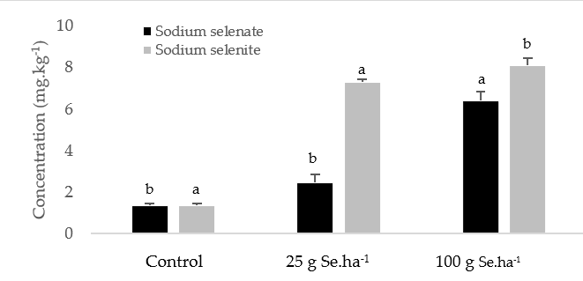
Results and Discussion
Foliar spraying with sodium selenate and sodium selenite promoted the accumulation of Se in the brown grains. Foliar fertilization with Se interfered with the accumulation of other chemical entities. When selenate was applied only the contents of Ca increased significantly, whereas the other chemical elements did not varied significantly.
Conclusions
Foliar spraying with selenate or selenite concentrations (25 and 100 g Se.ha⁻¹) did not surpass the threshold of toxicity in O. sativa L. Poaceae. The average of Se biofortification index was 1.8-4.7 times in selenate treatment and 5.4-6.0 times in selenite treatment. The contents of Ca, Fe, K and P varied according to the form and concentration applied however the C, H and O contents did not vary significantly. The application of both forms increased grain weight in the genotype and did not affect the colorimetric analysis. Accordingly, it is concluded that the applied itinerary applied for biofortification in rice (variety OP1509) can be implemented to minimize Se malnutrition.

Slide 4


Acknowledgments
Authors thanks to Paula Marques, Cátia Silva (COTARROZ) and Orivárzea (Orizicultores do Ribatejo, S.A.) for technical assistance as well as to project PDR2020-101-030671 for the financial support. We also thanks to the Research centres (GeoBioTec) UIDB/04035/2020 and (CEF) UIDB/00239/2020 for support facilities. This work was supported by the project PDR2020-101-030671.This work was further support by the research center grant Nº UID/FIS/04559/2013 to LIBPhys‐UNL.

