Slide 1
Title of the Presentation
Fakhara Sabir ¹, Gábor Katona ¹, Ruba Ismail ¹ and Ildiko Csoka ¹
¹ Faculty of Pharmacy, Institute of Pharmaceutical Technology and Regulatory Affairs, University of Szeged, H-6720 Szeged, Hungary
* Corresponding author: csoka@pharm.u-szeged.hu, Tel.+36-62-546-116

Slide 2
Development and Optimization of N-Propyl gallate Encapsulated Hyaluronic Acid Based Hydrogel for Nose to Brain Delivery by Applying Quality by Design Methodology
Abstract: The aim of this research work was to develop n-propylgallate encapsulated solid lipid nanoparticles (PG-SLNs) and load them into a Hyaluronic acid (HA) based hydrogel (HG) for intranasal delivery. Simple modified solvent injection technique was used for the preparation of the PG-SLNs via the Quality-by Design (QbD) approach. The optimized PG-SLNs with an average hydrodynamic diameter of 103±46.04 nm with polydispersity index (PDI) of 0.16±0.001 and zeta potential of -36±4.78 mV of were obtained. The percentage yield of PG-SLNs was found to be 80.78±0.1% with an encapsulation efficiency of 84±0.5% and loading capacity of 60±0.1%. In vitro drug release from the hydrogel containing PG-SLNs showed sustained release profile with a burst effect of slower and controlled to a greater extent (15%) and (60%) of the drug from hydrogel within 720 mints following diffusion based release kinetics. The in vitro permeability studies showed the total permeation of PG from HG was 600 μg/cm² within 60 mints that showed significant permeation of PG. Findings of this work strongly emphasize that PG-SLNs loaded hydrogel and permeation enhancer holds significant potential to be delivered through intranasal route.
Keywords: nose to brain; n-propylgallate; SLN; hydrogel; Quality by Design

Slide 3
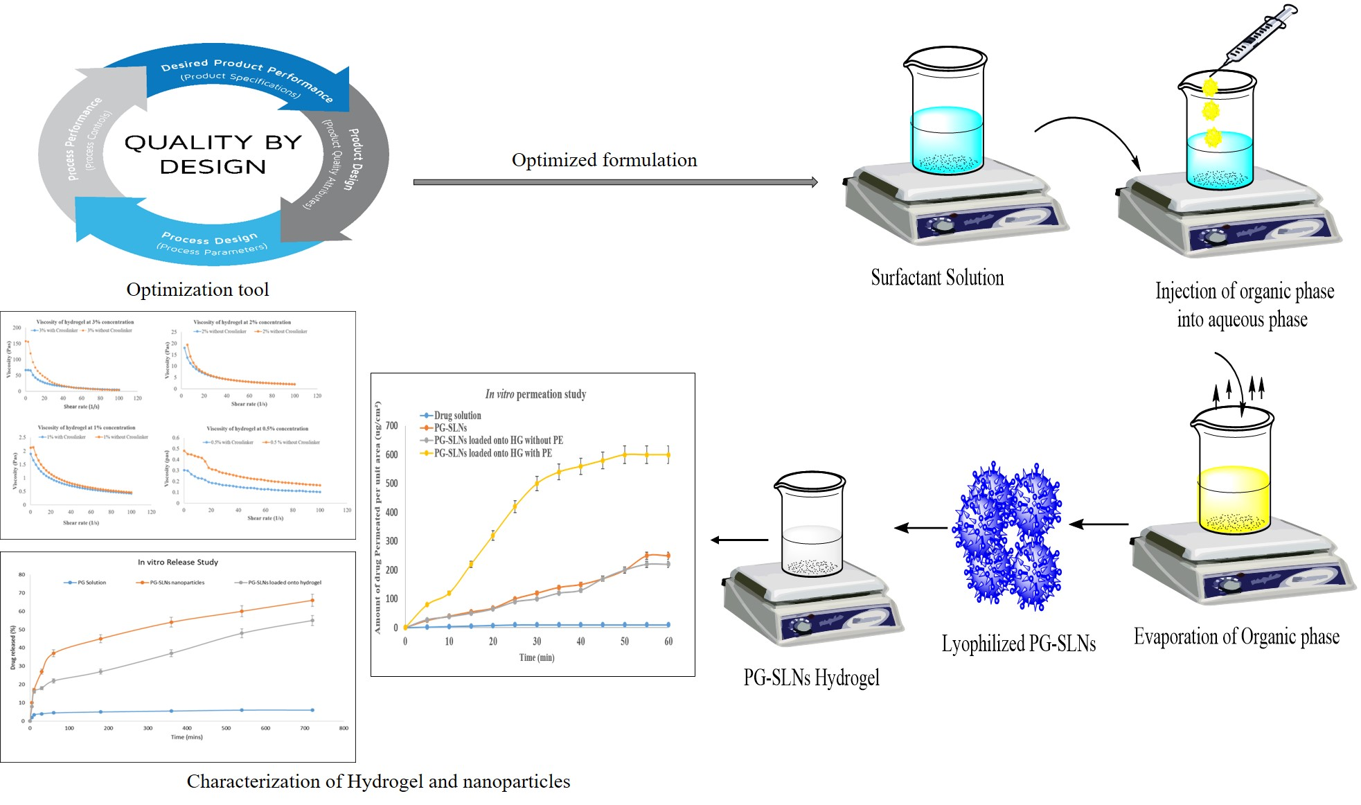
Graphical Abstract

Slide 4
Aims and Objective of study
Development and loading of PG-SLNs into chemically linked HA hydrogel with permeation enhancer (Transcutol-P) and crosslinker glutaraldehyde suitable for nose to brain delivery by applying QbD.
Characterization of developed nanoparticles encapsulated with PG and PG loaded HA-hydrogel for intranasal delivery.

Slide 5
Methodology
Application of QbD design and DOE for development of PG-SLNs
Development of Optimized PG-SLNs via Solvent injection method
Characterization of NPs and Hydrogel
Particle size,Zeta potential,PDI,mucoadhesivity,viscosity,permeability, release studies
Development of PG-SLNs loaded HA based Hydrogel

Slide 6
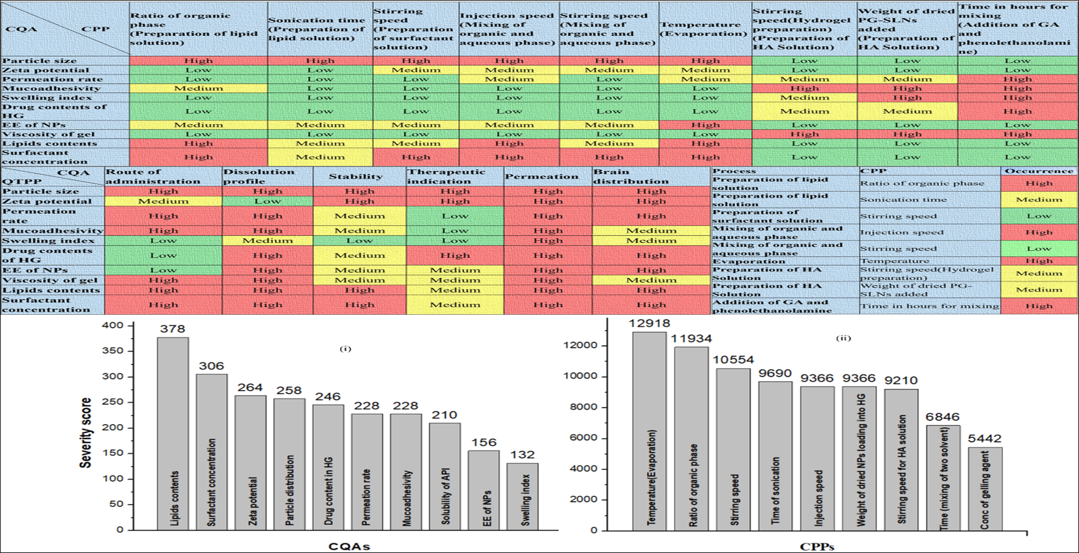
Results and Discussion
Risk Assessment
****Interdependence rating and estimation of the QTPP and CQAs and CQAs-CPPs, and Pareto charts showing the severity/impact among selected

Slide 7
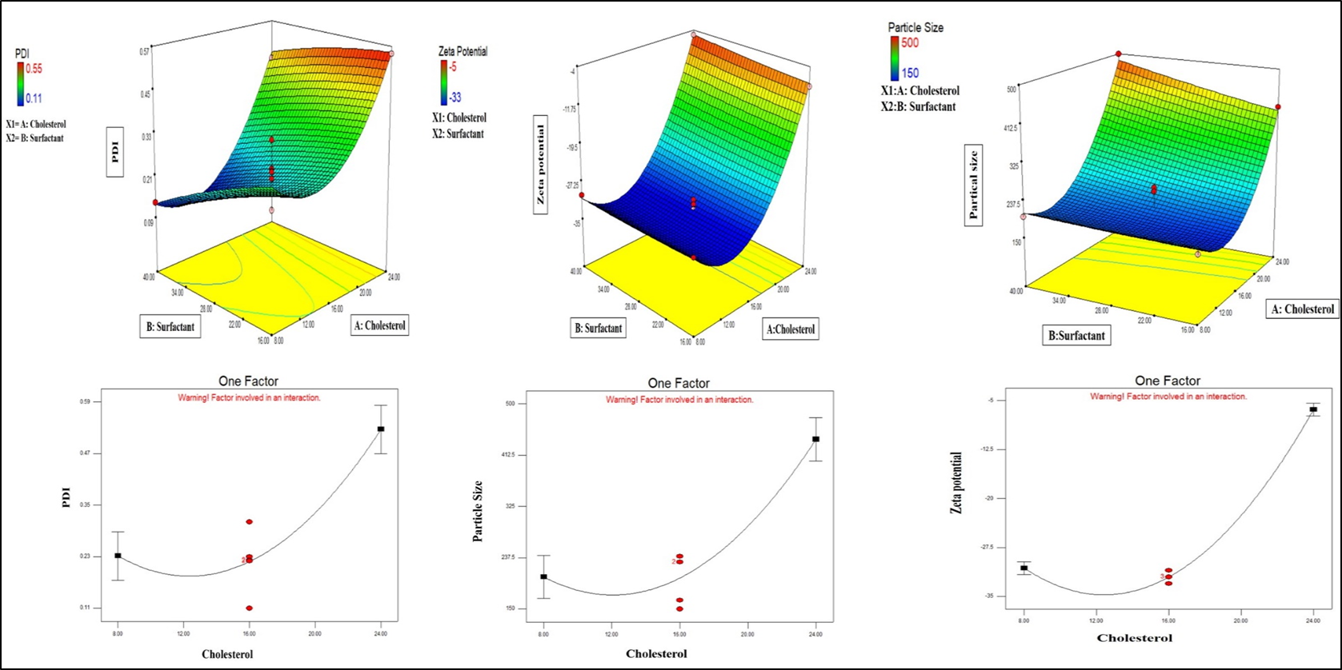
Results and Discussion Response Surface Quadratic Model
3D surface plot show combine effect of cholesterol and surfactant on Particle size,PDI and Zeta potential.
One factor interaction plot showed Cholesterol was significantly invovled in effecting the all studies factors under obervation.

Slide 8
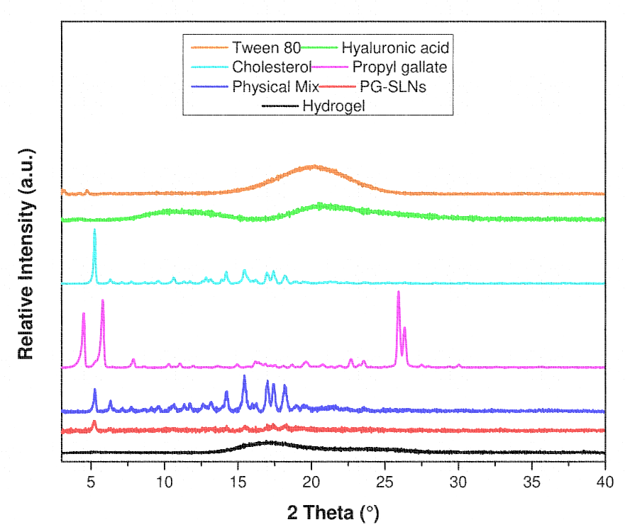
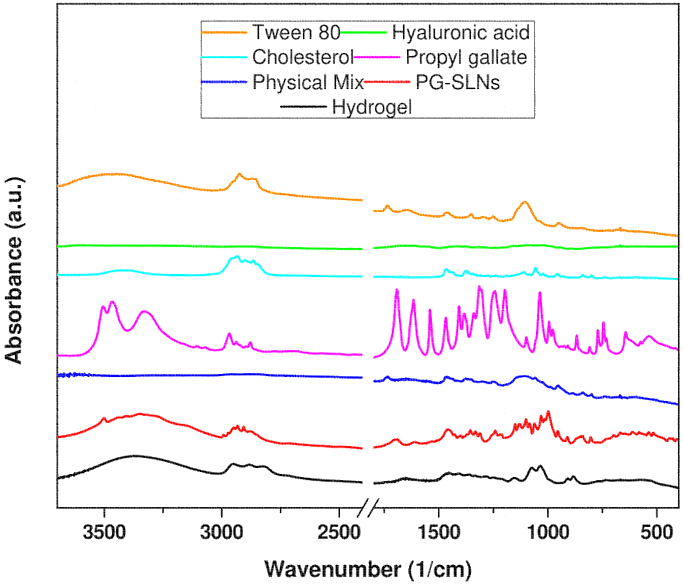
Results and Discussion FTIR and XRPD
****No interaction was found between the formulation component and final formulation, XRPD results show conversion of crystalline form of PG into amorphous form in PG-SLNs

Slide 9
Results and Discussion
Particle Size, Zeta Potential, PDI
Zeta sizer were used for analysis
PG-SLNs with an average size of 103±46.04 nm,PDI of 0.16±0.001, Zeta potential of -36±4.78 mv

Slide 10
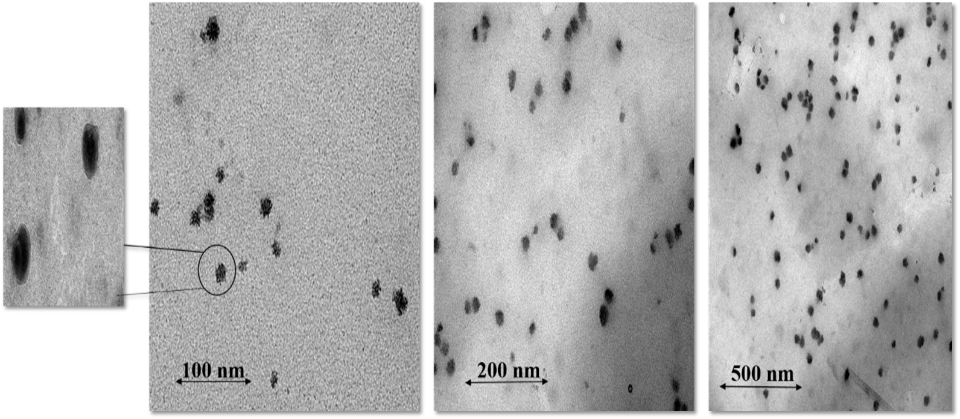
Results and Discussion
Morphological study (TEM analysis)
***Particles were spherical in shape and within nanorange
And results were comparable with particle size analysis of zeta sizer

Slide 11
Results and Discussion
Characterization of Hydrogel
Conc. Hydrogel | pH value of different conc of HA-Hydrogel | % Swelling ratio | % Drug Contents | Spread ability mm² | Muco-adhesivity | Viscosity with CL(Pas) | Viscosity without CL(Pas)
0.5 | 5.3±0.2 | 400 | 78± 2.5 | 222.45± 0.22 | *** | 0.112 | 0.181
1 | 5.2±0.3 | 900 | 82±3.3 | 360±0.33 | Good | 1.88 | 2.11
2 | 5.5±0.4 | 1300 | 80±1.4 | 320±0.44 | Good | 14.29 | 15.45
3 | 5.9±0.6 | 2000 | 79±4.2 | 340±0.012 | Good | 66.34 | 157
***The hydrogel at concentration 1% show best results in all performed studies. We selected this concentration for further in vitro release and permeation testing

Slide 12
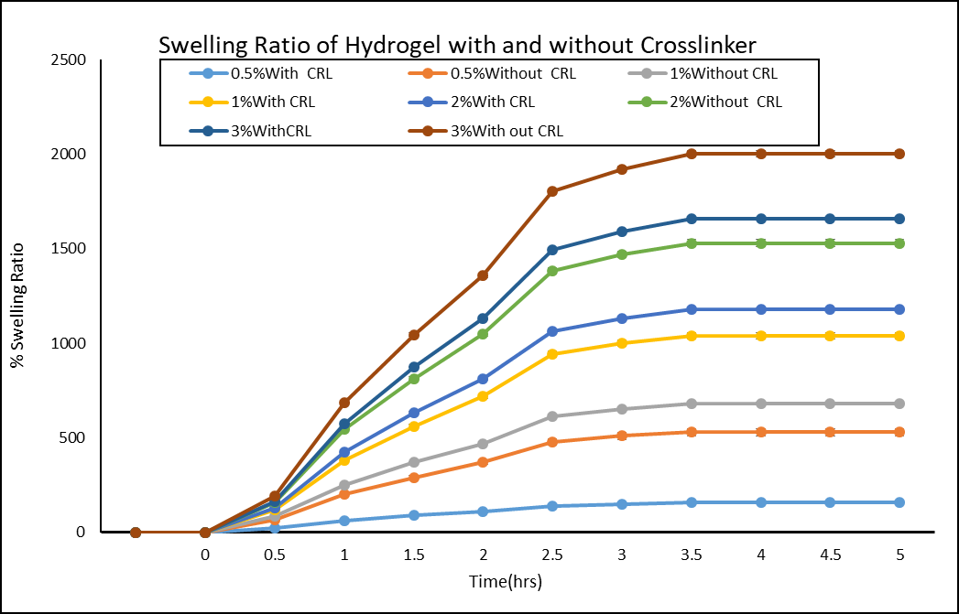
Results and Discussion
Swelling study results showed that hydrogel without cross linker showed greater swelling index. it can be concluded that by adding cross-linker, mechanical strength of hydrogel enhances and has more precise control on release of nano-carrier from gel matrix as compare to simple hydrogel which is mechanically fragile that can get fractured easily thus larger pores may be created through which nano-carriers can easily escape with initiating a burst release

Slide 13
Results and Discussion Viscosity measurement
At different concentration of hyaluronic acid viscosity of hydrogel was measured to get optimized concentration suitable for intranasal administration

Slide 14
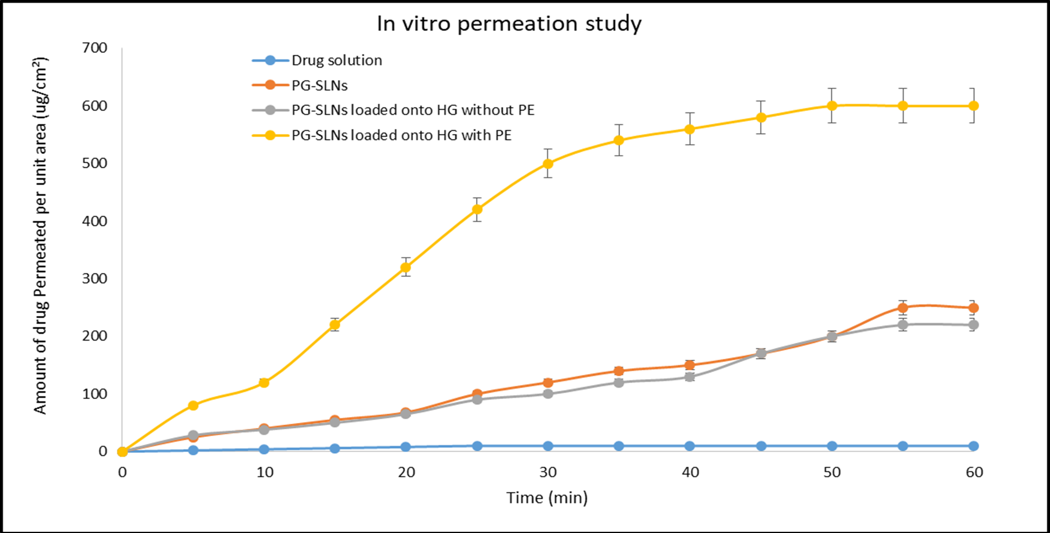
Results and Discussion
For In vitro permeability study of nano-formulation and hydrogel Side bi side equipment was used for permeation study

Slide 15
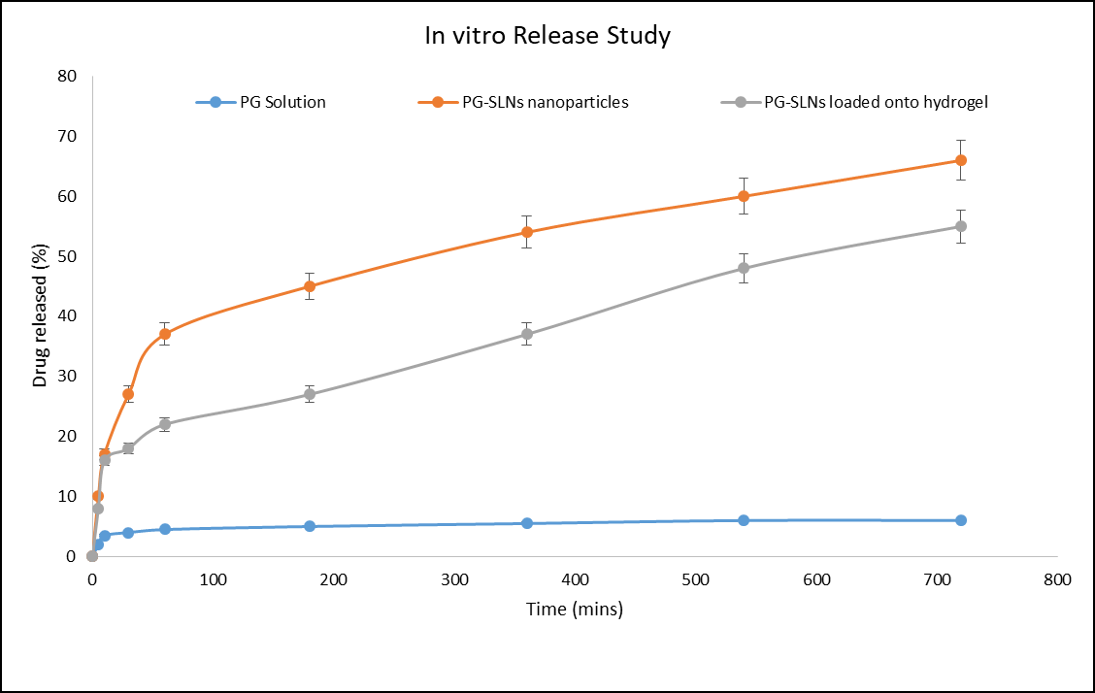
Results and Discussion
In vitro Release study of Nano-formulation and Hydrogel showed initial burst released in case of hydrogel has been slower and controlled to a greater extent

Slide 16
Conclusions
PG-SLNs were successfully prepared in this study using the modified injection method. For the optimization of formulation and process parameters, initial risk assessment study was applied as a part of QbD approach.
The PG-SLNs showed an average size of roughly 100 nm with a homogenous distribution, negative surface charge, drug release reaching roughly 60% and high EE (> 80%) (complying with the predefined QTPP).
The viscosity and mucoadhesivity results reflect enhanced adherence property of optimized HA-HG loaded with PG-SLNs. Compared to PG-SLNs, in vitro permeation studies showed the superiority of the PG-SLNs loaded into HA-HG and transuctol-P system with a less initial burst effect and more sustained release.
The optimized platform provides in vitro proof of the potential of combining the advantages of lipid based NPs with HG as a promising intransal delivery system.
Notes:
It is concluded that the QbD methodology and RA tool helps us to rationalized the product. With the assistance of the following tool we get rationalized lipid nanoparticles that is more suitable for intranasal delivery
The physiochemical characterization studies of NPs and HG has shown the results within criteria, likewise the PG-SLNs with an average size of 103±46.04 nm were obtained with PDI of 0.16±0.001, Zeta potential of -36±4.78 mv obtained with percentage yield of NPs was found to be 80.78±0.0125% and encapsulation efficiency was found to be 84±0.477%. And loading capacity was about 60±0.034%, all the results of optimized formulation was within standard criteria

Slide 17
Acknowledgments
The authors want to express their acknowledgement to the supporters. This study was supported by the Ministry of Human Capacities, Hungary (Grant 20391-3/2018/FEKUSTRAT) and by the National Research, Development and Innovation Office, Hungary (GINOP 2.3.2-15-2016-00060) projects.

Slide 18
References
1. Mistry, A., S. Stolnik. ; L. Illum, Nanoparticles for direct nose-to-brain delivery of drugs. Int.J.Pharm, 2009. 379(1): p. 146-157.
2. Kumar, M., et al., Evaluation of neuropeptide loaded trimethyl chitosan nanoparticles for nose to brain delivery. Int.J Biol.Macro, 2013. 61: p. 189-195.
3. Gonçalves, J., et al., Nose-to-brain delivery of levetiracetam after intranasal administration to mice. Int.J.Pharm, 2019. 564: p. 329-339.
4. Eskandani, M., et al., Formulation, characterization, and geno/cytotoxicity studies of galbanic acid-loaded solid lipid nanoparticles. Pharm.Bio, 2015. 53(10): p. 1525-1538.

Slide 19
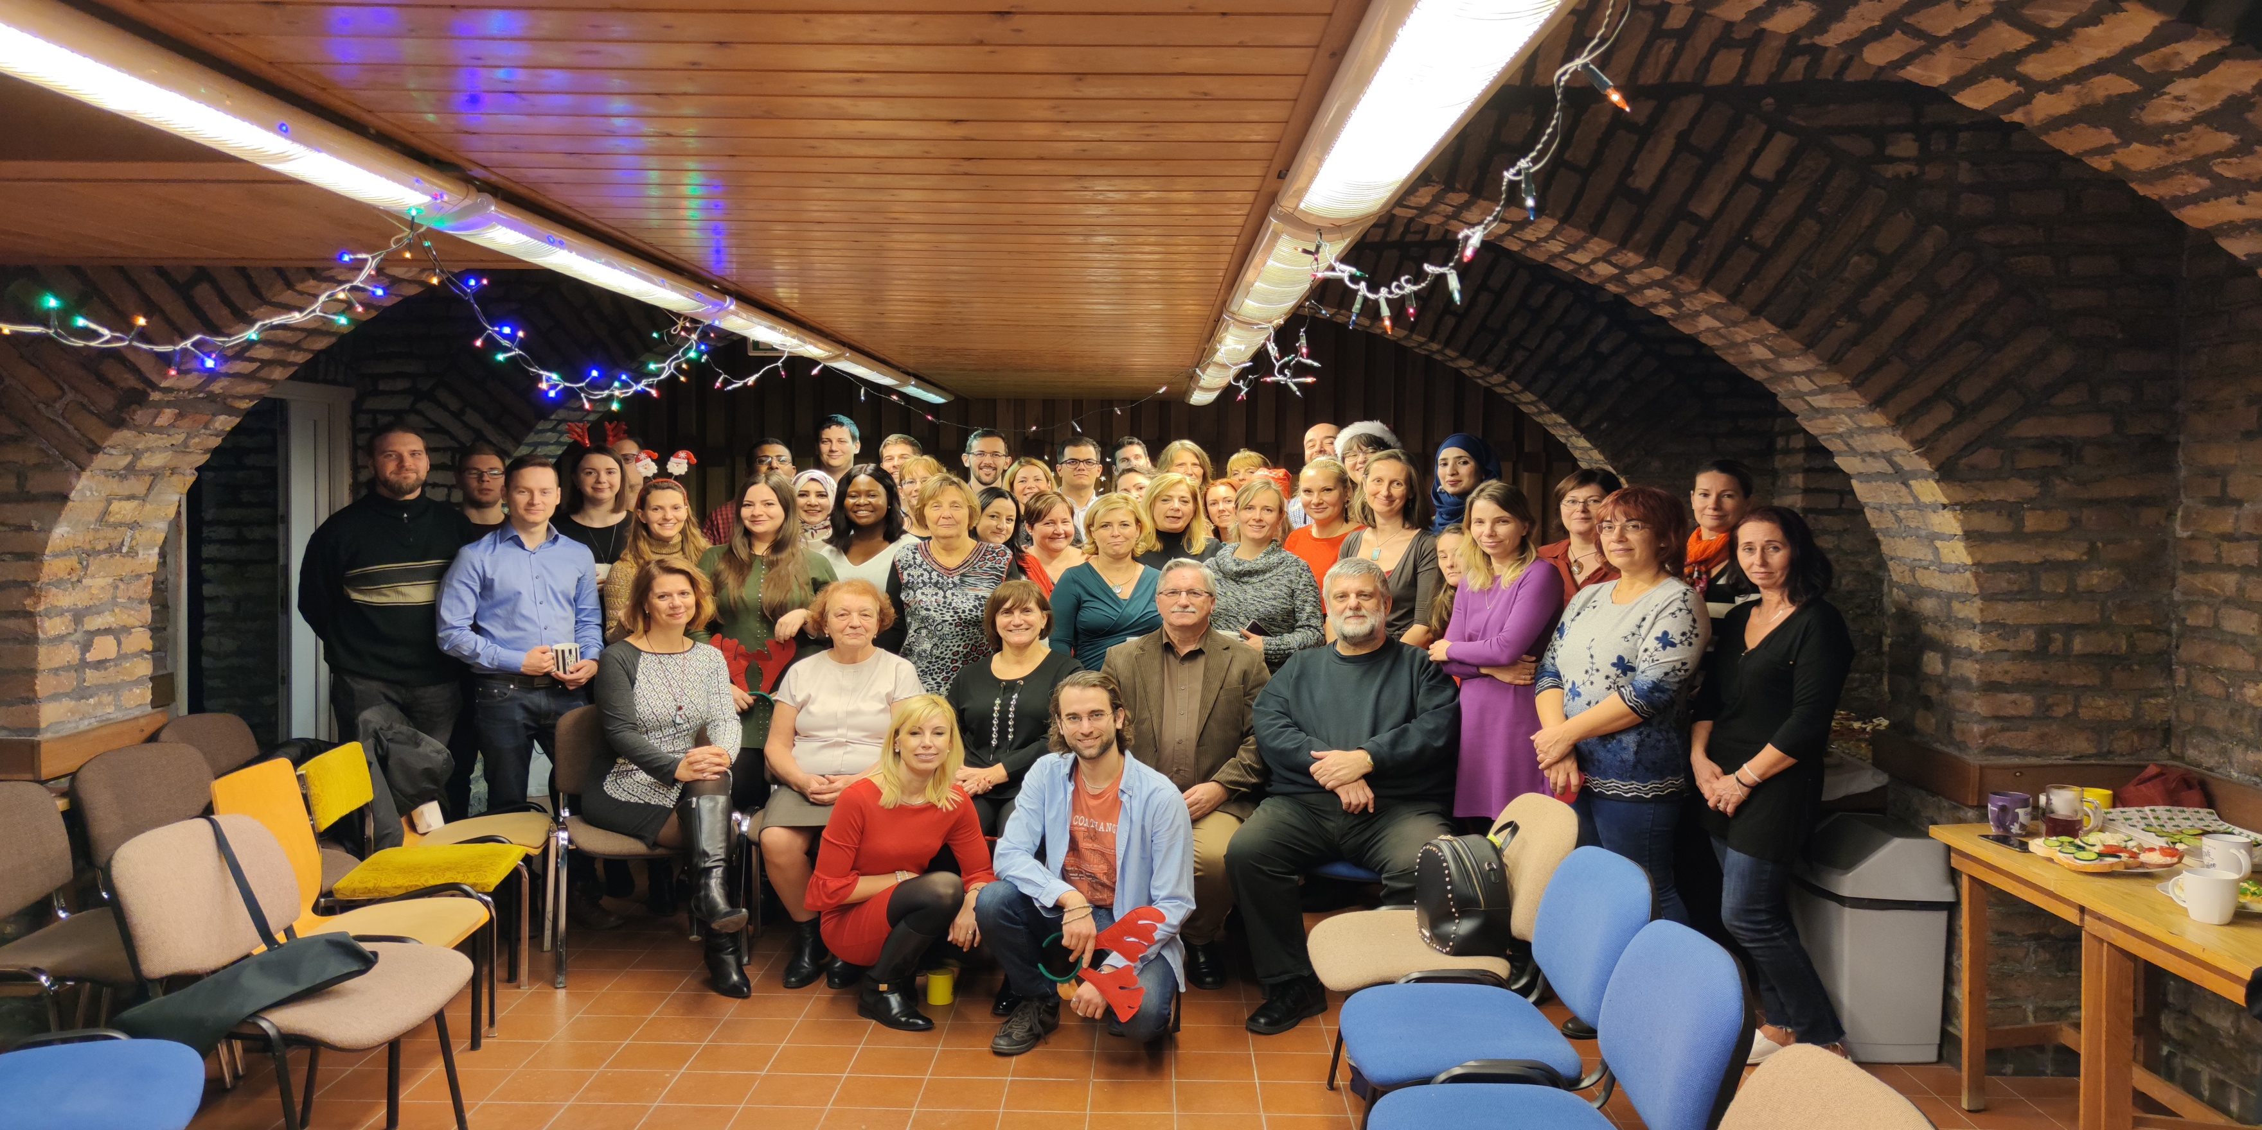
Dr. Ildiko Csoka
Dr.Gábor Katona
Dr. Pallagi Edina
Dr.Rita Ambrus
Dr. Dorina Gabriella Dobó
Dr. Ruba Ismail

