Slide 1



Oxyresveratrol Supplementation In Hyper-Branched Cyclodextrin Based Nanosponges As Antiaging Enhancer in Caenorhabditis Elegans
Adrián Matencio¹*, M. Alejandra Guerrero-Rubio², Fabrizio Caldera¹, Claudio Cecone¹, Alberto Rubin Pedrazzo¹, Silvia Navarro-Orcajada², Francesco Trotta¹, Francisco García-Carmona² and José Manuel López-Nicolás²
¹ - Dip. Di Chimica, Università di Torino, via P. Giuria 7, 10125,Torino, Italy
² - Departamento de Bioquímica y Biología Molecular A, Unidad Docente de Biología, Facultad de Veterinaria. Regional Campus of International Excellence “Campus Mare Nostrum”. Universidad de Murcia, Murcia, Spain
*Correspondence: adrian.matencioduran@unito.it

Slide 2

Abstract: 1) background: The desire to live longer lives demans novel strategies to perform this target. For that reason, in this work [1] the increase of the Caenorhabditis elegans (C.elegans) lifespan extension using hyper-branched cyclodextrin-based nanosponges (CD-NS) complexing oxyresveratrol (OXY) was evaluated. 2) Methods: The titration displacement of fluorescein was used to calculate the apparent complexation constant (K_{F}) between CD-NS and OXY. Moreover, PDE4 was expressed, purified and refolded in presence of cyclodextrins (CDs) to study its possible inhibition as pharmacological target of OXY. 3) Results: The effect of OXY on PDE4 displayed a competitive in vitro inhibition corroborated in silico. A maximum increase of the in vivo life expectancy of about 9.6% of using OXY/CD-NS complexes in comparison with the control was obtained without toxicity. 4) Conclusions: These results as a whole represent new opportunities to use OXY and CD-NS in lifespan products.
Keywords: lifespan; Caenorhabditis elegans; oxyresveratrol

Slide 3
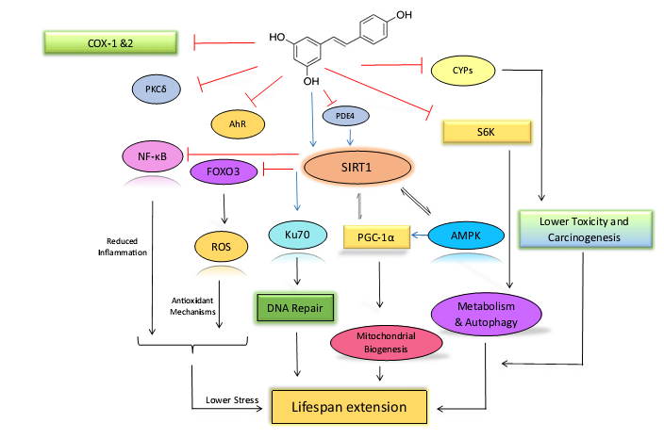
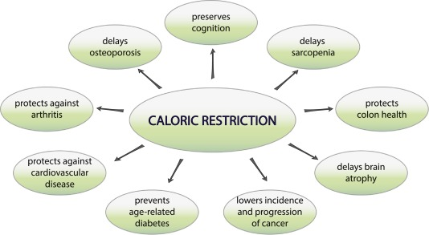



Introduction

Slide 4
Results and Discussion 1: K_{F} for Oxyresveratrol/NSs
Fluorescein
Fluorescein/OXY
[CD-NS] µM
[OXY] µM
K_{F} = 1.20 x 10⁵M⁻¹± 1.23 x 10⁴ M⁻¹

Slide 5
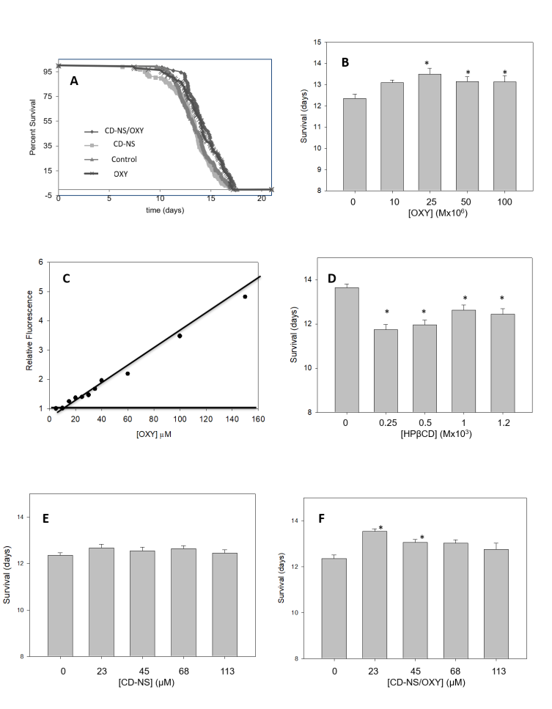
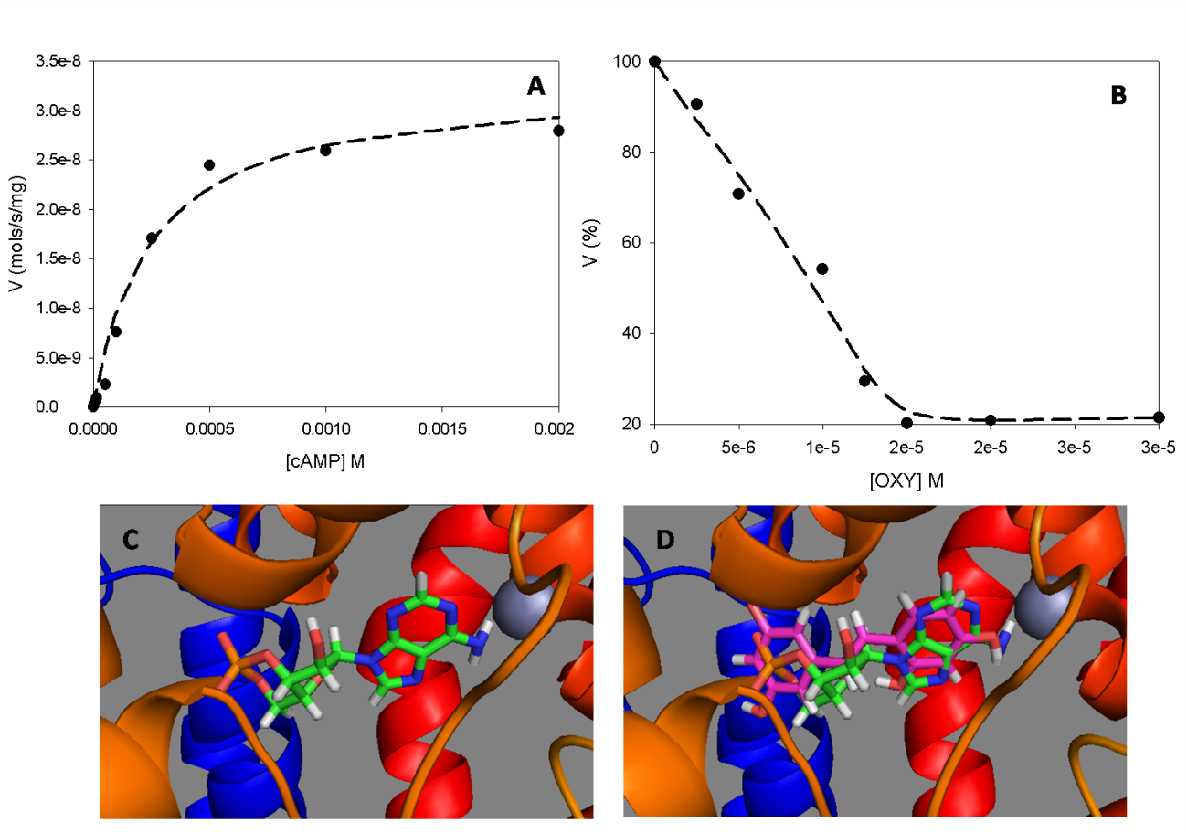

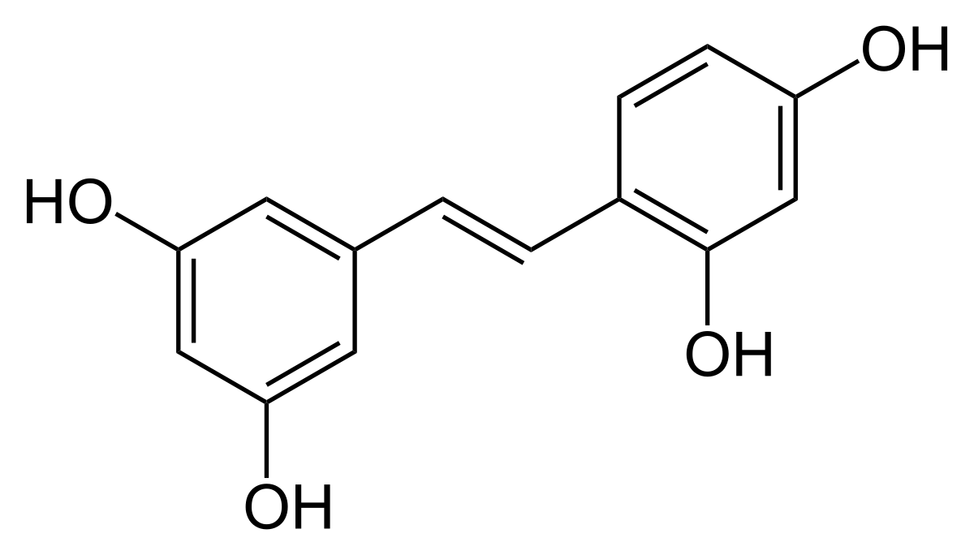

Results and Discussion 2: Effect of OXY against PDE4 and in in vivo lifespan

Slide 6
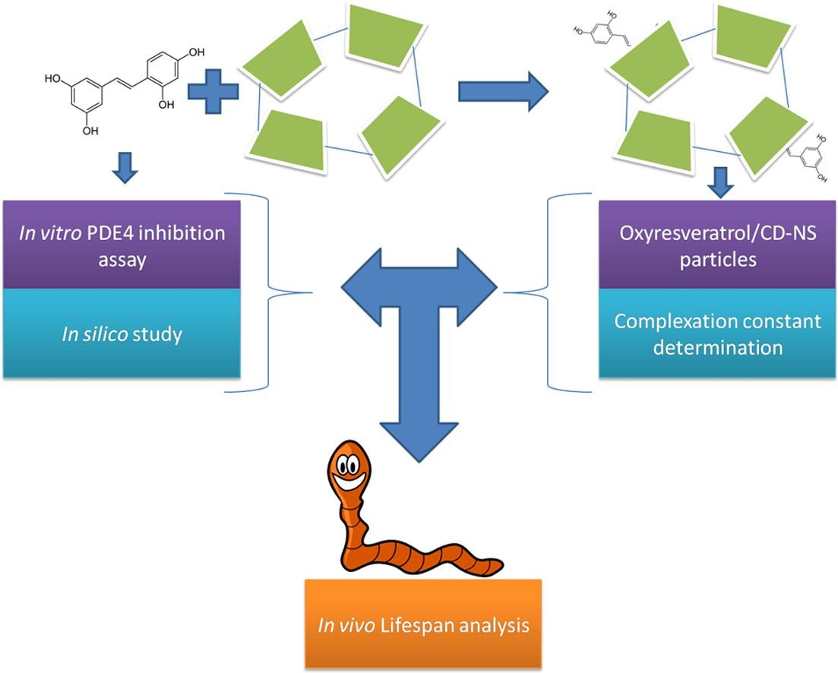
Supplementary Materials
Original article with the complete information:
Matencio, A., Guerrero-Rubio, M. A., Caldera, F., Cecone, C., Trotta, F., García-Carmona, F., & López-Nicolás, J. M. (2020). Lifespan extension in Caenorhabditis elegans by oxyresveratrol supplementation in hyper-branched cyclodextrin-based nanosponges. International Journal of Pharmaceutics, 589, 119862 - https://www.sciencedirect.com/science/article/pii/S0378517320308474?via%3Dihub

Slide 7




Acknowledgments
Thanks for your attention

