Slide 1
Topic
Potential of different sources of sulfur in mitigating cadmium-induced toxicity in mustard
IQBAL RASHID MIR
GK-1966
Advanced Plant Physiology and Biochemistry Lab
Aligarh Muslim University, Aligarh

Slide 2
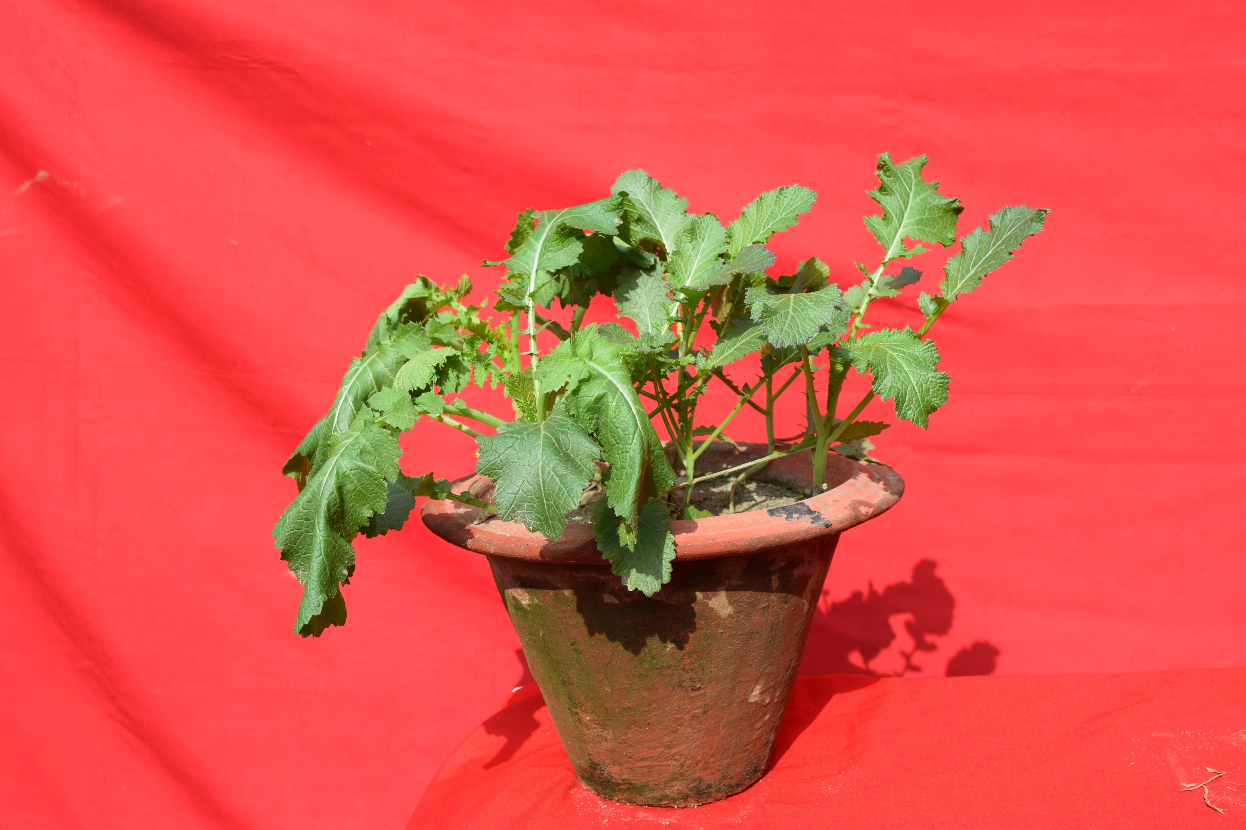
Indian mustard (Brassica juncea L.)
Brassica juncea belongs to the family Brassicaceae (Cruciferae) commonly called as mustard family.
It is amphidiploid bearing chromosome number 18.
Some important species of Brassica which are extensively used for oil extraction are B. juncea (Indian mustard), B. campestris var. sarson (Yellow sarson), B. campestris var. dichotomo (Brown sarson), B. campestris var. toria (Lahi) and Brassica napus (Kali sarson).

Slide 3
Cadmium(Cd)
The heavy metal, Cd is commonly released into the arable soil from industrial processes and farming practices, and has been ranked No. 7 among the top 20 toxins.
Even at low concentrations, Cd is toxic for most of the plants at concentrations greater than 5–10 μg Cd g-1 leaf dry weight, except Cd-hyperaccumulators which can tolerate Cd concentrations of 100 μg Cd g-1 leaf dry Weight.
Cd toxicity in plants results in generation of ROS that causes cell death due to oxidative stress such as membrane lipid peroxidation, protein oxidation, enzyme inhibition and damage to nucleic acids.
Brassica juncea cultivars have differential ability to accumulate and detoxify Cd which plays a significant role in expression of high tolerance in crop plants to Cd toxicity and therefore acts as an efficient tool in phytoextraction.
It has been found that different cultivars of Brassica juncea differ in their ability to extract and detoxify Cd. Therefore smart slection of plant cultivars with the ability to detoxify Cd could be best strategy to counter inhibitory effects of Cd in crop plants.

Slide 4
Experimental setup
CdCl₂ was used as a source of Cd and was added to pots at the time of sowing.
The level of Cd used in the experiment was 200 mg Cd Kg⁻¹ soil.
Four different sources of S used were, elemental S (Sº), ammonium sulfate [(NH₄)₂SO₄], gypsum (CaSO₄.2H₂O) and magnesium sulfate (MgSO₄) for obtaining 200 mg S Kg⁻¹ soil. 200 S was selected from our previous work (Khan et al. 2015).
Plants were grown either with 200 mg Cd, elemental S, ammonium sulfate, gypsum, and magnesium sulfate or in combined treatment of Cd + elemental S, Cd + ammonium sulfate, Cd + gypsum and Cd + magnesium sulfate.
Plants fed only with water served as control.
Elemental S was given 15 days before sowing while as all other sources were supplied at the time of sowing. Treatments in all the experiments were arranged in a factorial randomized block design, and the number of replicates for each treatment was four (n=4).

Slide 5
The following parameters were studied at 40 DAS.
A- Plant growth
B- Photosynthetic characters
Chlorophyll content
Net photosynthesis
Stomatal conductance
Fv/Fm Values
C- Oxidative stress
(i) Hydrogen peroxide content
Plant fresh weight
Plant dry weight
Leaf area

Slide 6
The following parameters were studied at 40 DAS.
D- Antioxidant metabolism
Superoxide dismutase activity
Glutathione reductase activity

Slide 7
RESULTS

Slide 9
The effect of Cd stress on B. juncea growth under different S forms was examined in terms of plant fresh biomass, plant dry biomass, and leaf area. Plants subjected to 200 Cd showed a decline in fresh biomass by 17.90%, dry biomass by 26.66%, and leaf area by 8.45% relative to control plants (Fig 3 A-C).
Plants recieving S in different forms showed a subtle increase in all the afore-said growth biomarkers in plants without stress, and elemental S showed a maximum increase of 53.64%, 71.28%, and 56.40% respectively versus control.
Furthermore, significant amelioration of Cd toxicity was seen in plants receiving different S sources, but this increase in growth was less pronounced than S treated non-stressed plants.
In Cd exposed plants, application of elemental S enhanced considerably fresh biomass by 20.61%, dry biomass by 28.71%, and leaf area by 24.59% compared to control and conspicuously restored the damage caused by Cd.

Slide 11
The plants raised in presence Cd 200 exhibited reduced leaf gas exchange parameters (P_{N}, gs, and C_{i}), chlorophyll content, maximal PS II efficiency, and Rubisco activity in B. juncea plants.
Cd supplementation considerably abridged P_{N} (22.21%) gs (19.86%), C_{i} (30.65%) and chlorophyll content (21.22%), in comparison to control.
Although under non-stressed conditions, photosynthetic attributes were enhanced by all the four S sources and elemental S reported an imminent upsurge in increasing above-said attributes among other S forms.
However, Cd stressed plants when treated with S sources curtailed Cd-induced photosynthetic inhibition and elemental S showed more prominent effect than other three S sources and increased P_{N}, gs, C_{i} and chlorophyll content by 28.99%, 64.27%, 32.27%, and 34.25% respectively compared to control (Fig. 2 A-D).
. Moreover, 200 Cd also reduced PSII efficiency by18.32% and Rubisco activity by 27.53%.
However, the follow-up application of different sources of S to Cd treated plants relieved the ill effects of Cd on PSII efficiency and Rubisco activity

Slide 12
H₂O₂ content
Cd toxicity lead to substantial intensification in H₂O₂ content by 2.23 times compared to control plants.
Application of different S sources moderated the production of oxidative marker produced as a consequence Cd toxicity and recovered the oxidative damage, with elemental S treated plants showing most prominent reduction of all than control plants.
However H₂O₂ accretion was more obvious in magnesium sulfate treated plants, which recorded the highest increase in stress biomarker by 1.7 times among all S forms under excess Cd over control (Fig. 5 I, J).

Slide 14
Plants exposed to Cd showed a subtle increase in the activities of all the two antioxidants by 91.48%, and 52.83% and this increase was higher than stress-free plants supplied with different S sources, indicating the response of plants inherent defense capability to counter oxidative stress
Furthermore, plants treated with various S forms exhibited an outburst in antioxidant activities and showed the most befitting response by increasing activity of SOD and GR enzymes under Cd exposure.
The performance of antioxidant activities of SOD and GR was recorded highest using elemental S (3.59 times and 2.16 times ) respectively with respect to control

Slide 15
Conclusion
In summary, it may be said that 200 S was found more effective in counteracting Cd stress.
The greater S availability reduced oxidative stress.
The S supply as elemental sulfur increased enzymatic and non-enzymatic antioxidant for detoxification of Cd stress.
Thus, supplementation of S as elemental S could be used in soils contaminated with Cd to get improved growth and photosynthesis.
This addendum also demonstrated the role of different S sources (elemental S, ammonium sulfate, gypsum, and magnesium sulfate) and their response towards Cd and that elemental S was more significant among all S sources in detoxifying Cd-induced phytotoxicity.
In conclusion, we can say that S application to mustard plants in appropriate concentration and form could be an effective approach to guarantee the safe and sustainable growth of mustard plants under elevated Cd levels.

Slide 16
Thanks

