Slide 1
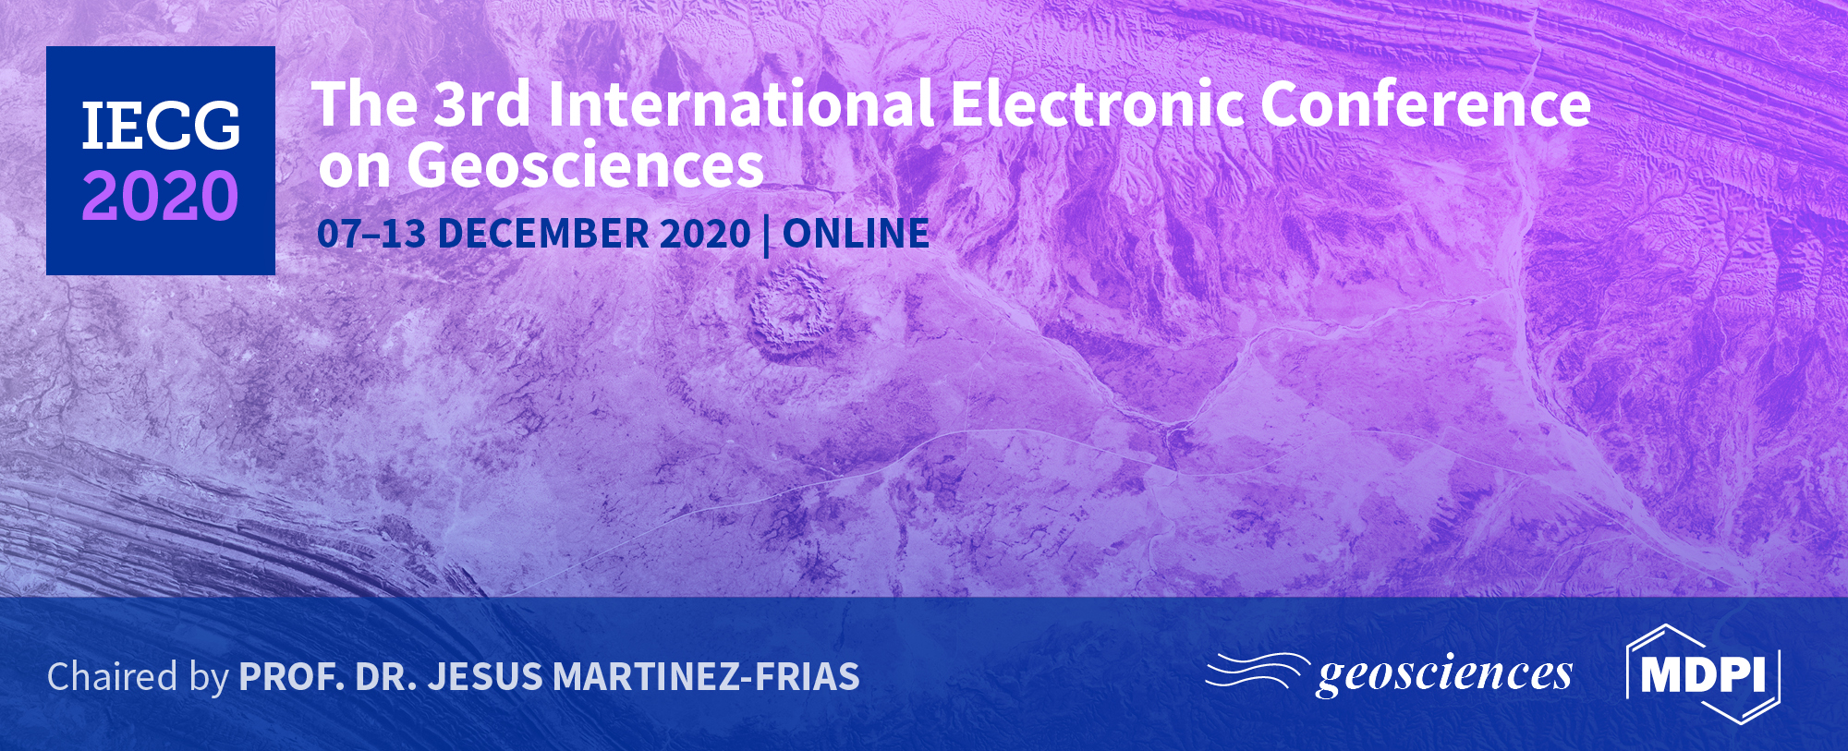
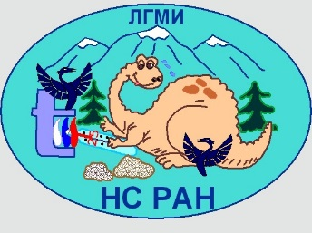
Title of the Presentation
Kseniia Nepeina¹
Hybrid adaptation scientific investigations and mentoring system in geopolygons conditions
¹ Research Station RAS in Bishkek,
Bishkek-49, RS RAS, Chu region, Kyrgyzstan;
.
* Corresponding author: nepeina.k@mail.ru

Slide 2
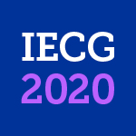
Abstract: In this work, the view of a series of practical research-and-educational activities and mentorship within the institute Research Station RAS in Bishkek (RS RAS) are presented. STEM learning on-site, specifically related to the Earth sciences, is important. RS RAS in Bishkek is studying geodynamics, stressed and deformed state and deep structure of Tien Shan, seismotectonic, geoenvironmental and engineering-geological aspects. All field activities have been continued and have been made by special groups of maximum 3 persons. At the RS RAS a mentorship program within the organization for mentees is introduced. However, COVID-19 quarantine forced us to make mostly online seminars for organization staff and provide online educational training for the students of American University of Central Asia (AUCA) and Kyrgyz Russian Slavic University (KRSU). Under the support of the Rossotrudnichestvo the agreement on scientific and technical cooperation between the Kyrgyz National University named after Jusup Balasagyn and the RS RAS was signed on September 30th, 2020. I admit that the new remote technologies should be included in future development because the accessible geophysical equipment degrades rather quickly and especially because of daily use and temperature changes.
Keywords: geopolygon; field training; mentorship;
on-site education; online training

Slide 3
Outline
Traditional model
Geopolygon conditions
Mobile technologies
Results and Conclusions

Slide 4
Research Station RAS in Bishkek (RS RAS)
RS RAS (http://www.gdirc.ru/en) is an academic institution and is a part of Bishkek Geodynamic Proving Ground of the International Research Center (IRC BGPG) with the Multiple-Access Geosciences System (MAGS) (http://ckp-rf.ru/ckp/500801/ is studying geodynamics, stressed and deformed state and deep structure of Tien Shan, seismotectonic, geoenvironmental and engineering-geological aspects.
Tectonics, Volume: 29, Issue: 6, Zubovich et al., 2010, DOI: 10.1029/2010TC002772
Map of the central Tien Shan and surroundings showing topography, shallow‐focus seismicity, selected cities, and the trace of the Talas‐Ferghana fault (TFF). The red box iondicates Bishkek Geodynamic Proving Ground within the Tien Shan.
Some of the employees are involved in the educational process with the basic universities in Kyrgyzstan, situated in Bishkek city: Kyrgyz-Russian Slavic University (KRSU), American University of Central Asia (AUCA) and Kyrgyz National University named after Jusup Balasagyn (KNU)

Slide 5
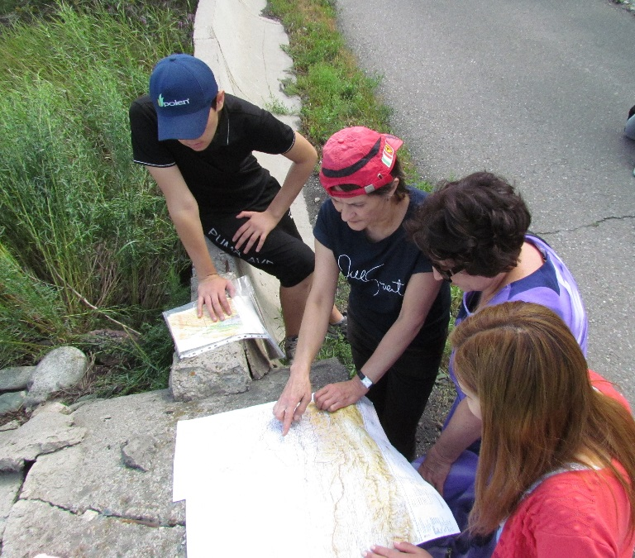
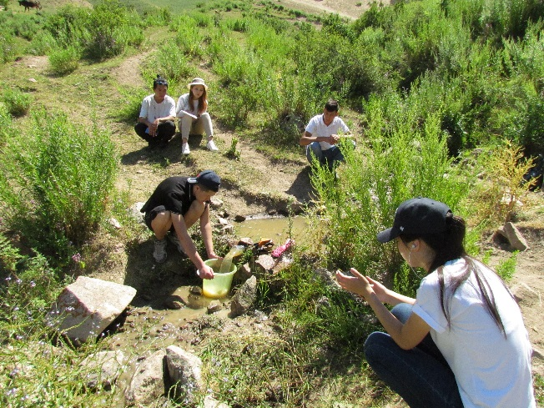
STEM learning on-site: traditional model for outdoors
For the internships and trainings RS RAS uses the geopolygons - test sites, under the historical view of a series of practical research-and-educational activities.
(photo credit © RS RAS)
Geomorphological complexes
Matching geomorphological features with the on topographic maps of different scales
The connection of geomorphological complexes with hydrogeological structures in the river canyons in BGRG
Processes of physical weathering;
Exogenous processes (erosion, landslides, suffusion, the surface activity of water springs
Physical properties of minerals, their structural structures and forms of occurrence in nature
An individual report preparation

Slide 6
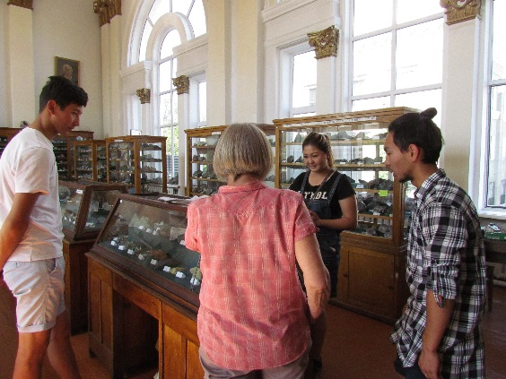
STEM training on-site: traditional model for indoors
(photo credit
© RS RAS)
At the KRSU faculties, the following disciplines are in the program:
Geophysics
Mining geophysics
Basics of mining and oil and gas business
Construction geotechnology
Measurements in a physical experiment
Hydrogeology
Programming languages and methods, Object-oriented programming, System software, Computer graphics

Slide 7
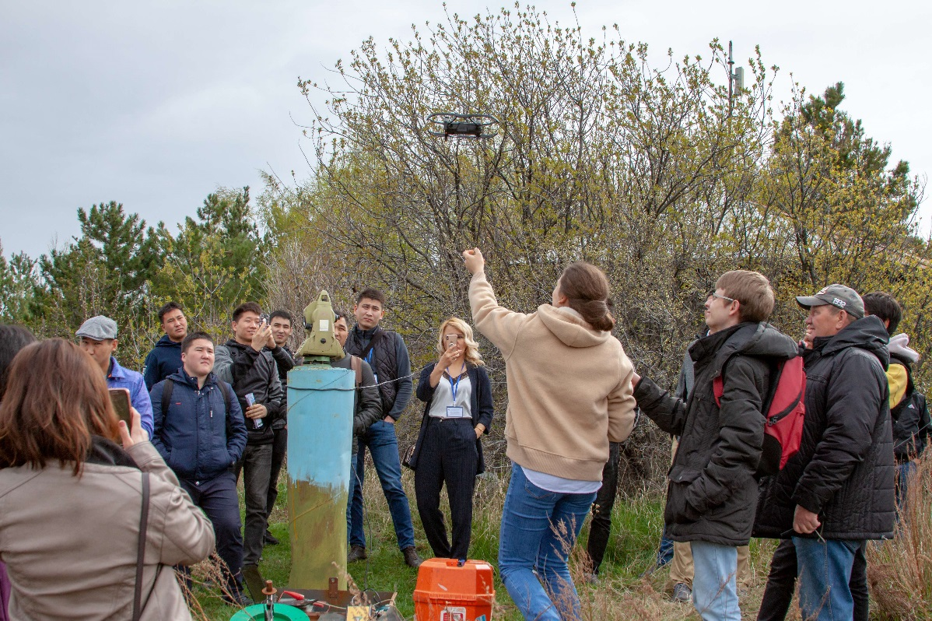
Geopolygon
Field demonstration of the quadcopter shot by the Global Positioning System laboratory RS RAS
Equipment exhibition for the magnetotelluric investigations.
The activity was made during the conference for young scientists, PhD and graduate students in 2018
The activity was made during the conference for young scientists, PhD and graduate students in 2018
(photo credit © RS RAS)

Slide 8
COVID-19: hybrid adaptation in geopolygons conditions
It means the joint approach to work (provide scientific investigations and mentorship) either online in web space or offline in natural outcrops.
All data storage from on-site stationary monitoring points of BGPG has been still 50/50 offline/online. All field activities have been continued and have been made by special groups of a maximum of 3 persons.
This adaptation follows the GEO major goals [Pedersen et al., 2009]:
1. Use Internet tools that are intuitive, that are relevant to "real" life
2. Make this new technology accessible to an ever wider community
3. Use the technology to promote project-based experimentation, field measurements, and data interpretation
4. Create and support an environment wherein mentee and mentors can communicatу without barriers in a different form (as video, filming, creation, programming, etc.)

Slide 9
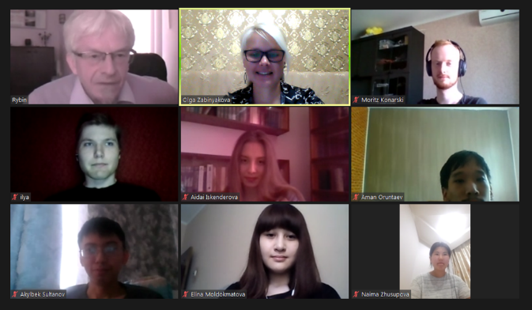
Mobile technologies: online
The webinars could be now documented – they are recorded, so the questions and specific difficulties can effect of the future training programs on the core participants, as well on the total research group. However, some troubles occurred due to a lack of computing power and memory, free Skype version and unstable internet connection.
Mobile technologies
Skype
Webex
Zoom
Microsoft Teams
Other Platforms
The first meeting RS RAS staff with the students of the American University of Central Asia
Zoom app screenshot
(photo credit © RS RAS)

Slide 10
Mentoring system
Mentoring
Training / Learning
Support: advice
Success: direction, build the leadership skills
Goal matching: improve knowledge or become an expert
Sharing the experience
Socializing
Communication and
Comprehension skills
Team work
Practical research
and other researchers review, leadership skills
Confidence and
Independence
Collective ethics
Researcher identity
Individual advantages
Personal area of interest for professional development
The own pace of understanding
The mentor's role of “being a guide” involved providing specific guidance on things that they have already experienced to the mentees. Also the field where the mentees are unfamiliar with and when individuals are tasked with a developing goal to train geological-and-mining or computational tests on the verified tested area.

Slide 11
Results and Discussion
Internal webinar of the Laboratory of deep magnetotelluric investigations (LDMI) consolidated around 10 participants via Skype. Since January 2020 we produce 34 webinars about equipment for electromagnetic (EM) methods, EM theory, geological-and-geophysical interpretation, geoelectric anomalies and noise correction, features of digital processing and direct modeling for the impedance calculation.
Under the support of the Rossotrudnichestvo the Kyrgyz National University named after Jusup Balasagyn (KNU) and the Research Station RAS in Bishkek signed the agreement on September 30th, 2020.
Conclusions
(photo credit © KNU)
The hybrid adaptation as the online and offline approach was launched successfully. The educational trainings were passed with new tools and in different conditions under the creativity and enthusiasm of tutors, faced the modified way.
However, the stress rate of webinars preparation and studying in remote conditions pose some other difficulties: resolving technical difficulties beforehand (e.g. inadequate access to resources such as computers, webcams, reliable internet, and learning spaces free of distractions), self-management and self-control, developing digital literacy and netiquette.

Slide 12
Acknowledgments
The research is partly funded by the state assignment of the Ministry of Science and Higher Education of the Russian Federation for the Research Station of the Russian Academy of Sciences (AAAA-A19-119020190063-2).
I thank the ideological support of the international cooperation on scientific and technical cooperation between the Kyrgyz National University named after Jusup Balasagyn (KNU) and the Research Station RAS in Bishkek under the support of the Federal Agency for the Commonwealth of Independent States Affairs, Compatriots Living Abroad, and International Humanitarian Cooperation (Rossotrudnichestvo). I especially acknowledge my colleagues to share their experience and to be involved in mentorship, trainings and webinars.

