Slide 1
Fomes fomentarius extract decrease negative effects of cadmium ions at the early stages of barley development
Alexander Ermoshin *, Irina Kiseleva, Olga Sinenko, Irina Nikkonen, Viltor Novikov
Ural Federal University, Lenin av., 51, Ekaterinburg, Russia, 620000
* Corresponding author: Alexander.Ermoshin@urfu.ru

Slide 2
Abstract:
Cadmium ions are toxic to living organisms and cause oxidative stress. Looking for anti-toxicants with antioxidant, antiradical and chelating activity is promising therefore. Fomes fomentarius is one of the most common wood-destroying fungi in Eurasia; though its chemical composition and biological effects were not studied sufficiently.
This work is aimed to study separate and joint effects of fungal extracts and Cd²⁺ (250 μM) on barley seedlings. Cd²⁺ caused 95% decrease in root length compared to control (water) and fungi extract (2 mg / ml) - 25%. Twice diluted extract stimulated root growth by 12%. The changes in shoot length were not so prominent: 44% decrease in the case of Cd²⁺ and 36% in fungi extract (2 mg / ml), and 20% stimulation at lower extract concentration.
The joint action of Cd²⁺ and extracts (1 mg / ml) has shown that the root length was 30% of control, which is 6 times higher than in the case of Cd^{2+.} The shoot length was one third higher compared to Cd²⁺ and reached 71% of the control.
Thus, addition of tinder fungus extract (1 mg / ml) reduced the negative effect of Cd²⁺but did not completely block it. Perhaps this effect was associated with the high content of phenolic compounds in the extract (3.5 μg/ml) and their antioxidant activity. The ABTS* test showed that extract inhibited the formation of radicals by 51%, which is comparable to standard antioxidant rutin. We suggest that Fomes fomentarius extract could be tested further as a bio-based product, reducing toxic effect of heavy metals.
Keywords: barley, growth, stress, cadmium, Fomes fomentarius

Slide 3
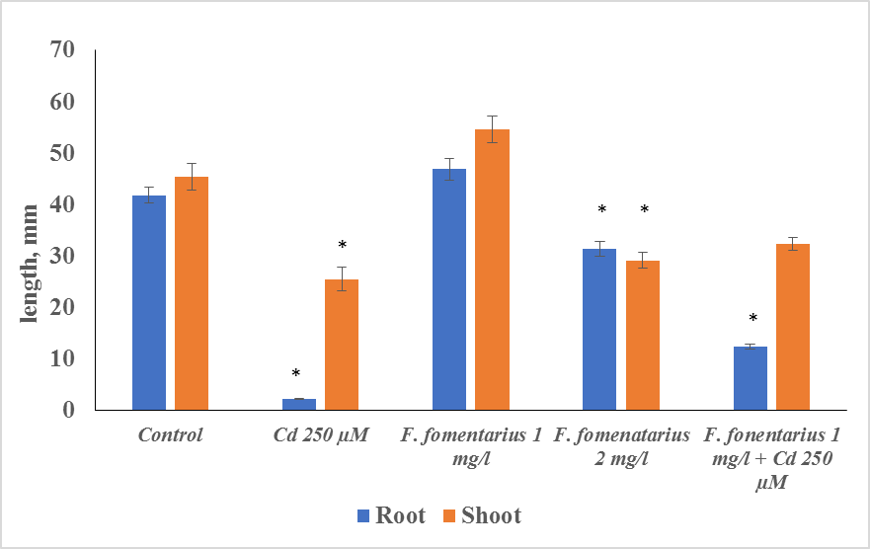
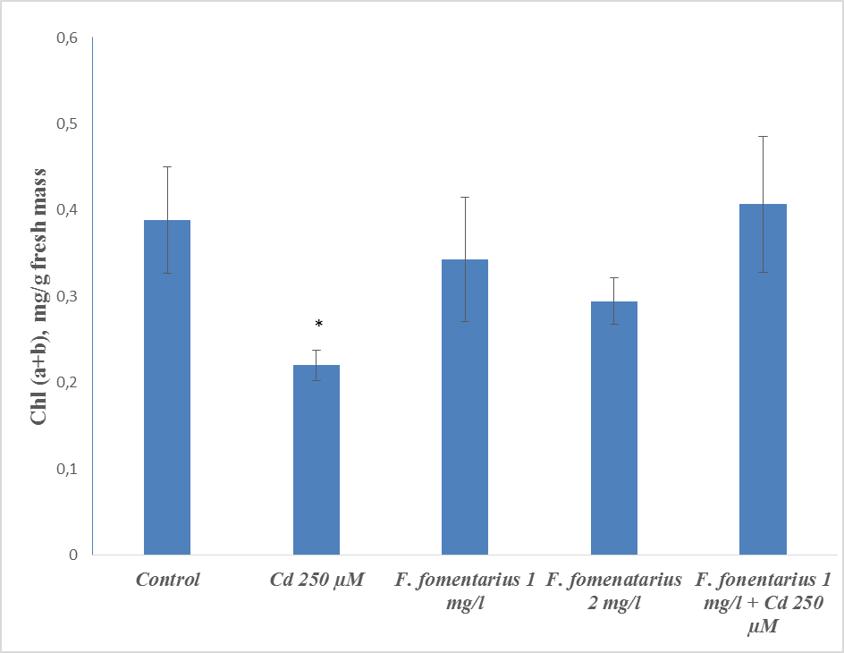
Results
Barley root and shoot length under the influence of Cd²⁺ and Fungi extract
* - significantly different from the control at p <0.05
Chlorophyll content in barley leaf under
the influence of Cd²⁺ and Fungi extract

Slide 4
Discussion
The addition of F. fomentarius extract (1 mg / ml) reduced the negative effect of Cd²⁺but did not completely block it. This effect was associated with the high content of phenolic compounds in the extract (3.5 μg / ml) and their antioxidant activity.
The ABTS* test showed that extract inhibited the formation of radicals by 51%, which is comparable to standard antioxidant rutin.
Thus, Fomes fomentarius extract could be tested further as a bio-based product, reducing toxic effect of heavy metals.

Slide 5
Conclusion
Cadmium ions are widely spread in contaminated soils, and are highly toxic to plants. To a greater extent, they affect the growth of roots than shoots, which may be related to the barrier function of the root.
Our study have shown that the use of low concentrations of extracts (1 mg / ml) obtained from Fomes fomentarius practically do not suppress plant growth and also reduce the negative effect of cadmium ions (250 μM) in the case of joint application.
The widespread habitation of F. fomentarius, its availability and the possibility of cultivation in vitro, and low effective concentrations make it possible to recommend this biological resource for the production of bioprotective preparations for plant growing.

Slide 6
Acknowledgments
The research was supported by The Ministry of Education and Science of the Russian federation Agreement no.02.A03.21.0006

