Slide 1
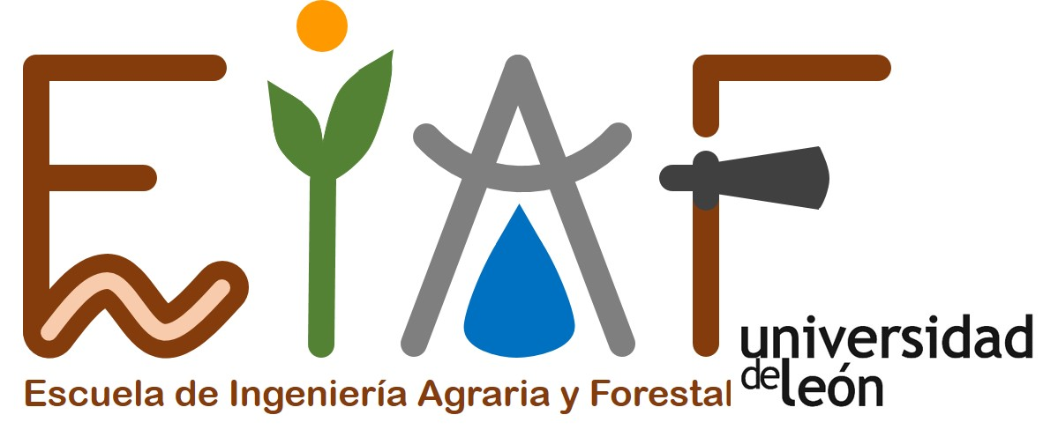
Effects of Cymbopogon winterianus and Ocimum basilicum against the stored Phaseolus vulgaris bean pest, Acanthoscelides obtectus
Álvaro Rodríguez-González ¹*, Óscar González-López ¹, Sara Mayo-Prieto ¹, Guzmán Carro-Huerga ¹, Sara Del Ser-Herrero ¹, Samuel Álvarez-García ¹, Alicia Lorenzana ¹ and Pedro A. Casquero ¹
¹ Grupo Universitario de Investigación en Ingeniería y Agricultura Sostenible (GUIIAS). Instituto de Medio Ambiente Recursos Naturales y Biodiversidad (INMARENBIO). Escuela de Ingeniería Agraria y Forestal (EIAF). Universidad de Leon. Avenida de Portugal 41, 24071, León, Spain.
* Corresponding author: alrog@unileon.es

Slide 2
Abstract: Acanthoscelides obtectus, is an insect pest that attacks wild and cultivated common beans, Phaseolus vulgaris L. There is an increasing demand in the search for new active substances and natural plant products for pest control for the reduction of adverse effects on human health and environment. This investigation evaluated under laboratory conditions, three doses (24, 60 and 120 µL) of Cymbopogon winterianus and Ocimum basilicum essential oils over bean seeds placed in Petri dish in which A. obtectus insects were added before. Treatments of bean seeds with different doses provided different survival on A. obtectus adults. The essential oils affected the development of A. obtectus insects since the greatest doses applied on beans decreased the emergence of insects. Also, reduced the number of exit holes of insects by damaged beans and the bean weight lost, from 2,987% (control treatment) to 1,014% and 1,221% with the dose 120 µL of C. winterianus and O. basilicum, respectively. The ability of both doses of C. winterianus and O. basilicum to reduce their longevity, their subsequent emergence from insects, and protect the bean seeds, make these essential oils a suitable tool for the control of adults of this insect pest in small storages.
Keywords: Bean pest; essential oils; insecticidal properties;
development, emergence; bean damage.

Slide 3
Results and Discussion
Table 2: Survival of A. obtectus insects exposed during 15 days on Petri dishes to beans sprayed with different doses of C. winterianus and O. basilicum essential oils and controls
Treatments | Insects |  |  |  | Mean* |  | Median |  | Overall comparisons**
 | Alive | Dead | Dead (%) |  | Estimate±SE |  | Estimate |  | Χ² | df | P
Control | 76 | 24 | 24.00 |  | 22.68±0.48eª |  | 23.00
C. winterianus (24µL) | 42 | 58 | 58.00 |  | 20.23±0.41dA ^{b} |  | 20.00 |  | 0.571 | (1,198) | 0.450
O. basilicum (24µL) | 41 | 59 | 59.00 |  | 20.56±0.52dA |  | 20.00
C. winterianus (60µL) | 27 | 73 | 73.00 |  | 19.55±0.41cA |  | 20.00 |  | 0.021 | (1,198) | 0.884
O. basilicum (60µL) | 40 | 60 | 60.00 |  | 19.12±0.53bcA |  | 19.00
C. winterianus (120µL) | 9 | 91 | 91.00 |  | 17.89±1.06bB |  | 17.00 |  | 7.591 | (1,198) | 0.006
O. basilicum (120µL) | 17 | 83 | 83.00 |  | 16.01±0.31aA |  | 16.00
* Test of equality of survival distributions for all treatments (Log Rank; Mantel-Cox) (Chi-Square (Χ²)=103.071; df=6,693; P<0.001). ** Test of equality of survival distributions between treatments (Log Rank; Mantel-Cox). ª Different lowercase letters indicate significant differences among different dose of essential oils and control; (P < 0.05). ^{b} Different capital letters indicate significant differences between essential oils within same dose; (P < 0.05).
Insects subjected to 120µL of C. winterianus and O. basilicum essential oils had a significantly lower survival than insect that were subjected to lower doses, as 91.00 and 83.00% of the evaluated insects died with C.winterianus and O. basilicum essential oils, respectively.
Insects subjected to 120µL of O. basilicum oil had an estimate of 16.01 days of life, significantly lower than that obtained in the rest of doses and the control (22.68 days). If we compare the same doses of both essential oils, only insects subjected to the 120µL of O. basilicum had a significantly lower survival than the insects that were subjected to the 120µL dose of C. winterianus (17.89 days).

Slide 4
Results and Discussion
Table 3: Number of damaged beans (mean ± SE), number of holes per bean (mean ± SE) and bean weight loss (% ± SE) caused by A. obtectus adults emerged from 40 g of beans treated in Petri dishes with different doses of C. winterianus and O. basilicum essential oils.
Essential oil | Dose (µl) | Number of damaged beans (with at least one hole) | Number of holes per bean damaged | Bean weight loss (%)
-- | Control | 4.60 ± 0.98a ¹ | 3.66± 0.88ab ¹ | 2.98 ± 0.3a ¹
C. winterianus | 24 | 5.60 ± 0.40a | 2.14 ± 0.19bc | 2.00 ± 0.31bc
 | 60 | 4.60 ± 0.40a | 2.61 ± 0.23abc | 1.76 ± 0.36bcd
 | 120 | 5.00 ± 1.14a | 1.91 ± 0.16c | 1.01 ± 0.09d
O. basilicum | 24 | 3.60 ± 0.75a | 3.83 ± 0.87a | 2.10 ± 0.31b
 | 60 | 6.00 ± 1.26a | 1.98 ± 0.46c | 1.91 ± 0.44bc
 | 120 | 5.20 ± 1.06a | 1.68 ± 0.22c | 1.22 ± 0.13cd
F |  | 0.726 | 2.745 | 4.547
df |  | 6.28 | 6.28 | 6.28
P |  | 0.633 | 0.032 | 0.002
¹ Different lowercase letters indicate significant differences among beans treated with different doses of essential oils and control; LSD test at 0.05.
Applications of different doses of C. winterianuss and O. basilicum over beans reduced A. obtectus attack, reducing significantly the number of holes per bean affected by the insects. Beans treated with the highest doses (120µl) had a significantly lower number of holes per bean than the 24µl doses (2.14 and 3.83 holes per bean with C. winterianus and O. basilicum, respectively) and control (3.66 holes per bean).
Beans incubated with A. obtectus (previously treated with different doses of C. winterianus and O. basilicum essential oils) showed weight losses ranging between 1.01% (120 μl dose of C. winterianus) and 2.10% (24 μl dose of O. basilicum), while beans under control treatment had a weight loss (2.98%) significantly higher than the rest of doses evaluated.

Slide 5
Conclusions
O. basilicum and C. winterianus essential oils affected the development of A. obtectus insects since the greatest doses applied on beans decreased the emergence of the bean weevil.
Also, they reduced the number of exit holes of insects per damaged bean and the bean weight loss, from 2.,987% in control treatment, to 1.014% and 1.221% with 120 µL of C. winterianus and O. basilicum, respectively.
The ability of both doses of C. winterianus and O. basilicum to reduce the insect longevity, their subsequent emergence from beans, and protect the bean seeds, make these essential oils a suitable tool for the control of adults of this insect pest in small storages.

Slide 6
Acknowledgments
This work was funded by the Ministry of Science, Innovation and Universities (Government of Spain), according to the Resolution of July 27, 2018, (BOE No. 184, of July 31) through the grant awarded to Álvaro Rodríguez González (PTA2017–14403-I).

