Slide 1
Effects of metformin on antioxidative response of Lactuca sativa plants.
Inês Leitão^{1*}, Miguel P. Mourato¹, Joana Sales¹,Maria Matilde Marques², Maria Conceição Oliveira², Luisa L. Martins¹
¹ LEAF - Linking Landscape, Environment, Agriculture and Food, Instituto Superior de Agronomia, Tapada da Ajuda, 1349-017 Lisboa, Portugal;
² Centro de Química Estrutural, Instituto Superior Técnico, Av. Rovisco Pais, 1, 1049-001 Lisboa, Portugal.
* Corresponding author: inesibleitao@isa.ulisboa.pt

Slide 2
Abstract: The occurrence of pharmaceuticals in the ecosystems is considered of growing concern since these compounds may affect different organisms, causing changes on their metabolism and possibly contributing to food chain contamination. Our study aims to understand how lettuce cope with metformin (MTF), evaluating the oxidative stress and other effects on the plant metabolism. Lettuce was produced in a hydroponic culture contaminated with MTF. After 1, 8 and 15 days plants were harvested and analysed. Enzymatic and non-enzymatic parameters were determined following spectrophotometric methods. Concentrations of H₂O₂ and MDA were obtained under MTF contamination, revealing differences on day 15. This study showed that MTF affected plant metabolism inducing oxidative stress and that different tissues responded differently to the abiotic stress caused. Antioxidative enzymes results showed different trends in roots and leaves indicating a specific role in the tolerance mechanism related with plant tissues. Enzymatic response indicated a more intense stress, and also a more effective response, in leaves than in roots. The antioxidative protection mechanism in leaves were mainly due to the activity of CAT, GPOD and APX, showing that these enzymes have an important role in the defence mechanism against toxic effect of MTF.
Keywords: enzymes; oxidative stress; hydrogen peroxide;
defense mechanisms.

Slide 3
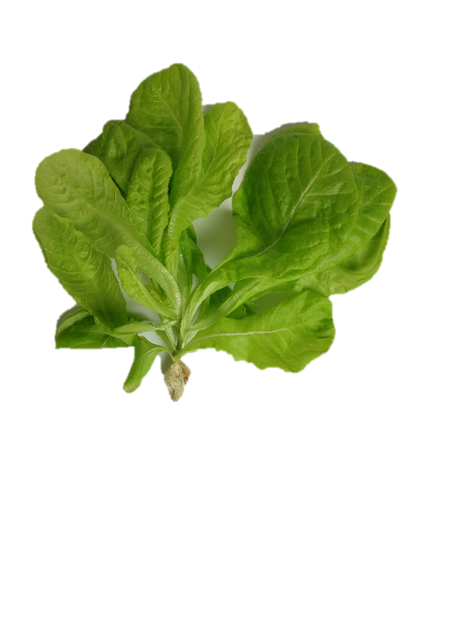
Results and Discussion
Scavenging processes
GPX activity in roots decrease over day 15 of exposure for all concentrations of MTF.
ROS
Leaves
Roots
↑SOD ↑CAT
↑GPOD ↑APX
↑CAT
↑GPOD
In leaves GPX revealed similar to control.
GR in leaves expressed an increasing trend occurred progressively on day 8 from 0.1 to 5 mg L⁻¹ MTF.
Regulation against oxidative stress caused in leaves.
MTF
Stress Indicators
Leaves
Roots
H₂O₂ MDA
H₂O₂ MDA
H₂O₂ Differences to control on every day of exposure
MDA No differences to control observed.
Both with more changes for longer exposure
Activation of defence mechanism and ROS scavenging?
Defense mechanisms are activated by cells in order to adapt and acclimate to abiotic stress caused by MTF presence.

Slide 4
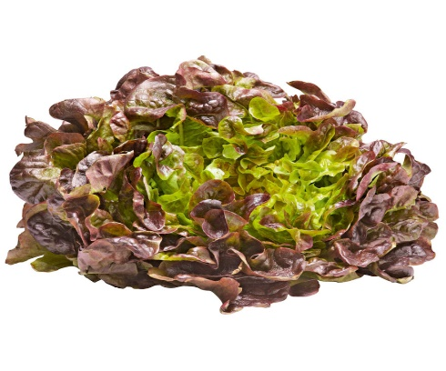
Conclusions
The results of enzymatic activity and stress indicators confirm that metformin induce oxidative stress in lettuce plants.
Model plant
Red leaf lettuce
Lactuca sativa L.
Induced abiotic stress by Metformin
Tolerance
Overall response to pharmaceuticals as emerging contaminants
Stress indicators
Activation of defense mechanisms
ROS scavenging enzymes revealed changes in both tissues, but in general, leaves were more affected than roots.
These results point to different responses according metabolism of radicular and foliar tissues.

Slide 5
Acknowledgments
Inês Leitão acknowledges funding from the Universidade de Lisboa in the form of a PhD grant. This work was partially supported by the FCT-funded research unit LEAF - Linking Landscape, Environment, Agriculture and Food (UID/AGR/04129/2013). Thanks are also due to RNEM, the Portuguese Mass Spectrometry Network (LISBOA-16 01-0145-FEDER-022125-IST).

