Slide 1
Karima Loucif^{1,2}, Abderrahmane Boulahrouf¹, Pierre Duez²
¹ Laboratory of Microbiological Engineering and Applications, University of Brothers Mentouri, Constantine 1, Chaâbat Erssas Campus, Ain El Bey Road, Constantine 25000, Algeria;
² Unit of Therapeutic Chemistry and Pharmacognosy Unit, Faculty of Medicine and Pharmacy, University of Mons (UMONS), Belgium
Thermophilic Actinobacteria Derived From Algerian Ecosystem as an alternative strategy for salt tolerance in Triticum durum

Slide 2
Problems
Plants face various biotic and abiotic stresses in adverse environmental conditions. salinity & phytopathogen fungi
I
II
Saline stress is the most serious threat because salt deposition on arable land turns cultivatable land into unproductive area

Slide 3
Aims
Determine the effect of six thermophilic actinobacteria isolated from saharan ecosystem of Southeast Algeria, under salinity stress, on :
I
Roots and Shoots elongation
II
Proline accumulation
III
Chlorophyll a, chlorophyll b and chlorophyll tot content

Slide 4
Aims
Investigate their antifungal potential against Aspergillus niger by estimation of Percentage Growth Inhibition of filamentous fungi

Slide 5
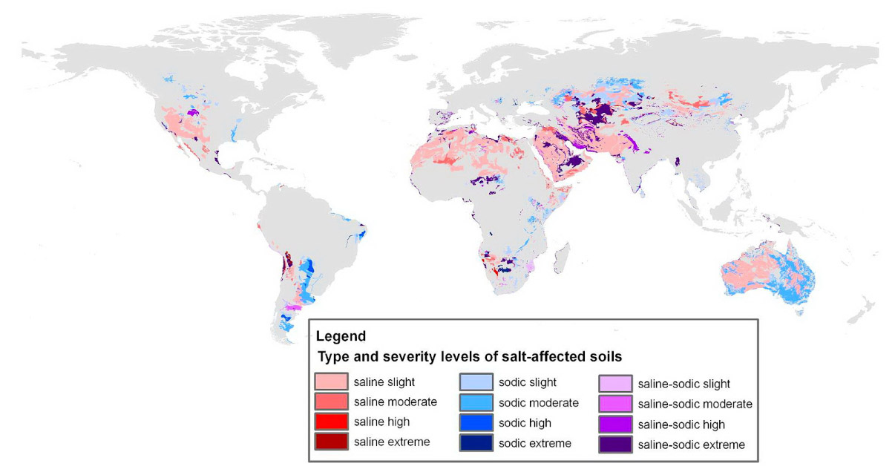
Web Site: https://www.salineagricultureworldwide.com/salinization

Slide 6
Experiments

Slide 7
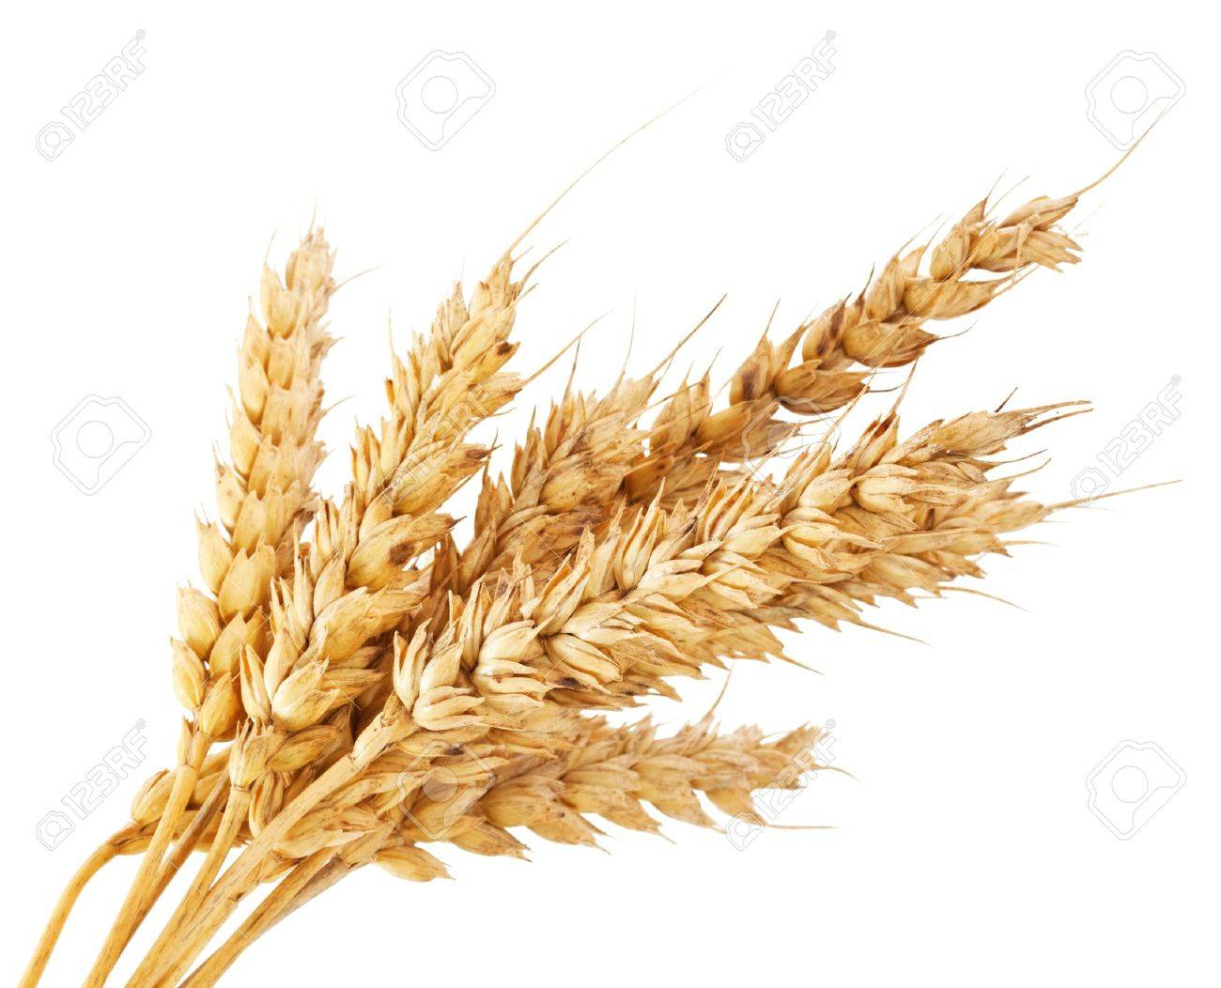
Screening for antifungal activity of actinomycetes isolates

Slide 8
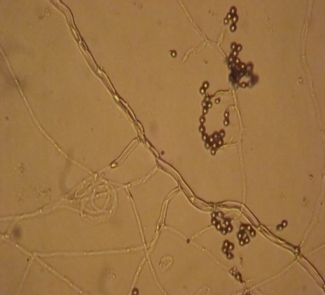
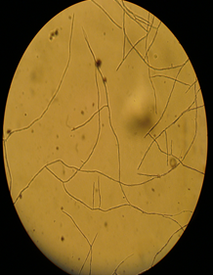
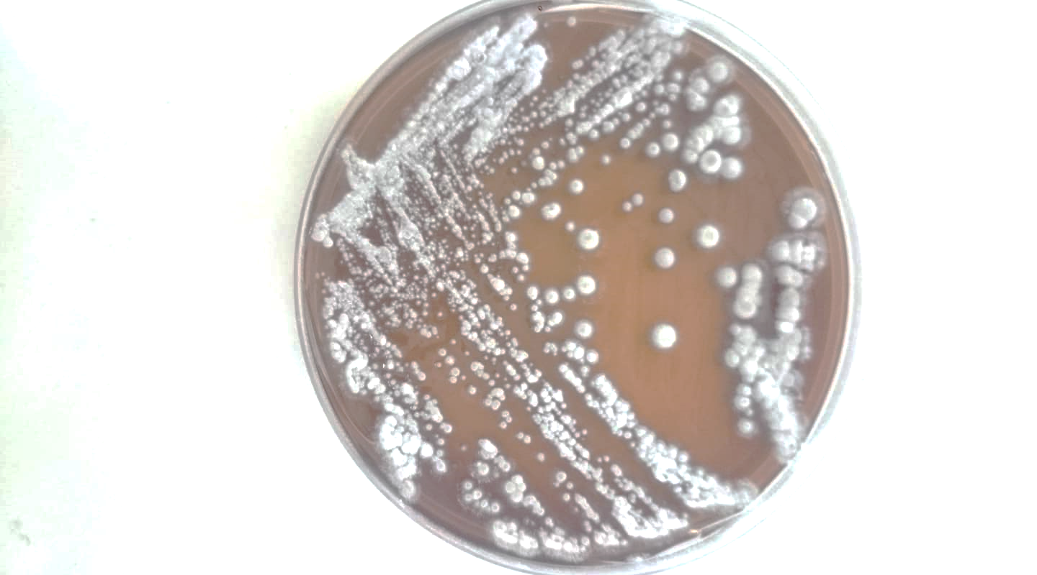
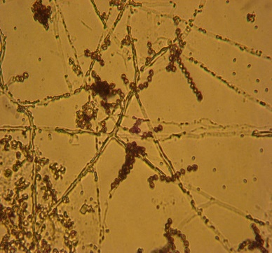
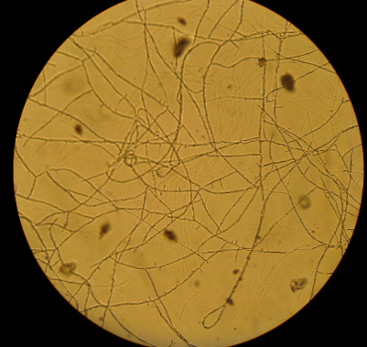
Actinomycete Strains
Fig. Microscopic aspect and culture character of thermophilic actinobacteria isolated from saharan soil of Algeria

Slide 9
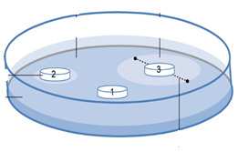
Agar Diffusion technique – Antifungi activity against Aspergillus niger provided by National Intitute of Agronomic Research, Algeria
1st Step
Actinomycete strains culture for 7 days at 30 °C
On PELG, Bennett & GLM culture media
2nd Step
Incubation at 4°C for 4 h than at 25°C for 3 days

Slide 10
Results

Slide 11
Antifungal activity detection
Figure 1. Antifungal activity of actinomycete strains. (a) Number and percentage of active strains; (b) percentage growth inhibition. Results followed by same letters are not significantly different according to Tukey’s HSD post-hoc test (p > 0.05).

Slide 12
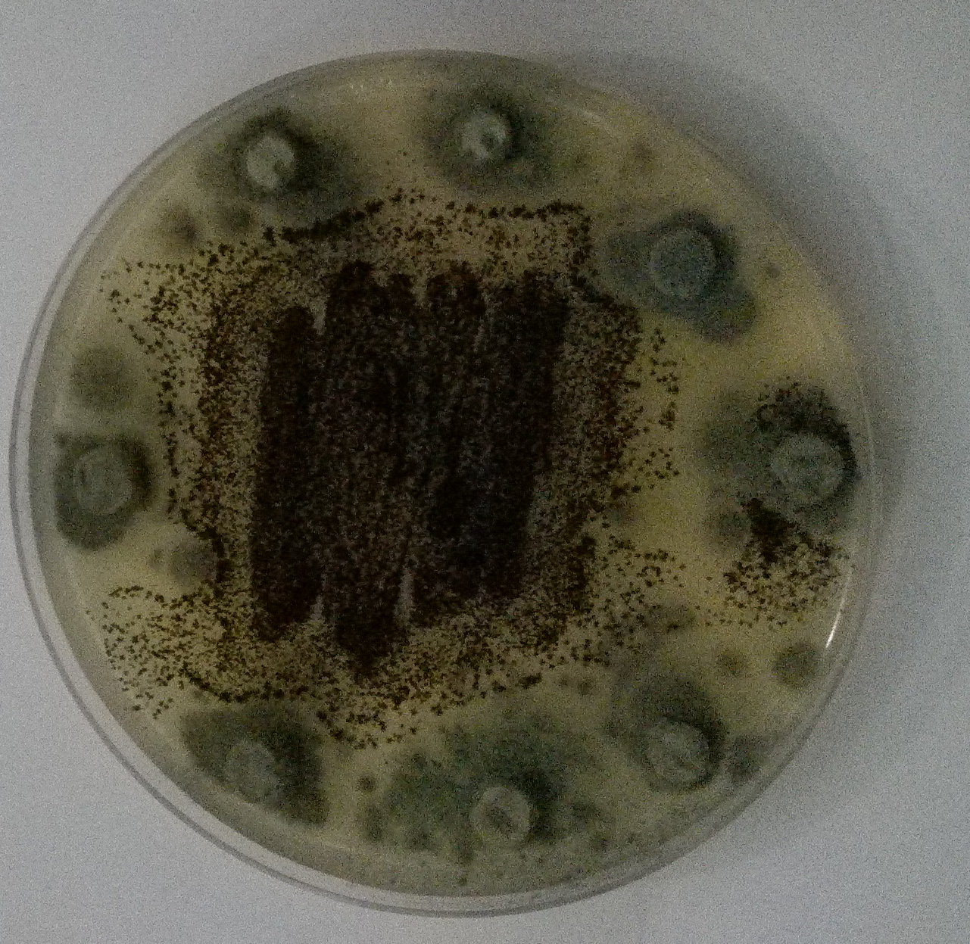
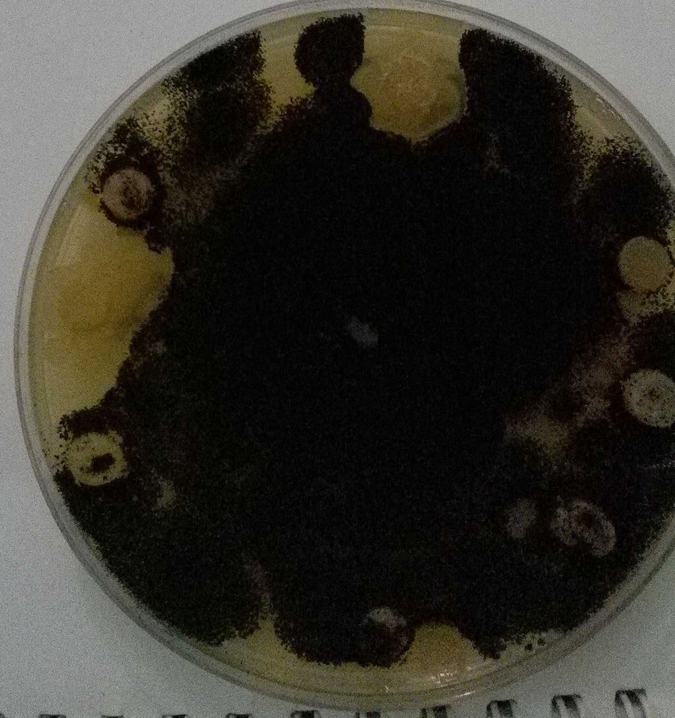
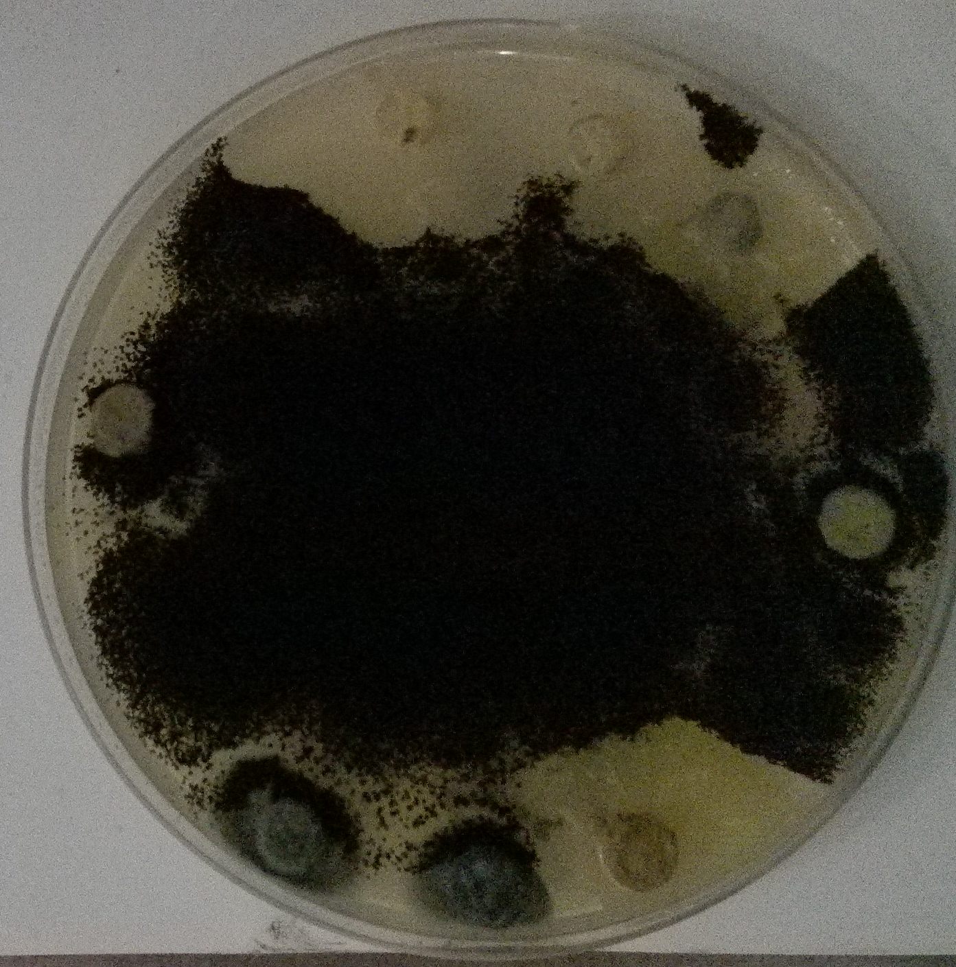
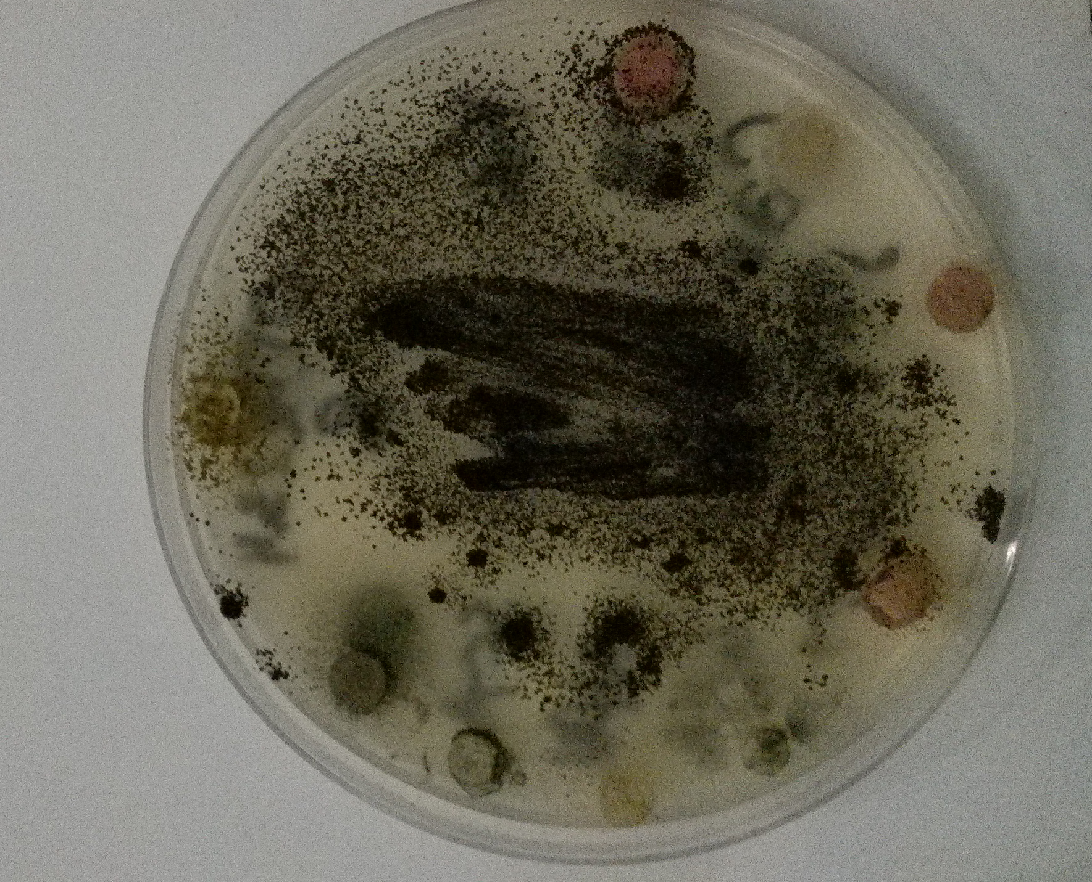
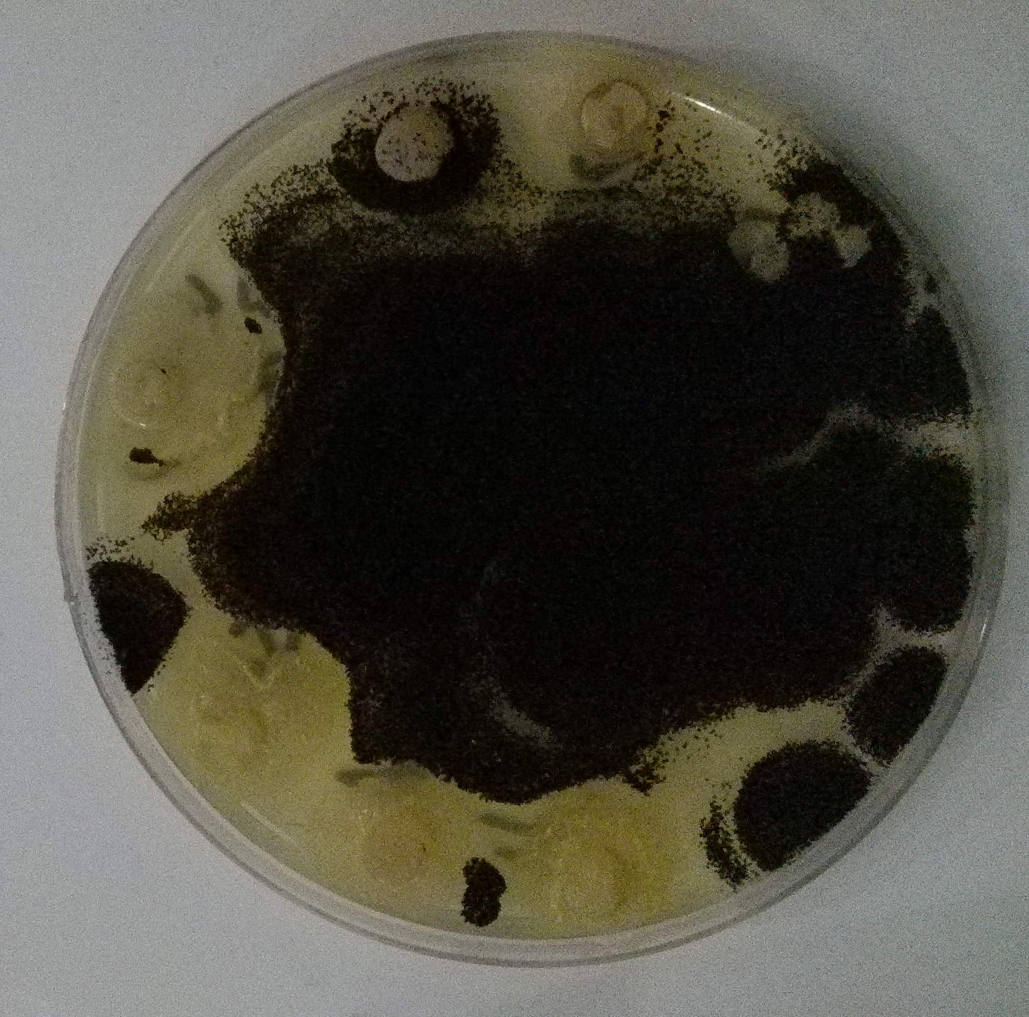
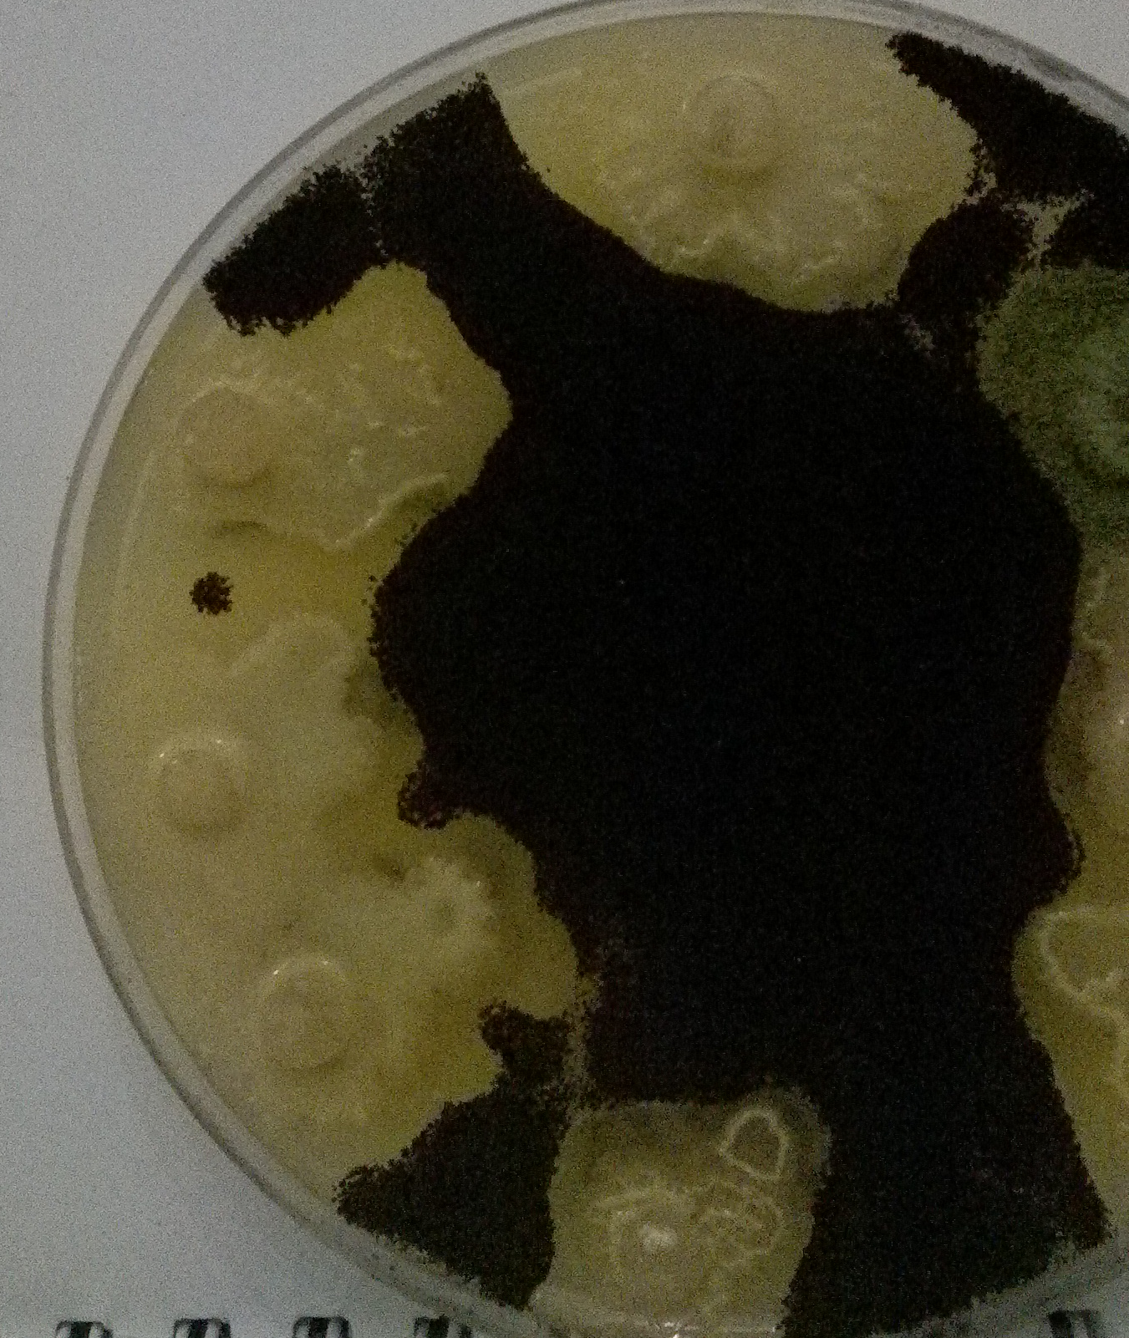
Fig 3. variation of inhibition zones diameter generated by thermophilic actinobacteria strains against Aspergillus niger

Slide 13
Effect of the actinomycete strains on seed germination of Durum wheat under saline stress

Slide 14
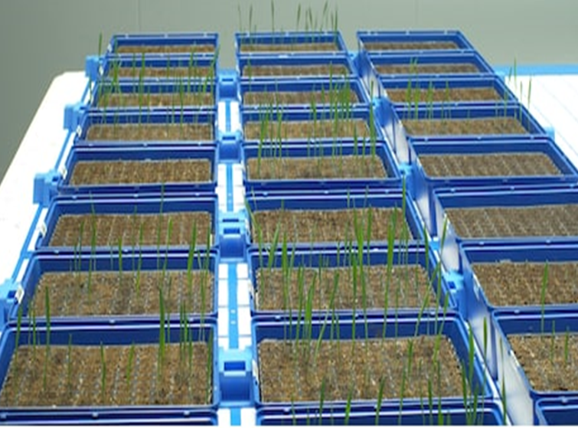
Greenhouse experience

Slide 15
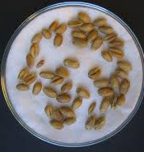
Plant analysis
** Root & Shoot lenghts
** Free Proline Content
** Chlorophyll a, Chlorophyll b & total Chlorophyll Contents:
Chl_{a} (mg L⁻¹) = 12.41 (OD 663) - 2.59 (OD 645)
Chl_{b} (mg L⁻¹) = 22.9 (OD 645) - 4.68 (OD 663)
Chl_{tot} (mg L⁻¹) = Chl_{a} + Chl_{b}
(1) Sterilization with sodium hypochlorite solution 20% (v/v)
(2) Rinsing several times with sterile distilled water
Different spore suspensions (10⁶ spores.mL⁻¹)
Irrigation with tap water twice a week for 7 days
Uninoculated seeds
Statistical analysis
** All data were presented as : (mean ± standard deviation)
** The data were analyzed using XLSTAT 2014 software
** One-way ANOVA (analysis of variance) was employed utilizing Tukey’s Honestly Significant Difference post-hoc test
Inoculated seeds
NaCl solutions (0M, 0,3M, 0,6M, 09M, 1,1M, 1,4M, 1,7M)

Slide 16
Results

Slide 17
b
c
Chl content (mg. mL⁻¹)
Lenght (cm)
Proline content (µg of proline. g FW⁻¹)
Figure 2. morpho-physiological parameters of Durum wheat uninoculated with the actinomycete strains. (a) contents of chlorophyll a, chlorophyll b and chlorophyll tot ; (b) Shoot and root lenght ; (c) Free Proline Content. Results followed by the same case letter are not significantly different according to Tukey’s HSD post-hoc test (p > 0.05)

Slide 18
Chl content (mg. mL⁻¹)
Chl content (mg. mL⁻¹)
Chl content (mg. mL⁻¹)
Chl content (mg. mL⁻¹)
Chl content (mg. mL⁻¹)
Chl content (mg. mL⁻¹)
Figure 3. Contents of chlorophyll a (Chla), chlorophyll b (Chlb), and total chlorophyll (Chltot) on Durum wheat inoculated with the selected actinomycete strains: (a) WSC2; (b) WGS9; (c) WCD; (d) OTH 2.2.2.3; (e) OTH 1.3.1; (f) OTH 1.2.2. The results followed by the same letter are not significantly different according to Tukey’s HSD post-hoc test (p > 0.05).

Slide 19
Lenght (cm)
Lenght (cm)
Lenght (cm)
Lenght (cm)
Lenght (cm)
Lenght (cm)
Figure 4. Shoot and root length (A), of shoots and roots of Durum wheat inoculated with the selected actinomycete strains : (a) WSC2 ; (b) WGS9 ; (c) WCD ; (d) OTH 2.2.2.3 ; (e) OTH 1.3.1 ; (f) OTH 1.2.2. Results followed by the same case letter are not significantly different according to Tukey’s HSD post-hoc test (p > 0.05).

Slide 20
Proline content (µg of proline. g FW⁻¹)
Proline content (µg of proline. g FW⁻¹)
Proline content (µg of proline. g FW⁻¹)
Proline content (µg of proline. g FW⁻¹)
Proline content (µg of proline. g FW⁻¹)
Proline content (µg of proline. g FW⁻¹)
Figure 5. Free Proline Content of Durum wheat inoculated with the selected actinomycete strains. (a) WSC2 ; (b) WGS9 ; (c) WCD ; (d) OTH 2.2.2.3 ; (e) OTH 1.3.1 ; (f) OTH 1.2.2. Results followed by the same case letter are not significantly different according to Tukey’s HSD post-hoc test (p > 0.05).

Slide 21
Conclusion

Slide 22
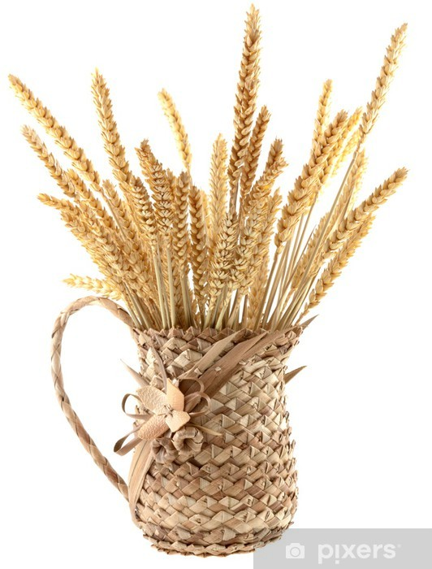
** Thermophilic Actinobacteria Strains can play a pivotal role in conferring salt tolerance in Durum wheat (Triticum durum Desf.) and a good in vitro antifungal control against the inhibitory effects of Aspergillus niger through its plant growth promoting activity.
** Therefore, it is plausible to mention that thermophilic actinobacteria are an effective approach for improving the growth of salt-sensitive plants and this strategy could be applied for sustainable agriculture.

Slide 23
References
[1] Riadh, K. ; Wided, M.; Hans-Werner, K.; Chedly, A. Responses of halophytes to environmental stresses with special emphasis to salinity. Adv Bot Res. 2010, 5 (3) : 117–145.
[2] Kitouni, M. ; Boudemagh, A. ; Oulmi, L. ; Reghioua, S. ; Boughachiche, F. ; Zerizer H et al. Isolation of actinomycetes producing bioactive substances from water, soil and tree bark samples of the north–east of Algeria. Journal de Mycologie Médicale. 2005, 15 : 45–51.
[3] Shukla, P. S. ; Agarwal, P. K. ; Jha, B. Improved Salinity Tolerance of Arachis hypogaea (L.) by the Interaction of Halotolerant Plant-Growth-Promoting Rhizobacteria. J Plant Growth Regul. DOI 10.1007/s00344-011-9231-y.
[4] Tavakoli, M. ; Poustini, K. ; Alizadeh, H. Proline Accumulation and Related Genes in Wheat Leaves under Salinity Stress. J. Agr. Sci. Tech. 2016, Vol. 18: 707-716.

Slide 24
Thank you for your attention

