Slide 1
Title of the Presentation
“New” solutions to the problem of poorly soluble drugs – the role of "green“ anti-crystal engineering
Lidia Tajber ^{1,}*, Hanah Mesallati¹, Julija Zotova¹, Żaneta Wojnarowska² and Anita Umerska¹
¹ School of Pharmacy and Pharmaceutical Sciences, Trinity College Dublin, College Green, Dublin 2, Ireland;
² Institute of Physics, University of Silesia, SMCEBI, 75 Pułku Piechoty 1A, 41-500 Chorzów, Poland.
* Corresponding author: ltajber@tcd.ie

Slide 2
Abstract: One of the areas of pharmaceutical research that has seen a significant surge in interest lies in the optimisation of physical forms of active pharmaceutical ingredients (APIs). Alterations of the solid form of APIs mostly aim at improving a drug’s solubility. Research has led to the development of various crystalline multicomponent API systems, such as salts and co-crystals, however the recent emphasis is on non-crystalline or weakly crystalline materials, such as amorphous solid dispersions, or less traditional forms, such as ionic liquids and (deep) eutectic mixtures. To design such systems, the principles of anti-crystal engineering might be applied, whereby the concept of synthon interactions is used to make a mixture with a weak or no crystallisation potential. For pharmaceutical applications, such a mixture will have a very desirable property – non-existent or very low crystal lattice (energy) allowing the drug molecules to be readily available for transport and absorption. This work concentrates on the mechanochemical, green approach to anti-crystal engineering. The concept of amorphous polymeric salts will be presented, with ball mill facilitating the proton transfer between the API and the polymer. Another example will show how mechanochemistry can facilitate the formation of ionic liquids.
Keywords: multicomponent system; amorphous polymeric salt; ionic liquid; solubility

Slide 3
Introduction – Multicomponent pharmaceutical systems
Several active pharmaceutical ingredients (APIs) show poor aqueous solubility
Research has led to the development of multicomponent API systems, including crystalline salts, co-crystals, eutectics, deep eutectic mixtures, ionic liquids and solid dispersions
These forms differ in their solid state behaviour, crystallisation propensity and degree of ionisation affecting solubility and bioavailability of APIs
There is no solution suitable for all APIs
Traditional salts are a “gold standard”:
Ionised molecules have better solubility
However, there might be a better option – ionise AND avoid (or at least reduce) crystallinity of multicomponent systems

Slide 4
Introduction – Mechanochemistry and green manufacturing
Multicomponent pharmaceutical systems can be prepared by mechanochemistry (a solvent-free or solvent-poor process)
Mechanochemistry is chemical synthesis enabled or sustained by mechanical force
A mechanochemical process in most cases involves milling, neat grinding or solvent-assisted grinding of chemical substances at ambient temperatures or with heating
Mechanochemical-based processes are regarded as environmentally-friendly (green)
Current pharma manufacturing processes typically consume considerable amounts of energy and water
Do and Friscic; ACS Cent. Sci. 2017, 3, 13-19.

Slide 5
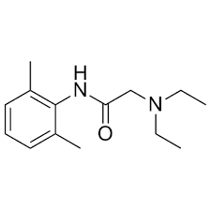
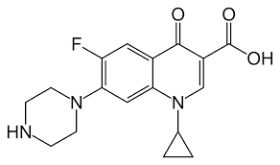
Results and Discussion
APIs
pK_{a1} = 6.1
pK_{a2} = 8.7
pK_{a} = 7.9
Ciprofloxacin (CIP)
Lidocaine (LID)
Counterions/coformers
n=3, glutaric acid
n=4, adipic acid
n=5, pimelic acid
n=6, suberic acid
Eudragit L100
Eudragit L100-55
Hypromellose acetate succinate -HPMCAS
Poly(acrylate) – Carbopol
Dicarboxylic acids
Acidic polymers
Eudragit L100-55
Classification of the multicomponent systems in question
SUPERCOOLED LIQUIDS
AMORPHOUS SYSTEMS
CRYSTALLINE SYSTEMS
Ionic liquids
Amorphous and polymeric salts
Ionic liquids/Salts
API ionised
(deep) eutectic mixtures
Solid dispersions
Eutectic/ Cocrystals
API unionised

Slide 6
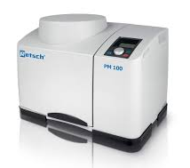
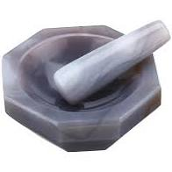
Results and Discussion – Mechanism of mechanosynthetic production
Polymer
(large molecule)
AMORPHOUS POLYMERIC SALT
+
+
+
+
+
+
+
+
+
Activation of surface
Disordered
system
Crystalline
system
+
-
-
+
-
+
-
API
-
+
+
-
+
-
+
-
-
+
+
-
+
-
+
-
-
+
-
+
Coformer/
Counterion
(small molecule)
IONIC LIQUID
(disordered/ supercooled)
IONIC LIQUID
(crystalline)
Retsch ball mill PM 100
Agate mortar and pestle

Slide 7
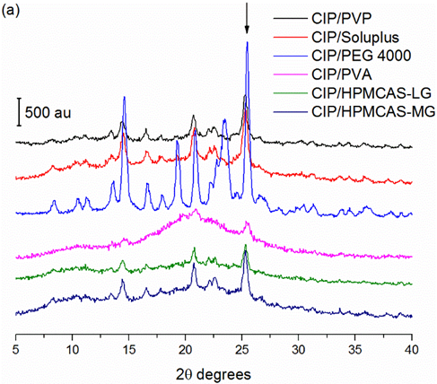
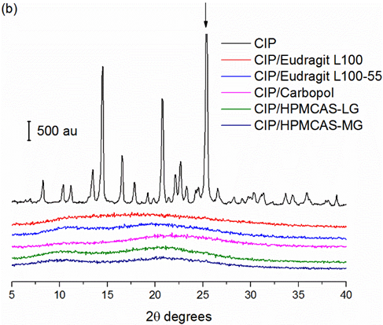
Results and Discussion – Reactivity of API (CIP)
PXRD
Ball mill, 400 rpm
Polymer content = 40% w/w
Polymer content = 40% w/w
except HMPCAS mixes = 60%
Amorphous polymeric salts
The peak at 25.3° 2θ indicates to the major slip plane in the crystal lattice of CIP and it is most likely to be persistent following ball milling
Mesallati et al.; Cryst. Growth Des. 2016, 16, 6574-6585.
Mesallati et al.; Mol Pharm. 2017, 14, 2209-2223.

Slide 8
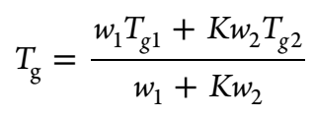
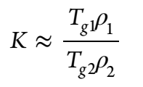
Results and Discussion – Intermolecular interactions (CIP)
Thermal analysis
T_{g} – glass transition temperature
Total signal
Heat flow traces from temperature modulated DSC (StepScan). Solid lines: specific heat curves. Dotted lines: isokinetic baseline curves
T_{g} CIP = 86.7 °C
Sample | Experimental T_{g} (°C) | Predicted T_{g} (°C) | ΔT_{g}
CIP/Eudragit L100 | 154.1 | 106.1 | 48
CIP/Eudragit L100-55 | 136.3 | 91.7 | 45
CIP/HPMCAS-LG | 112.4 | 104.9 | 7.5
CIP/HPMCAS-MG | 106.4 | 105.4 | 1
Gordon-Taylor eq.
Mesallati et al.; Mol Pharm. 2017, 14, 2209-2223.

Slide 9
Results and Discussion – Solubility studies (CIP)
Water, 37 °C
FaSSIF, 37 °C
Diffusion controlled mechanism
Dissolution controlled mechanism “Spring and parachute”
Effect of pH
Mesallati et al.; Mol Pharm. 2017, 14, 2209-2223.

Slide 10
Results and Discussion – Separating pH effects from supersaturation (CIP)
Henderson-Hasselbalch eq.
Mesallati et al.; Mol Pharm. 2017, 14, 2209-2223.

Slide 11
Results and Discussion - Reactivity of API (LID)
Polarised Optical Microscopy – room temperature studies of the interface
LID + glutaric acid (C5) → lidocainium hemiglutarate
Mechanism: solid interdiffusion; “submerged” eutectic as a product of a solid state reaction
LID + suberic acid (C8) → lidocainium hemisuberate
Mechanism: solid state reactivity; solid eutectic formation
Ionic liquids
Zotova et al.; ACS Sustain. Chem. Eng. 2020, accepted.

Slide 12
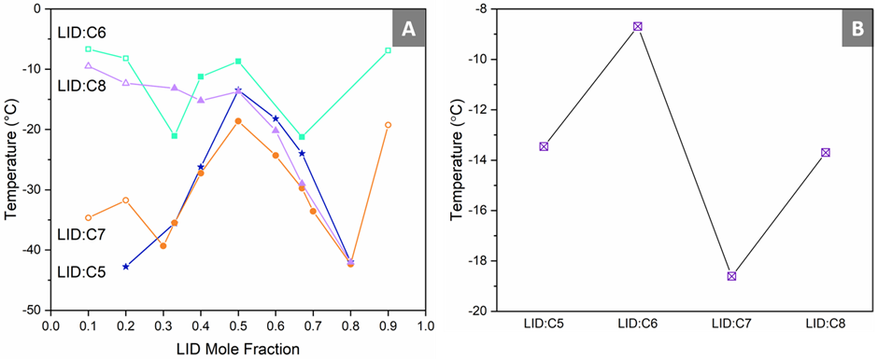
Results and Discussion - Intermolecular interactions (LID)
Thermal analysis
PXRD
LID + glutaric acid → lidocainium hemiglutarate
Ionic liquids
Extrapolated T_{g} LID = -63 °C
Infrared analysis
T_{g} values as a function of LID mole fraction
T_{g} values of the systems at equimolar compositions
Wojnarowska et al.; Phys. Chem. Chem. Phys. 2018, 20, 27361-27367.
Zotova et al.; ACS Sustain. Chem. Eng. 2020, accepted.

Slide 13
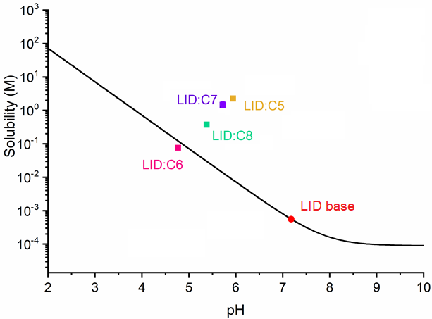
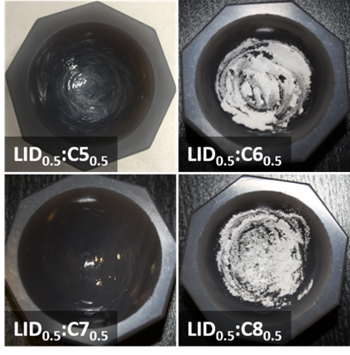
Results and Discussion – Preliminary solubility studies (LID)
pH-solubility curve for LID systems (water at 25 °C)
LID:C6 – “conventional salt”
LID:C5; LID:C7 and LID:C8 – ionic liquids
Zotova et al.; ACS Sustain. Chem. Eng. 2020, accepted.

Slide 14
Conclusions
Simple mechanochemical processing –involving just a proton transfer – is a promising method of formation of multicomponent pharmaceutical systems
Amorphous polymeric salts can be produced by neat grinding (ball mill)
Ionic liquids formed via different mechanisms depending of the counterion
The presence of ionic interactions increases the glass transition temperature of the systems
Aqueous solubility can be substantially improved by using “new” solutions such as amorphous polymeric salts and ionic liquids

Slide 15
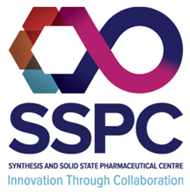
Acknowledgments
My research group, past and current members
Collaborators
Science Foundation Ireland, grant number 15/CDA/3602 (Career Development Award)
Science Foundation Ireland, Synthesis and Solid State Pharmaceutical Centre (SSPC), grant number 12/RC/2275
COST Action CA18112 - Mechanochemistry for Sustainable Industry
COST Action CA18112

