Slide 1
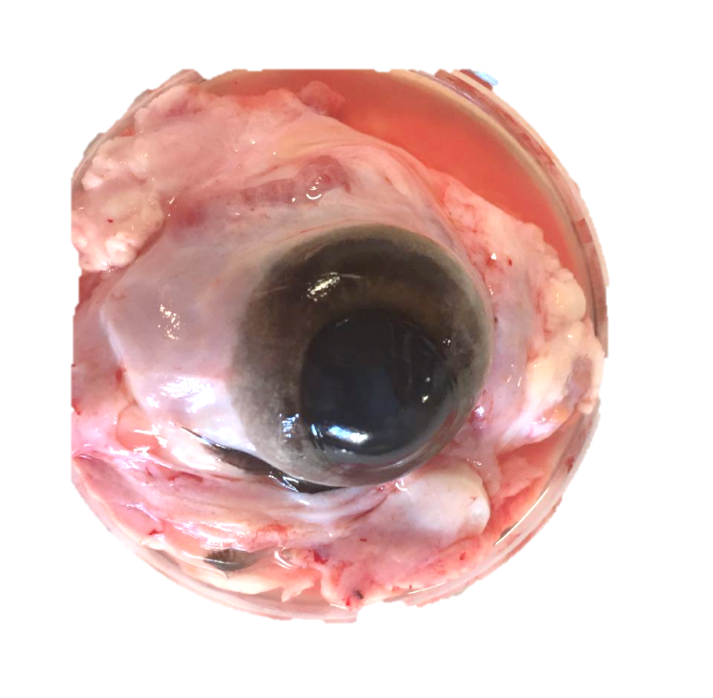
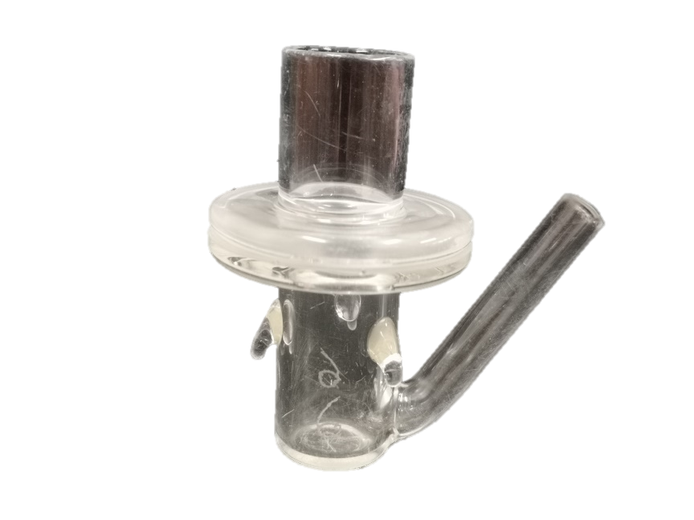
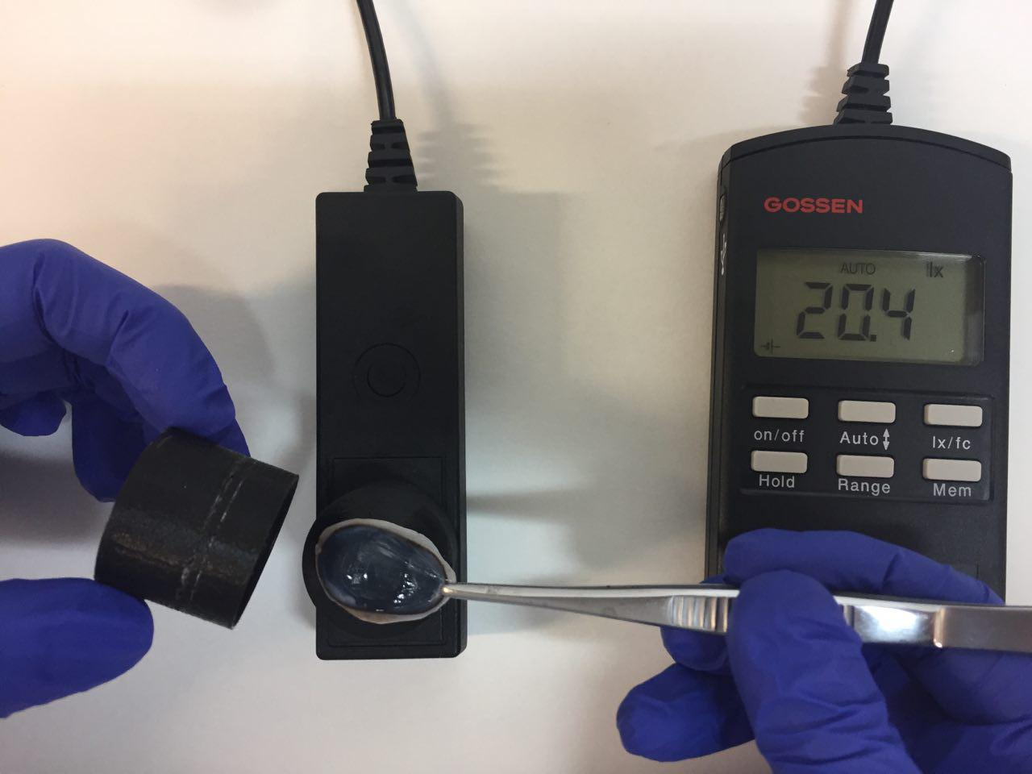
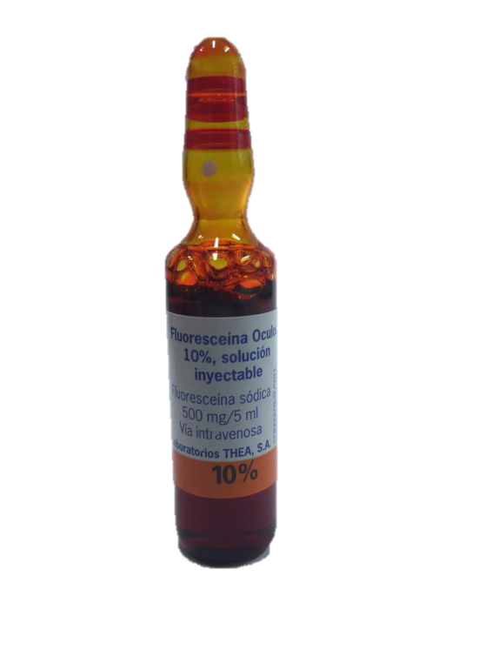
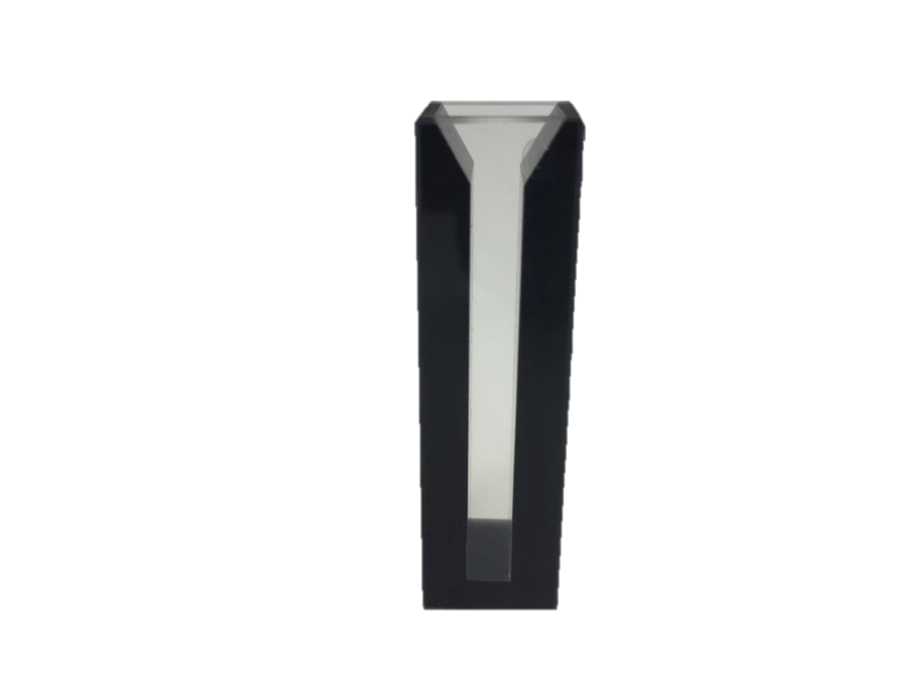
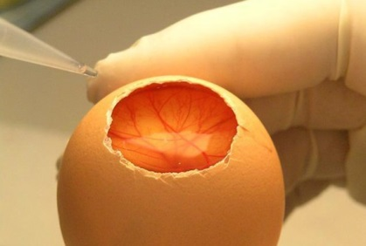
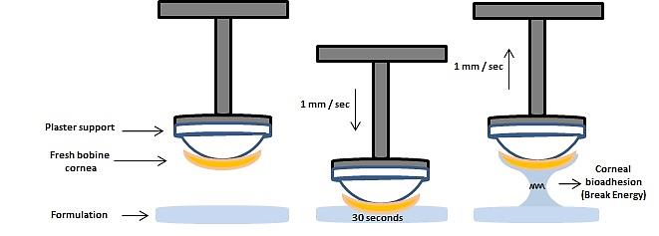
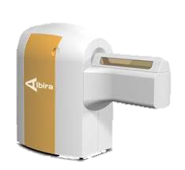
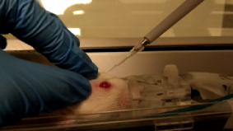
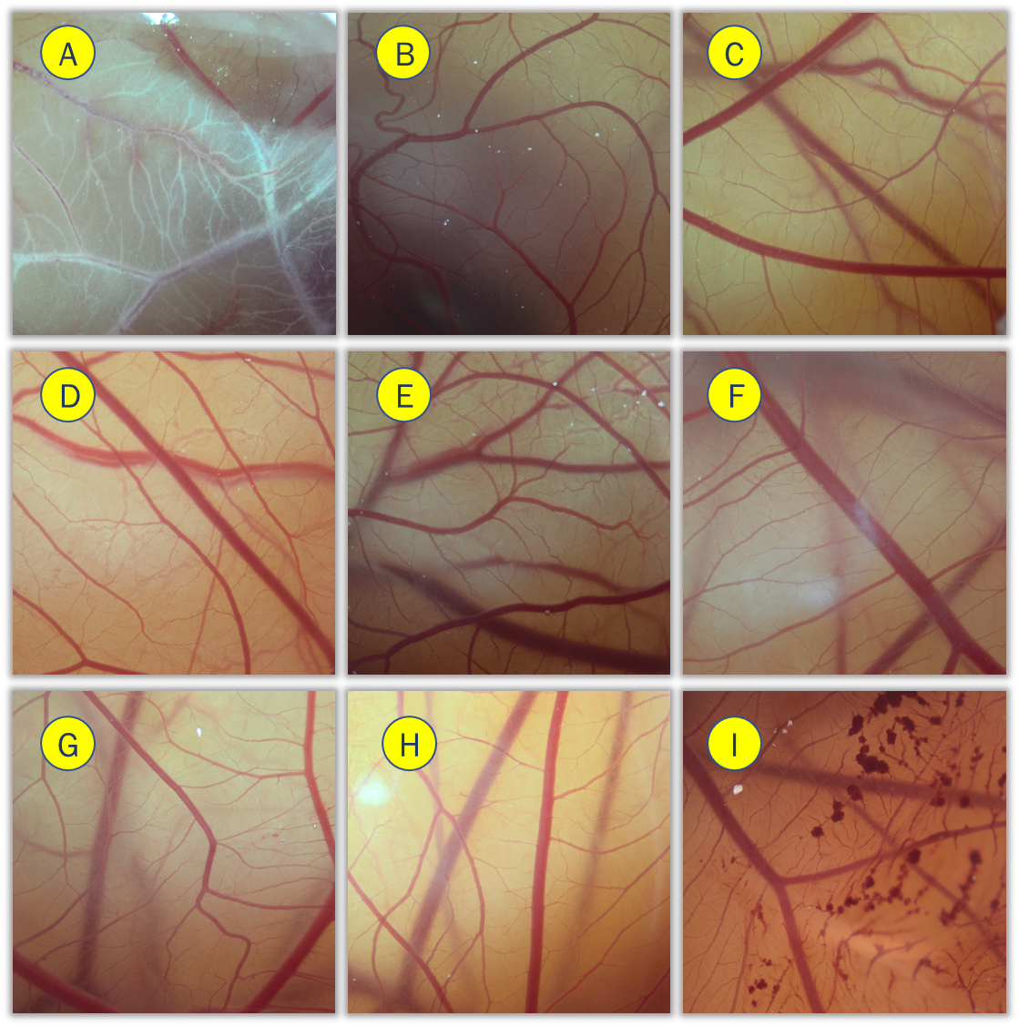
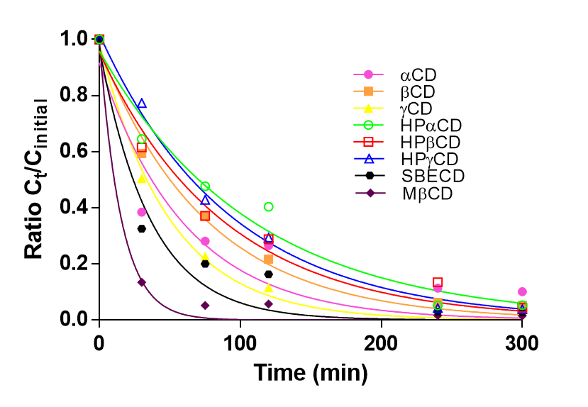
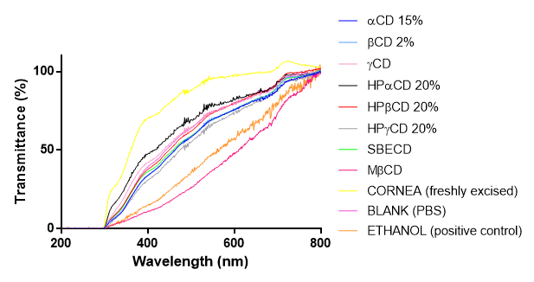
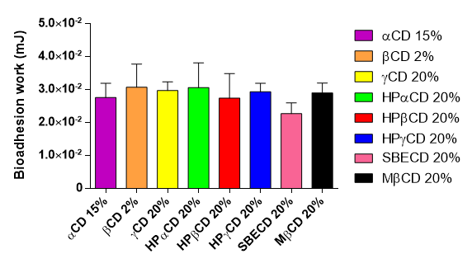
In vitro and in vivo ophthalmic bioadhesion and ocular safety characterization of cyclodextrin based-solutions.
Díaz-Tomé Victoria^{1,2} †, García-Otero Xurxo^{1,3} †, Varela-Fernández Ruben^{1,4}, Blanco-Fernández Guillermo^{1,5},
Gómez-Lado Noemí³, Fernández-Ferreiro Anxo², Otero-Espinar Francisco J.^{1,5}
1. Pharmacology, Pharmacy and Pharmaceutical Technology. University of Santiago de Compostela (USC). Spain. victoriadiaztome@gmail.com
2. Clinical Pharmacology Group. Health Research Institute of Santiago de Compostela (IDIS). Spain.
3. Molecular Imaging Group. Health Research Institute of Santiago de Compostela (IDIS). Spain.
4. Clinical Neurosciences Group. University Clinical Hospital, Health Research Institute of Santiago de Compostela (IDIS). Spain.
5. Paraquasil Group. University Clinical Hospital, Health Research Institute of Santiago de Compostela (IDIS). Santiago de Compostela. Spain.
† The authors contributed equally: Victoria Díaz-Tomé and Xurxo García-Otero
Introduction and Objectives
The use of cyclodextrins in ophthalmic formulations is highly expanded due to their ability to improve the drug solubility by forming inclusion complexes, increasing the drug bioavailability and stability. Different safety levels have been described for ophthalmic route in some types of cyclodextrins [1]. The aim of this work was to compare the corneal alterations as a consequence of the aqueous solutions contact of different cyclodextrins (αCD 15%, HPαCD 20%, βCD 2%, HPβCD 20%, ɣCD 20%, HPɣCD 20%, SBECD 20%, MβCD 20%) by Bovine Corneal Opacity and Permeability (BCOP) and Hen´s Egg Test Chorioallantoic Membrane (HET-CAM) assays. In addition, as the bioadhesive ability of some cyclodextrins has already been described [2], their ocular mucoadhesive ability was also compared by ex vivo assays (fresh bovine cornea) and in vivo assays (instillation in rats eyes in order to obtain Positron Emission Tomography (PET) images).
METHODS
IRRITATION STUDIES
BCOP
HET-CAM
Excised corneas were placed
on Franz Cells.
B. Transmitance and Opacity were measured
before and after corneal formulation contact.
C. Fluorescein permeability was measured at 90 min. by UV-Vis spectrophotometry.
Lysis, hemorrhage and coagulation processes were assessed in the chorioallantoideal membrane (CAM) of fertilized chicken eggs after 5 minutes application of each formulation.
PBS OR FORMULATION
4mg / mL
Egg shell
removal
Lysis
Hemorrhage
Coagulation
PBS
Spectrophotometer
Agilent Cary UV Vis
Luxmeter Gossen Mavolux 5032C
PBS
MUCOADHESION STUDIES
Ex vivo
In vivo
A SHIMADZU® texturometer
Albira PET/CT Preclinical Imaging System
7.5 µL formulations + ¹⁸F-FDG
RESULTS
IRRITATION STUDIES
MUCOADHESION STUDIES
BCOP
HET-CAM
In vivo
Figure 1. Transmitted light (TL %) values of bovine corneas treated with cyclodextrin solutions and ethanol after 10 min drug treatment and 120 min PBS treatment. 100% corresponds to the total light transmitted through bovine corneas incubated in PBS. *ETOH (C+): Ethanol (positive control).
Figure 4. Clearance ratio from the ocular surface determined by PET. Ct/Cinitial radioactivity ratio remaining on the ocular surface over time was calculated assuming Cinitial value recorded in the ROI (ocular globe) equaled 1.
Figure 5. Fused FDG PET/CT images at 0, 30 and 75 minutes post-administration, centered in the eyes (at the top) and in the nasal cavity (at the bottom) of the rat. Realize the FDG goes from the eyes to the nasal cavity and pharynx with time.
Figure 3. HET-CAM images 5 minutes post-instillation for the differents cyclodextrins solutions: A) αCD, B) βCD, C) ɣCD, D) HPαCD, E) HPβCD, F) HPɣCD, G) SBECD, H) MβCD, I) Ethanol (positive control).
 | HPαCD |  | HPβCD |  | HPϒCD |  | SBECD |  | MβCD |  | βCD |  | αCD |  | ϒCD
 | Mean | SD | Mean | SD | Mean | SD | Mean | SD | Mean | SD | Mean | SD | Mean | SD | Mean | SD
K (min⁻¹) | 0.0115 | 0.0063 | 0.0144 | 0.007 | 0.0111 | 0.0021 | 0.0318 | 0.022 | 0.0658 | 0.0078 | 0.0141 | 0.0038 | 0.0166 | 0.0027 | 0.0221 | 0.0067
t_{1/2} (min) | 72.04 | 29.44 | 59.85 | 32.39 | 64.31 | 11.84 | 27.98 | 12.07 | 10.65 | 1.22 | 51.66 | 12.58 | 42.64 | 6.25 | 33.56 | 9.73
AUC_{o}³⁰⁰ | 10024.75 | 3052.24 | 8945.5 | 2953.29 | 9252.25 | 1514.83 | 5323.75 | 1792.24 | 2901 | 471.41 | 7911.75 | 990.02 | 7728.5 | 430.9 | 5837.25 | 1153.98
Figure 2. Transmittance representation obtained after the instillation of differents cyclodextrins solutions.
→ The fluorescein permeability has been affected to a greater extent by the solution of αCD and HPɣCD.
CONCLUSIONS
Table1. Parameters obtained by the fitting of the % formulation remaining on the ocular surface obtained by PET imaging to a mono-compartimental model.
All tested cyclodextrins are safe for ophthalmic administration with the exception of:
→MβCD, due to the fact that significantly modifies corneal transparence . This fact is supported by transmittance and opacity values (Figures 1 and 2).
HPɣCD and αCD, because of the alterations on corneal permeability.
αCD modified the vessels’s appearance and color as presented on HET-CAM assay.
Additional studies are required for the determination of their toxicity.
Ex vivo mucoadhesive assay shows that all cyclodextrin solutions have similar bioadhesive properties, except for SBECD that presents a significantly lower bioadhesion work-value than the rest of cyclodextrins.
In vivo mucoadhesive results show hydroxypropylic cyclodextrins have a better t_{1/2} on the ocular surface than the rest of tested cyclodextrins. MβCD is associated with a lower t_{1/2}, probably due to an increase on animal´s blinking observed during the study.
Ex vivo
Figure 6. Maximum breaking strength and bioadhesion work obtained using
bovine cornea as a substrate.
REFERENCES
ACKNOWLEDGEMENTS
[1] EMA, Background Review for Cyclodextrins Used as Excipients, pp. 1–17, 2014.
[2] Marc Francois, Eric Snoeckx, Peter Putteman, Fons Wouters, Eddy De Proost, Urbain Delaet, Jef Peeters, and Marcus E. Brewster. A mucoadhesive, cyclodextrin-based vaginal cream formulation of itraconazole. AAPS PharmSci. 2003;5(1):E5.
García-Otero Xurxo and Varela-Fernández Rubén acknowledges the financial support of the Health Research Institute Foundation of Santiago de Compostela (FIDIS) (Predoctoral research fellowship).

