Slide 1


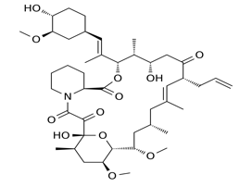

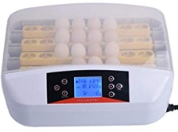
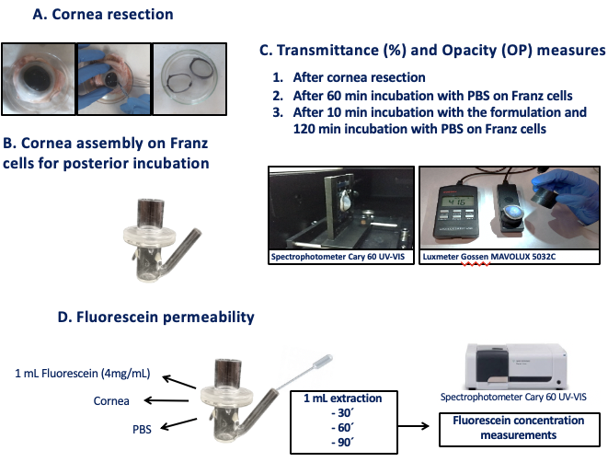
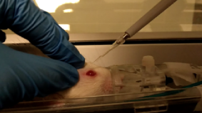
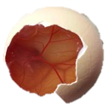
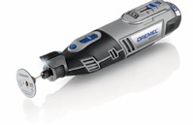
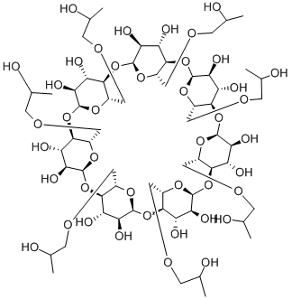

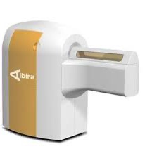
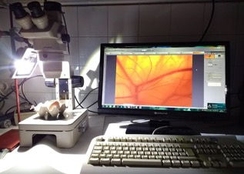
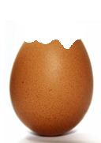
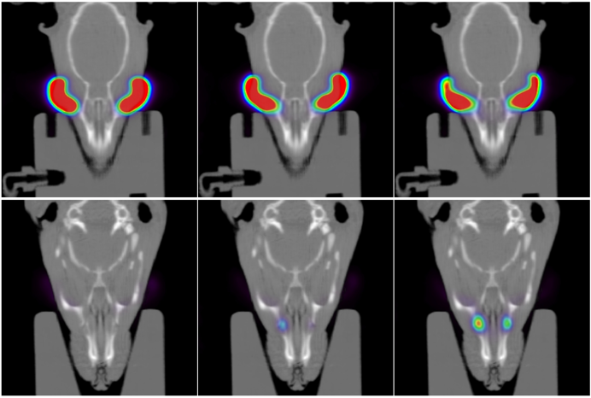
Ocular surface permanence and toxicity studies of Tacrolimus-(Hydroxypropyl-𝛽-cyclodextrin) eyedrops
X. García-Otero^{1,2}, R. Varela-Fernández¹, V. Díaz-Tomé^{1,3}, C. Bendicho-Lavilla^{1,4}, M. González-Barcia³, J. Blanco-Méndez^{1,4}, P. Aguiar², A. Fernández-Ferreiro³ and F. J. Otero-Espinar^{1,4}
¹Pharmacology, Pharmacy and Pharmaceutical Technology Department. Faculty of Pharmacy. University of Santiago de Compostela (USC). Santiago de Compostela. Spain.
²Molecular Imaging Group. University Clinical Hospital, Health Research Institute Foundation of Santiago de Compostela (FIDIS). Santiago de Compostela. Spain.
³Clinical Pharmacology Group. University Clinical Hospital, Health Research Institute Foundation of Santiago de Compostela (FIDIS). Santiago de Compostela. Spain.
⁴Paraquasil Group. University Clinical Hospital, Health Research Institute Foundation of Santiago de Compostela (FIDIS). Santiago de Compostela. Spain.
e-mail: xurxo.garcia.otero@gmail.com
INTRODUCTION
Noninfectious uveitis is a disease often caused by an autoimmune response, inflammatory cytokines promote the activation of T-cells and trigger recruitment of large numbers of circulation inflammatory leukocytes into the eye. This process may cause irreversible tissue damage and visual impairment. Since tacrolimus inhibits T-cell proliferation and suppresses the release of inflammatory cytokines, it can theoretically be used to reduce inflammatory activity in uveitis patients [1].
Hospital pharmacy prepares tacrolimus eye drops reformulating from parenteral drugs (Prograf®) as magistral formulations because there is not any commercial alternative. However, Prograf® (tacrolimus solubilized in ethanol) has some irritating compounds that cause discomfort and unpleasantness to the patient, so these excipients had to be removed. Due to tacrolimus poorly solubility, the purpose of this work was to improve the drug solubility complexing tacrolimus with HPßCD, evaluate the safety, and study the ocular permanence of the eye drops.
MATERIALS AND METHODS
Solubility
Ocular permanence
HETCAM
BCOP
7.5 µL of formulations
+
¹⁸F-FDG
Incubation
9 days
35,5°C 65% RH
PET images acquisition time:
0, 30, 75, 120, 240 and 300 minutes
Fertilized Broiler Eggs
Automatic incubator
Tacrolimus
+
Chorioallantoic membrane (CAM)
Dremel® Drill
5 minutes monitoring
300 µL
formulation
Olympus SZ60 Lens
HPßCD
=
Lysis
Haemorrhage
Coagulation
Tacrolimus-HPßCD Complex
2 male Sprague-Dawley rats (4 eyes)
RESULTS
Solubility
Ocular permanence
A
A
B
B
Figure 3. Fusion PET/CT images of the rat's head in which the formulation remains on the ocular surface after instillation (A) and subsequently it is eliminated by the nasolacrimal ducts (B) at 0, 30, 75 min post-administration.
Figure 4. Clearance rate of the formulations (LIQ 20, LIQ 40, BSS 20 and BSS 40) from the ocular surface determined by PET/CT.
Figure 1. Tacrolimus solubility diagram at different [HPßCD] in water.
Figure 2. Tacrolimus solubility with 20, 30 and 40% (w/v) of HPßCD in water (H₂O), Balanced Salt Solution® (BSS) and Liquifilm® (LIQ).
HETCAM
BCOP
Figure 5. HETCAM images 5 minutes post-instillation for the different formulations.
A: PBS (Control -),
B: 20% HPßCD (H₂O) (w/v)
C: 20% HPßCD (BSS) (w/v)
D: 20% HPßCD (LIQ) (w/v)
E: 30% HPßCD (H₂O) (w/v)
F: 30% HPßCD (BSS) (w/v)
G: 30% HPßCD (LIQ) (w/v)
H: 40% HPßCD (H₂O) (w/v)
I: 40% HPßCD (BSS) (w/v)
J: 40% HPßCD (LIQ) (w/v)
K: F_{REF} (0,03%)
L: Ethanol (Control +)
Figure 6. Transmittance (%) representation obtained after the instillation of different formulations on Franz diffusion cells using corneas.
Figure 7. Cornea’s opacity (%) after 10 minutes formulation and 120 minutes PBS incubation on Franz diffusion cells.
CONCLUSIONS
Results reveal tacrolimus solubility improvement and irritation absence. Higher permanence on the ocular surface is achieved with higher HPßCD concentrations. Liquifilm® eyedrops present less ocular clearance than BSS® ones. These formulations would enhance the patient’s adherence-to-treatment, reducing eye discomfort.
REFERENCES
ACKNOWLEDGEMENTS
Zhai J, Gu J, Yuan J, Chen J. Tacrolimus in the treatment of ocular diseases. BioDrugs. 2011;25:89–103.
A. Fernández-Ferreiro, M. González-Barcia et al. Evaluation of the in vitro ocular toxicity of the fortified antibiotic eye drops prepared at the Hospital Pharmacy Departments. Farm Hosp. 2016;40(5):352-70.
X.G-O and R.V-F acknowledges the financial support of the Health Research Institute Foundation of Santiago de Compostela (FIDIS) (Predoctoral research fellowship).

