Slide 1


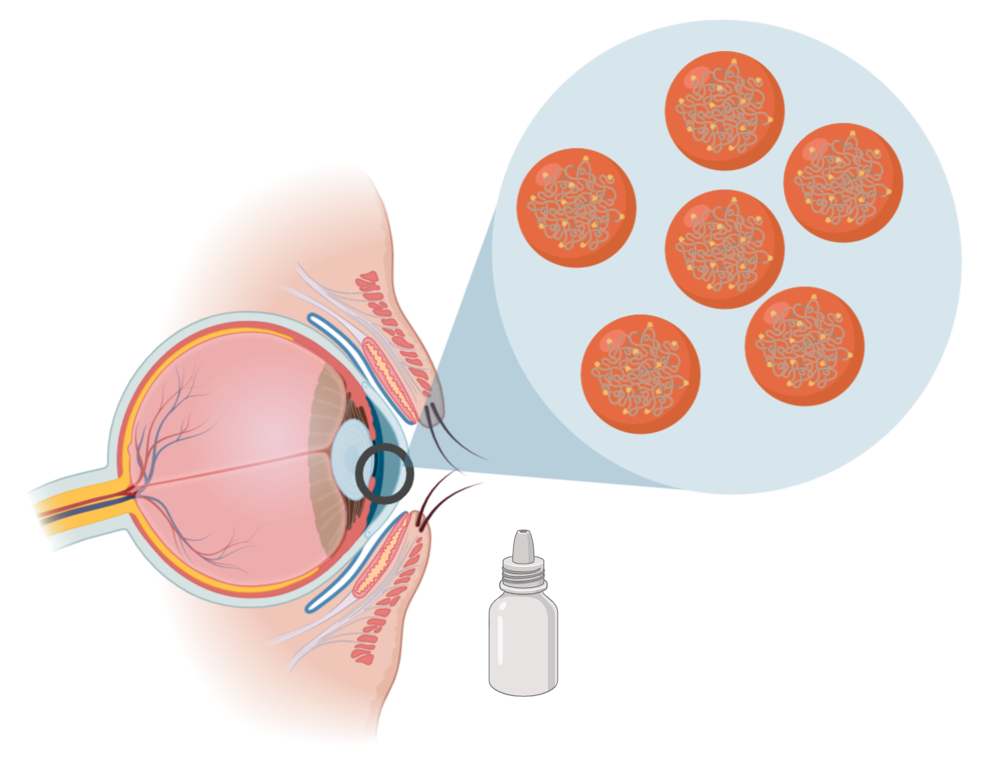
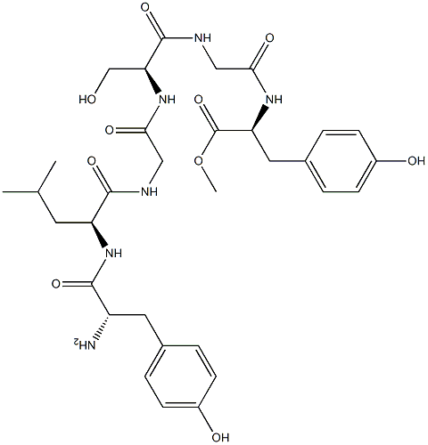
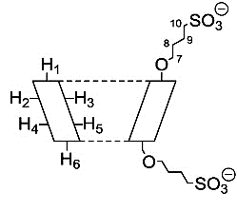
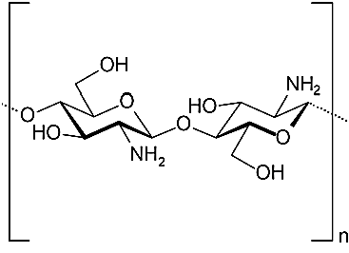
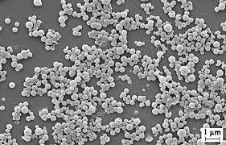
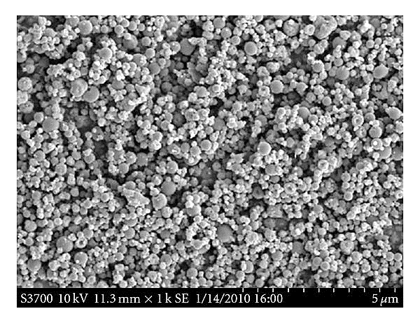
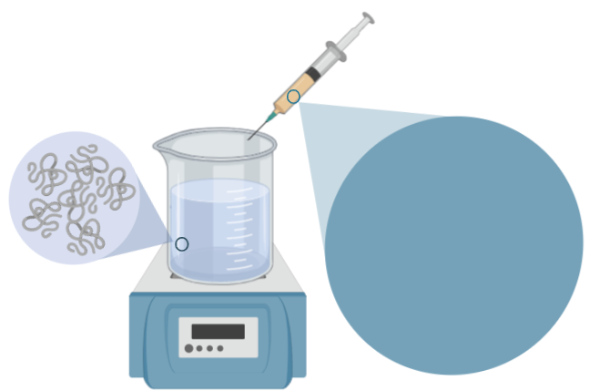
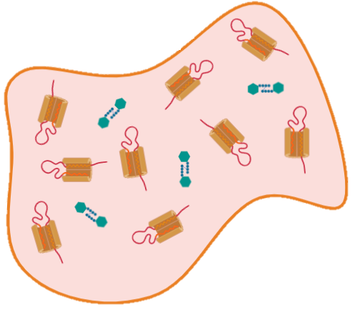
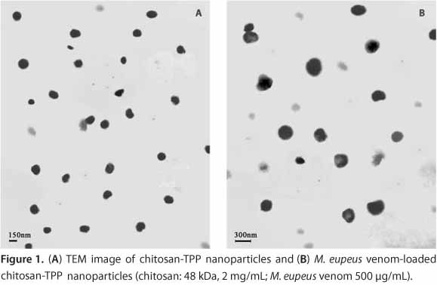
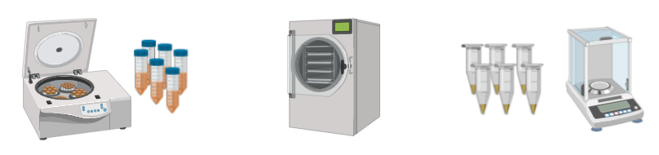
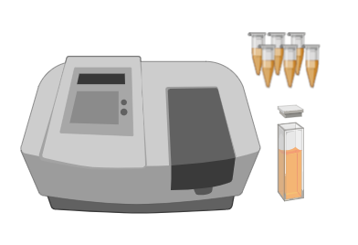
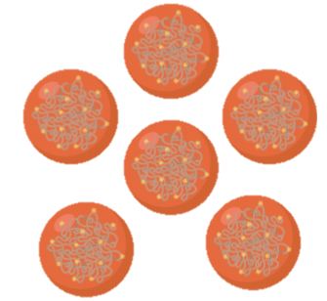
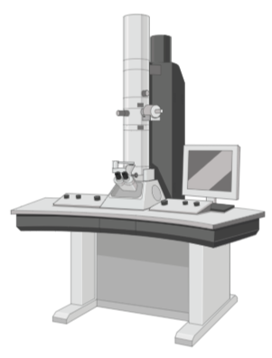
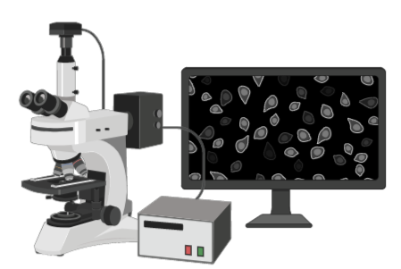
Design, preparation and characterization of lactoferrin-loaded sulfobutylether-β-cyclodextrin/chitosan nanoparticles as a therapeutic alternative for keratoconus treatment
R. Varela-Fernández^{1,2}, X. García-Otero¹, M. I. Lema-Gesto², M. González-Barcia³, and F. J. Otero-Espinar¹
Department of Pharmacology, Pharmacy and Pharmaceutical Technology. University of Santiago de Compostela (USC). Campus vida. Santiago de Compostela. Zip Code: 15782. Spain. francisco.otero@usc.es.
Clinical Neurosciences Group. University Clinical Hospital, Health Research Institute of Santiago de Compostela (IDIS). Travesía da Choupana s/n Santiago de Compostela. Zip Code: 15706. Spain. mariaisabel.lema@usc.es.
Molecular Imaging Group. University Clinical Hospital, Health Research Institute of Santiago de Compostela (IDIS). Travesía da Choupana s/n Santiago de Compostela. Zip Code: 15706. Spain.
Clinical Pharmacology Group. University Clinical Hospital, Health Research Institute of Santiago de Compostela (IDIS). Travesía da Choupana s/n Santiago de Compostela. Zip Code: 15706. Spain. miguel.gonzalez.barcia@sergas.es.
Introduction and objectives
Results
Lactoferrin has shown potential as a good therapeutic alternative in the treatment of Keratoconus [1]. Chitosan/Cyclodextrin nanoparticles as novel drug delivery systems (DDS) could successfully encapsulate hydrophobic drugs [2]. The aim of this work was based on the design, preparation, and characterization of lactoferrin-loaded CS/SBE-β-CD nanoparticles as topical ophthalmic DDS for the keratoconus treatment.
Phase diagram of nanoparticle's formation and physicochemical characterization
Phase diagram reveals that only CS/SBE-β-CD specific ratios lead to nanoparticle’s formation. The appearance of opalescence was used as an indicator of nanoparticle formation, also confirmed by Dynamic Light Scattering (DLS).
Low amounts of initial CS/SBE-β-CD give rise to no nanoparticle’s formation, while precipitation occurred when high amounts of initial compounds were used.
Lactoferrin
SBE-β-CD
Phase diagram formation for lactoferrin-loaded CS/SBE-β-CD nanoparticle’s formation.
Topical ophthalmic administration
Chitosan
Methodology
Changes in size and PDI values during the optimization procedure of CS/SBE-β-CD nanoparticles.
Morphological characterisation of nanoparticles
Preparation of lactoferrin CS/SBE-β-CD NPs
Scanning electron micrographs show that lactoferrin-loaded CS/SBE-β-CD nanoparticles were predominantly spherical in shape.
Transmission electron microscopy images indicate that these nanosystems may have an irregular surface.
Nanoparticles were spontaneously obtained via ionotropic gelation. 1 ml lactoferrin/SBE-β-CD aqueous solution was added to 3 ml CS acidic aqueous solution under magnetic stirring at room temperature.
Scanning Electron Microscopy (SEM)
Chitosan
Lactoferrin/SBE-β-CD inclusion complexes
Transmission Electron Microscopy (TEM)
Characterisation of lactoferrin CS/SBE-β-CD NPs
Long-term stability to storage study
Sample preparation
Freeze-drying
Production yield (PY)
Encapsulation efficiency (EE)
Loading capacity (LC)
Conclusion
Size and ζ Potential
Lactoferrin-loaded CS/SBE-β-CD nanoparticles were proposed as a new ocular drug delivery system with the virtue of easy administration, prolonged drug release time, improved ocular bioavailability and reduced dosing frequency. Lactoferrin CS/SBE-β-CD nanoparticles show considerable potential as hydrophilic drug carrier and have the capacity to deliver drugs to specific target sites, possibly revolutionizing the Keratoconus therapy.
Bibliography
Imaging analysis
SEM and TEM analysis
[1] Mas Tur V, MacGregor C, Jayaswal R, O’Brart D, Maycock N. A review of keratoconus: Diagnosis, pathophysiology, and genetics. Surv Ophthalmol. 2017 Dec;62(6):770–83.
[2] Jingou J, Shilei H, Weiqi L, Danjun W, Tengfei W, Yi X. Preparation, characterization of hydrophilic and hydrophobic drug in combine loaded chitosan/cyclodextrin nanoparticles and in vitro release study. Colloids Surf B Biointerfaces. 2011;83(1):103-7.

