Slide 1
Peptide nanoparticle-mediated combinatorial delivery of cancer-related siRNAs for synergistic anti-proliferative activity in triple-negative breast cancer cells Ivan Pyankov², Anna Egorova^{1,2}, Marianna Maretina^{1,2}, Vladislav Baranov^{1,2}, Anton Kiselev ¹*
¹ Institute of Obstetrics, Gynecology and Reproductology named after D.O. Ott, Saint-Petersburg, Russia;
² Saint Petersburg State University, Saint-Petersburg, Russia.
* Corresponding author: ankiselev@yahoo.co.uk

Slide 2
Abstract:
Triple-negative breast cancer (TNBC) is one of the deadliest types of cancer for women of different age groups. Frequently this cancer does not respond to conservative treatment. Combinatorial RNAi can be suggested as an advanced approach to TNBC therapy. Due to the fact that TNBC cells overexpress chemokine receptor 4, we used modular L1 peptide nanoparticles modified with CXCR4 ligand for combinatorial delivery of siRNAs suppressing major transduction pathways.
TNBC cell line MDA-MB-231 was used as a cellular model. Genes encoding the AQP3, CDC20, and COL4A2 proteins responsible for proliferative activity in TNBC cells were selected as RNAi targets. The siRNA binding ability of the carrier was studied at different charge ratios. The silencing specificity was demonstrated for all siRNAs studied.
AlamarBlue exclusion assay has shown a significant reduction in the anti-proliferative activity after combinatorial siRNA transfection compared to single siRNA delivery. The most significant synergistic effects have been demonstrated after combinatorial transfection with anti-CDC20 siRNA.
Based on our findings, we have concluded that combinatorial treatment by L1-polyplexes formed with AQP3, CDC20, and COL4A2 siRNAs effectively inhibits proliferation of TNBC cells and can be suggested as useful tool for RNAi-mediated cancer therapy.
Keywords: Triple-negative breast cancer; peptide; siRNA delivery;
RNAi; AQP3; CDC20; COL4A2; MDA-MB-231

Slide 3
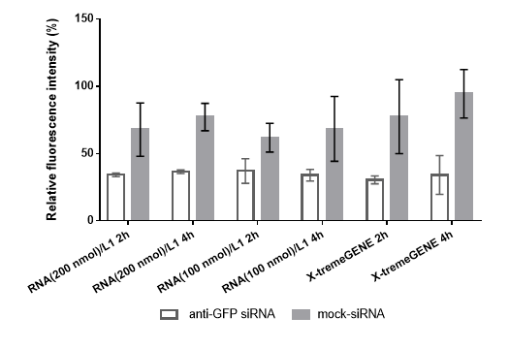
Results and Discussion
There were no statistically significant differences in GFP gene-silencing results between complexes incubated with MDA-MB 231 cells for 2 and 4 hours.
Fig. 1. Silencing of the GFP gene expression after the treatment of MDA-MB-231 cells with siRNA/L1 and siRNA/X-tremeGENE complexes.

Slide 4
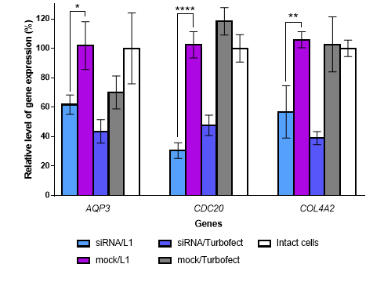
Results and Discussion
The efficiency of target genes silencing by siRNA/L1 complexes is comparable to the efficiency of Turbofect.
Relative level of CDC20 gene expression decreased by more than 60% compared to level in cells treated with mock siRNA/L1 and intact cells.
Fig. 2. Silencing of AQP3, CDC20 and COL4A4 gene expression after the treatment of MDA-MB-231 cells by siRNA/L1 complexes *p<0.05, **p<0.01, ****p<0.0001 compared to cells treated with mock siRNA/L1

Slide 5
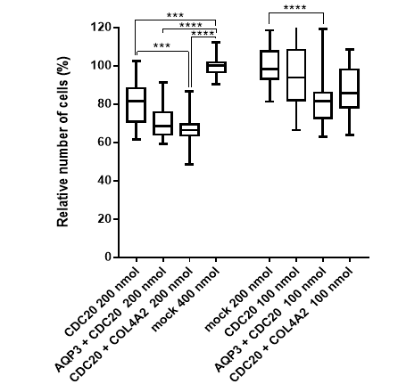
Results and Discussion
Statistically significant difference was shown for all complexes with combinatorial anti-CDC20 siRNA delivery (200 nmol) compared to single anti-CDC20 siRNA treatment.
Fig. 3. Relative number of MDA-MB-231 cells after combinatorial treatment with siRNA/L1 complexes according to Alamar blue assay; *p<0.05, **p<0.01, ***p<0.005, ****p<0.0001 compared to cells treated with mock siRNA

Slide 6
Conclusions
The highest degree of proliferative activity inhibition in MDA-MB-231 cells was shown by a L1-based complex containing 200 nmol anti-CDC20 siRNA and 200 nmol anti-COL4A2 siRNA;
Combinatorial treatment by L1-polyplexes formed with AQP3, CDC20, and COL4A2 siRNAs effectively inhibits proliferation of TNBC cells and can be suggested as useful tool for RNAi-mediated cancer therapy.

Slide 7
Acknowledgments
Grant RSF 19-73-10045
President of Russian Federation scholarship
SP-822.2018.4

