Slide 1
Development of RGD-conjugated peptide-based polyplexes with anionic coating for delivery of herpes thymidine kinase gene to uterine fibroids cells
Sofia Shtykalova^{1,2}, Anna Egorova¹, Alexander Selutin¹, Svetlana Freund², Marianna Maretina¹, Vladislav Baranov^{1,2} and Anton Kiselev^{1,}*
¹ Institute of Obstetrics, Gynecology and Reproductology named after D.O. Ott, Saint-Petersburg, Russia;
² Department of Genetics & Biotechnology, Saint Petersburg State University, Saint-Petersburg, Russia.
* Corresponding author: ankiselev@yahoo.co.uk

Slide 2
Abstract:
Uterine fibroids (UF) occupies the 2nd place in the structure of gynecological pathology and is often the cause of infertility. Precise ultrasound localization makes the disease a perfect target for suicidal gene therapy in situ. However, excessive extracellular matrix (ECM) of UF represents a formidable barrier for gene delivery by means of nanoparticles. Coating with polyanions can provide colloidal stability of the polyplexes and resistance to ECM. We developed αvβ3-integrin-targeted peptide-based carrier and anionic peptide coating for DNA delivery into αvβ3-expressing cells, including primary leiomyoma cells (PLC).
Arginine-histidine-rich peptide carriers conjugated with cycloRGD ligand were synthesized. The physicochemical properties of DNA-polyplexes with anionic coating were tested. Suicidal gene therapy with HSV1-TK gene with subsequent ganciclovir treatment was held for PLC obtained after myomectomy.
DNA condensation analysis shows that the addition of anionic peptides does not lead to the destruction of the nucleopeptide complexes. Moreover, negatively charged coating allowed successful transfection in the presence of serum. AlamarBlue and TrypanBlue exclusion assays of PLC showed a decline of proliferative activity among cells transfected with HSV1-TK gene carrying complexes in comparison with the control LacZ gene transfected cells.
Keywords: gene therapy; herpes thymidine kinase; leiomyoma;
peptide-based carrier; anionic coating.

Slide 3
Results
DNA : core peptide charge ratio is 1:8
The graph shows the change in the fluorescence intensity of the ethidium bromide with an increase in the time of incubation with dextran sulphate (DS). The red frame shows an increased speed of polyplex degradation due to interaction with DS.
The graphs (right) show the change in the fluorescence intensity of the ethidium bromide with an increase in the DNA : negatively charged peptide charge ratios with standard deviation (S.D.)
DNA : core peptide charge ratio is 1:12

Slide 4
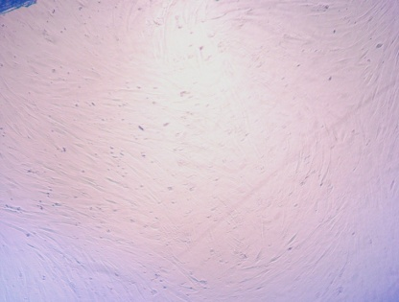
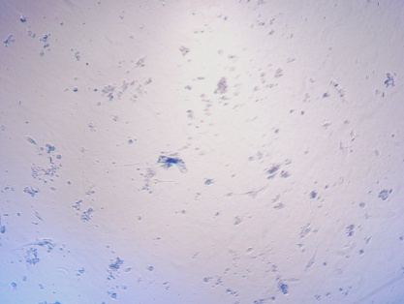
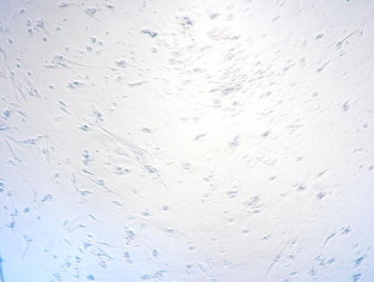
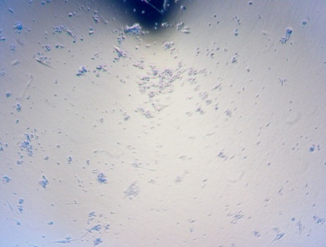
Results
***
R6p/cRGD-E6p lacZ
R6p/cRGD-E6p TK
Results of Alamar blue assay after transfection of primary uterine leiomyoma cells by DNA-complexes with anionic coating in presence of fetal bovine serum (*** - p.value < 0.005). GCV – gancyclovir.
***
R6p/E6p lacZ
R6p/E6p TK
***
Primary leiomyoma cells after transfection with nucleopeptide polyplexes.
Results of Trypan blue staining after transfection of primary uterine leiomyoma cells in presence of fetal bovine serum (*** - p.value < 0.005). GCV – gancyclovir.

Slide 5
Conclusions
The study shows that the utilization of peptide carriers modified with RGD-ligand and negatively charged peptides is a promising approach for the development of targeted DNA delivery systems. Developed carriers demonstrated high specificity and transfection efficacy of primary leiomyoma cells with subsequent successful suicidal gene therapy.

Slide 6
Acknowledgments
Grant RSF 19-15-00108
President of Russian Federation scholarship
SP-822.2018.4

