Slide 1

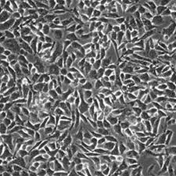

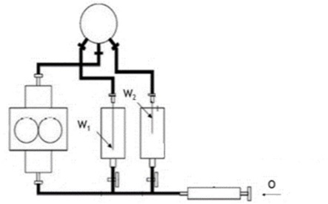

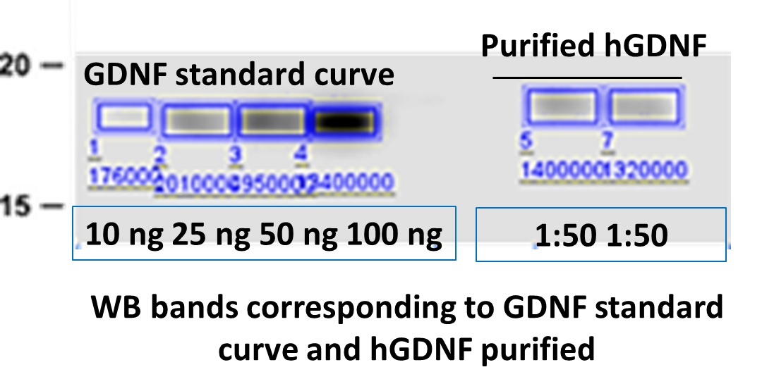
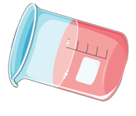
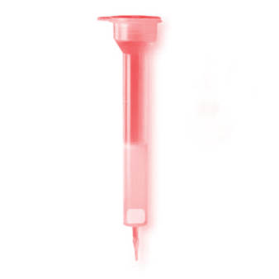

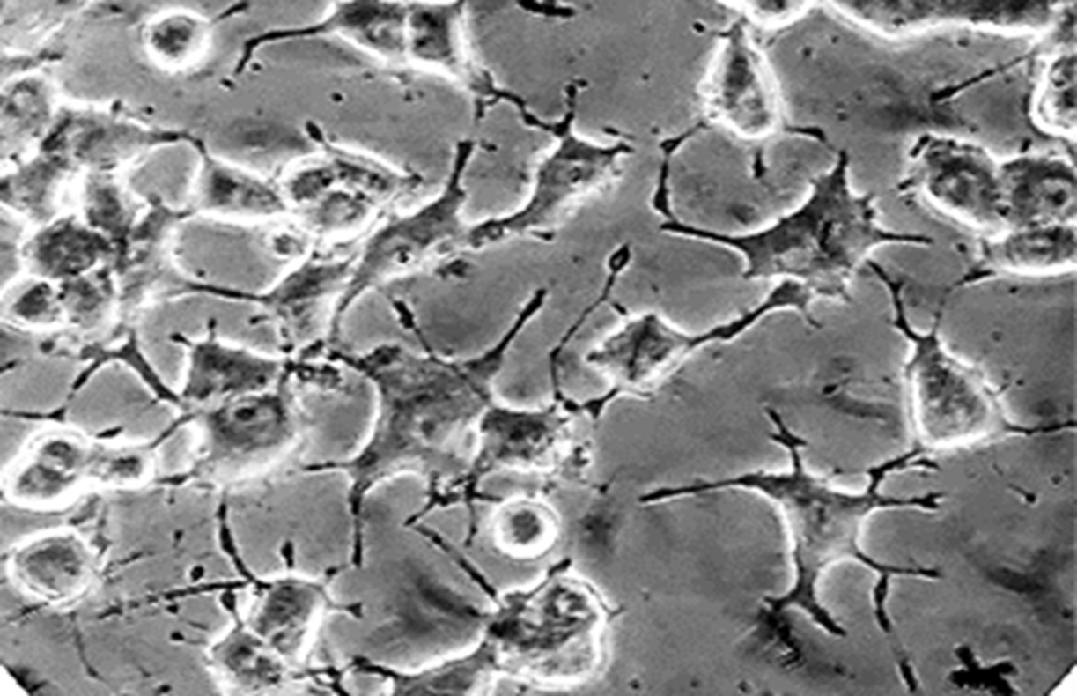


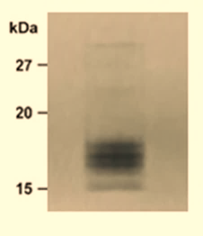


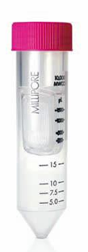
Sustained GDNF delivery via PLGA nanoparticles
Pablo Vicente Torres-Ortega^{1,2}, Cristian Smerdou ^{2,3}, Elisa Garbayo^{1,2}, María J. Blanco Prieto^{1,2}*
1 Department of Pharmaceutical Technology and Chemistry, Faculty of Pharmacy and Nutrition, Universidad de Navarra, C/ Irunlarrea 1, 31008 Pamplona, Spain
2 Navarra Institute for Health Research, IdiSNA, C/ Irunlarrea 3, 31008 Pamplona, Spain
3 Division of Gene Therapy, School of Medicine, Center for Applied Medical Research (CIMA), University of Navarra, Av. Pío XII 55, 31008 Pamplona, Spain
INTRODUCTION
Glial cell line-derived neurotrophic factor (GDNF) is a protein with remarkable trophic actions on dopaminergic neurons which is under investigation for Parkinson's disease (PD) therapy^{1,2}. It is a highly glycosylated biopharmaceutical in which the composition of attached glycans potentially influences drug efficacy and immunogenicity². Hence, the use of recombinant GDNF from mammalian cells is essential to avoid safety issues². Moreover, although several approaches to deliver this protein to the brain have been described³, a promising strategy would be the use of nanoparticles (NPs) containing GDNF in the dopamine-depleted brain areas.
The objective of this work is to develop and characterize biodegradable NPs loaded with recombinant GDNF produced in mammalian cells for brain tissue engineering.
RESULTS
hGDNF expression and purification
hGDNF-loaded NPs preparation and characterization
Future perspectives
B) NPs characterization
A) hGDNF expression in BHK cells
A) hGDNF-loaded NPs preparation
A two-component hydrogel based on HA functionalization with adamantane (guest) and β-cyclodextrin (host) will be prepared and characterized.
GDNF-NPs will be included in the hydrogel for its local brain administration.
B1
hGDNF-NPs were formulated by double emulsión solvent evaporation using One Recirculation Machine (TROMS) Technology
Size, PDI and EE
BHK-21 cells
PLGA | MEAN SIZE | PDI | EE%
NPs (n=3) | 405.5 ± 2.9 nm | 0.08 ± 0.03 | 61.65±7
POLYMERIC GDNF-NPs FORMULATION (W₁/O/W₂)
W₁ : hGDNF +Albumin +PEG + PBS
O: PLGA + Organic solvent
W₂ : Poly(vinyl alcohol) 1%
B2
SEM analysis
CONCLUSIONS
GDNF-loaded NPs were successfully prepared by W1/O/W2 emulsion/extraction process using TROMS technology with a high drug entrapment efficiency.
The developed nanosystem has great potential for brain tissue engineering applications.
Electroporation
Centrifugation and filtration
B) hGDNF purification
Scheme of TROMS Technology
WB analysis
B4
In vitro release study of GDNF from NPs
Spherical particles.
Uniform size distribution of NPs.
No aggregation.
REFERENCES
Cation exchange chromatography
1. E. Garbayo et al, Effective GDNF brain delivery using microspheres-A promising strategy for Parkinson’s disease.
2. R.A. Barker et al, GDNF and Parkinson’s Disease: Where Next? A Summary from a Recent Workshop.
3. P.V. Torres-Ortega et al, Micro- and nanotechnology approaches to improve Parkinson’s disease therapy.
4. E. Ansorena et al. A simple and efficient method for the production of human glycosylated glial cell line-derived neurotrophic factor using a Semliki Forest virus expression system.
Fast Flow
resin
Protein mixture
B3
Bioactivity
GDNF
ACKNOWLEDGEMENTS
GDNF released within the first 24 hours was 19.10 ± 3.5%, followed by a phase of sustained-release with 50.6 ± 3.1% of GDNF being released within 28 days.
PC12 cell-based bioassay showed that GDNF remains bioactive after its nanoencapsulation.
This work was supported by the Spanish Ministry of Education (program FPU (FPU17/01212)) and Government of Navarra (2019_66_NAB9).
E. Garbayo is supported by a “Ramon y Cajal Fellowship (RYC2018-025897-I).
Coomassie Blue staining showed that hGDNF obtained was highly pure
Concentration

