Slide 1
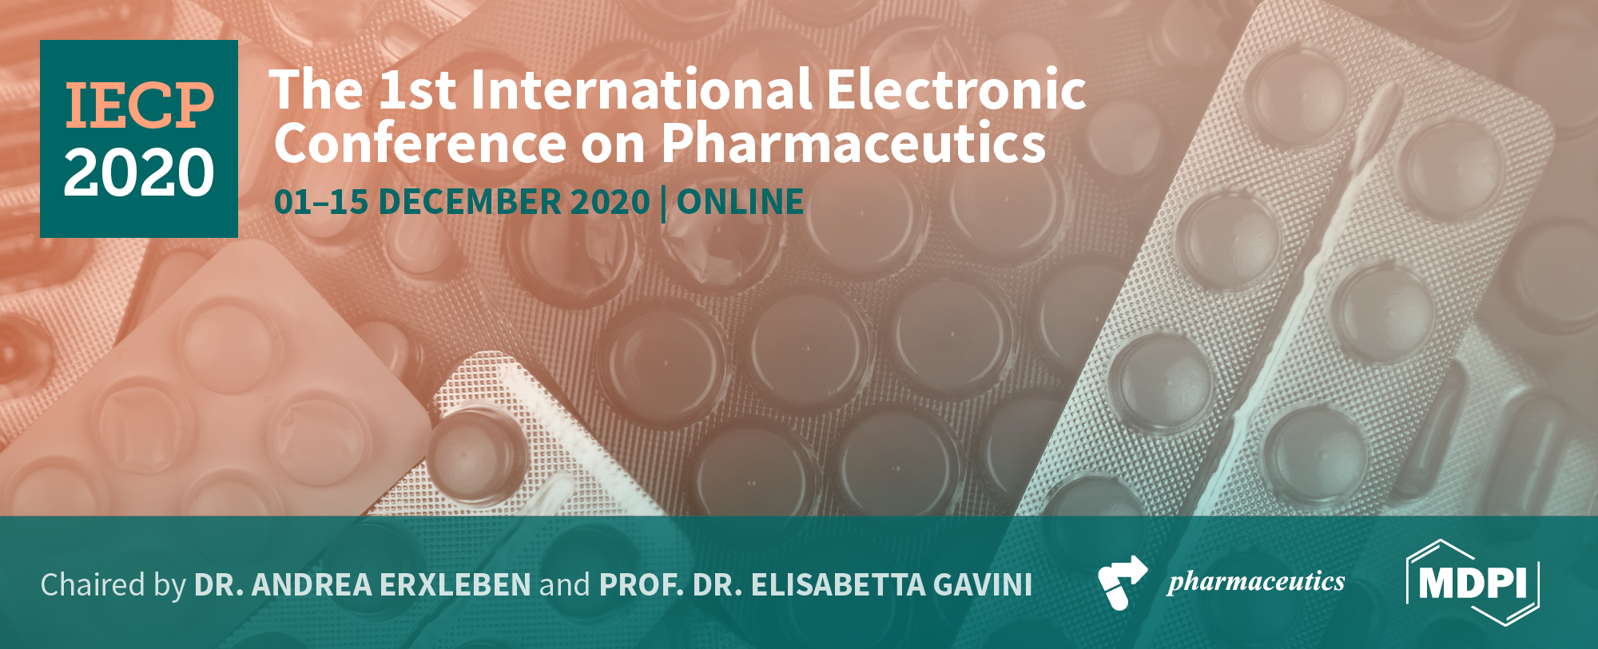

EFFECT OF GAMMA STERILIZATION ON CBD LOADED-PLGA-MICROPARTICLES
A.I. Fraguas-Sánchez ¹, A. Fernández-Carballido¹, and A.I. Torres-Suárez ^{1,} *
¹ Department of Pharmaceutics and Food Technology, Faculty of Pharmacy, Complutense University.
* Corresponding author:galaaaa@ucm.es

Slide 2

Abstract: Background: Cannabidiol (CBD), the main non-psychotropic cannabinoid, has emerged as a potential therapeutic agent. However, its low aqueous solubility hinders the development of effective parenteral formulations. The use of polymeric microparticles as CBD carriers could resolve this challenge and allows to obtain an extended CBD release after a single administration. Among all the available polymers, poly(lactic-co-glycolic acid) (PLGA), FDA approved for various medical applications, is one the most used. Ionizing radiation has been proposed as an effective sterilizing method for PLGA microparticles, which is essential for their parenteral administration. The aim of this work was to evaluate the effect of gamma sterilization on the characteristics of CBD loaded microparticles. Methods: Microparticles were prepared by solvent evaporation technique, using PLGA-RG 502 as polymer, and sterilized by gamma irradiation at a dose of 25 kGy. Both, non-sterile and sterile formulations were then characterized by DLS, SEM and DSC. CBD content and CBD release were also evaluated by HPLC. Results: No differences in particle morphology and particle size were detected between sterile and non-sterile formulations. All microparticles exhibited a spherical shape, a smooth surface, and an average particle size around 25 µm. DSC analysis showed the absence of the CBD melting peak in sterile and non-sterile CBD microparticles, indicating that it is dissolved or molecularly dispersed within the polymeric matrix and that no crystallization processes occurred during sterilization. However, a reduction on PLGA glass transition was appreciated in both 10-Mps and 20-Mps sterile formulations compared with their non-sterile counterparts. A significant lower CBD content was also detected in sterile microparticles, observing a CBD degradation during sterilization of 13.75% and 10.28% in 10-Mps and 20-Mps respectively. Finally, a faster CBD release was appreciated in sterile microparticles compared with their counterparts, due to the faster PLGA degradation in sterilized microparticles. Conclusions: Due to the CBD degradation during sterilization process and the acceleration of the release of this drug from PLGA microparticles, gamma irradiation is not an adequate method to sterilize CBD-PLGA-microparticles.
Keywords: cannabinoids, drug delivery, polymeric microparticles, sterilization.

Slide 3
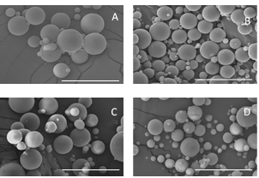
Results and Discussion
A) Effect on the physicochemical properties of CBD loaded microparticles
Gamma irradiation did not induce changes on particle shape and surface. Both, sterile and non-sterile formulations were spheres with a smooth surface.
Figure 1: SEM images of 10-Mps (A), 20-Mps (B), Sterile-10-Mps (C) and Sterile-20-Mps (D). Scale bar: 50µm.

Slide 4
A significant change (p value < 0.05) in particle size were not detected either, showing all formulations a mean particle size, expressed as volume diameter, around 25µM.
Table 1: Characteristics of non-sterile and sterile CBD loaded microparticles.
DSC analyses demonstrated the absence of CBD characteristic melting point in both non-sterile and sterile CBD loaded microparticles, indicating that the drug is dissolved or molecularly dispersed within the polymer matrix and that no crystallization occurred during sterilization. No effect on polymer glass transition temperature was also appreciated, probably due to the use of dry ice to protect the samples, as reported by other authors in indomethacin loaded PLGA microparticles, where non protected samples showed a decrease in the Tg value.

Slide 5
B) Effect on the drug content, drug release and polymer erosion
Regarding CBD content, a significant decrease was observed in both sterile 10-Mps and 20-Mps compared with their non-sterile counterparts, indicating a CBD degradation during gamma irradiation. A 13.75% and 10.28% of CBD loss was detected in sterile formulations prepared with a CBD: PLGA ratio of 10: 100 and 20:100 respectively. This could be attributed to the degradation of the superficial CBD that was not completely entrapped into the polymer matrix induced by gamma irradiation.
Table 1: Characteristics of non-sterile and sterile CBD loaded microparticles.

Slide 6
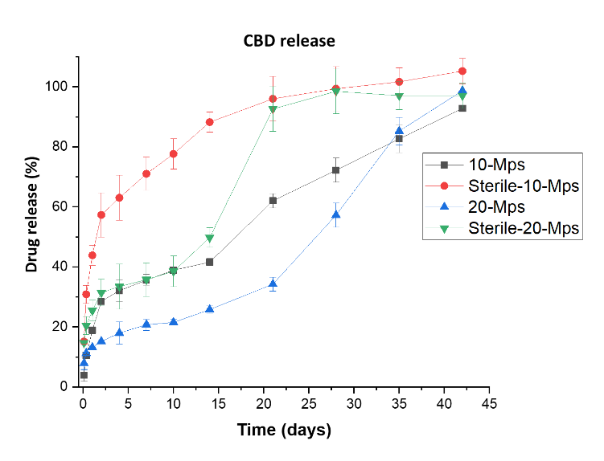
A change in drug release profile was also detected in gamma irradiated formulations, showing these microparticles a faster CBD release. While in non-sterile 10-Mps formulations an extended CBD release was appreciated for 40 days (with more than 80% of the drug released), their sterile counterpart exhibited almost the 90% of the CBD released in 15 days. Similar data was obtained in 20-Mps formulations. While non-sterile 20-Mps microparticles also released more than 80% of the CBD in 35 days, sterile 20-Mps reached almost the 90% of the CBD release in 21 days.
Figure 2: CBD release studies of non-sterile and sterile 10-Mps and 20-Mps

Slide 7
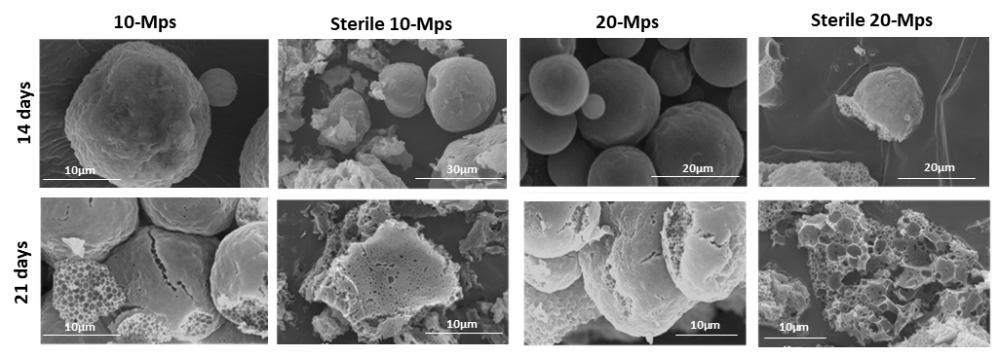
Polymer degradation analyses during release studies demonstrated a higher polymer erosion in both sterile 10-Mps and 20-Mps formulations. While sterile formulations microparticles started to lost their shape and showed a high pore formation at day 14, non-sterile formulations, although exhibited signs of corrugations, maintained their spherical shape and did not exhibited that high pore formation, indicating a slower polymer erosion.
Figure 3: SEM images of non-sterile and sterile CBD-loaded PLGA microparticles during release studies after 14 and 21 days.
The lower molecular weight of sterilized formulations can explain the faster polymer erosion and drug release that was detected in gamma irradiated CBD loaded microparticles.

Slide 8
Conclusions
Due to the CBD degradation during sterilization process and the acceleration of the release of this drug from PLGA microparticles, gamma irradiation is not an adequate method to sterilize CBD-PLGA microparticles. The sterility of the microparticles could be achieved by the previous sterilization of the aqueous and the organic phases followed by the microparticle elaboration in aseptic conditions.

Slide 9
Methods:
Elaboration of CBD loaded-PLGA microparticles:
Microparticles were prepared by the oil-in-water (O/W) emulsion–solvent evaporation technique using PLGA-RG®-502 as polymer and a CBD:PLGA ratio of 10:100 (10-Mps) and 20:100 (20-Mps) [10]. PLGA (500 mg) and CBD (50 or 100 mg) were dissolved in 5 ml of DCM and the resulting organic phase was dropped onto 250 ml of an aqueous solution of PVA at 0.5% under strirring at 4000 and 6000 rpm for 10-Mps and 20-Mps respectively. Then, the resulting O/W emulsion was stirred at 200 rpm for 3-4 hours and filtered using a 5 μm PTFE membrane. The collected microparticles were washed thrice with 50 ml of of demineralized to remove residual PVA and lyophilized at -50ºC and 0.2 mbar with a Lyo Quest freeze-drier (Azbil Telstar, S.L.,Terrasa, Spain).
Sterilization of CBD-loaded-PLGA-microparticles: Both, 10-Mps and 20-Mps CBD-loaded microparticles were sterilized by gamma irradiation at the recommended dose of 25 kG. During sterilization, formulations were placed in a container with dry ice to avoid formulation heating.
Characterization of CBD-loaded-PLGA-microparticles: Both, sterile and non-sterile 10-Mps and 20-Mps were characterized by determining their morphology (SEM), particle size (DLS), drug physical state and polymer glass transition temperature (DSC), drug loading and drus release (HPLC), polymer degradation (SEM)

Slide 10
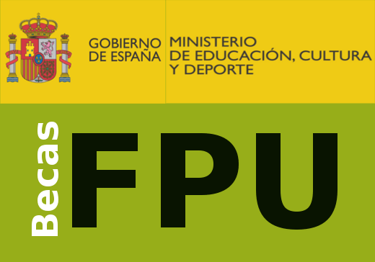

Acknowledgments
A.I. Fraguas-Sánchez has been granted with a research fellowship (Ref: FPU 14/06441), a mobility grant (EST 17/ 00553) from the Ministry of Education of Spain, and the Juan Abelló I doctoral prize from the Doctoral Academy of Spain.

