Slide 1
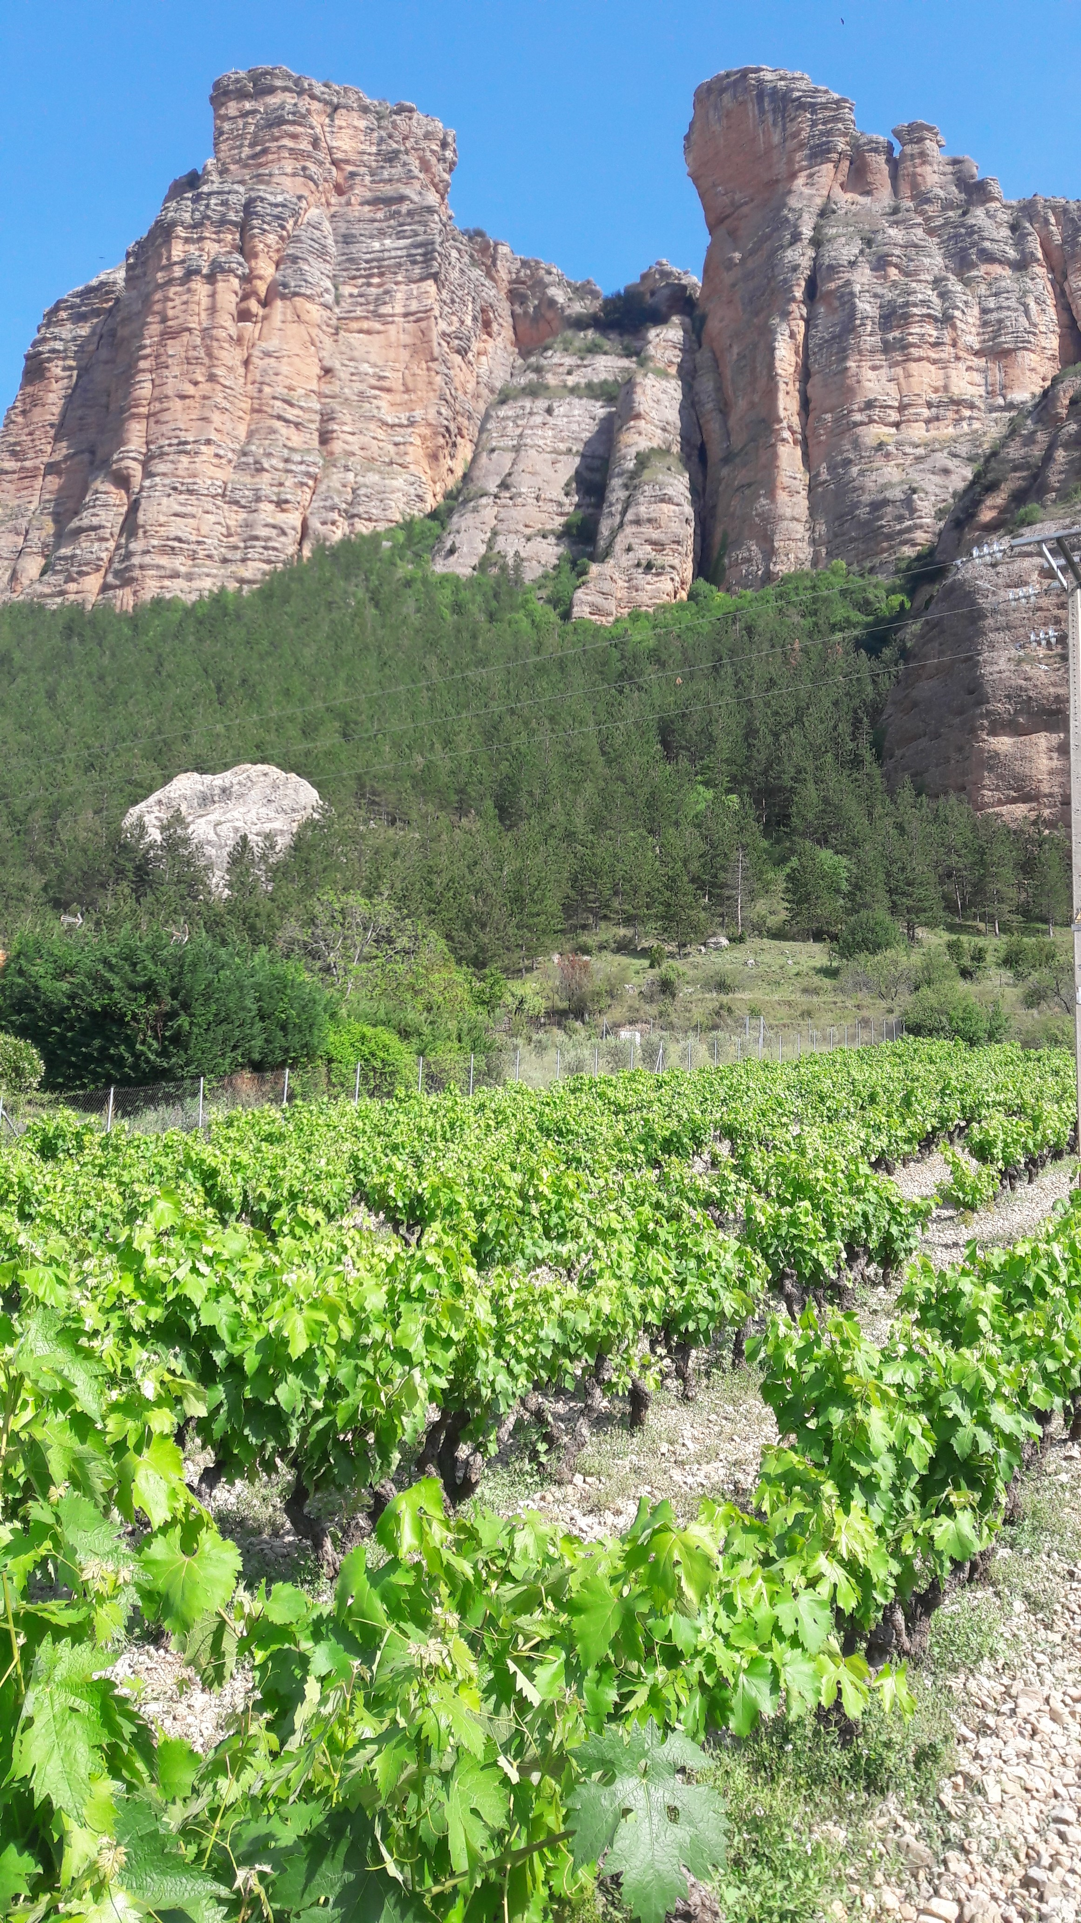





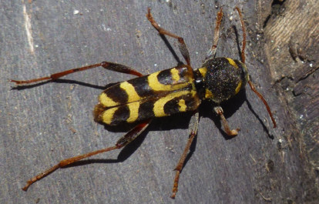
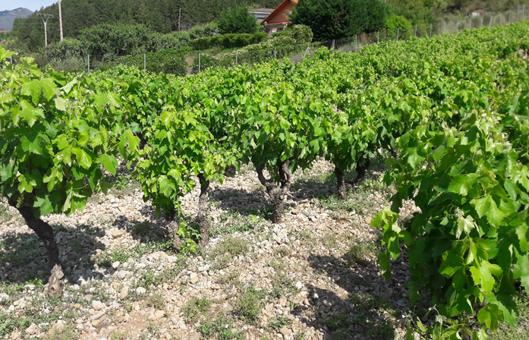
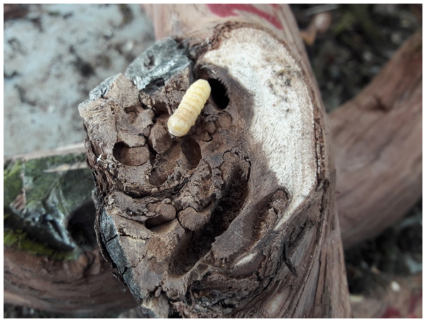
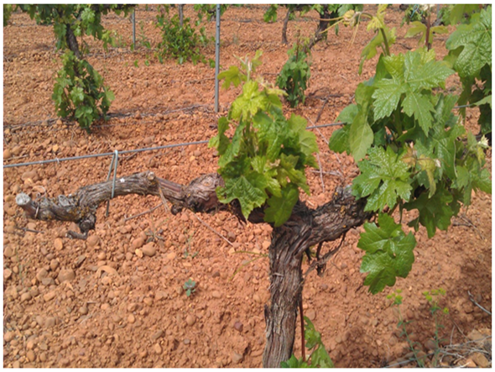
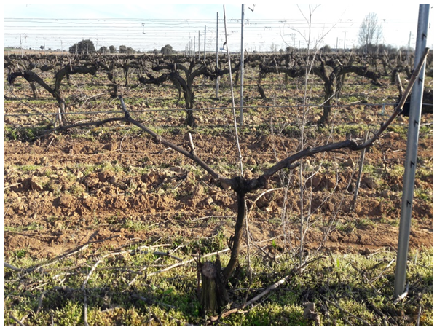
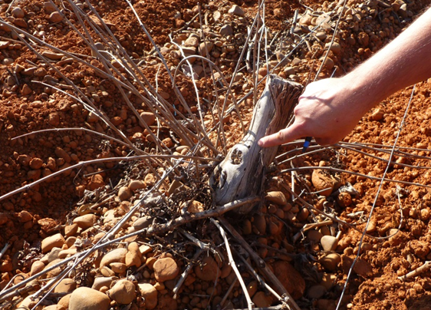
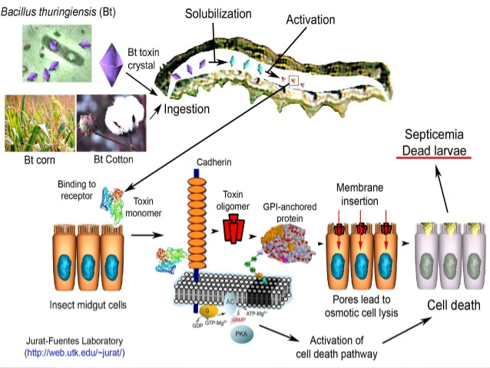
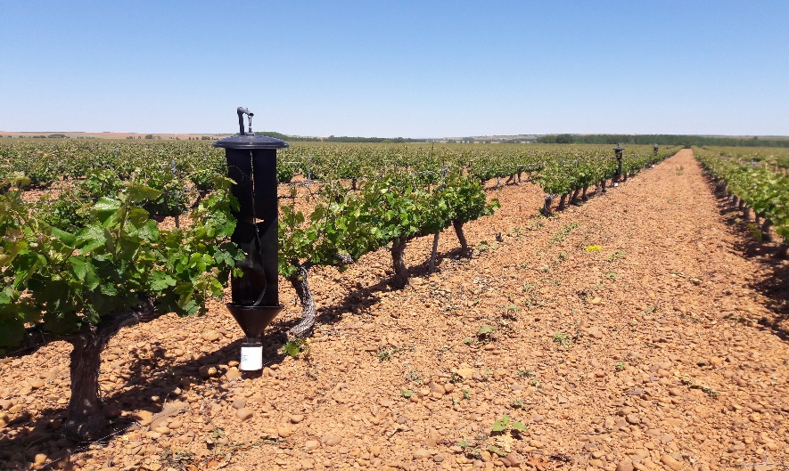
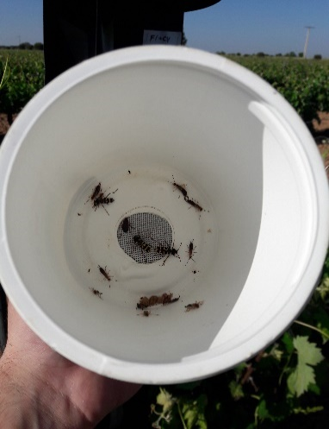
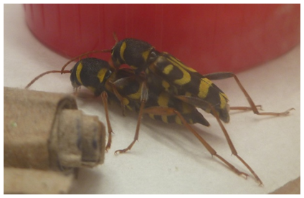
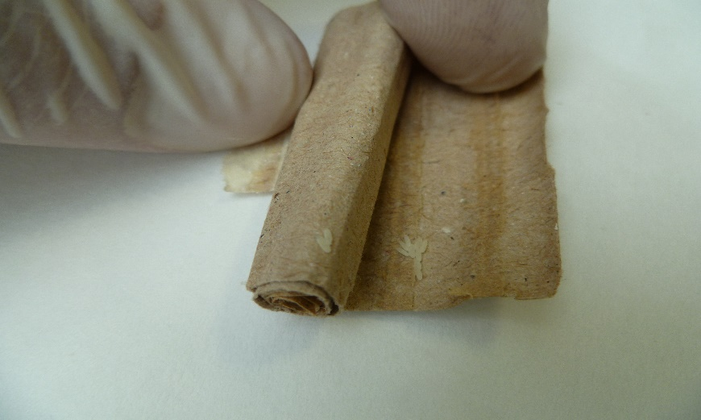
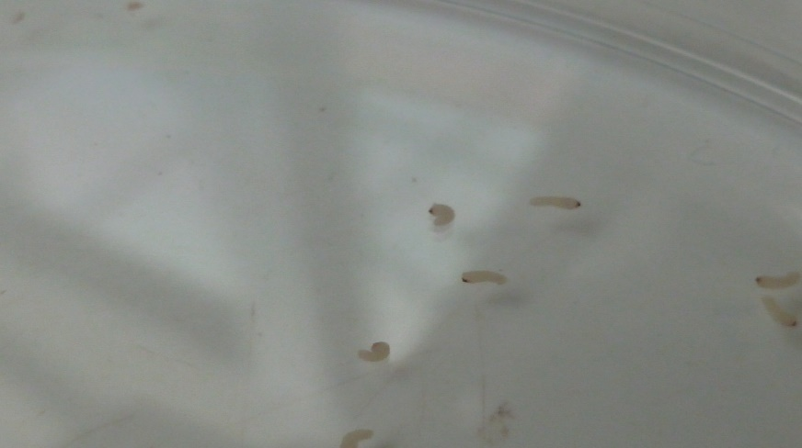
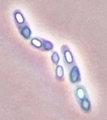
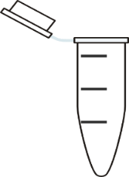
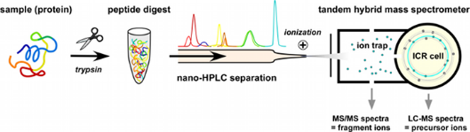
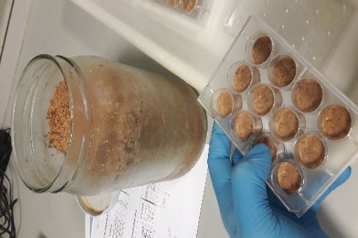
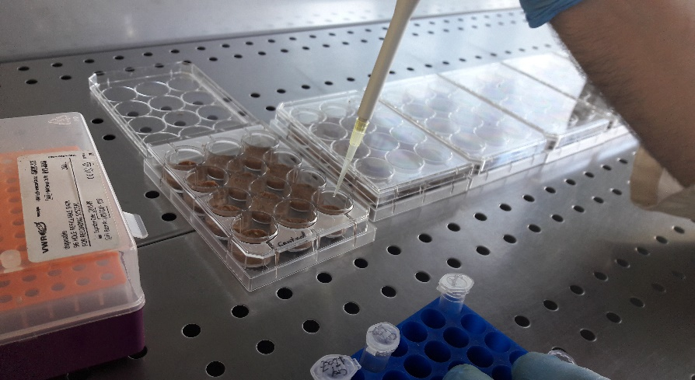
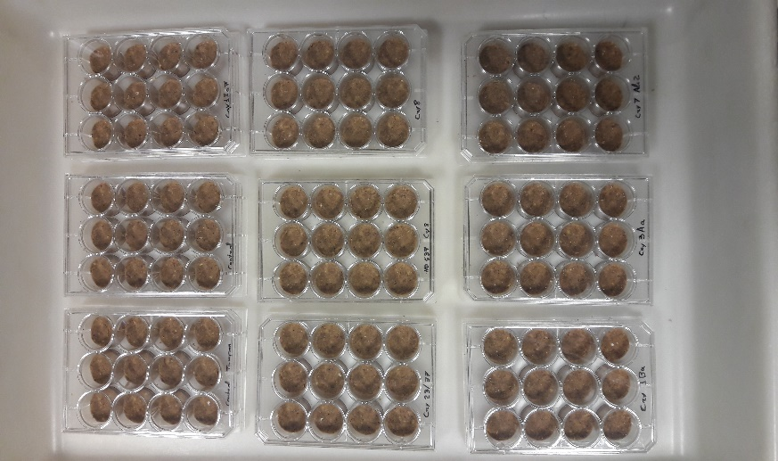
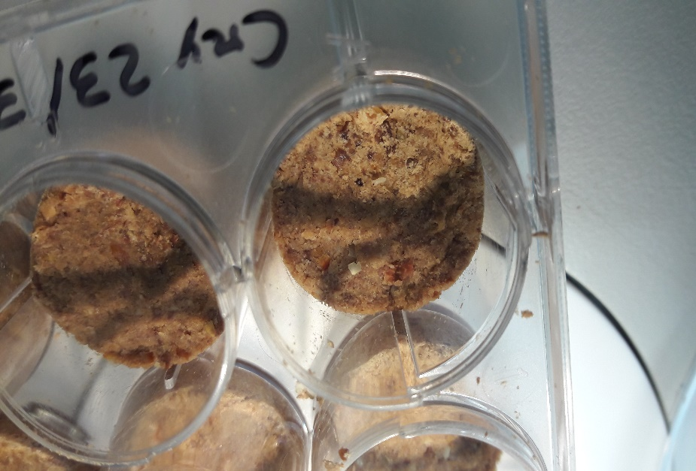
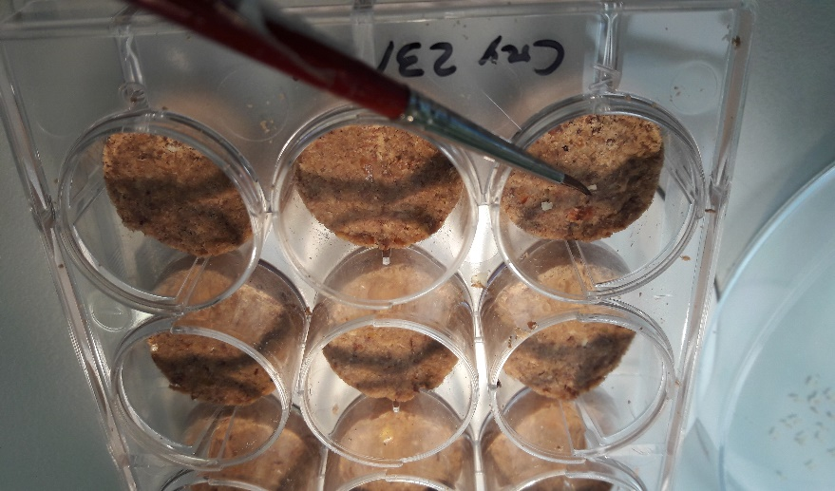
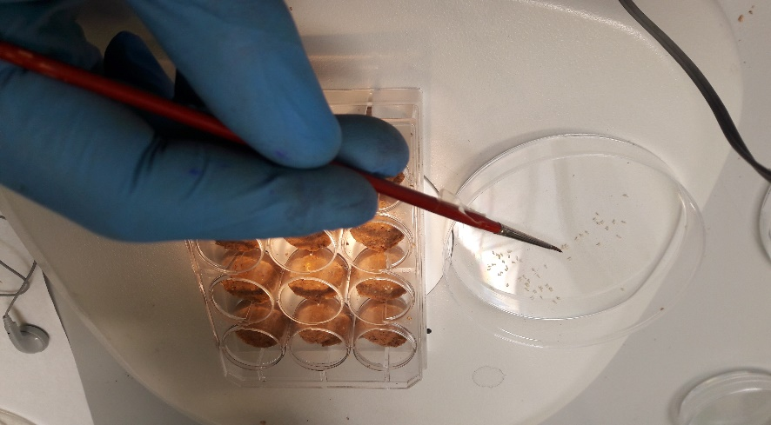
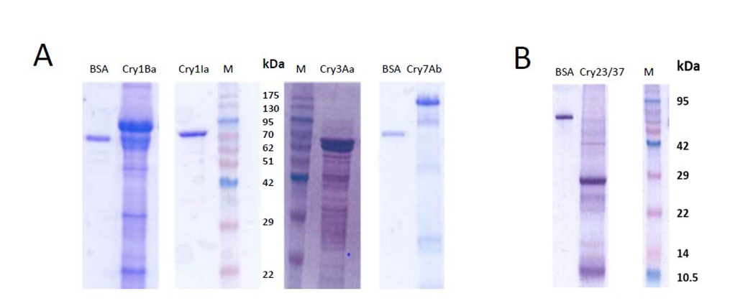
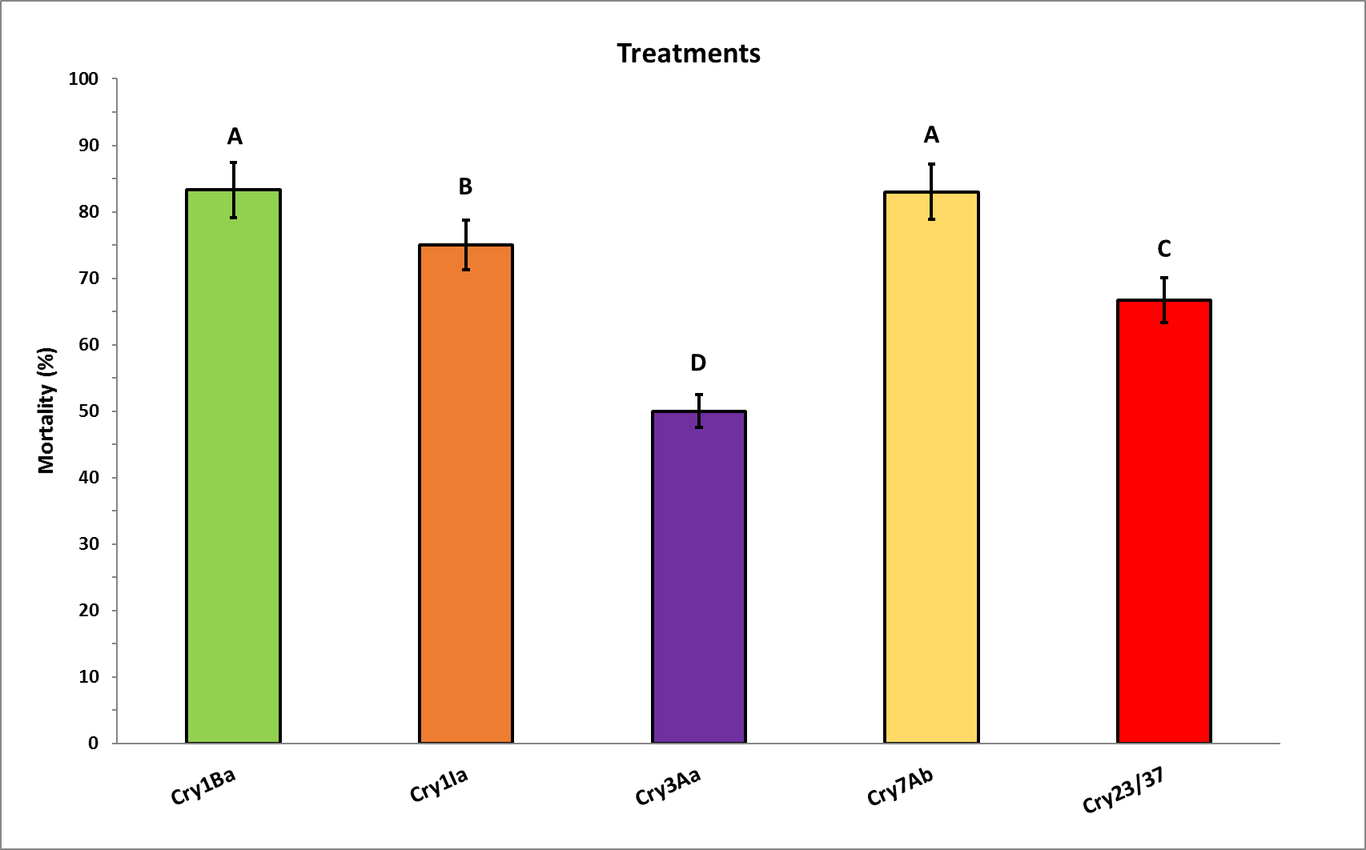

Susceptibility of Xylotrechus arvicola (Coleoptera: Cerambycidae) to five Cry toxins
Álvaro Rodríguez-González ¹*, Alejandra J. Porteous-Álvarez ¹, Mario Del Val ¹, Pedro A. Casquero ¹ and Baltasar Escriche ²*
1.- Grupo Universitario de Investigación en Ingeniería y Agricultura Sostenible (GUIIAS). Instituto de Medio Ambiente Recursos Naturales y Biodiversidad (INMARENBIO). Escuela de Ingeniería Agraria y Forestal (EIAF). Universidad de León. Avenida de Portugal 41, 24071, León, Spain.
2.- Instituto Universitario de Biotecnología y Biomedicina (BIOTECMED). Departamento de Genética. Universitat de Valencia, 46100 Burjassot, Spain.
* Correspondence: A.R.G. (alrog@unileon.es) and B.E. (baltasar.escriche@uv.es)
Xylotrechus arvicola is a significant pest in vineyards (Vitis vinifera) in the main wine-producing regions of Iberian Peninsula.
X. arvicola larvae bore the grapevine wood and make galleries, which cause structural damages to the plant and a decrease in the quality and quantity of its production. Cry toxins that exhibited toxicity against coleopteran larvae may be an alternative for its control.
Introduction
Cry proteins mode of action
Insect pest collections and X. arvicola rearing
Materials and Methods
Vineyards:
Laboratory:
2. Insect mate, lay eggs on substrates for oviposition, and neonate larvae are collected in a Petri dish
1. Insects captured with CROSSTRAP®
Test Toxic Activity
Cry proteins evaluated
Single dose bioassays:
1. Surface contamination method over semi synthetic diet and introduction of X. arvicola neonate larvae
Crystal
solubilization
Protein
Results and discussion
Protein Profile
Toxic Activity
The evaluation of insecticide active substances against coleopteran pests with a long and cryptic biological cycle is a challenge.
We have successfully applied the bioassay protocol used on X. arvicola larvae with other pesticides.
However, the accuracy of the results could be discussed, since some toxicological effects do not depend on the Cry proteins which can be degraded in a long treatment period .
Nevertheless, we can assess the results since we assume the generally accepted fact that the main insect toxicity effect of Cry preparation relies on the Cry proteins in the sample, and, with the reported data, we have, at least, preliminary toxic information.
Analysis of expression of strains that produced a single Cry protein (A), and the Bt EG10327 strain which produced Cry23Aa (about 30 kDa) and Cry37Aa (about 15 kDa) (B). BSA: 750 ng bovine serum albumin (BSA). M: molecular mass marker (Pink pre‐stained protein ladder Pink B4MWP02, Nippon genetics).
Corrected mortality (% ± SE) of X. arvicola neonate larvae exposure to 1 mg/cm2 of Cry proteins applied over an artificial diet. Abbott’s formula was used for correction. Different letters on the bars indicate statistically significant differences (LDS test) among the mortality rates.
We thank to R.M. Gonzalez for her support in toxin preparation. This work was supported by the Spanish Ministry of Science and Innovation (Ref. RTI2018-095204-B-C21 and PTA2017–14403-I), co-funded by EU FEDER funds
The Cry proteins evaluated have demonstrated different toxicity activity against the insect pests assayed, with over 50% mortality rates in all cases. Cry1Ba and Cry7Ab showed the most aggressive responses.
The larval stage tested is previous to drilling in the plant, which makes spray treatments feasible.
The results can help in designing combinations of Cry proteins as biopesticides to apply them by the time these larvae hatch to increase vine wood protection.
Acknowledgments
Conclusions
Conclusions

