Slide 1
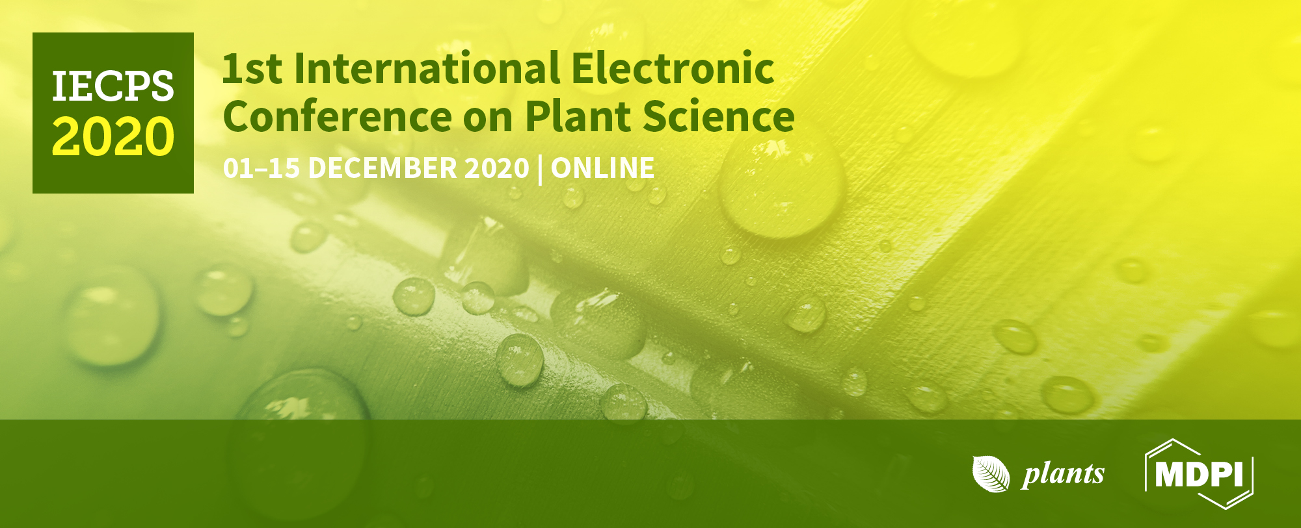


Isolation and genetic characterization of bacteria associated with Philaenus spumarius for the control of Xylella fastidiosa
Ana Afonseca*, Sofia Silva, Cristina Cameirão, and Paula Baptista
Centro de Investigação de Montanha (CIMO), Instituto Politécnico de Bragança, Campus de Santa Apolónia, 5300-253 Bragança, Portugal
* Corresponding author: anafilipa.afonseca53@gmail.com

Slide 2
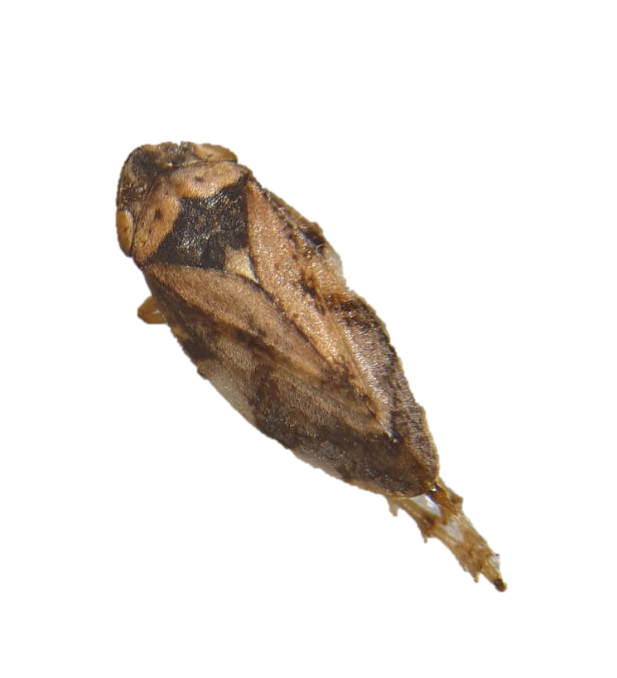

Abstract:
The endosymbiotic bacteria that live within the body of insects are involved in many aspects of the host physiology, including reproduction and defense. Philaenus spumarius was identified as one of the main vector of Xylella fastidiosa, a bacterium responsible for several diseases in a variety of agricultural crops of high importance. In this work, different media types were evaluated for the isolation of bacteria living within P. spumarius adults, for their potential exploitation in the management X. fastidiosa. Specifically, was compared the effect of minimal (Luria Bertani - LB) and complex (Modified Melin-Norkrans - MMN) media, with and without fetal bovine or gelling agents, on the abundance and diversity of bacteria. The collection of isolates obtained and of others previously obtained was further characterized by BOX-PCR and sequencing of the 16S ribosomal RNA (rRNA) gene.
Keywords: Culture media; DNA fingerprinting; BOX-PCR; 16S rRNA gene sequencing
Philaenus spumarius

Slide 3
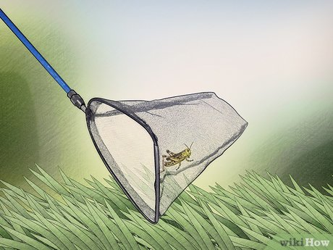

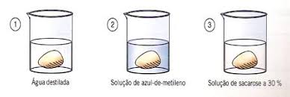
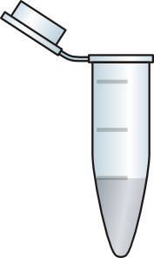
Material and Methods
Sampling
Isolation of bacteria
Genetic characterization
P. spumarius
Surface sterilization of adults
16S rRNA sequencing
BOX-PCR (primer BOXA1R)
Bragança (Portugal)
1 min Alcohol 70%
1 min Bleach 5%
Sterile dH₂O
(3X, 2 min)
Adult grinding
Solid medium
Liquid medium
LB - Luria Bertani
MMN - Modified Melin-Norkrans
FB - Fetal bovine
Inoculation
MMN with and without FB
LB with and without FB

Slide 4
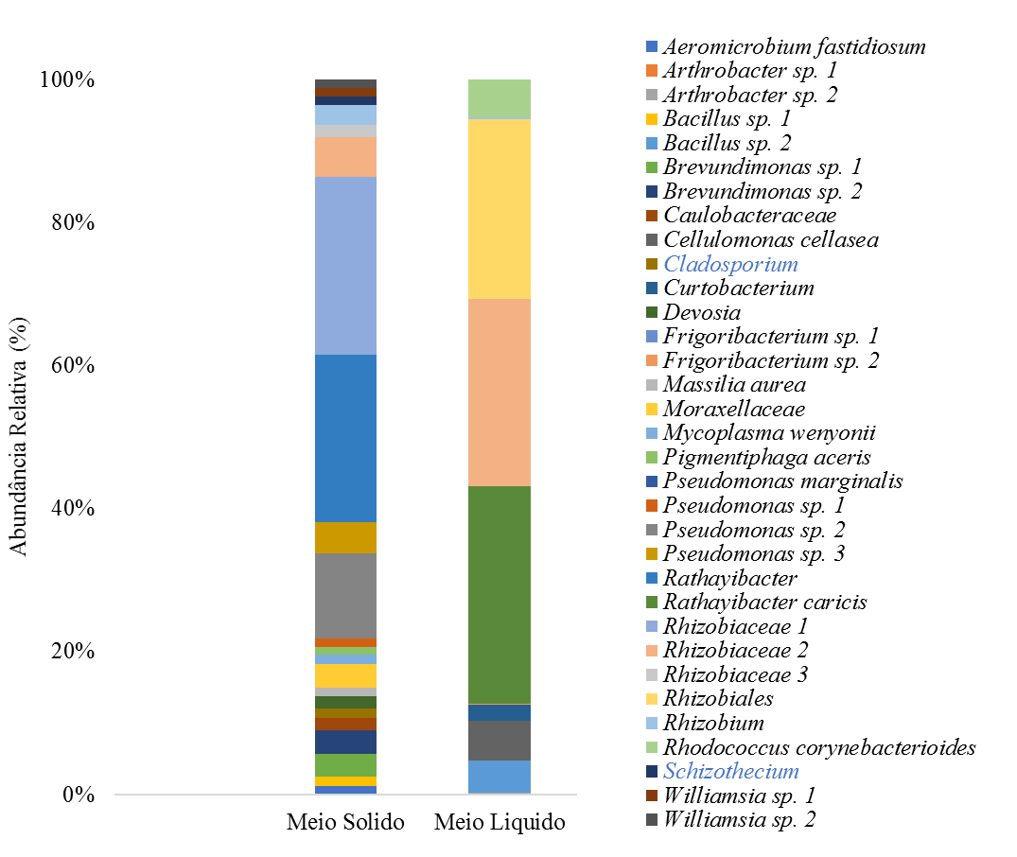
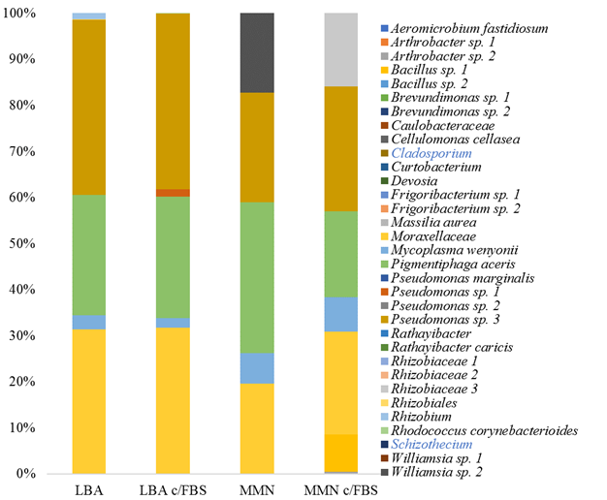
Results and Discussion
Solid vs. Liquid media
Type of culture media
Relative Abundance (%)
Solid
Liquid
LBA
LBA + FB
MMN
MMN + FB
The solid media facilitated the growth of more diverse bacterial taxa
No differences on the diversity of bacteria among the two media
The addition of FB leads to a slight increase in bacterial abundance

Slide 5
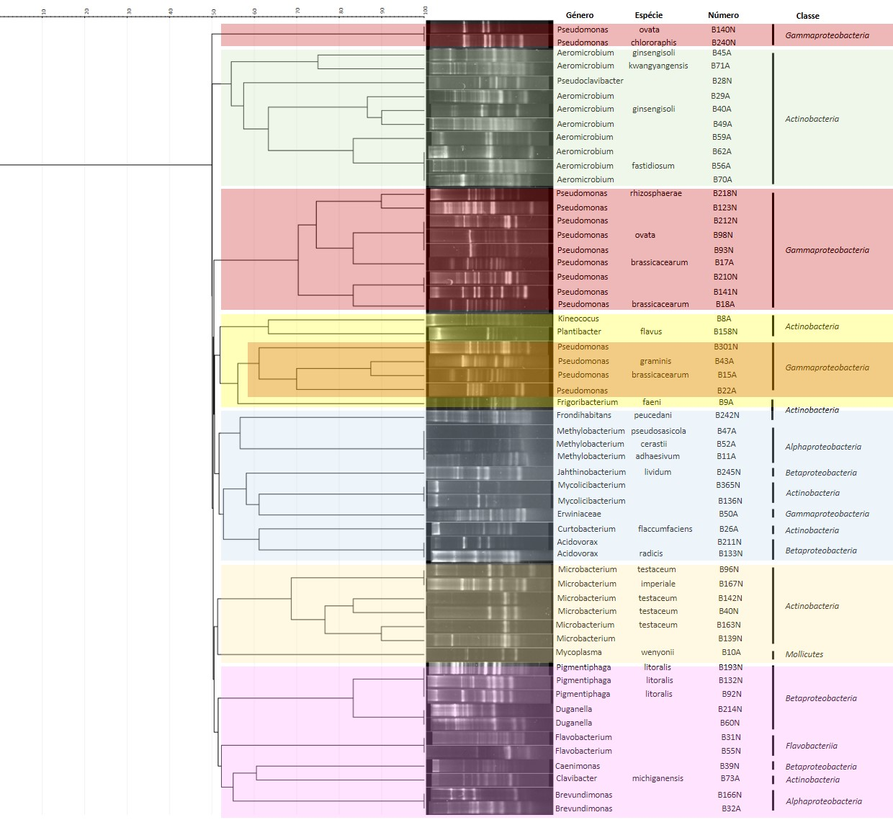
Genus
Species
Isolate
Class
The BOX-PCR revealed a high discriminatory power, allowing the differentiation of the bacteria at the intra-species level
Results and Discussion
Dendrogram BOX-PCR patterns showing the relationship between bacterial isolates (Dice coeficiente; UPGMA clustering method).

Slide 6
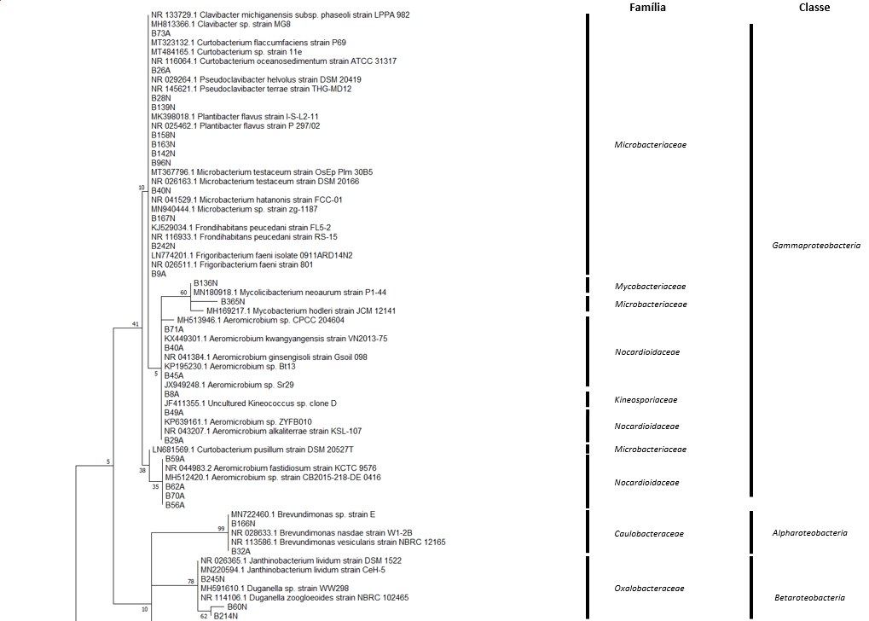
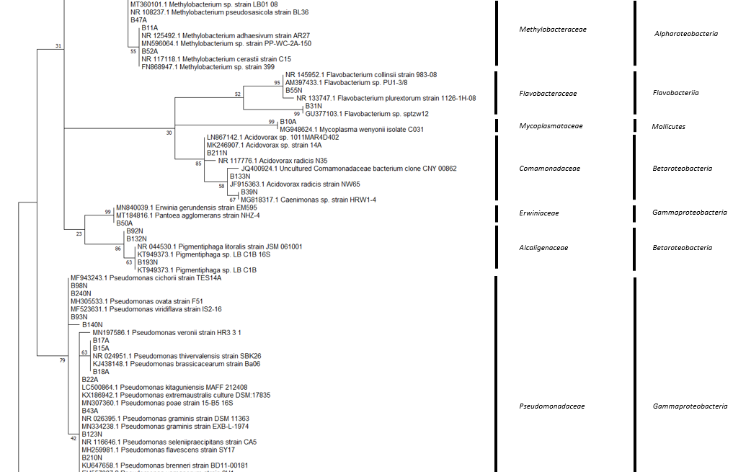
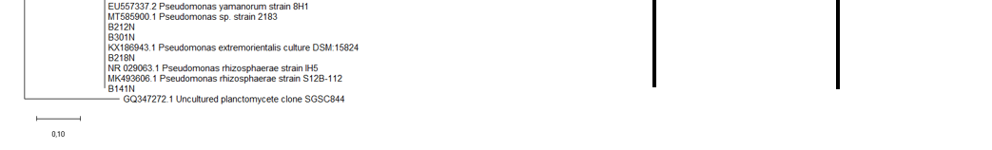
Family
Class
16S rRNA gene sequencing method is more suitable in phylogenetic evaluations, generally grouping isolates belonging to the same genus
Results and Discussion
Phylogenetic tree constructed based on 16S rRNA sequences using the Maximum Likelihood (ML) method. The evolutionary model applied to the analysis was K2 + G + I.

Slide 7
The exclusive growth of some species in MMN or LB, indicate that both media are complementary
Clustering of the isolates using BOX-PCR fingerprinting was different to that obtained from the 16S rRNA gene phylogenetic tree
The BOX-PCR has a higher discriminatory power than 16S rRNA gene
Futures studies should evaluate the function of these microorganisms in P. spumarius.
Conclusions

Slide 8
Acknowledgments
This work has received funding from the European Union’s Horizon 2020 research and innovation programme under Grant Agreement N. 727987 “Xylella fastidiosa Active Containment Through a multidisciplinary-Oriented Research Strategy, XF-ACTORS

