Slide 1
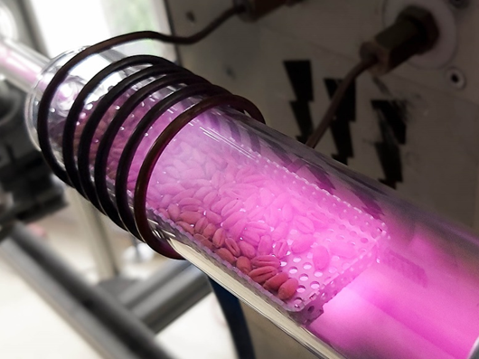
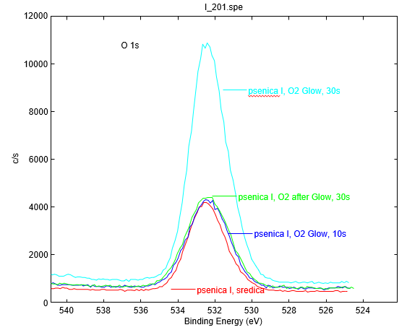
Exploring the Effects of Cold Plasma on Wheat Seed Surface, Germination and Growth
Pia Starič^{1,*} , Ita Junkar¹ , Katarina Vogel–Mikuš^{1,2}, Miran Mozetič¹
¹”Jožef Stefan” Institute, Jamova cesta 39, 1000 Ljubljana, Slovenia
²University of Ljubljana, Biotechnical faculty, Večna pot 111, 1000 Ljubljana, Slovenia
* corresponding author (pia.staric@ijs.si)
INTRODUCTION:
Seeds have large economic importance all over the world. They are an essential source of minerals, proteins, starch, and oil reserves in the early stages of plant development and growth. A high abundance of such molecules makes seeds of cereals and legumes a major food source for the majority of human world population. However, to gain optimal yield of important crops and to avoid pests, many farmers use pesticides and agrochemicals before, during, or/and after harvesting of crops. A wide and common use of such chemicals can cause pest resistance and harmful effects on soil and the surrounding environment, which represents a global threat to the environment.
The non-thermal or “cold” plasma technology is becoming more and more popular in the field of agriculture. It has been successfully used by scientists for the treatment of various types of seeds under specific conditions. Plasma treatment has, in some cases, triggered specific responses in plant seed growth and development, which could be used to agricultural advantage. Many researchers have reported changes in hydrophilic properties of seed surface and increased water uptake. Moreover, plasma-treated seeds showed improved growth, increased yield and triggered possible plant resistance to abiotic stress such as drought and salinity.
The objective of our experiment is to identify surface changes after cold plasma treatment, and the influence of plasma treatment on seed development and early growth. Different direct and indirect plasma treatments were applied on seeds of two winter wheat varieties. We examined and detected changes in the chemical composition of seed coat and changes in hydrophilic properties of seed surface. Plasma treatment also affected the dynamics of water uptake of seeds, germination rate and the root number of plants.
METHODS:
Figure 1: Wheat seeds in during treatment with direct plasma mode (glow region).
Seed material:
Plasma treatment:
XPS analysis:
Investigation of changes in chemical composition of seed surface.
Seeds of two winter wheat (Triticum aestivum) varieties.
Low pressure oxygen RF plasma
Direct treatment (glow region) for 10, 30 and 90 s
Indirect treatment (after glow region) for 30, 90 and 180 s
Seed germination and growth parameters of seedlings:
Calculating final germination rate and measuring root and shoot length and root number
Water contact angle measurements:
Measuring the changes in hydrophilic properties of the seed surface.
Water uptake of seeds:
Inspecting if changed chemical surface and hydrophilic properties affect water uptake of seeds.
RESULTS:
XPS analysis of seed surface revealed that plasma treatment causes a decrease in C, and increase in O (Figure 2) and N content compared to control. In contrast with untreated seeds, plasma treated (direct and indirect) seeds also displayed signals for K and Ca elements. Similar results were found in both winter wheat varieties.
We measured root length, total length of root system, number of roots per plant and shoot height. Significant difference was only found in the number of roots. Ingenio wheat variety seedlings, pre-treated with cold plasma all had higher number of roots compared to control. The highest number of roots was found in seeds pretreated with indirect cold plasma treatment for 180 s).
Glow, 30 s
After glow, 30 s
CONCLUSIONS:
XPS and WCA analysis showed that there is no statistically significant difference between the two wheat varieties.
Plasma treatment changed the chemical composition of seed surface and increased hydrophilic properties of seed coat.
Changes in chemical composition and hydrophilic properties affected the water uptake of seeds. With more hydrophilic surface, water enters the seed easier than in untreated seed where surface is more hydrophobic.
Plasma pre-treatment of seeds did not change the germination rate of both wheat varieties, except for the direct plasma treatment for 90 s, where germination rate was lower, compared to control.
Plasma treatment increased the number of roots of wheat variety Ingenio compared to untreated seeds.
The same plasma pre-treatment conditions affect the two wheat varieties differently.
Glow, 10 s
Control
Figure 2: XPS signal of oxygen content on wheat seed coats for different plasma treatments.
Vacuum conditions do not affect water contact angle (WCA) of seed coat. Plasma treatment, on the other hand, decreases WCA by half, and in longer treatments (90 s in direct mode or 180 s in indirect mode) the value of WCA decreased to one third of the control values in both winter wheat varieties. Indirect plasma treatment of seeds for 90 s had slightly higher WCA than direct plasma treatment for 90 s. This could be attributed to less aggressive properties of indirect plasma treatment and thus a smaller decrease in WCA.
Plasma treatment caused an increase in the water uptake of seeds compared to control. There was no difference between plasma treatments. Bernstein wheat variety had smaller water uptake in both control and plasma treated seeds, compared to Ingenio wheat variety.
Seed germination of plasma pre-treated seed remained the same as control for Bernstein: 96,8%; Ingenio: 100%). Lower germination rate was noticed only in seeds treated with plasma for 90 s in glow region (Bernstein: 93,2%; Ingenio: 86,6%).

