Slide 1
Understanding fungal communities of olive tree leaves for application to climate change adaptation
Helgeneusa Costa ¹, Vitor Ramos ¹, Jose A. Pereira ¹, Paula Baptista ^{1,*}
¹ Centro de Investigação de Montanha (CIMO), Instituto Politécnico de Bragança, Campus de Sta. Apolónia, 5300-253 Bragança, Portugal
* Corresponding author: pbaptista@ipb.pt

Slide 2
Abstract
The olive tree (Olea europaea subsp. europaea L.) is a typical plant of the Mediterranean vegetation, well adapted to drought and poor soils being also tolerant to high solar irradiance. The phyllosphere microbiota associated with these plants is likely to play a role in their tolerance to such harsh environmental conditions. Here, we have characterized the endophytic and epiphytic fungal community present in leaves of olive trees, for potential application of these insights to climate change adaptation. Leave samples were collected from a rainfed olive orchard near Mirandela (NE Portugal). Fungi were isolated and counted from the surface and inner tissues of leaves. The isolates obtained were identified by ITS rRNA gene sequencing and their phylogenetic diversity was then analyzed. A Celerioriella-like species and two unassigned species belonging to Phaeomoniellaceae and Pleosporineae were the most abundant taxa within 23 species (out of 161) found in both epiphytic and endophytic subsamples. These strains are good candidates to be studied for their resilience
to climate changes in order to be applied as "tolerance inducers"
in olive crops from this Mediterranean area.
Keywords: Fungal diversity; endophytes; epiphytes;
Internal transcribed spacer; phylogeny

Slide 3
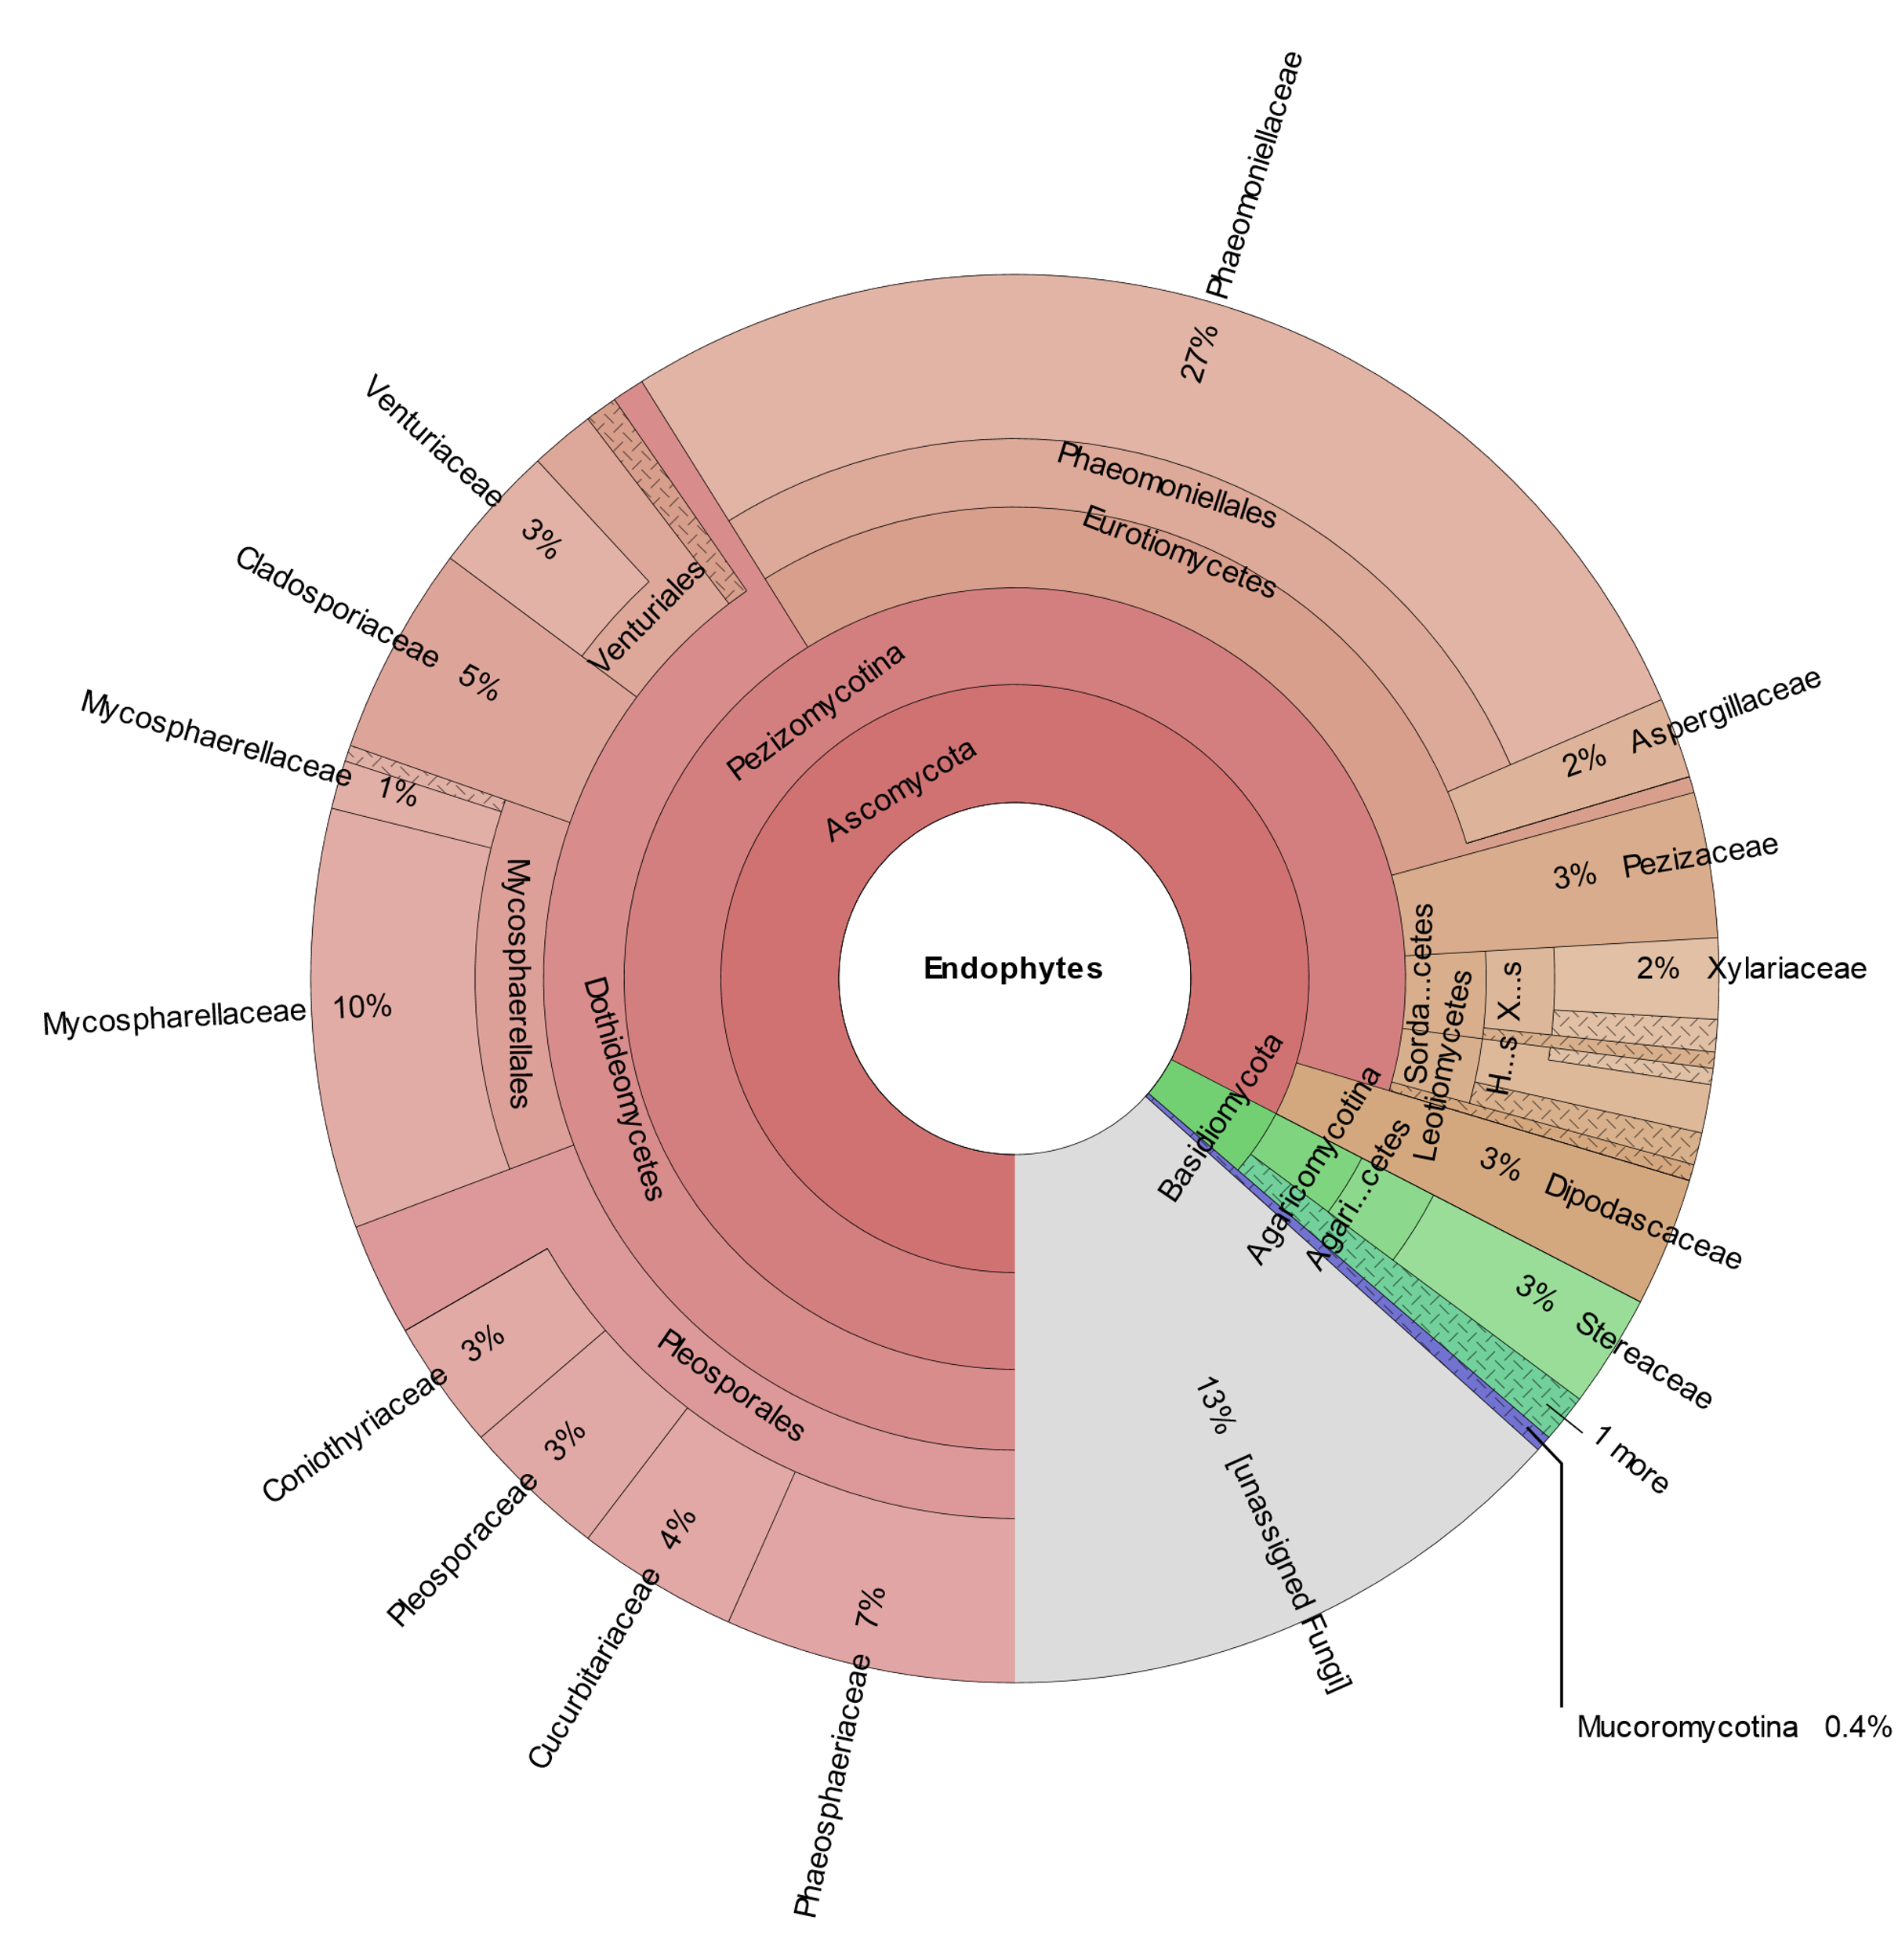
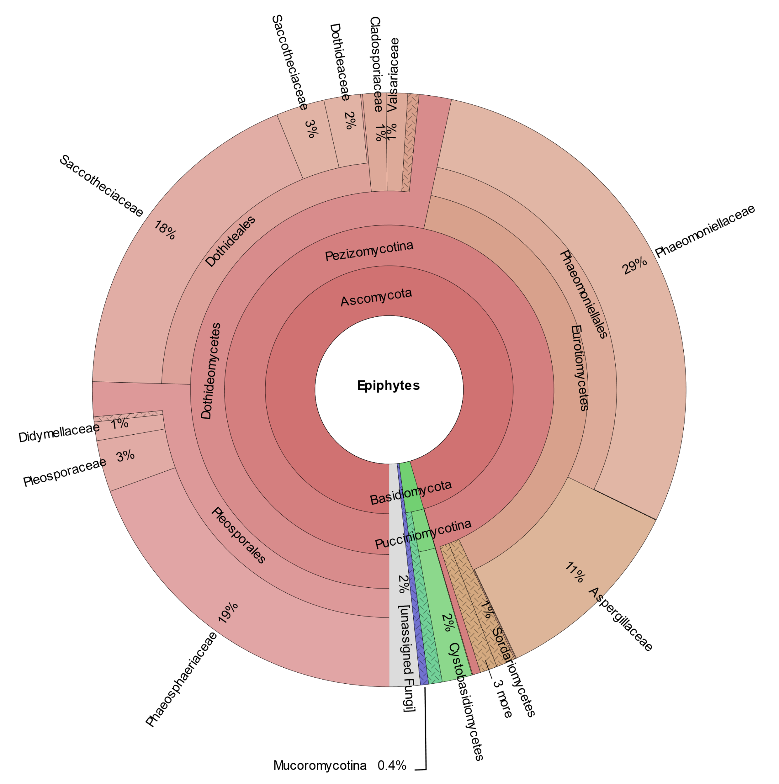
Results and Discussion
Phaeomoniellaceae
species 11 (11.5%) *
Higher species richness in epiphytes (99 spp.)
Higher species evenness in endophytes
Several endophytes fungi unassigned
Phaeomoniellaceae
species 9 (5.6%) *
Pseudocercospora aff.
cladosporioides (4.8%) *
Aureobasidium aff.
pullulans (15.5%) *
Phaeomoniellales
species 1 (4.2%) *
aff. Celerioriella sp.
(18.3%) *
unidentified sp. 1
(8.1%) *
Didymocyrtis sp.(3.3%) *
The five most abundant taxa * represented:
63,9% of epiphytes
33,3% of endophytes
Pleosporineae species 1 (19.4%) *
Aspergillus tennesseensis (6.5%) *

Slide 4
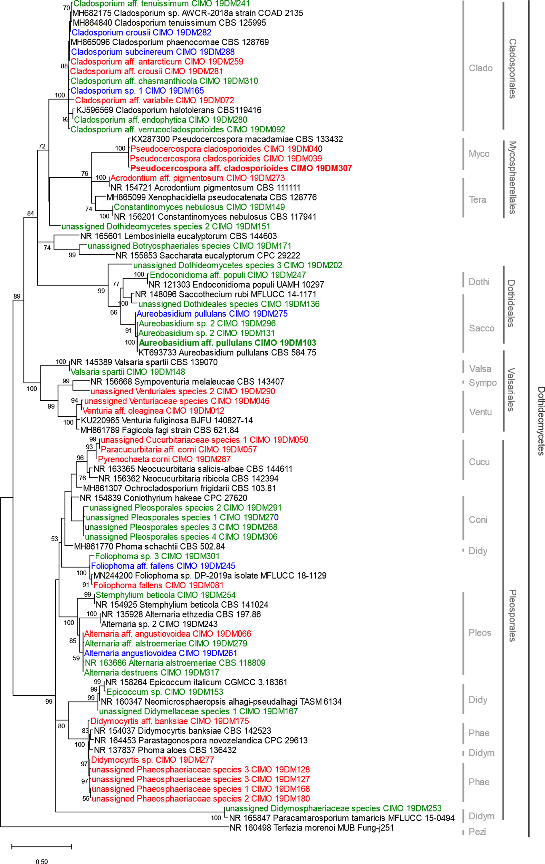
Results and Discussion: phylogeny of Dothideomycetes
Epi
Most abundants
Endo
Epi&Endo

Slide 5
Results and Discussion: phylogeny of Dothideomycetes (cont.)
Epi
Endo
Most abundants
Epi&Endo

Slide 6
Results and Discussion: phylogeny of remaining taxa from the Pezizomycotina subphylum (cont.)
Epi
Most abundants
Endo
Epi&Endo

Slide 7
Results and Discussion: phylogeny of remaining taxa from the Pezizomycotina subphylum
Epi
Endo
Epi&Endo

Slide 8
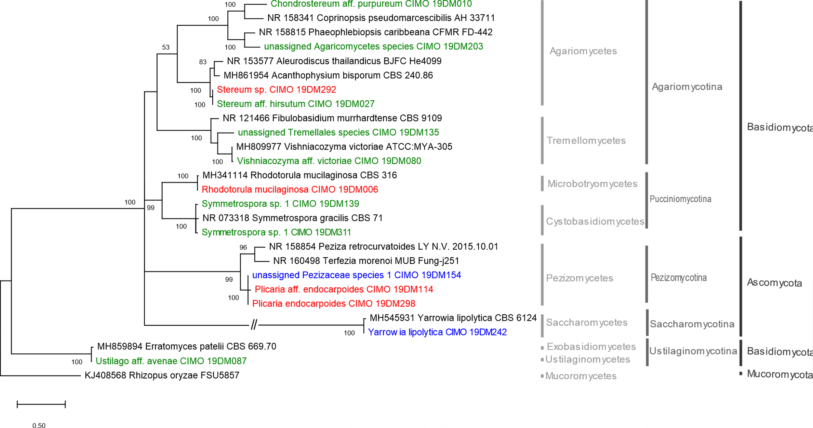
Results and Discussion: phylogeny of Basidiomycota and of remaining Ascomycota taxa
Epi
Endo
Epi&Endo

Slide 9
Conclusions
Twenty-three fungal species (out of 161) found to live both epiphytically and endophytically, w/ some being abundant
Phaeomoniellaceae → abundant, but understudied on olive trees; several unassigned species (novel taxa)
May species from this group play as climate change bioindicators and/or "tolerance inducers" in olive crops?
Further research is needed

Slide 10
Acknowledgments
This work is supported by FEDER funds through the COMPETE (Operational Programme for Competitiveness Factors) and by National funds through the FCT (Foundation for Science and Technology) within the POCI-01-0145-FEDER-031133 (MicOlives) project.
Helgeneusa Costa also acknowledges FCT for her «Verão com Ciência» fellowship.
Image credits
https://commons.wikimedia.org/wiki/File:01_01_phylogeny_of_fungi_-_simplified_(M._Piepenbring).PNG
https://creazilla.com/nodes/67318-olive-branch-clipart

