Slide 1



Fruit-associated endophytes from olive cultivars with different levels of resistance to fruit fly and their relationship with pest infestation
Teresa Lopes, Vitor Ramos, Cristina Cameirão, José Alberto Pereira, Paula Baptista*
Centro de Investigação de Montanha (CIMO), Instituto Politécnico de Bragança. Campus de Santa Apolónia, 5300-253 Bragança, Portugal.
* Corresponding author: pbaptista@ipb.pt

Slide 2

Abstract
Different olive cultivars exhibit different propensities to fruit fly infestation and the causes are still unclear. We want to disclose the potential role of the olive endophytes in conferring such susceptibility differences. Accordingly, the endophytic microbial composition of infested and non-infested fruits from cultivars Madural (susceptible to olive fly) and Cobrançosa (less susceptible) were studied. A culture-dependent approach was used, being the isolates identified by sequencing of their internal transcribed spacer (for fungi) and 16S rRNA gene regions (for bacteria). Overall, there was a larger consortium of bacteria associated to olives than fungi. The microbial communities were mostly composed of Proteobacteria, Actinobacteria, Ascomycota and Basidiomycota. Both host cultivar and infestation level had a negligible effect on microbial community composition. Despite this, it was found a clear positive association of microbial consortia with the resistant cultivar (Kocuria sp., Actinobacterium sp., Rhodococcus sp., Pseudomonas citronellolis, Aspergillus flavus, Stereum sp., and Cladosporium sp.) and non-infested fruits (Kocuria sp., Stereum sp., and Vishniacozyma victoria). Their function roles on host cultivar susceptibility/resistance to fruit fly is a topic that requires further studies.
Keywords: Bactrocera oleae Rossi; susceptibility of olive cultivars; bacteria; fungi; biocontrol

Slide 3
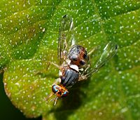
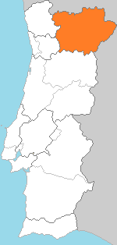
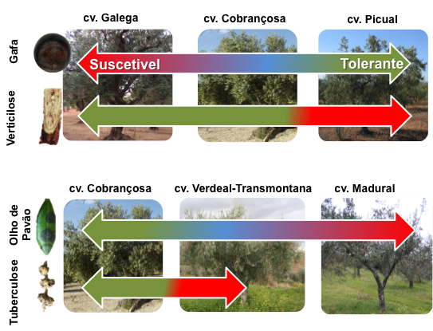
Susceptibility of Olive Tree Cultivars to Olive Fly Attack
Tolerant
Susceptible
The exact reason of differences on susceptibility is currently unknown.

Slide 4
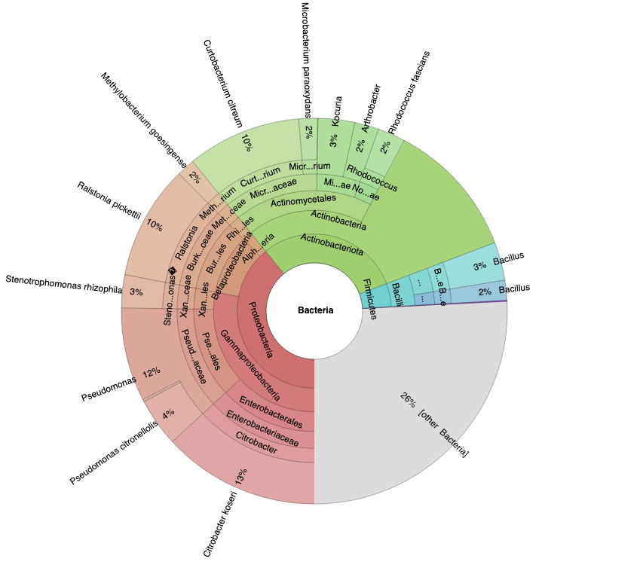
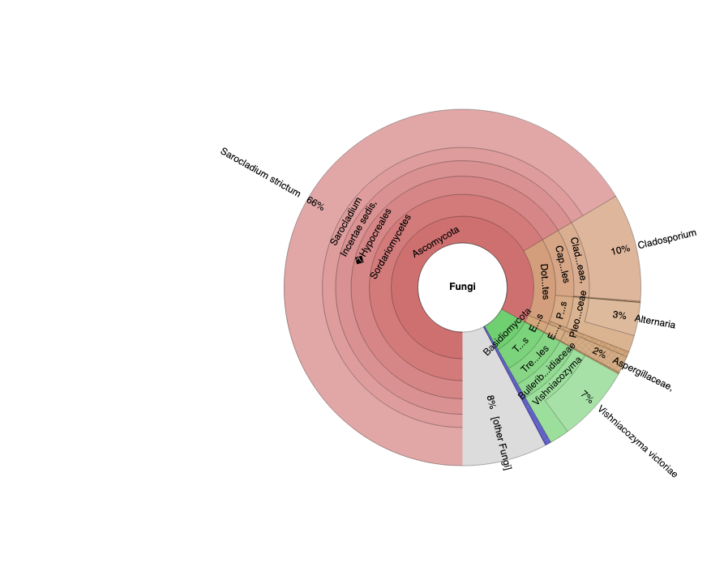
Microbial diversity
a
b
Major phyla:
Proteobacteria and Actinobacteria
Ascomycota and Basidiomycota.
Cumulative curves reached asymptote emphasising the adequate sampling
4
4

Slide 5
Bacterial Community
CAN THEY SHAPE ENDOPHYTIC COMMUNITY?
Kruskal stress = 0.117
Kruskal stress = 0.117
Cobrançosa vs. Madural
Infested vs. Non infested
 | ANOSIM | PERMANOVA
Cultivar | 0.225*** | 0,021**
Infestation level | 0.210*** | 0,013^{n.s.}

Slide 6
Fungal Community
CAN THEY SHAPE ENDOPHYTIC COMMUNITY?
Kruskal stress = 0.118
Kruskal stress = 0.118
Cobrançosa vs. Madural
Infested vs. Non infested
 | ANOSIM | PREMANOVA
Cultivar | 0.216*** | 0,023**
Infestation level | 0.189*** | 0,012^{n.s.}

Slide 7
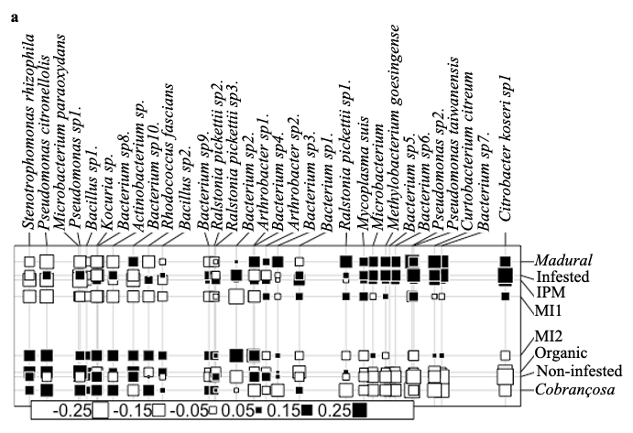
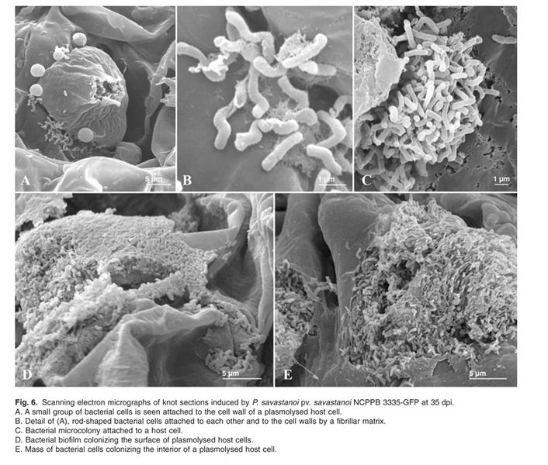
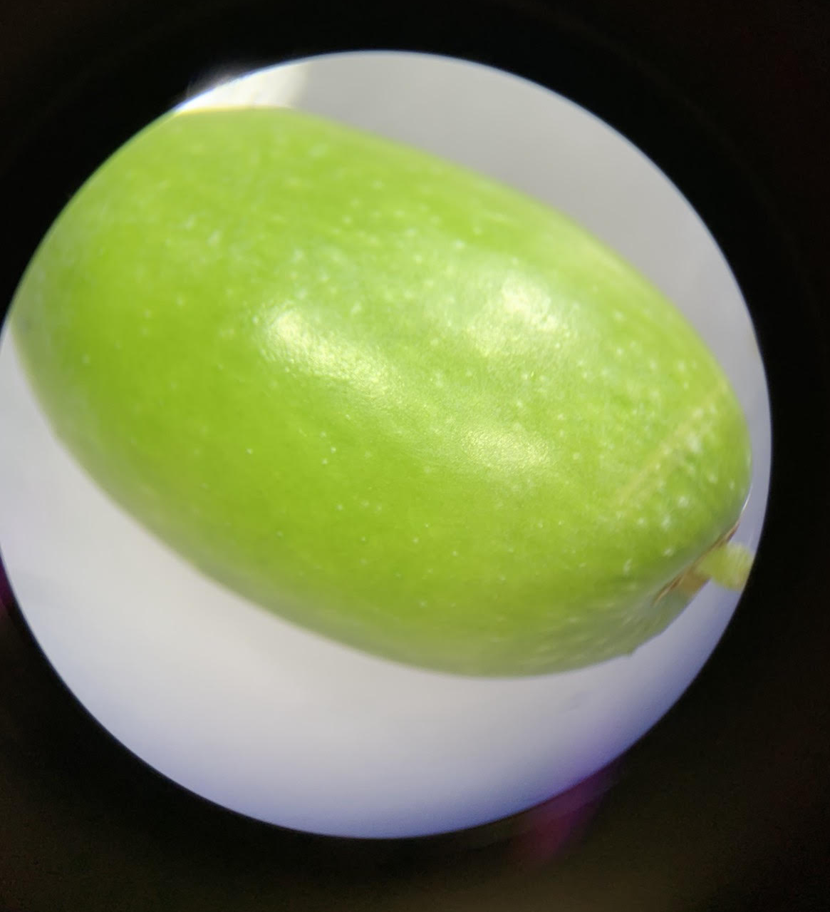
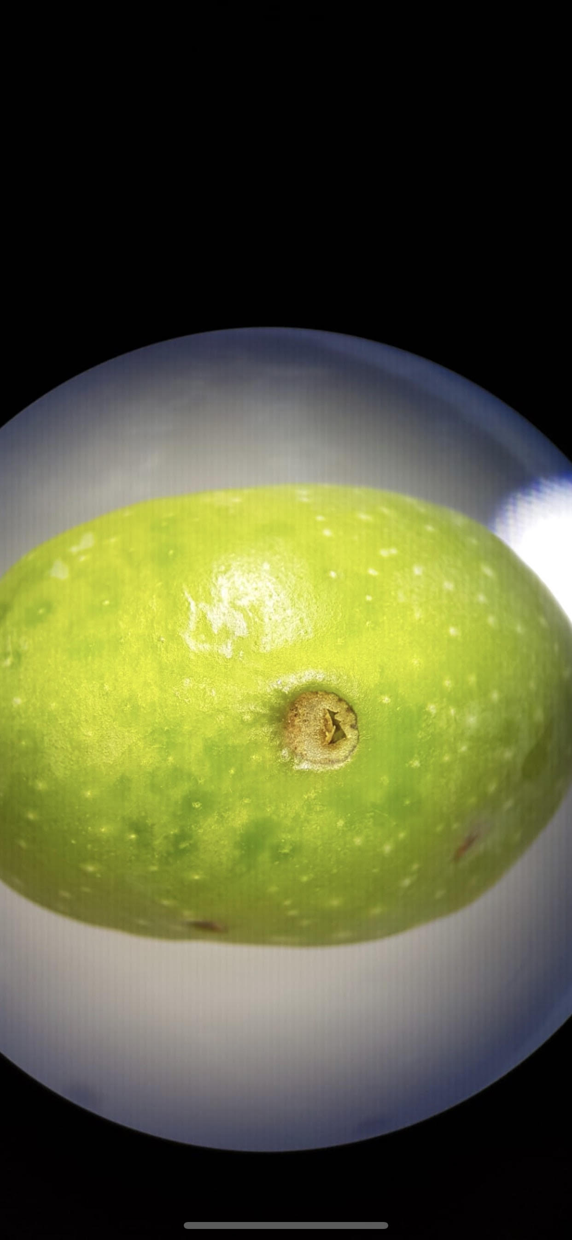

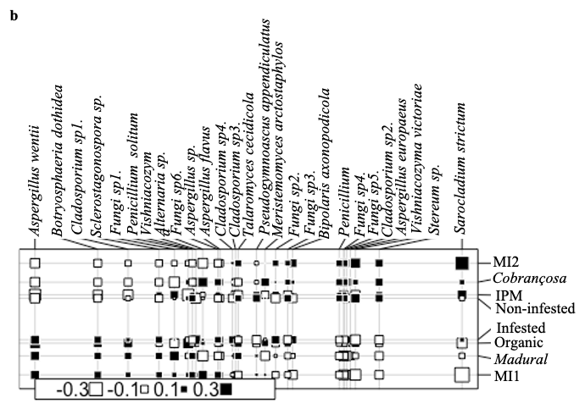
Bacteria
Bacteria
Fungi
Olive fruit endophytes
Fungi

Slide 8
Kocuria sp.
Actinobacterium sp.
Rhodococcus sp.
Pseudomonas citronellolis
Aspergillus flavus
Stereum sp
Cladosporium sp.
Kocuria sp.
Stereum sp.
Vishniacozyma victoria
Pseudomonas sp.
Curtobacterium citreum
Ralstonia pickettii
Aspergillus wentii
Citrobacter koseri
Alternaria sp
Sarocladium strictum
positively correlated
with
cv. Madural
positively correlated
with
cv. Cobrançosa
positively correlated
with
infested fruits
Olive fruit endophytes
positively correlated
with
non-infested fruits
What can they do?
Could they be useful?
Most species are plant pathogen but some are able to promote plant growth and promote disease resistance.
Kocuria sp., P. citronellolis & V. victoria are potential olive biocontrol agents.
Notes:
Microbacterium paraoxydans, Kocuria sp., Penicillium solitum, Cladosporium sp3. and Vishniacozyma victoriae were the most associated with organic orchard and non-infested fruits.

Slide 9
No significant differences among the two types of cultivar and infestation level.
Cultivar influences 2.1% and 2.3% of the bacterial and fungal composition respectively.
Kocuria sp., P. citronellolis & V. Victoria are found to be endophytes with potential biocontrol activities in olive tree. However future studies must be done to confirm.
CONCLUSION

Slide 10


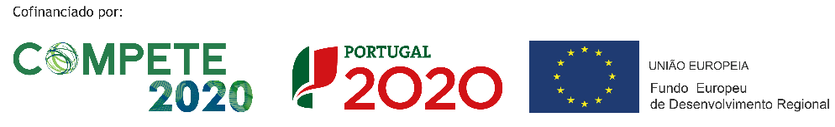
This work is supported by FEDER funds through the COMPETE (Operational Programme for Competitiveness Factors) and by National funds through the FCT (Foundation for Science and Technology) within the POCI-01-0145-FEDER-031133 (MicOlives) project.
ACKNOWLEDGEMENTS

