Slide 1
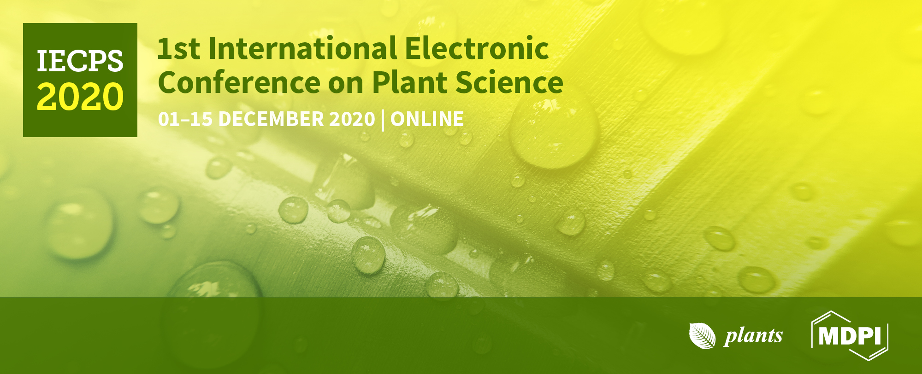


Conference Proceedings Paper
A novel plant-based biostimulant improves plant performances under drought stress in tomato
Francesca Silvana, Giampaolo Raimondi, Valerio Cirillo, Albino Maggio, Amalia Barone, Maria Manuela Rigano*
Department of Agricultural Sciences, University of Naples Federico II, Portici, 80055 Naples, Italy;
silvana.francesca@unina.it(S.F.); giampaolo.raimondi@unina.it(G.R) ;valerio.cirillo@unina.it (V.C.); almaggio@unina.it(A.M); ambarone@unina.it (A.B.)
*Correspondence: mrigano@unina.it (M.M.R.) ; Tel.: +39-0812532125

Slide 2

Abstract: Abiotic stress adversely affects crop production, causing yield reductions in important crops, including tomato (Solanum lycopersicum). Among different abiotic stresses, drought is considered to be the most critical one since limited water availability negatively impacts plants growth and development, especially in arid or semi-arid areas. The aim of this study was to understand how biostimulants may interact with critical physiological response mechanisms in tomato under limited water availability and to define strategies to improve tomato performances under drought stress. We investigated physiological responses of the tomato genotype ‘E42’ grown in open field under control condition (100% irrigation) and limited water availability (50% irrigation) and treated or not with a novel plant-based biostimulant named CycoFlow (Agriges, BN, Italia). Plants treated with the biostimulant showed an increase in stomatal conductance. The highest yield per plant was registered under the 100% water regimens in biostimulant-treated plants. Also, biostimulant-treated plants had higher pollen viability (+50.94% under water deficit) and higher fruit weight (+56.13% under water deficit) compared to non-treated plants. The treatment with the biostimulant had also an effect on antioxidants and pigments content in leaves and fruits. Altogether, these results indicate that the application of the biostimulant CycoFlow to tomato plants improved plant performances under limited water availability.
Keywords: bioassay, limited water availability, tomato yield, glycine betaine

Slide 3
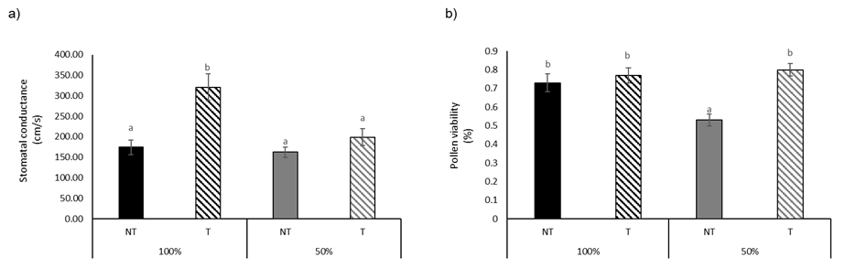
Results and Discussion
The treatment with CycoFlow caused an increase in stomatal conductance (up to 84.01%) under full irrigation and an increase in LDMC. Plants treated with Cycoflow and subjected to water deficit showed an increase in pollen viability of 50.94% compared to non-treated plants. The treatment with the biostimulant increased fruit weights (up to 56.13% under water deficit). The highest yield per plant was registered under the 100% water regimens in biostimulant treated plants.
Table 1. Leaf water potential, stomatal conductance, pollen viability, leaf dry matter content (LDMC) and biometric parameters of E42 treated with the biostimulant CycoFlow under two irrigation levels. Asterisks indicate significant differences according to ANOVA (ns = not significant; * = p < 0.05; ** = p < 0.01; *** = p < 0.001). Different letters indicate significant differences according to Tukey’s post-hoc test (p < 0.05).
Figure 1. Effect of CycoFlow on (a) stomatal conductance, (b) pollen viability of E42. Values are mean ± SE. Different letters indicate significant differences based on Tukey’s test (p ≤ 0.05).

Slide 4
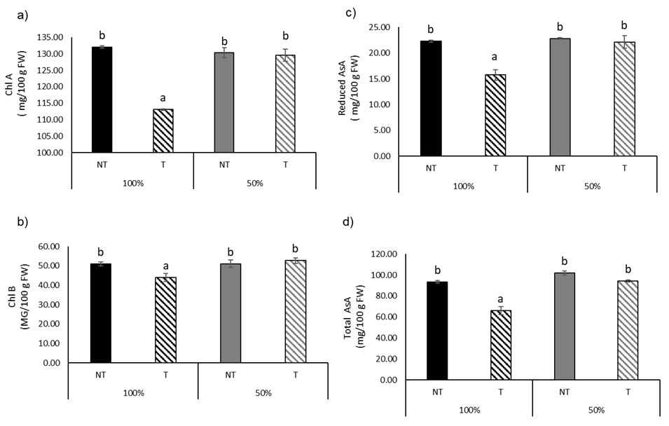
Results and Discussion (2)
The treatment with the biostimulant had a significant effect on chl A content, that decresed in treated non-stressed plants. The treatment with the biostimulant decreased the content of both reduced and total AsA under the 100% irrigation regimen. The antioxidant activity in the leaves increased by 98.09% after treatment with the biostimulant under limited water availability.
Table 2. Content of total AsA, reduced AsA, carotenoids, chlorophyll A and B (Chl A, B) and antioxidant activity (Frap) in leaves of E42 treated with the biostimulant CycoFlow under two irrigation regimens. Asterisks indicate significant differences according to ANOVA (ns = not significant; * = p < 0.05; ** = p < 0.01; *** = p < 0.001). Different letters indicate significant differences according to Tukey’s post-hoc test (p < 0.05).
Figure 1. Effect of CycoFlow on the content of (a) chlorophyll A, (b) chlorophyll B, (c) reduced AsA, (d) total AsA in leaves of E42. Values are mean ± SE. Different letters indicate significant differences based on Tukey’s test (p ≤ 0.05).

Slide 5
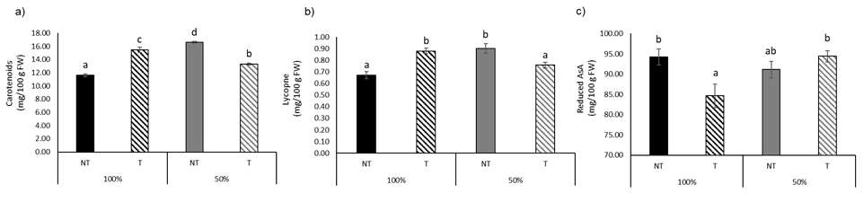
Results and Discussion (3)
On fruits, water deficit increased the content of carotenoid by 42.80% compared to non stressed plants. Reduced AsA, carotenoids and lycopene contents were significantly affected by the interaction between biostimulant treatments and water regime. The treatment with the biostimulant alone effected the content of total Ascorbic Acid.
Table 3. Content of total AsA , reduced AsA, carotenoids, β-carotene, lycopene and antioxidant activity (Frap) in fruit of E42 treated with the biostimulant CycoFlow under two irrigation regimens. Asterisks indicate significant differences according to ANOVA (ns = not significant; * = p < 0.05; ** = p < 0.01; *** = p < 0.001). Different letters indicate significant differences according to Tukey’s post-hoc test (p < 0.05).
Figure 3. Effect of CycoFlow on the content of (a) carotenoids, (b) lycopene, (c) reduced AsA in fruit of E42. Values are mean ± SE. Different letters indicate significant differences based on Tukey’s test (p ≤ 0.05).

Slide 6

Conclusions
In this paper we investigated the effects of the application of one plant-based biostimulant named CycoFlow on the nutritional quality and yield of tomatoes grown under limited water availability. The application of the CycoFlow biostimulant had a clear effect on plant growth and improved plant performances under stress conditions. Cycoflow application had also a clear effect on antioxidant activity and tomato fruit quality. It can be concluded that this plant-based biostimulant enhances defences mechanisms under water stress conditions, including the increase in antioxidants content. Additional research is needed to fully understand the mechanisms of action of this plant-based biostimulant.
Funding:
This research was funded by the European Union’s Horizon 2020 research
and innovation program (TOMRES, grant agreement no. 727929).

