Slide 1
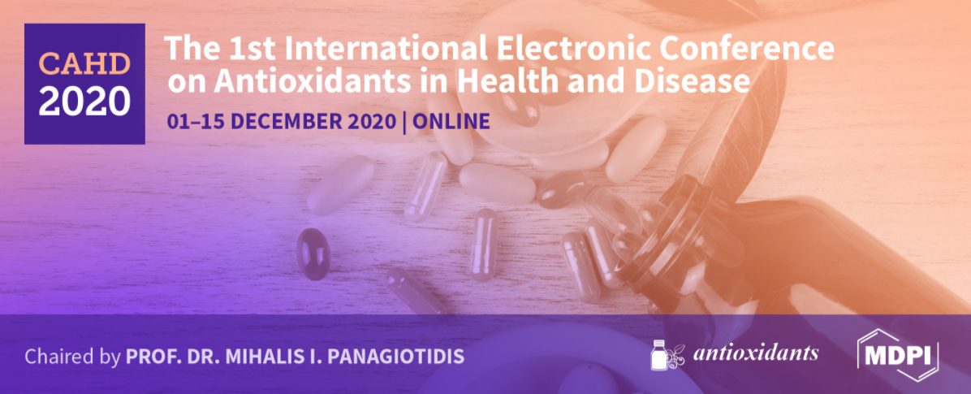
The effects of strawberry bioactive compounds on lipid metabolism and adipogenesis
Dr. Francesca Giampieri
Università Politecnica delle Marche
Dipartimento di Scienze Cliniche Specialistiche ed Odontostomatologiche

Slide 2
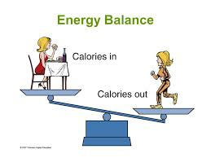
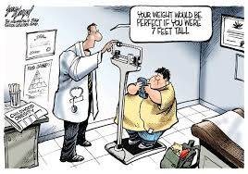
HOW CAN OBESITY BE DEFINED?
OBESITY is defined as abnormal or excessive fat accumulation that may impair health.
The fundamental cause of obesity and overweight is an energy imbalance between calories consumed and calories expended.

Slide 3
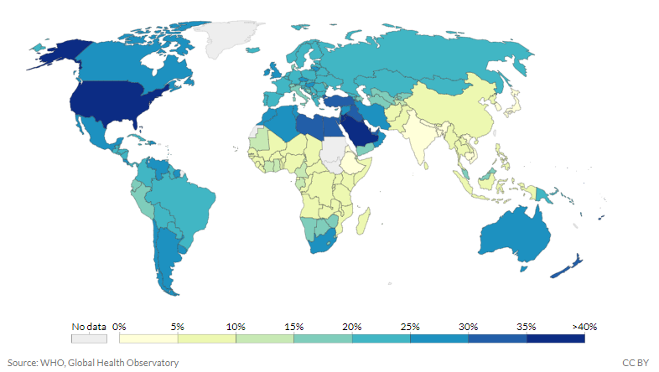
OVERWEIGHT AND OBESITY IN THE WORLD
Percentage of adults who are defined obese according to their BMI, 2016
Most of the world's population live in a country where there are more people overweight and obese than underweight.

Slide 4
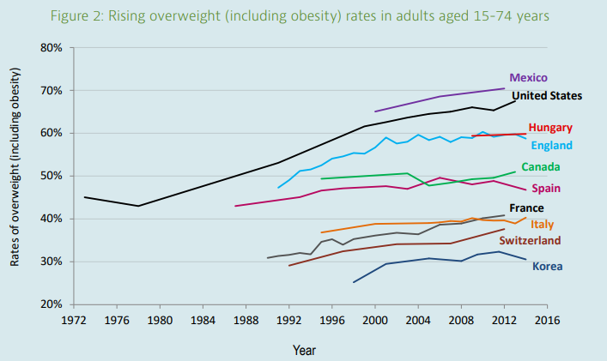
OVERWEIGHT AND OBESITY TRENDS IN THE WORLD
Rising overweight (including obesity) rates in adults aged 15 -74 years
OBESITY RATES ARE EXPECTED TO INCREASE FURTHER

Slide 5
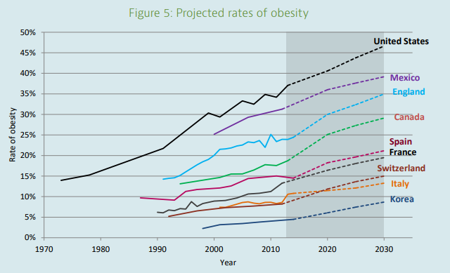
OVERWEIGHT AND OBESITY TRENDS IN THE WORLD
Rising overweight (including obesity) rates in adults aged 15 -74 years
OBESITY RATES ARE EXPECTED TO INCREASE FURTHER

Slide 6
FACTS ABOUT OVERWEIGHT AND OBESITY
More than 1.9 billion adults were overweight in 2016 and 650 million obese
In 2016, more than 1.9 billion adults were overweight and 650 million were obese.
At least 2.8 million people each year die as a result of being overweight or obese.
The prevalence of obesity nearly tripled between 1975 and 2016.
Once associated with high-income countries, obesity is now also prevalent in low- and middle-income countries.
By 2025 it is estimated that 2.7 billion adults and 268 million school-age children will be overweight or obese

Slide 7
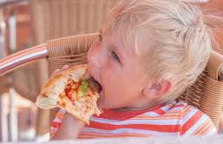
FACTS ABOUT OVERWEIGHT AND OBESITY
Globally, 41 million preschool children were overweight in 2016
Overweight children are likely to become obese adults.
They are more likely than non-overweight children to develop diabetes and CVDs at a younger age, which in turn are associated with a higher chance of premature death and disability.
Childhood obesity is one of the most serious public health challenges of the 21st century.

Slide 8
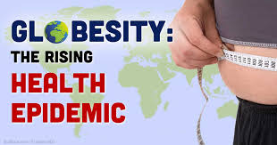
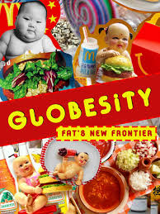
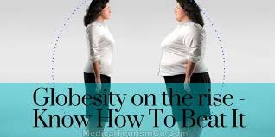
Obesity is a pandemic!!!!

Slide 9
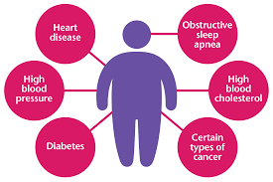
FACTS ABOUT OVERWEIGHT AND OBESITY
Global Disability-Adjusted Life-Years and Deaths Associated with a High Body-Mass Index (2015)
Coronary heart disease
Type 2 diabetes
Cancer (endometrial, breast, colon)
Hypertension
Stroke
Liver disease
Sleep apnea and respiratory problems
Osteoarthritis
Gynecological problems (abnormal menses, infertility)
OVERWEIGHT AND OBESITY ARE LINKED TO MORE DEATHS WORLDWIDE THAN UNDERWEIGHT

Slide 10
Risk factors of obesity
https://mumsfertility.com/overweight-obesity-causes-symptoms/

Slide 11
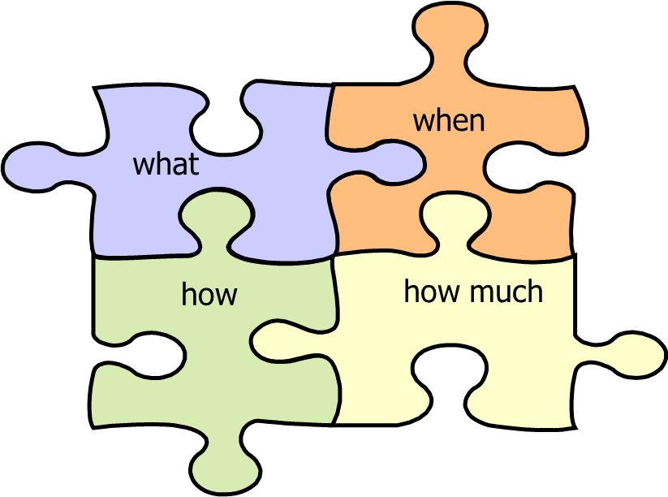
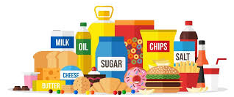
Health and nutrition
Modernization
Urbanization
Demographic changes
Socio-economic changes/economic growth
Globalization of the world food market
Media, marketing
Increased intake of calorie rich, low nutritive value foods: high intake of fats, trans fats, sugar, salt.

Slide 12
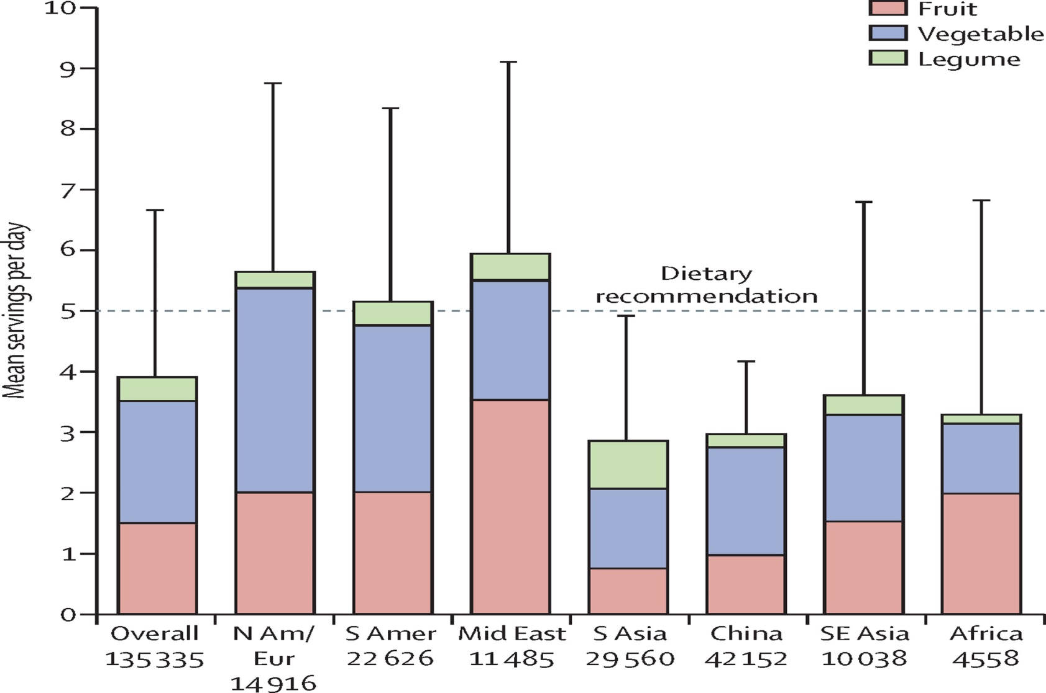
Health and nutrition

Slide 14
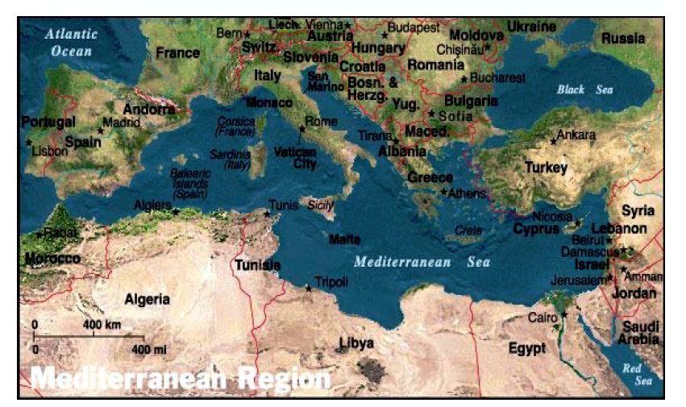
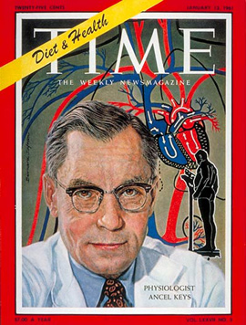
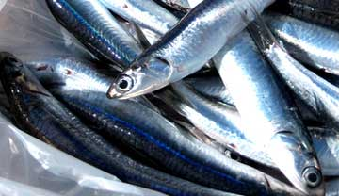
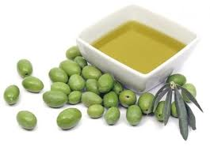
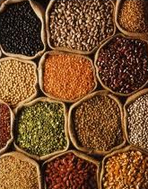
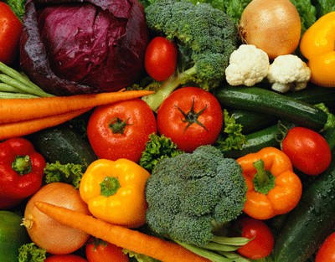
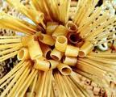
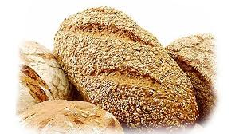
Mediterranean diet: a tool for primary prevention

Slide 15
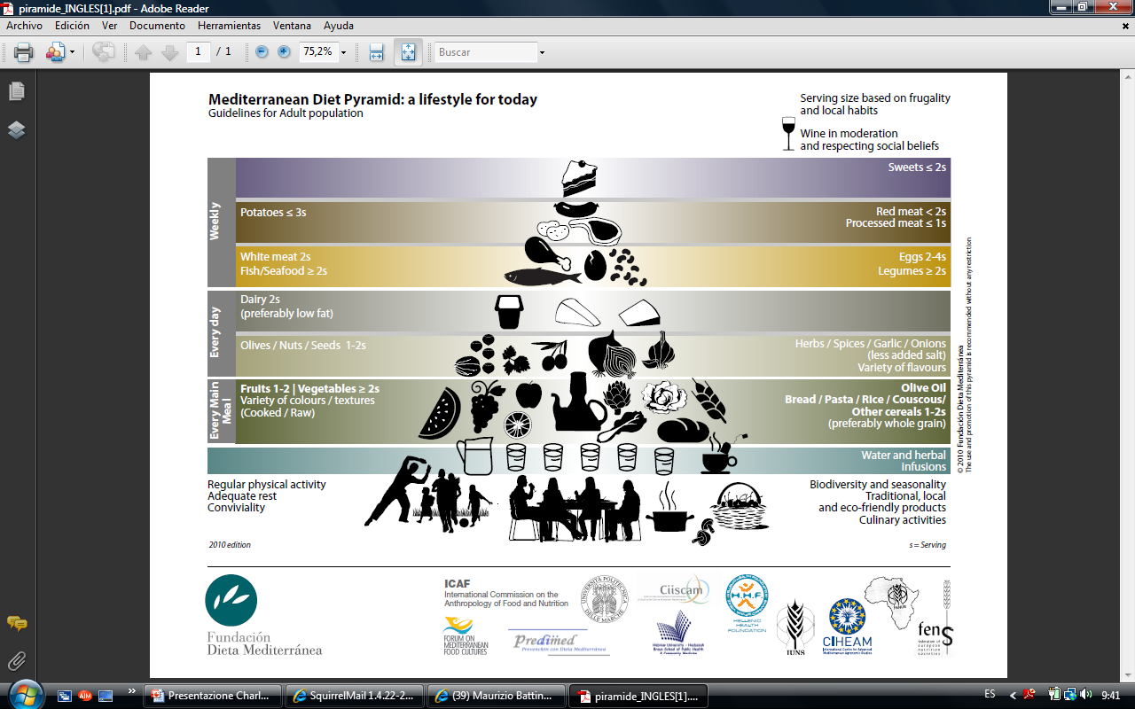

Slide 16
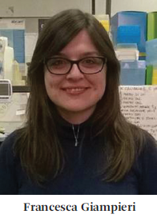
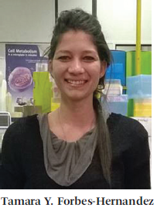
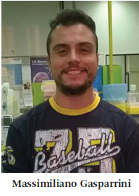
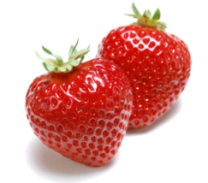
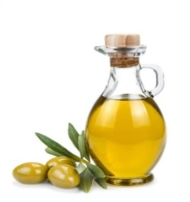
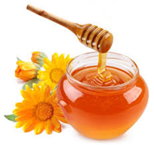
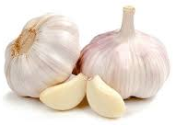
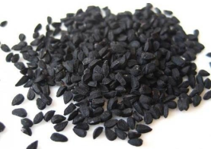
Sara Tulipani
José M.Alvarez-Suárez
Francesca Giampieri
Stefania Romandini
Tamara Y. Forbes-Hernandez
Luca Mazzoni
Bioenergetic
Lab
Massimiliano Gasparrini
Sadia Afrin
Danila Cianciosi
Alfonso Varela Lopez
Jiaojiao «JoJo» Zhang
Johura Ansary
In the last 25 years...
Nutritional and phytochemical characterization
In vitro studies of anti-inflammatory, antitumor, antioxidant, and anti-atherosclerotic effects in various cellular models.
In vivo studies with the aim of evaluating the effects on mitochondrial function, oxidative stress as well as on inflammatory, metabolic and apoptotic processes in animals and humans models

Slide 17
Anti-carcinogenic properties
Anti-inflammatory properties
Our findings…
Lipid-lowering effects
Antioxidant activity

Slide 18
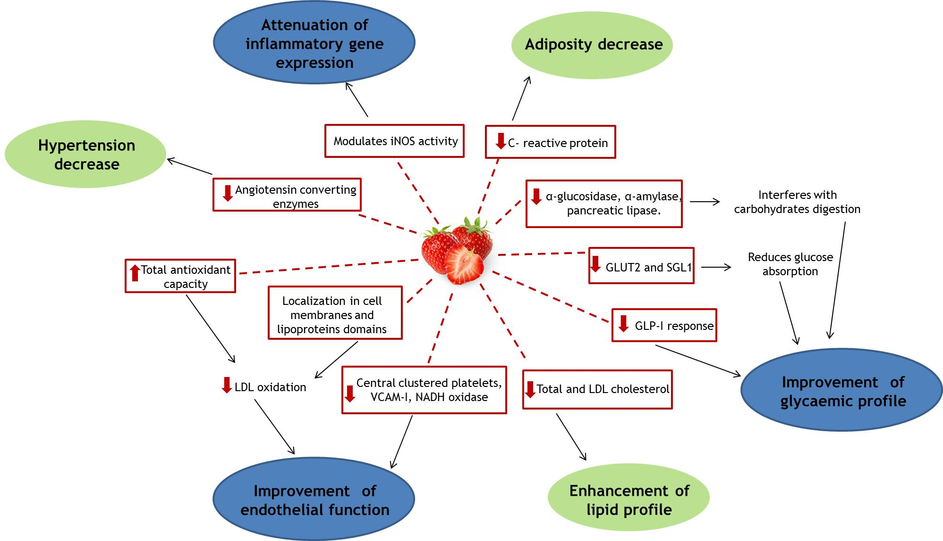

Slide 19
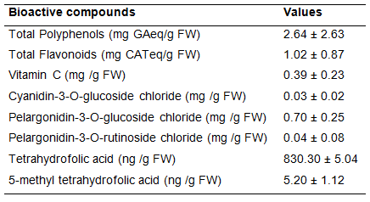
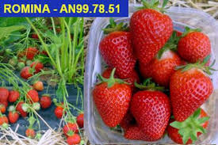
Strawberry Romina

Slide 20
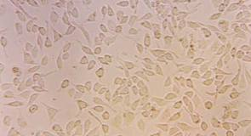
Lipid-lowering properties
of strawberry polyphenols
Strawberry treatment improves lipid profile and antioxidant status in HepG2 cells
HepG2
Triglycerides, Total and LDL-cholesterol
Lipid peroxidation
Forbes-Hernandez et al., 2017 Int J Mol Sci, 18, 1149.

Slide 21
Lipid-lowering properties
of strawberry polyphenols
Strawberry treatment improves lipid profile and antioxidant status in HepG2 cells
HepG2
Intracellular ROS production
Antioxidant enzymes activity
Forbes et al., 2017 Int J Mol Sci, 18, 1149.

Slide 22
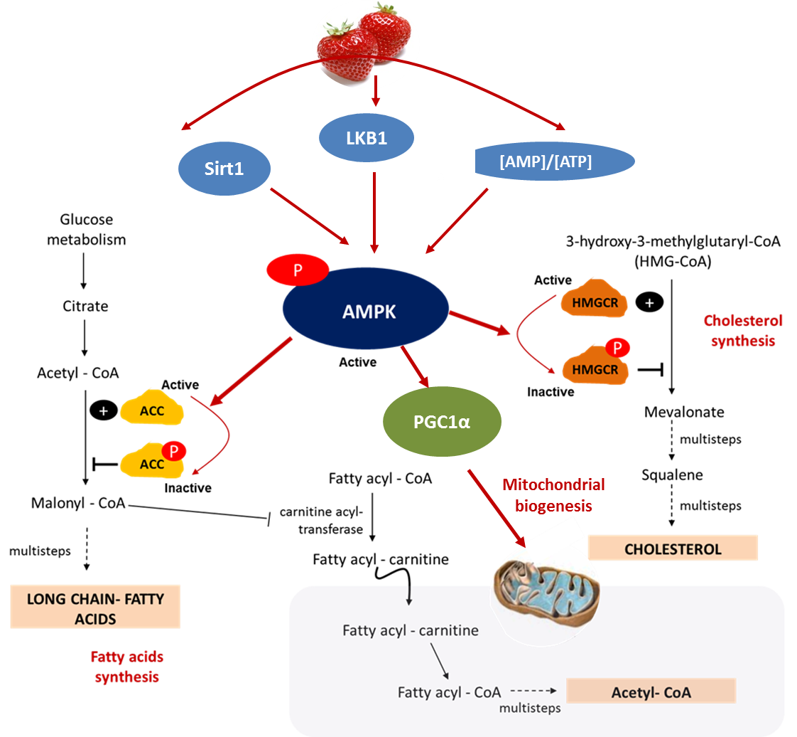
Lipid-lowering properties
of strawberry polyphenols

Slide 23
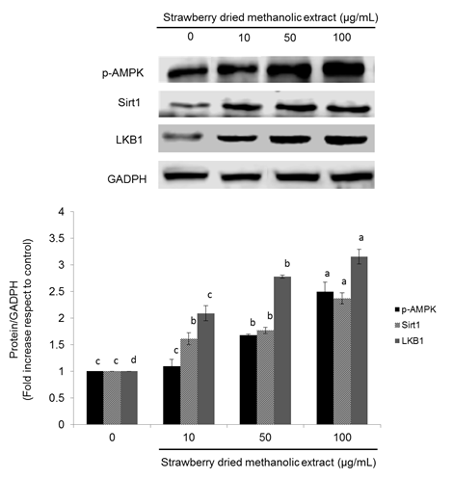
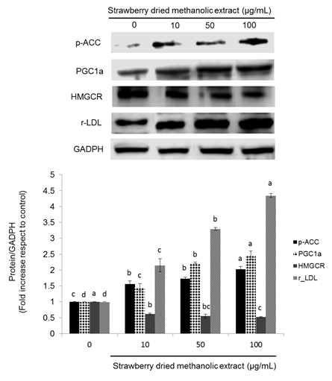
Lipid-lowering properties
of strawberry polyphenols
HepG2
Expression of proteins related to the AMPK pathway
Forbes-Hernandez et al., 2017 , Nutrients, 9,621.

Slide 24
Lipid-lowering properties
of strawberry polyphenols
How to confirm the involvement of AMPK pathway in the strawberry mechanisms of action?
COMPOUND C
LOVASTATIN
pharmacological compound with the important function of blocking the phosphorylation of AMPK and, as a consequence, to inactivate this protein.
member of the statins family, used to lower cholesterol and prevent cardiovascular diseases as a consequence of the inhibition of HMG-CoA reductase.
AMPK
HMG-CoA reductase
(HMGCR)
COMPOUND C ≠ STRAWBERRY = LOVASTATIN
Strawberry treatment has similar effects to the treatment with lovastatin and contrary to the obtained with Compound C regarding to lipid metabolism

Slide 25
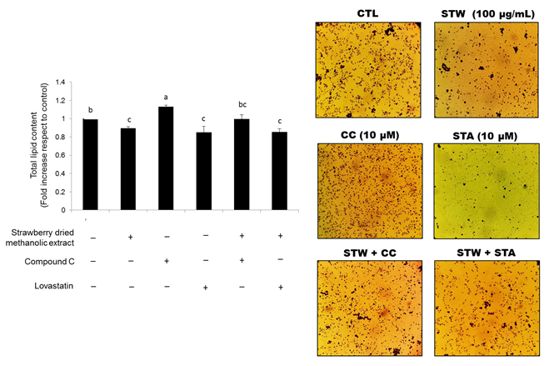
Lipid-lowering properties
of strawberry polyphenols
100 g/mL for 24h
HepG2
Forbes-Hernandez et al., 2017 , Nutrients, 9,621.

Slide 26
Lipid-lowering properties
of strawberry polyphenols
100 g/mL for 24h
HepG2
Forbes-Hernandez et al., 2017 , Nutrients, 9,621.

Slide 27
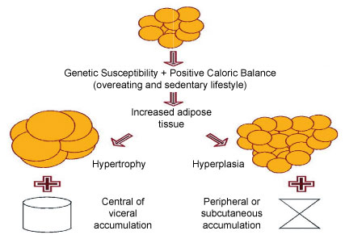
HOW CAN OBESITY BE DEFINED?
Adipogenic stimuli
ADIPOGENESIS
Abnormal or excessive fat accumulation.
Natural compounds
OBESITY

Slide 28
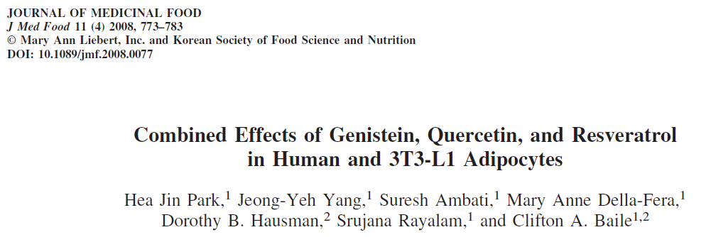
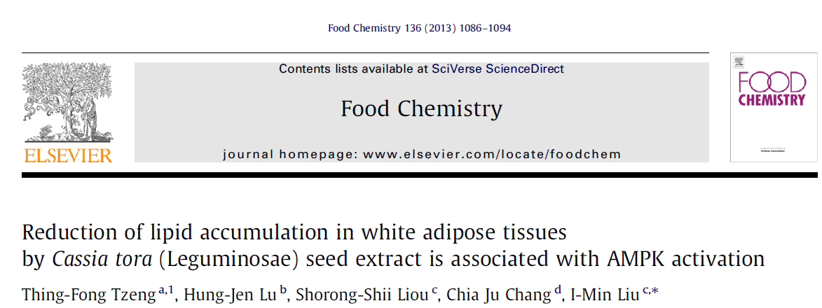

Slide 29
HOW CAN OBESITY BE DEFINED?
Adipogenic stimuli
ADIPOGENESIS
Could strawberries bioactive compounds regulate adipogenesis?
Abnormal or excessive fat accumulation.
OBESITY

Slide 30
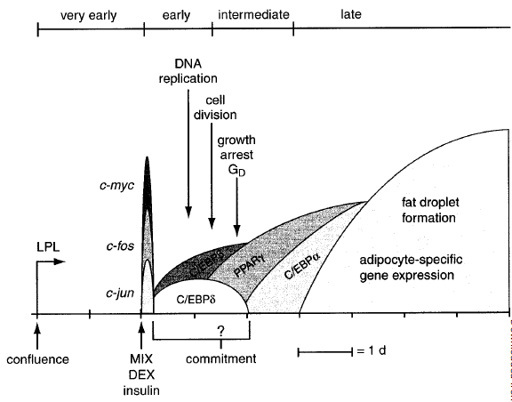
PROGRESSION OF 3T3-L1 PREADIPOCYTE DIFFERENTIATION

Slide 31
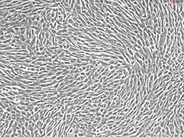
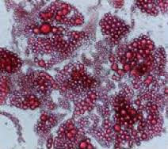
EXPERIMENTAL DESIGN
Evaluation of cell functions:
- Viability assay
- Apoptosis
- Intracellular ROS production
- Antioxidant enzymes activities
- Mitochondrial functionality
Pre-adipocytes
Adipogenic gene and protein expressions
Lipid metabolism:
- LDL-cholesterol and TAGs contents
- Lipid peroxidation
- Total lipid accumulation
Mature adipocytes

Slide 32
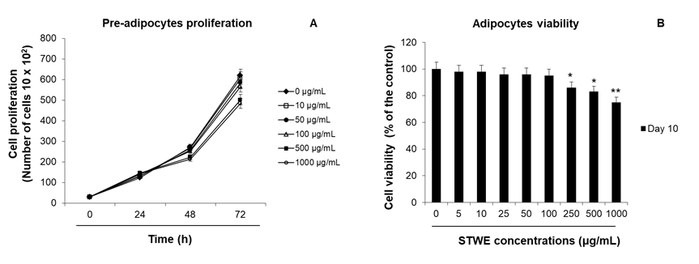
EFFECTS OF STRAWBERRY EXTRACT (STWE) ON PROLIFERATION AND VIABILITY OF 3T3-L1 CELLS
No significant (toxic) effect on cell proliferation was observed at concentrations of STWE ≤100 μg/mL
Forbes-Hernandez et al., Food Funct., 2020,11, 297-304

Slide 33
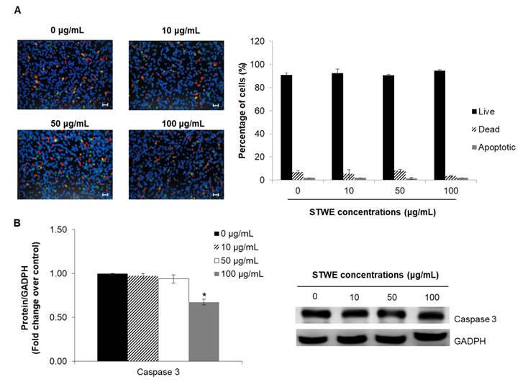
EFFECTS OF STWE ON MATURE ADIPOCYTES APOPTOSIS
Forbes-Hernandez et al., Food Funct., 2020,11, 297-304

Slide 34
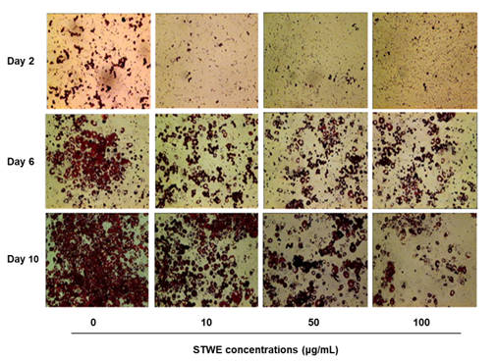
EFFECTS OF STWE ON 3T3-L1 CELLS DIFFERENTIATION
Inhibition of adipogenesis
Forbes-Hernandez et al., Food Funct., 2020,11, 297-304

Slide 35
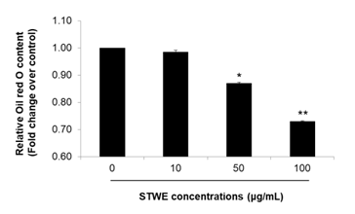
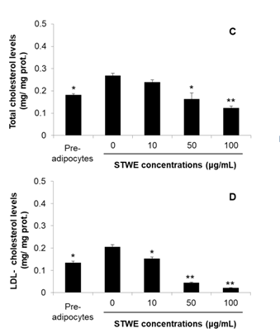
EFFECTS OF STWE ON LIPID ACCUMULATION
Decrease of total lipid content and improvement of lipid profile
Forbes-Hernandez et al., Food Funct., 2020,11, 297-304

Slide 36
EFFECTS OF STWE ON THE ADIPOGENIC TRANSCRIPTION FACTORS
Decrease of mRNA expression of C/EBP-α and PPAR-γ
Forbes-Hernandez et al., Food Funct., 2020,11, 297-304

Slide 37
EFFECTS OF STWE ON THE DIFFERENTIATION RELATED TRANSCRIPTION FACTORS
Adipogenic stimuli
Forbes-Hernandez et al., Food Funct., 2020,11, 297-304

Slide 38
EFFECTS OF STWE ON THE DIFFERENTIATION RELATED TRANSCRIPTION FACTORS
Forbes-Hernandez et al., Food Funct., 2020,11, 297-304

Slide 39
How to confirm the involvement of AMPK pathway in the strawberry mechanisms of action?
COMPOUND C
Pre-adipocytes
pharmacological compound with the important function of blocking the phosphorylation of AMPK and, as a consequence, to inactivate this protein.
AMPK
Adipocytes
COMPOUND C ≠ STRAWBERRY

Slide 40
EFFECTS OF AMPK INHIBITION IN THE EXPRESSION OF LIPOGENESIS AND FATTY ACIDS OXIDATION RELATED PROTEINS
Forbes-Hernandez et al., Food Funct., 2020,11, 297-304

Slide 41
EFFECTS OF AMPK INHIBITION ON THE EXPRESSION OF LIPOGENESIS AND LIPID PROFILE
Forbes-Hernandez et al., Food Funct., 2020,11, 297-304

Slide 42
EFFECTS OF STWE ON CELLULAR METABOLISM
Mitochondrial Respiration
Forbes-Hernandez et al., Food Funct., 2020,11, 297-304

Slide 43
EFFECTS OF STWE ON CELLULAR METABOLISM
Glycolytic function
Forbes-Hernandez et al., Food Funct., 2020,11, 297-304

Slide 44
EFFECTS OF STWE ON INTRACELLULAR ROS PRODUCTION
Forbes-Hernandez et al., Food Funct., 2020,11, 297-304

Slide 45
EFFECTS OF STWE ON LIPID PEROXIDATION
Forbes-Hernandez et al., Food Funct., 2020,11, 297-304

Slide 46
EFFECTS OF STWE ON ANTIOXIDANT ENZYMES ACTIVITY AND PROTEIN EXPRESSION
Forbes-Hernandez et al., Food Funct., 2020,11, 297-304

Slide 47
EFFECTS OF STWE ON LIPID PRO-INFLAMMATORY CYTOKINES
https://doi.org/10.3389/fendo.2013.00052
Forbes-Hernandez et al., Food Funct., 2020,11, 297-304

Slide 48
Strawberries consumption improves plasma lipids profile, biomarkers of antioxidant status, antihemolytic defenses and platelet function in healthy subjects.
23 healthy volunteers
Ingestion of 500 g of strawberries
Resting state
Central clustered platelet, activation phase
Degranulated platelet, end of activation process

Slide 49
Home messages...
STWE significantly reduced 3T3-L1 pre-adipocytes differentiation and lipid accumulation via the AMPK signaling pathway providing new insights into the molecular mechanism by which this STWE suppresses adipogenesis.
STWE supplementation significantly decreased ROS production and lipid peroxidation while increased antioxidant enzymes activities and expression in both pre-adipocytes and matures adipocytes.
It would be interesting to investigate whether strawberry extracts are equally efficient at all stages of differentiation or otherwise in one or more of them.
STWE could be a promising naturally occurring therapeutic agent for the prevention and treatment of obesity.

Slide 50
Thank you
for your kind attention

