Slide 1
Personalized Nutrition Plans based on Measurement of Specific Redox Biomarkers in Human Blood
Demetrios Kouretas
Professor, Animal Physiology - Toxicology

Slide 2

Is There a Way to Bridge the Gap Between Lifespan and Healthspan?
Lifespan
Healthspan

Slide 3
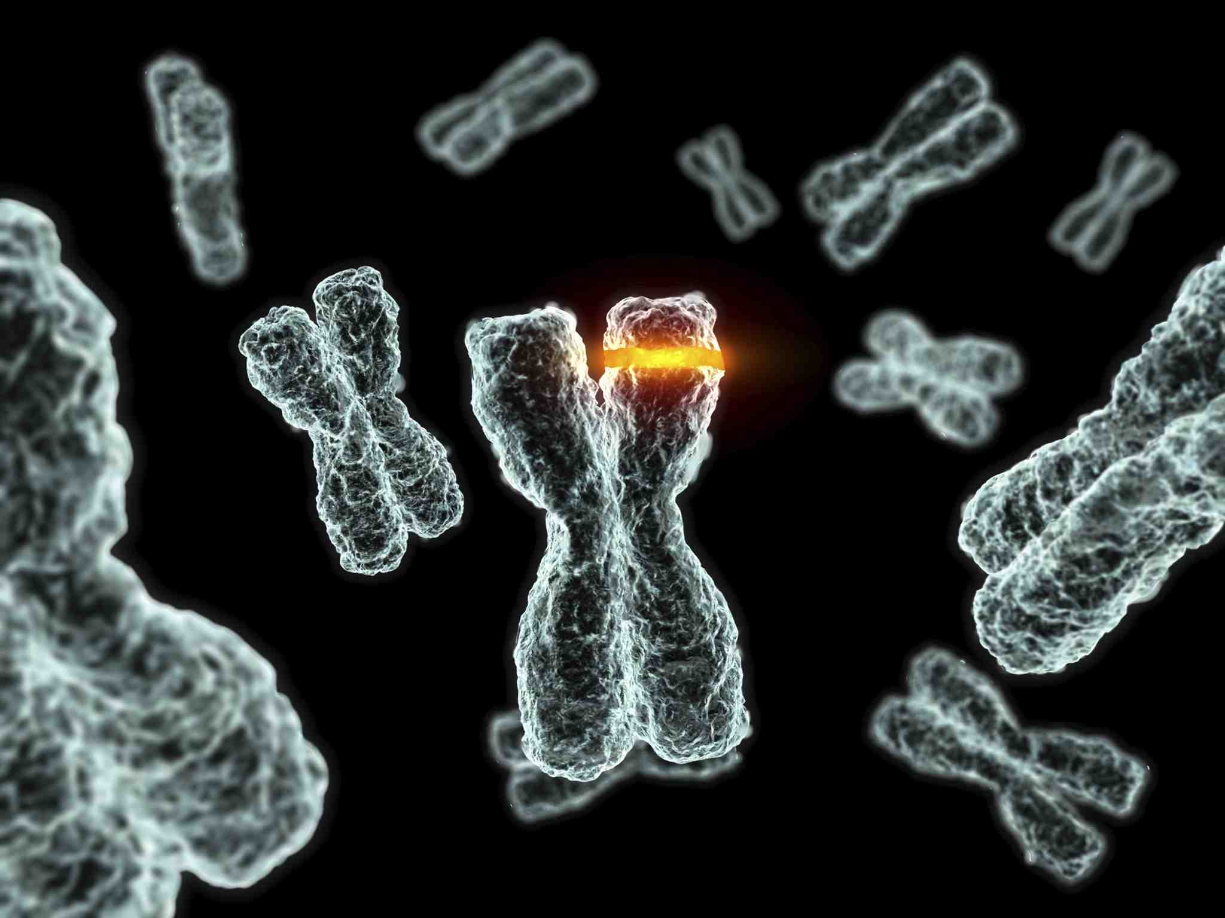
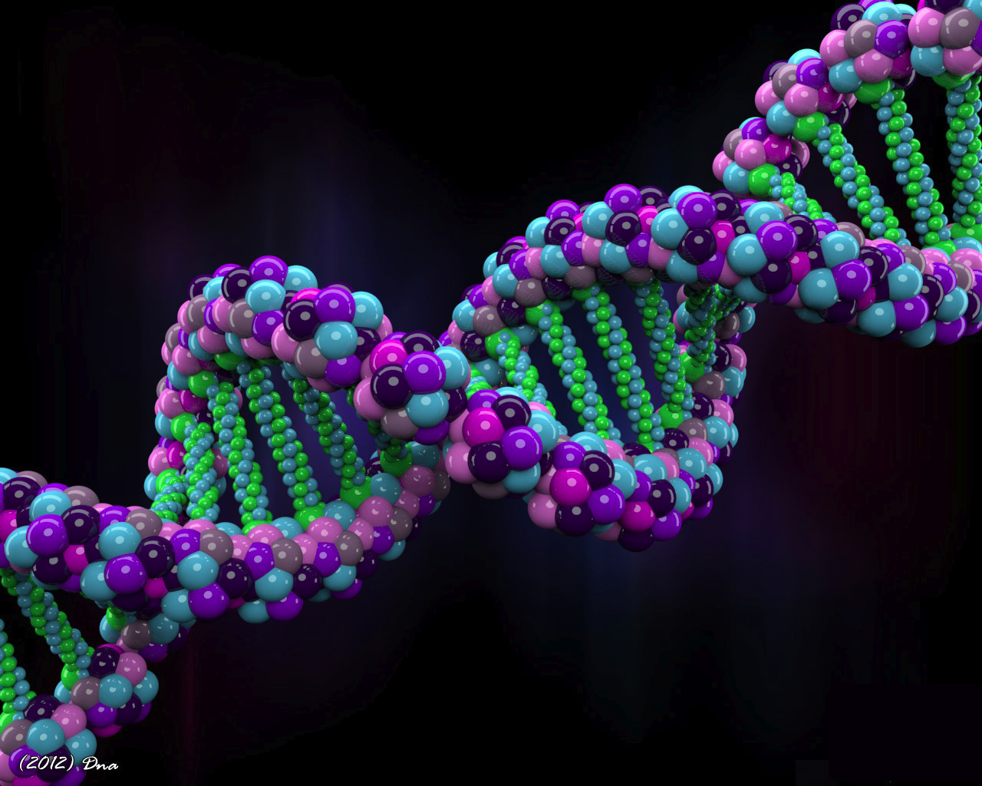

Is Your Lifespan (and/or Healthspan) “Programmed” in Your Genes?

Slide 4
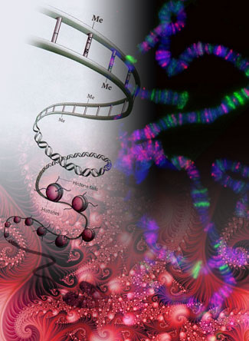

Your Genetic Make-up Influences Life Expectancy
Genetics
A glance at your family tree may indicate whether you have a tendency to live a long, healthy life
1
Exceptional longevity (1 to 3 decades longer than average) tends to run in families
2
Siblings of “super-centenarians” tend to live longer than average
Family History

Slide 5
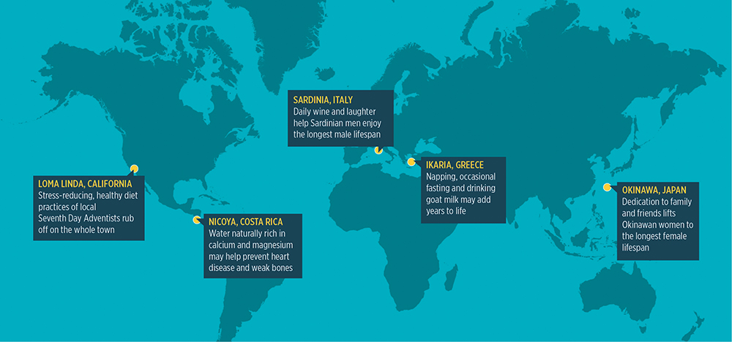
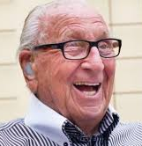
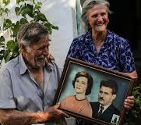
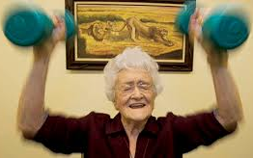
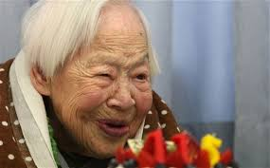
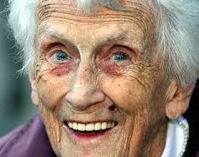
What Does Genetic Analysis of Exceptionally Long-lived People Reveal About Longevity?
There are “nodes” of exceptionally long-lived people throughout the world

Slide 6
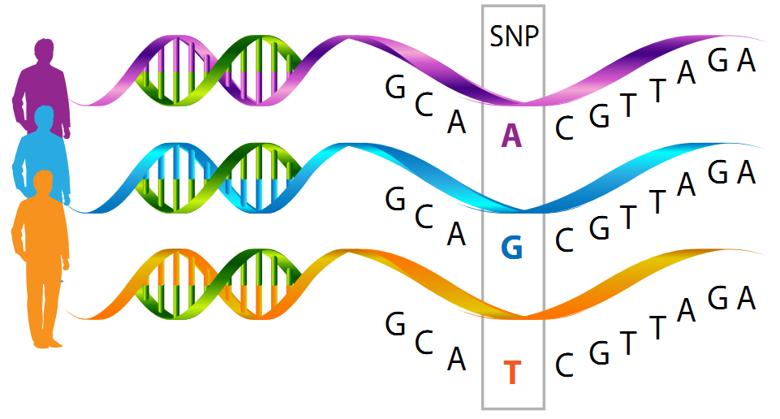
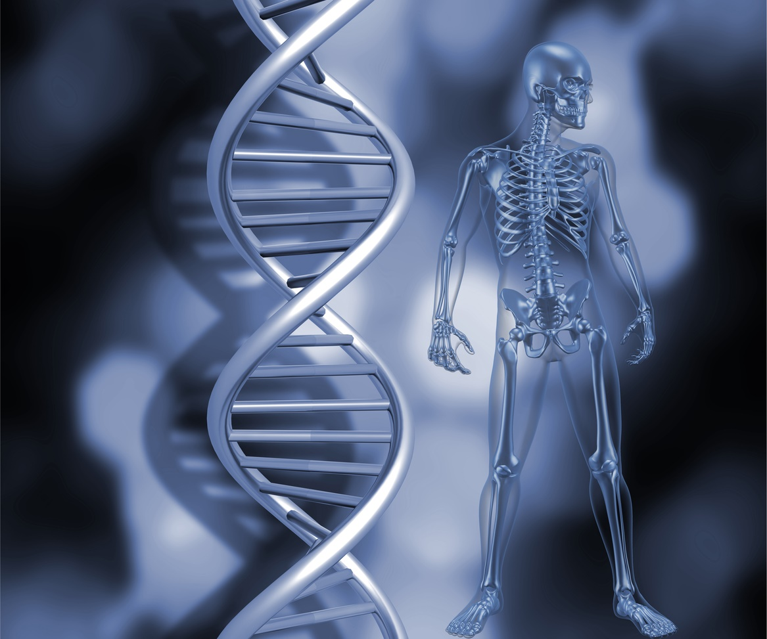
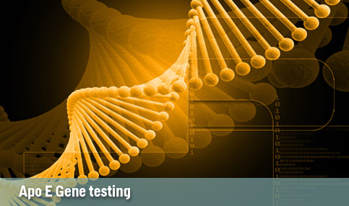

Genome Analysis [with “single nucleotide polymorphisms” (SNPs)] of Exceptionally Long-lived People Reveal…
Complex Genetic Signatures
Very Few Genes Consistently Involved
No Genes Associated With Diseases
Genes do not solely govern whether you will live longer than an average lifespan
19 different genetic groupings
FOXO3A
APOE
Many SNPs
Longevity genes confer resiliency

Slide 7



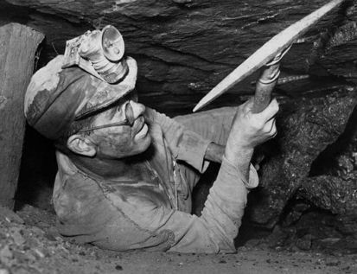
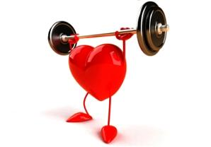
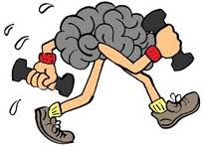
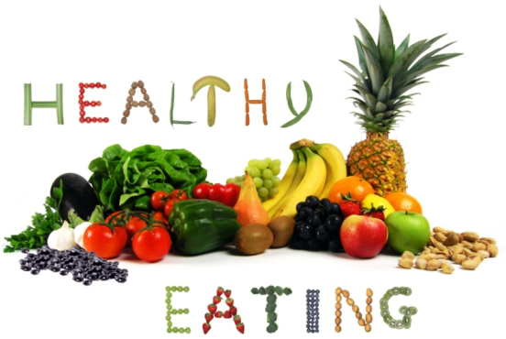
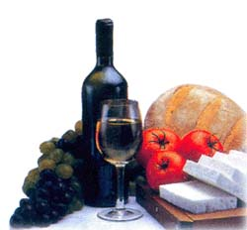
Genetic Analysis Suggests that Environment & Diet
are the Major Determinants for Healthy Aging
Genetics
Environment
15-25% of
longevity
quotient
Diet

Slide 8
Accentuating Positive Lifestyle Factors & Eliminating the Adverse Ones Promotes Healthy Aging
Activities of Daily Living
Faster Walk Times
Greater Handgrip Strength
Life- and health-span can be increased by as much as
10 years!
Better Psycho-social
Indices
Lower Levels of Depression
High Self-reported Life Satisfaction
Physiological
Lower Blood Pressure & glucose
Lower Indices of Inflammation

Slide 9
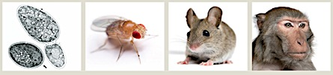

Diet is the Largest Factor Affecting Longevity and Healthy Aging
Genetics
Environment
Nutrient influence on healthy aging is being extensively studied in humans and in many animal models of aging
Diet

Slide 10
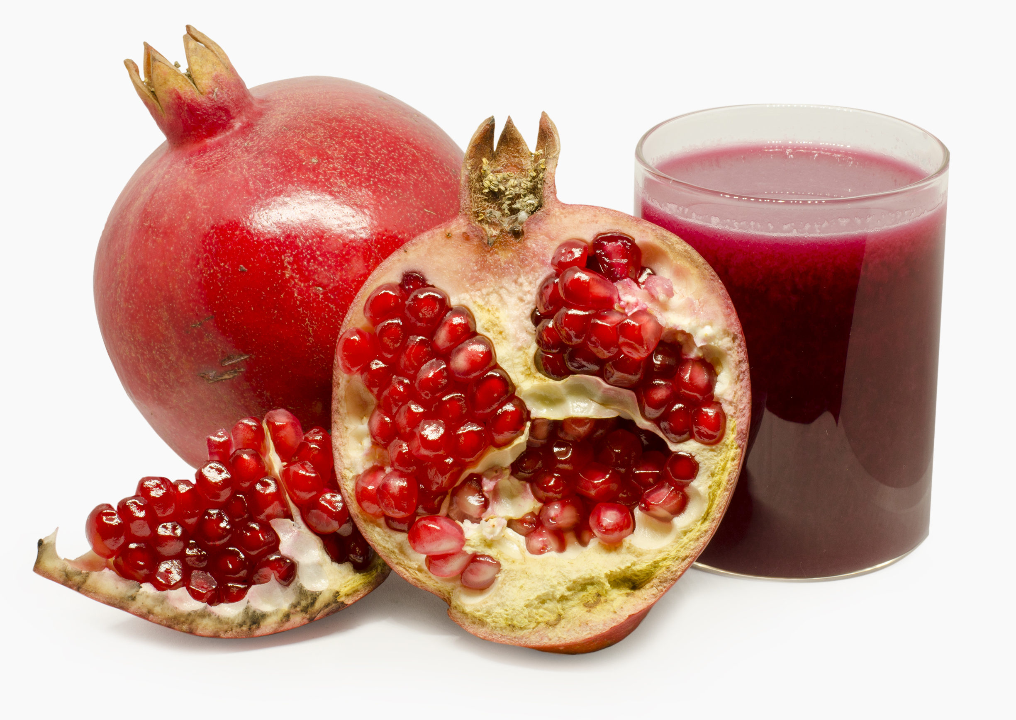

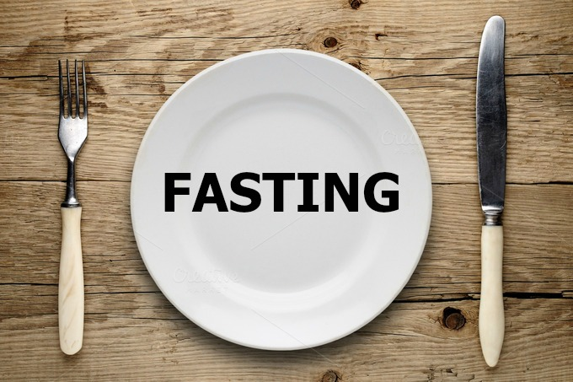
thE 3 PILLARS OF METABOLIC HEALTH

Slide 11
1ST PILLAR
Consumption of plant – derived products rich in polyphenols promotes healthy lifespan

Slide 12
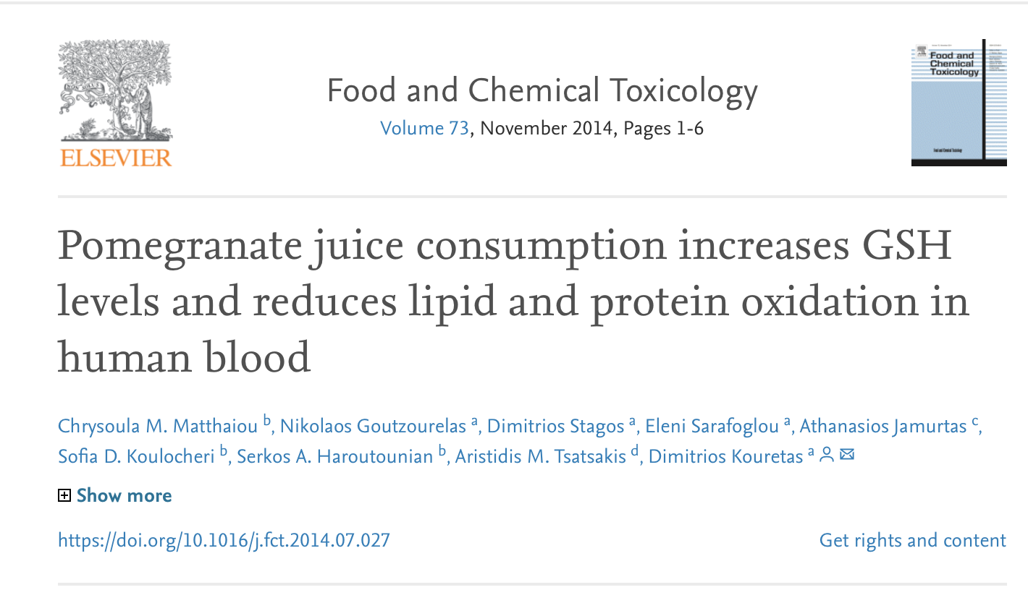
What is the quantity of antioxidants for a personalized nutrition regime?

Slide 13
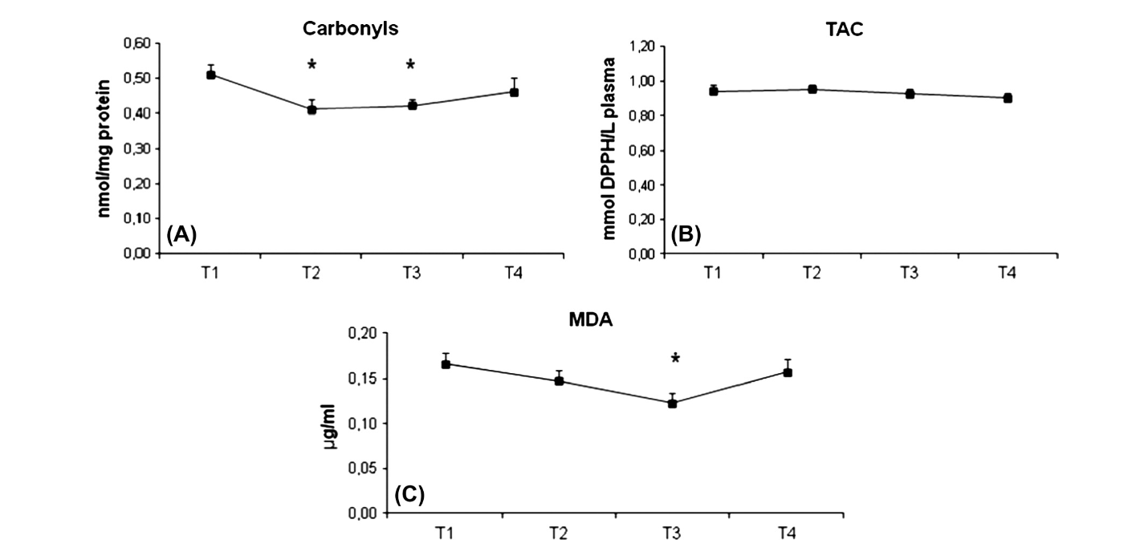
T1: BEFORE JUICE
T2: IMMEDIATELY AFTER STOPPING JUICE (2 WEEKS)
T3: A WEEK AFTER THE JUICE ΑDMINISTRATION
T4: 3 WEEKS AFTER STOPPING JUICE ΑDMINISTRATION

Slide 14
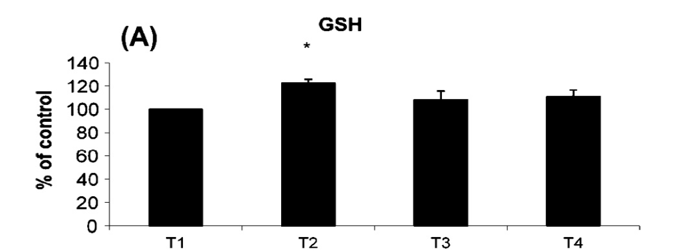
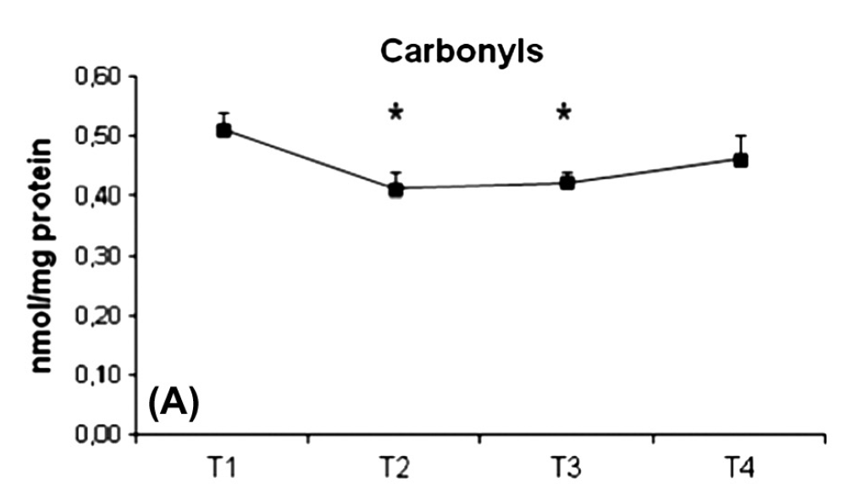
Statistically significant increase in GSH with pomegranate juice for 2 weeks
Statistically significant decrease in protein carbonyls with pomegranate juice for 2 weeks and maintained for 1 month
Notes:
T1: BEFORE JUICE
T2: IMMEDIATELY AFTER STOPPING JUICE (2 WEEKS)
T3: A WEEK AFTER THE JUICE ΑDMINISTRATION
T4: 3 WEEKS AFTER STOPPING JUICE ΑDMINISTRATION

Slide 15
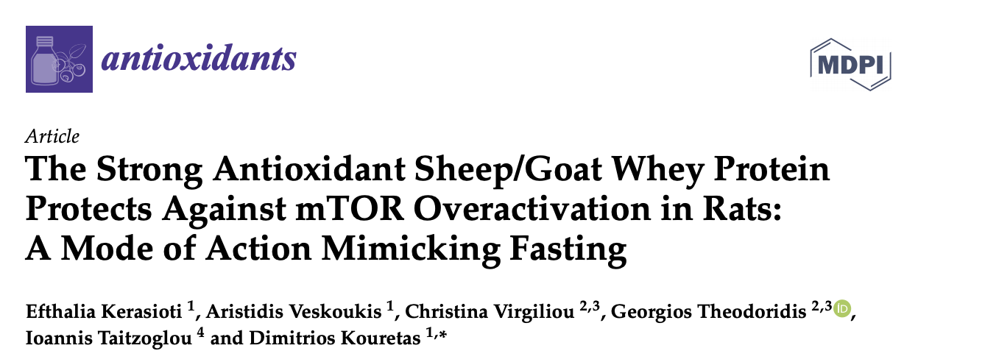

Slide 16
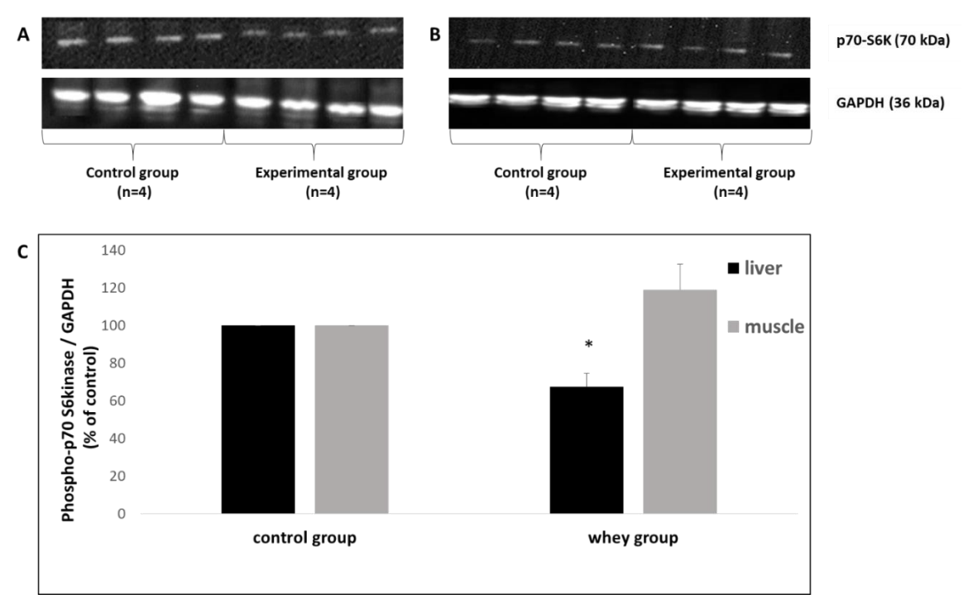
Sheep/Goat Whey Protein inactivates of mTOR

Slide 17
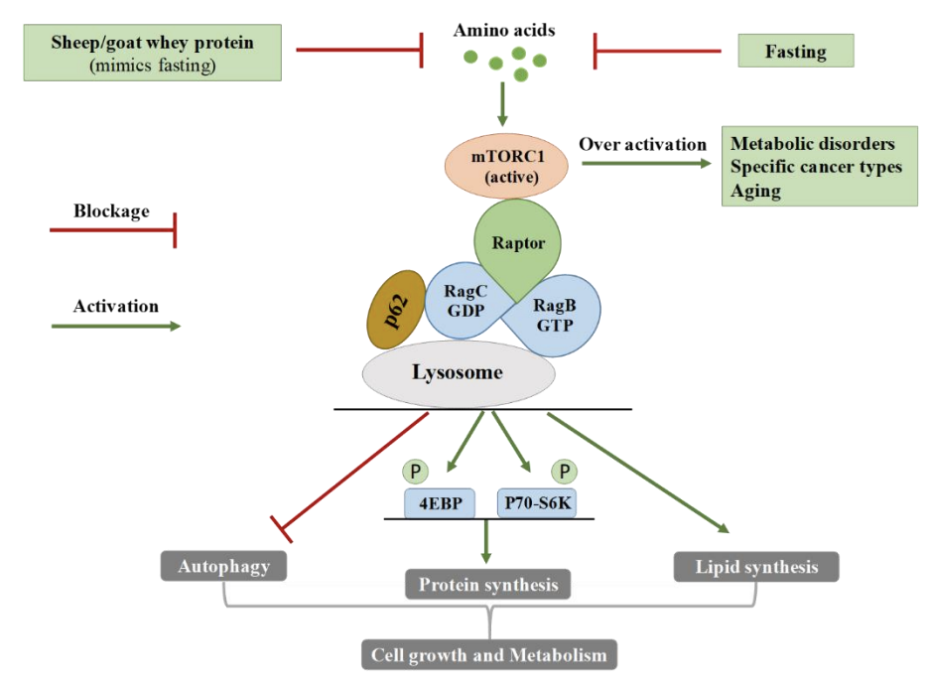
The molecular pathway of amino-acid-related (over) activation of mammalian target of rapamycin complex 1 (mTORC1) and the beneficial action of sheep/goat whey protein administration that mimics fasting.

Slide 18
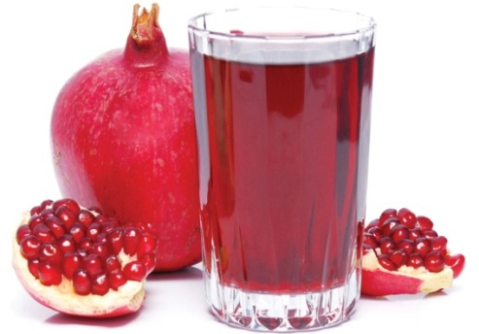
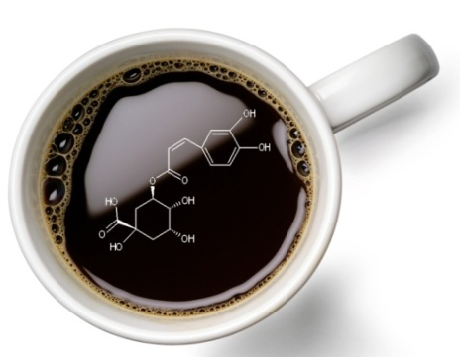
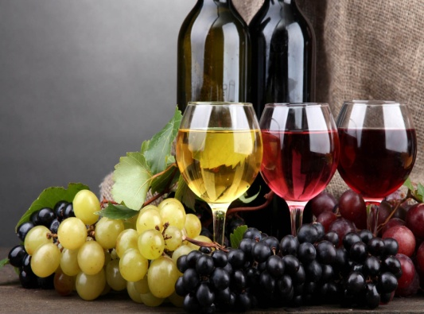
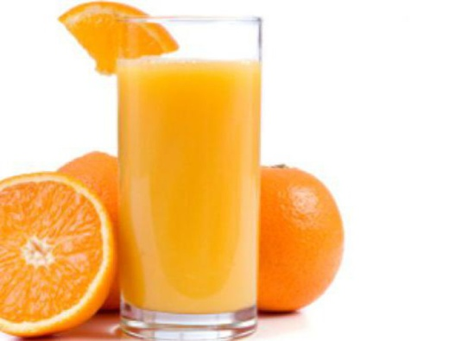
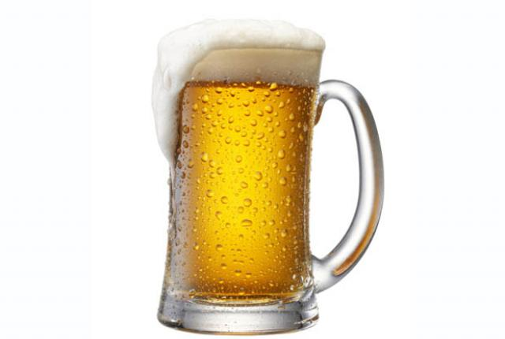
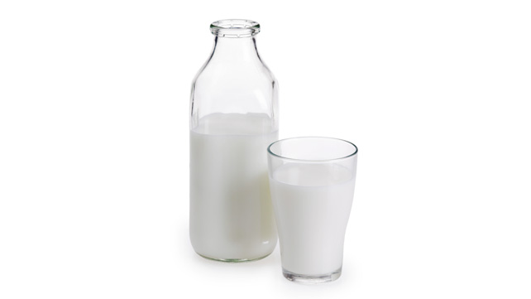
Comparison of antioxidants
1 glass of pomegranate juice
3 cups espresso
1 cup instant coffee
17 cups of juice
5 glasses of red wine
23 glasses of beer
50 glasses of white wine
100 glasses of milk

Slide 19
2nd PILLAR
Exercise promotes healthy lifespan

Slide 20
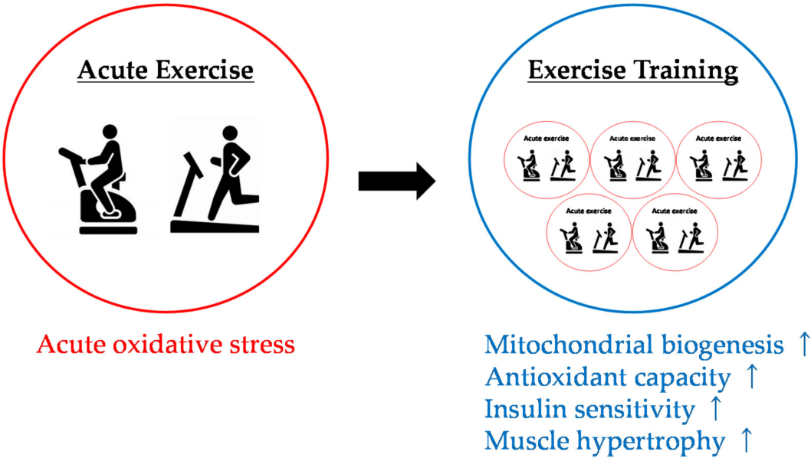

Reactive species and physiological adaptations to endurance training
VS
Takuji Kawamura, Isao Muraoka. Exercise-Induced Oxidative Stress and the Effects of Antioxidant Intake from a Physiological Viewpoint. Chemistry, MedicinePublished in Antioxidants 2018. DOI:10.3390/antiox7090119

Slide 21
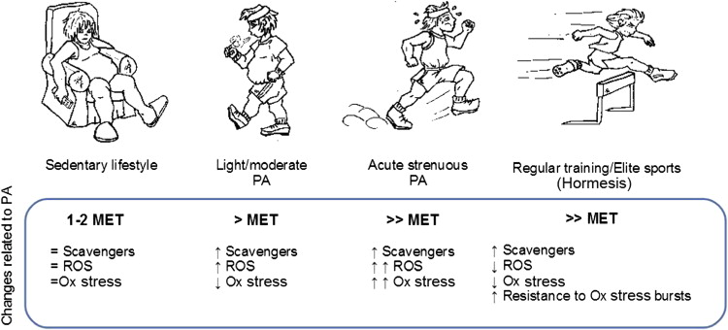
Effects of physical activity on oxidative stress status
Alessandro PingitoreM.D.,Giuseppina Pace PereiraLimaPh.D., FrancescaMastorciPh.D., AlfredoQuinonesM.D., GiorgioIervasiM.D., CristinaVassallePh.D. Exercise and oxidative stress: Potential effects of antioxidant dietary strategies in sports. Volume 31, Issues 7–8, July–August 2015, Pages 916-922

Slide 22
3RD PILLAR
Fasting induces metabolic shift and promotes healthy lifespan

Slide 23
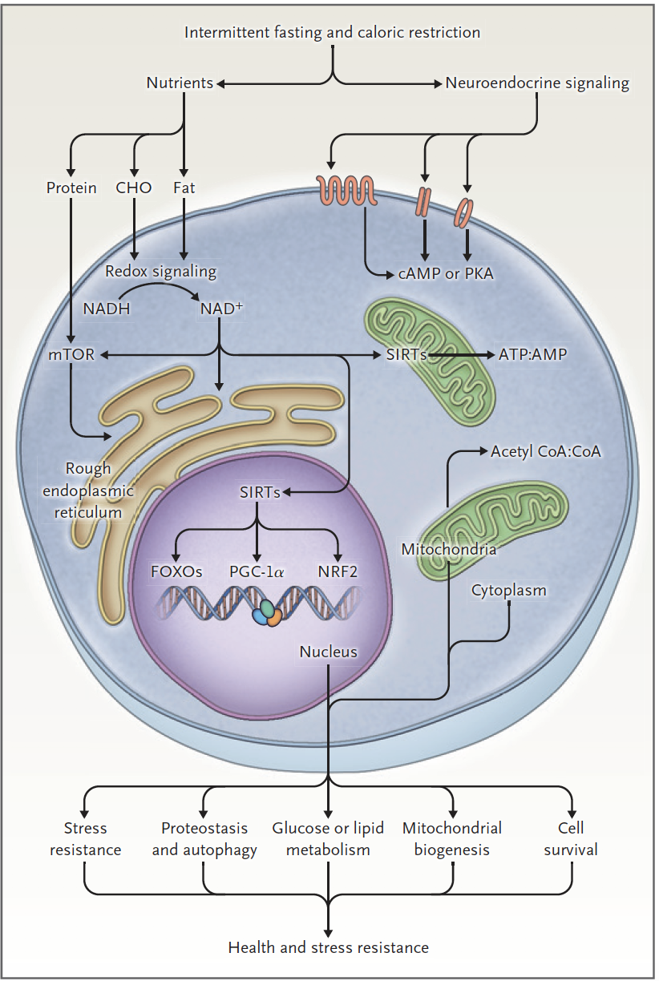
Fasting and health
Cellular Responses to Energy Restriction That Integrate Cycles of Feeding and Fasting with Metabolism.
Effects of Intermittent Fasting on Health,
Aging, and Disease. Rafael de Cabo, Ph.D., and Mark P. Mattson, Ph.D. N Engl J Med 2019;381:2541-51.
DOI: 10.1056/NEJMra1905136

Slide 24

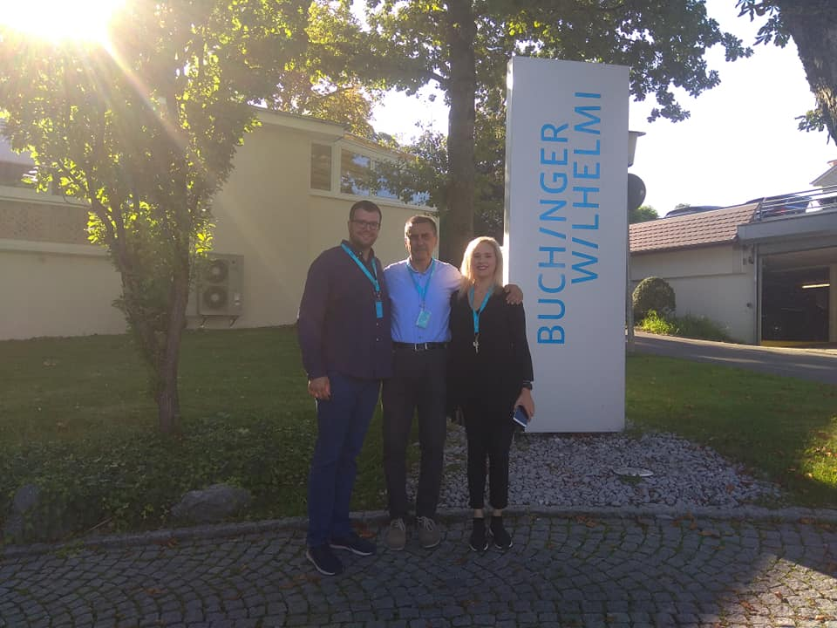
Buchinger Wilhelmi Clinic

Slide 25
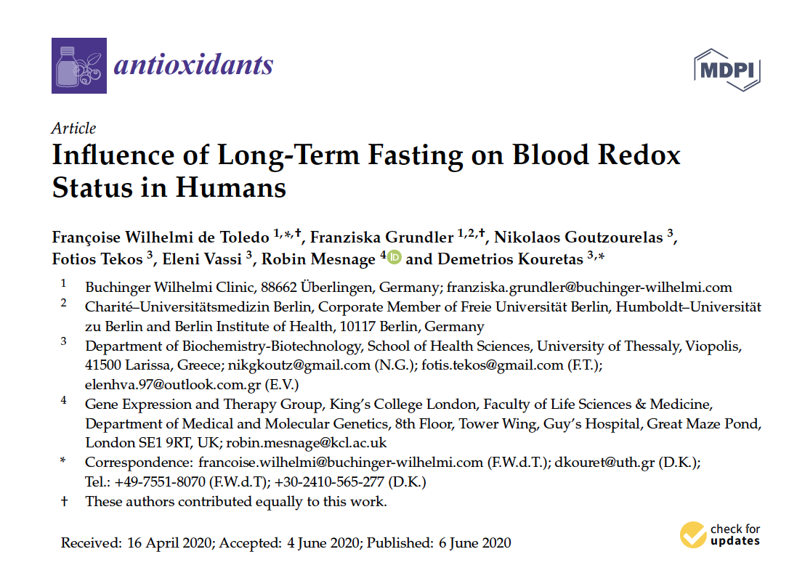

Slide 26
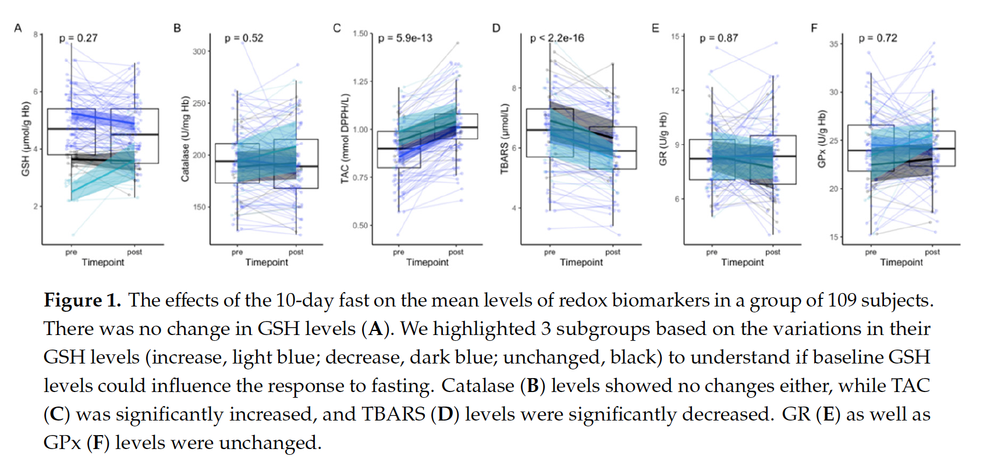

Slide 27
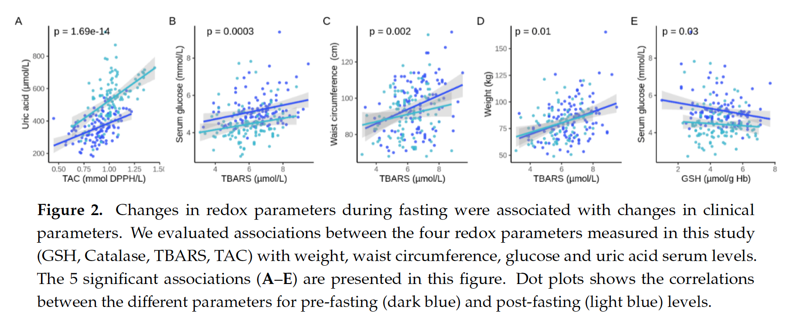

Slide 28
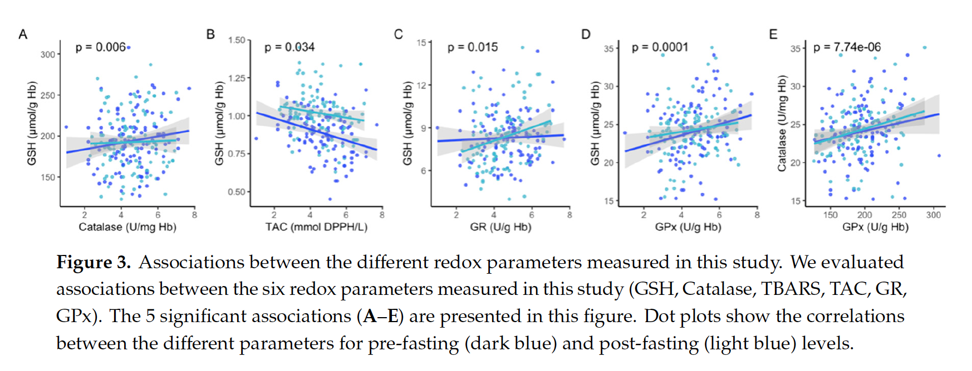

Slide 29
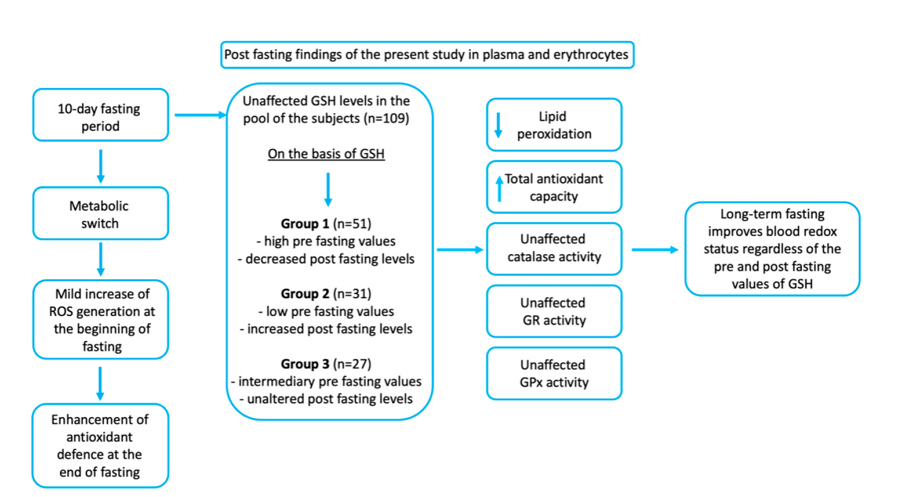

Slide 30

Human biomarker measurement services
Holistic evaluation of blood redox status measuring a wide range of biomarkers, before and after a proposed nutritional scheme

Slide 31
We measure the following biomarkers
The effect of personalized nutrition on human redox status is evaluated and human health is improved
Control of antioxidants
  GSH (reduced glutathione),
  TAC (total antioxidant capacity),
  Reducing Power,
  ABTS Radical scavenging
  Hydroxyl Radical scavenging
  Superoxide Radical scavenging
Control of critical gene products
  Catalase,
  GPx (glutathione peroxidase),
  SOD (peroxidase dismutase),
  GR (glutathione reductase) – enzymatic antioxidants that are involved in protecting the cell against free radicals.
Control of oxidative damage products
  TBARS (lipid peroxidation),
  Protein Carbonyls (oxidative protein damage)-the end products of free radical action.

Slide 32
Antioxidant consumption, exercise and fasting regulate baseline gsh levels in blood and improve human redox status
1st PILLAR
2nd PILLAR
3nd PILLAR

Slide 33
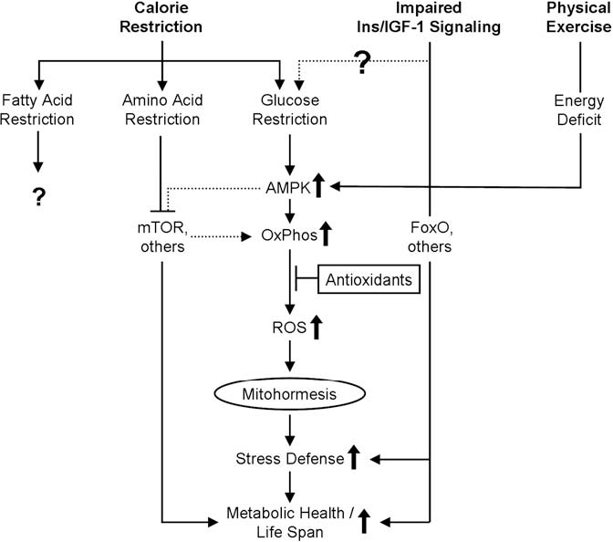
The 3 Pillars
We measure the following biomarkers:
GSH, TAC, Reducing Power,
ABTS, Hydroxyl Radical, Superoxide Radical, Catalase
GPx, SOD, GR
TBARS, Protein Carbonyls
How increased oxidative stress promotes longevity and metabolic health: The concept of mitochondrial hormesis (mitohormesis)
Michael Ristow, Kim Zarse. Biology, Medicine
Published in Experimental Gerontology 2010
DOI:10.1016/j.exger.2010.03.014

Slide 34

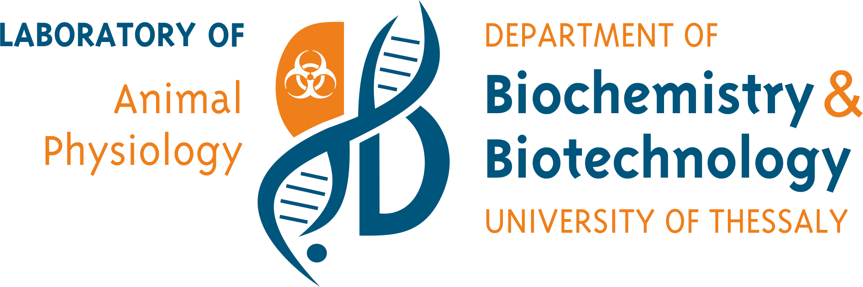
Thank you very much for your attention
Demetrios Kouretas
Professor, Animal Physiology - Toxicology
www.foodoxys.com
www.bio.uth.gr

