Slide 1
Modelling Polyphenol-Protein Interactions
Steve Euston
Institute of Biological Chemistry, Biophysics and Bioengineering, School of Engineering & Physical Sciences, Heriot-Watt University

Slide 2
Protein-Polyphenol Interactions
Evidence that protein-polyphenol interactions/complexes improve stability/bioavailability
theoretical methods for determining binding site and binding free energy
Molecular simulation
Molecular docking

Slide 3
Molecular Dynamics Simulation
Identifies binding site
Uses explicit solvent (water)
Explicit flexibility of protein and ligand
Can enter metastable binding states
Time consuming (long simulations)
Use accelerated MD to improve sampling
Meta-dynamics
Replica-exchange MD

Slide 4
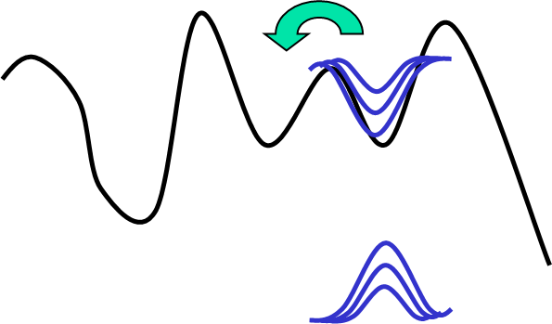
Metadynamics
atoms in the system are exposed to a bias force in the form of Gaussian potentials designed to drive the system away from its current configuration to a new one
Over the simulation, the Gaussians build up and exclude an increasing number of conformations

Slide 5
Replica Exchange MD
Have a system where high T simulations overcome barriers to conformational change, coupled to low T exploration of minimum energy states of those conformations
20ºC
30ºC
40ºC
50ºC
90ºC
80ºC
70ºC
60ºC

Slide 6
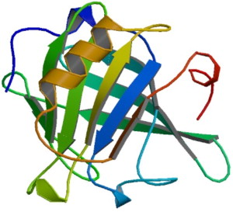
Binding Free Energy from MD
Can determine binding free energy using various methods
umbrella sampling is popular
Potential of mean force (PMF) along a reaction coordinate
Analysed using weighted histograms method (WHAM)
0
PMF (kJ/mol)
∆G_{bind}

Slide 7
Molecular docking
Number of freeware programs
Autodock/Autodock Vina
FlexX
Ligandfit etc
Rigid-body or flexible docking
Docking @ home
http://docking.cis.udel.edu/about/science/index.html

Slide 8
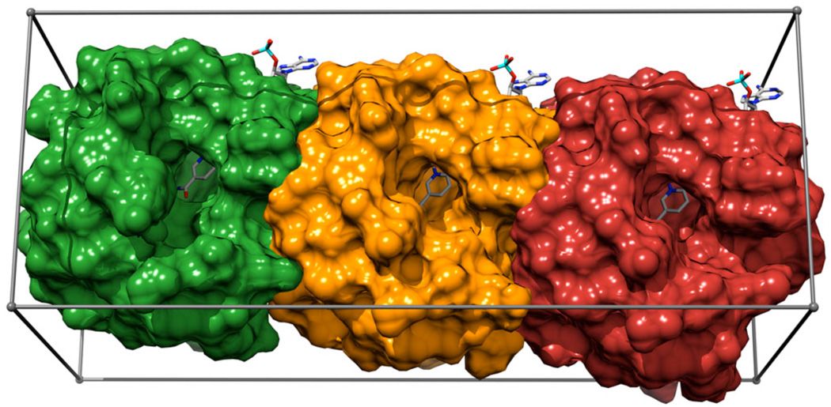
Molecular docking
Three parts to docking
defining the surface of the protein
Search algorithm (protein surface searching)
Scoring function (ranking of the different docked poses)
Cosconati, S., Forli, S., Perryman, A.L., Harris, R., Goodsell, D.S. and Olson, A.J., 2010. Virtual screening with AutoDock: theory and practice. Expert opinion on drug discovery, 5(6), pp.597-607.

Slide 9
Molecular docking
Three parts to docking
defining the surface of the protein
Search algorithm (protein surface searching)
Scoring function (ranking of the different docked poses)
Docking @ home
http://docking.cis.udel.edu/about/science/index.html
Huang, S.Y., 2014. Search strategies and evaluation in protein–protein docking: principles, advances and challenges. Drug discovery today, 19(8), pp.1081-1096.

Slide 10
Molecular docking
Three parts to docking
defining the surface of the protein
Search algorithm (protein surface searching)
Scoring function (ranking of the different docked poses)
Scoring = assigning binding energy
Forcefield based
Similar to MD
Empirical
Sum of energy terms (H-Bond, electrostatic, hydrophobic)
fast
Knowledge based
Database of potential based on pair interaction of atoms

Slide 11
Molecular docking
Net result of docking
Clusters of docking poses ranked on binding energy
Cluster on RMSD tolerance

Slide 12
Conclusions
Theoretical methods are useful in estimating binding site location and free energy of binding
Can be used for automated screening
Methods are approximate
Accuracy of force-fields
Limitations of rigid body approximation

