Slide 1


Biochar amendments improve licorice growth and nutrient uptake through altering the root system and soil enzyme activities in loamy sand under salt stress
Dilfuza Egamberdieva ^{1,2}, Zohreh Zoghi ³, Aida Kistaubayeva ², Ma Hua ^{1,4}, Stephan Wirth ¹, Sonoko Dorothea Kimura ^{1,5}
¹ Leibniz Centre for Agricultural Landscape Research (ZALF), Müncheberg, Germany.
² Department of Biotechnology, Al-Farabi Kazakh National University, 050040, Almaty, Kazakhstan.
³ Department of Forestry, Faculty of Natural Resources and Marine Sciences, Tarbiat Modares University, Noor, Mazandaran, Iran
⁴ School of Life Sciences, Chongqing University, Chongqing 401331, China;
⁵ Faculty of Life Sciences, Humboldt University of Berlin, Berlin, Germany
* Corresponding author: Dilfuza.Egamberdieva@zalf.de

Slide 2

Licorice (Glycyrrhiza uralensis Fish.) is considered as salt and drought tolerant leguminous plant. We hypothesized that the biochar amendment into the soil might alleviate salt stress in licorice by improving its plant growth, nutrient acquisition. The present study was designed to determine the effect of biochar on licorice plant growth, acquisition of C (carbon), nitrogen (N), and phosphorus (P) and on soil fluorescein diacetate (FDA) and enzyme activities under saline soil condition. Pyrolysis char from maize at 2, 4, and 6 % concentrations were used for pot experiments. The shoot and/or root biomass of licorice grown in soil amended with 2 and 4% MBC under non-saline and saline conditions was increased. The root architectural traits, like root length, surface area, project area, and root volume, as well as nodulation traits, were also significantly modified by biochar application at both 2 and 4% concentrations. The concentrations of N and K in plant tissue were increased under 2 and 4% MBC amendment compared to plants grown without biochar application. Moreover, soil amended with biochar showed a positive effect on soil hydrolase activities. This study demonstrated the beneficial effects of biochar from maize on growth and nutrient uptake of licorice by improving the nodule formation, root architecture, and soil biological activity in saline soil conditions.
Keywords: biochar, licorice, soil enzymes, salinity, nutrients, root

Slide 3
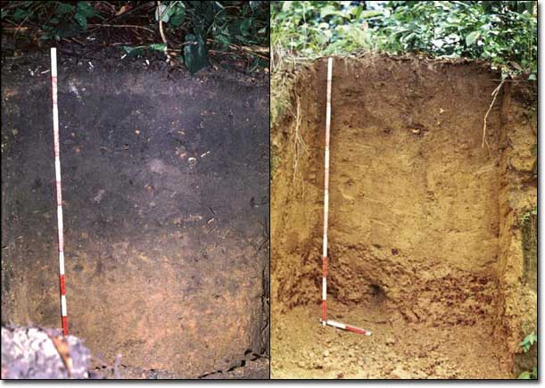
WHAT IS THE BIOCHAR
Terra Preta (fertile anthropogenic dark earths, Amazon basin), which were generated approximately 8000 years ago after soil was amended with bones, charcoal, and manure by indigenous natives (Glaser et al. 2007)
https://en.wikipedia.org/wiki/Terra_preta
Image courtesy of Carbon-terra.eu

Slide 4
Biochar is a highly porous charcoal made from organic waste and is high in organic carbon, mostly resistant to decomposition
Concept of low-temperature pyrolysis bio-energy with biochar sequestration.
Biomass
– manure
– organic
wastes
– bioenergy crops
(grasses, willows)
– crop residues
Transport
Energy
Coproducts (oil, cosmetics)
Industry
Biofuel
– bio-oil
– hydrogen
Pyrolysis
Residual heat
Returned to
soil as biochar
Typically, about 50% of the pyrolyzed biomass is converted into biochar and can be returned to soil.
(Lehmann 2007, Front Ecol Environ ).

Slide 5
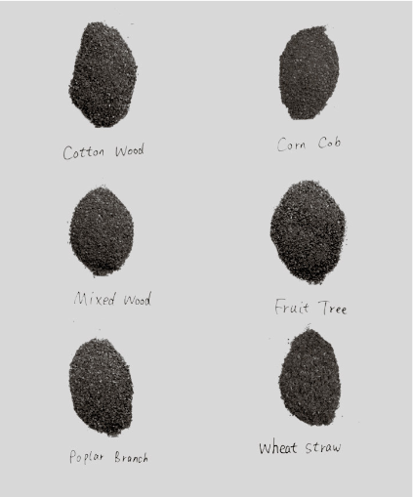
CLAIMED BENEFITS OF BIOCHAR:
Improved
soil cation exchange capacity
water holding capacity
soil aggregation
Increased
- stable carbon in soil
nutrient concentration
soil biological activity
Stimulated
- plant growth
plant tolerance to abiotic stresses
Aids in pathogen suppression

Slide 6
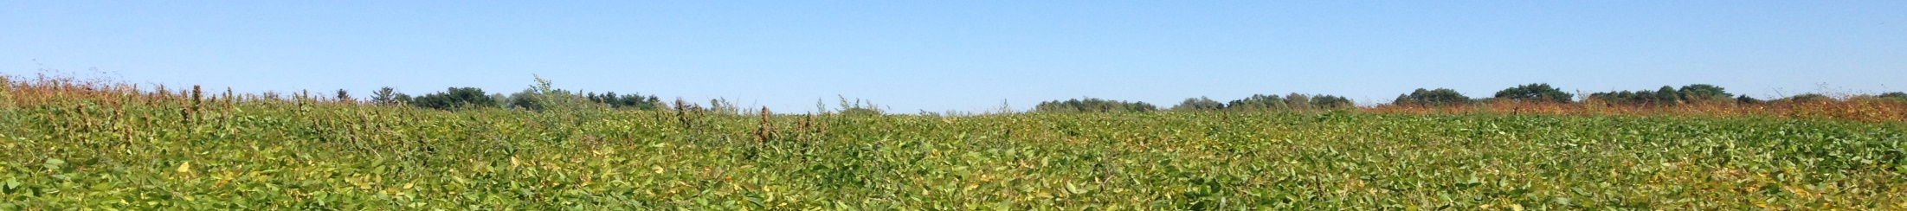
HYPOTHESIS
We hypothesized that biochar application in soil mitigates salt stress of licorice, improve nutrient acquisition through improving soil biological properties and root growth and that this beneficial effect depends on biochar concentration.
OBJECTIVES
to investigate to understand the effect of different biochar concentrations on plant and root growth and nutrient uptake (C, N, P),
to determine to determine the response of soil enzyme activities linked to carbon, nitrogen and phosphorus cycling in loamy sand under saline and non-saline conditions

Slide 7
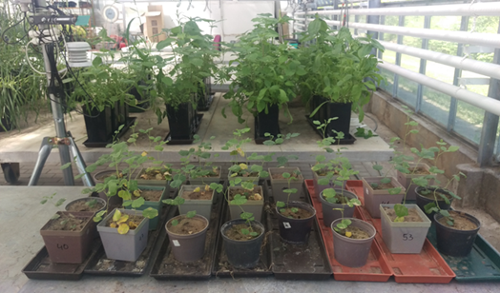
MATERIAL AND METHODS
- The biochar material was produced from maize by heating at 600ºC for 30 min (MBC)
- 2, 4 and 6%
Characterization of chars (Rabie et al. 2014)
Material | DM (%FW) | Ash (%DM) | C (%DM) | N (%DM) | P (g/kg FM) | K (g/kg FM) | pH | EC
MBC-char | 92.85 | 18.42 | 75.16 | 1.65 | 5.26 | 31.12 | 9.89 | 3.08
Loamy Sand soil:
pH, 6.2; organic C content, 0.55%; total N content, 0.07%; P content, 32.0 mg (100 g soil)⁻¹; K content, 1.25 g (100 g soil)⁻¹; and Mg content, 0.18 g (100 g soil⁻¹⁾.

Slide 8
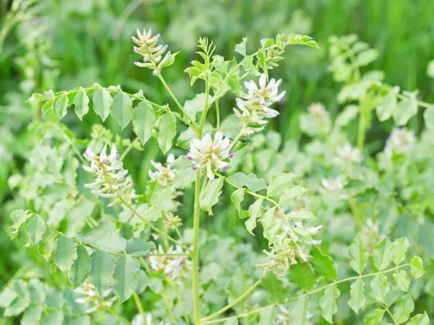
Liquorice (licorice (Glycyrrhiza uralensis Fisch.)
Small perennial leguminous herb of the family Fabaceae.
The plant is well adapted to grow in saline and arid soils because of itsr deep-reaching root system. shows high stress-resistance
Licorice is used in the restoration of soil fertility
Greenhouse conditions:
Temperature: 24 ◦C /16 ◦C (day/night)
Humidity: 50-60%
Day lenght: 12 h
Plants were grown for 40 days
Each treatment : 4 pots (2 plants per pot)
saline levels: 50 mM NaCl
Notes:
. It is a widely used herbal medicine, which shows high stress-resistance (Pan et al, 2006).
Licorice (Glycyrrhiza glabra L.) has been also considered as salt tolerant plant which could be used for remediation of abandoned salt affected soils. In addition licorice was considered to be an alternative income source for farmers in salt affected arid regions (Abe et al. 2005).
It can be successfully cultivated as salt tolerant plant which could be used for remediation of abandoned salt affected soils

Slide 9
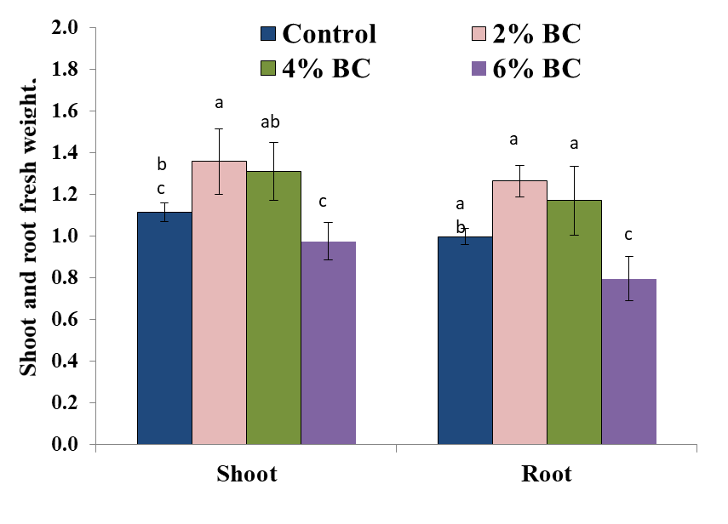
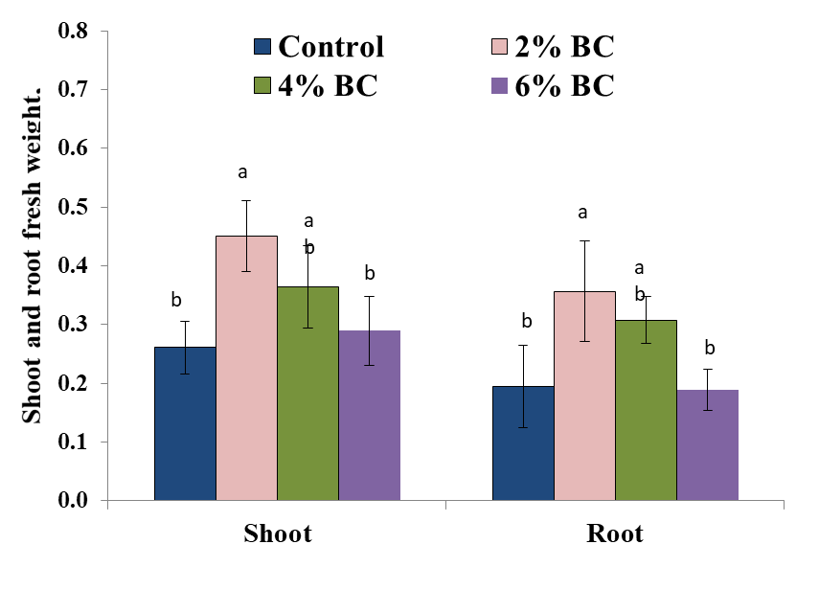
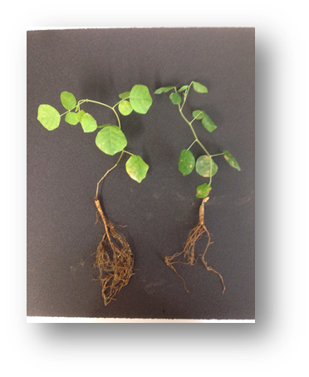
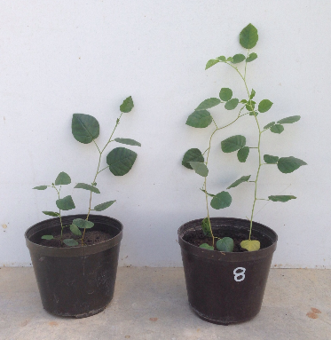
Shoot and root growth of licorice grown in soil amended with biochar under non-saline and saline soil conditions.
Non saline
Control 2%BC
Control 2%BC
Saline

Slide 10
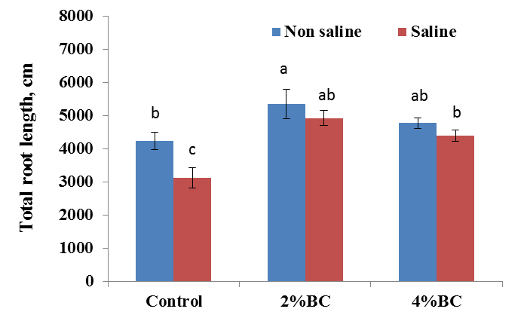
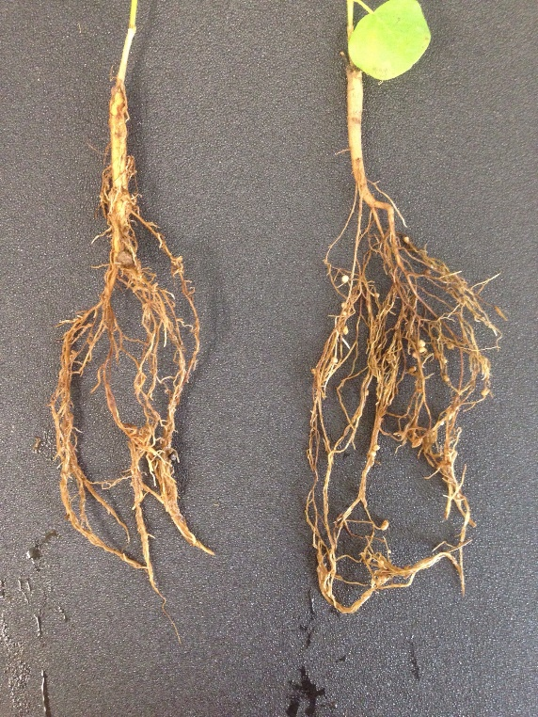
The root length of licorice grown in soil amended with biochar under non-saline and saline soil conditions.
Control
2%BC

Slide 11
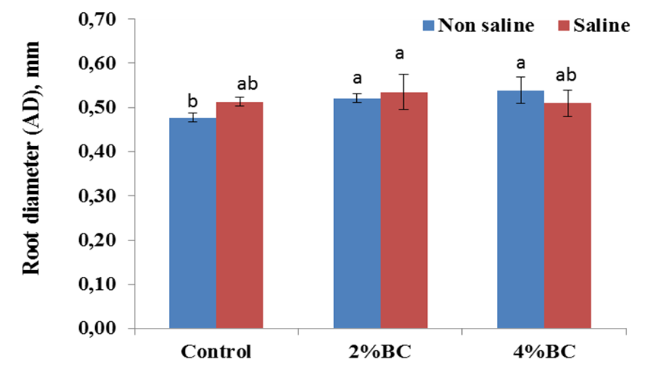
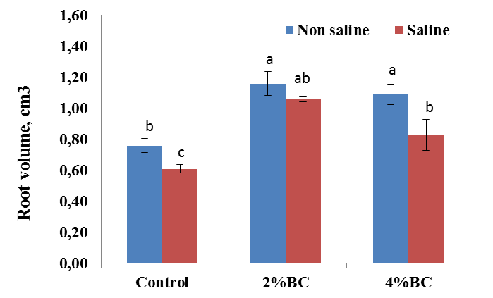
The root diameter and root volume of licorice grown in soil amended with biochar under non-saline and saline soil conditions
Root Diameter
Root Volume

Slide 12
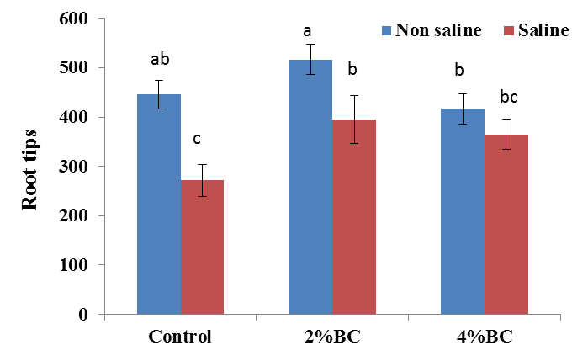
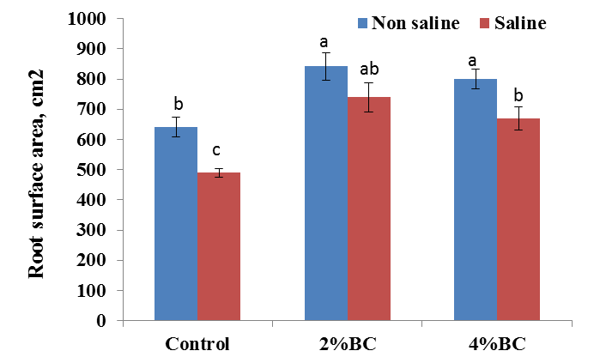
The root tips, and root surface area of licorice grown in soil amended with biochar under non-saline and saline soil conditions
Root Surface Area
Root Tipps

Slide 13
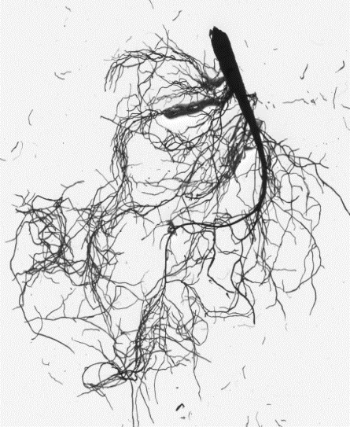
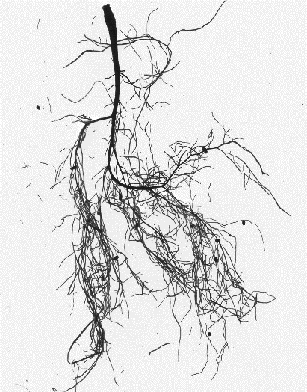
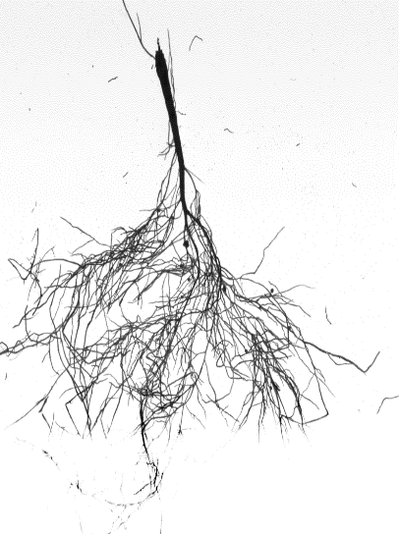
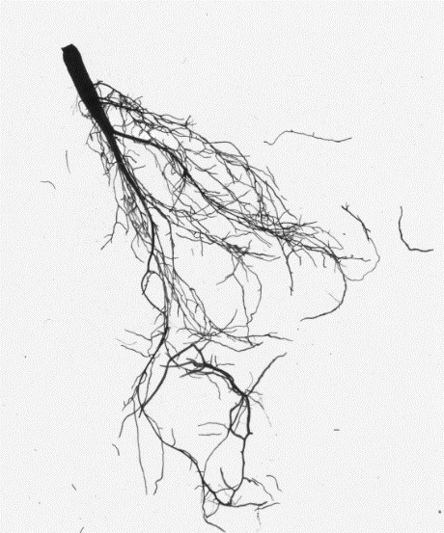
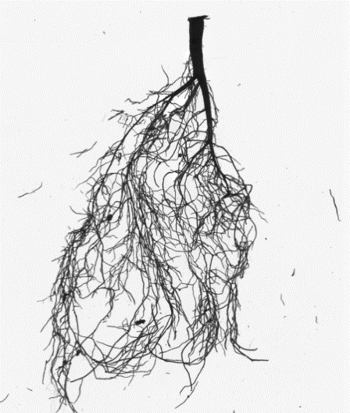
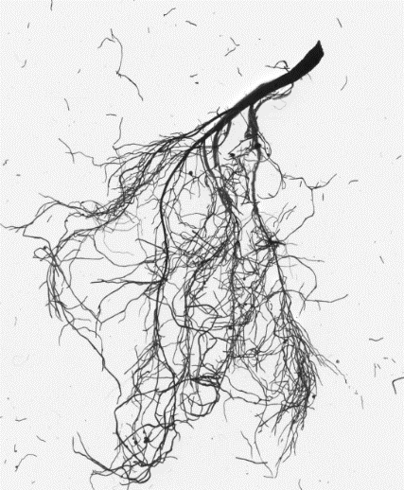
The root architecture of licorice grown in soil amended with biochar under non-saline and saline soil conditions
Control non saline
2% BC non saline
4% BC non saline
Control saline
2% BC saline
4% BC saline

Slide 14
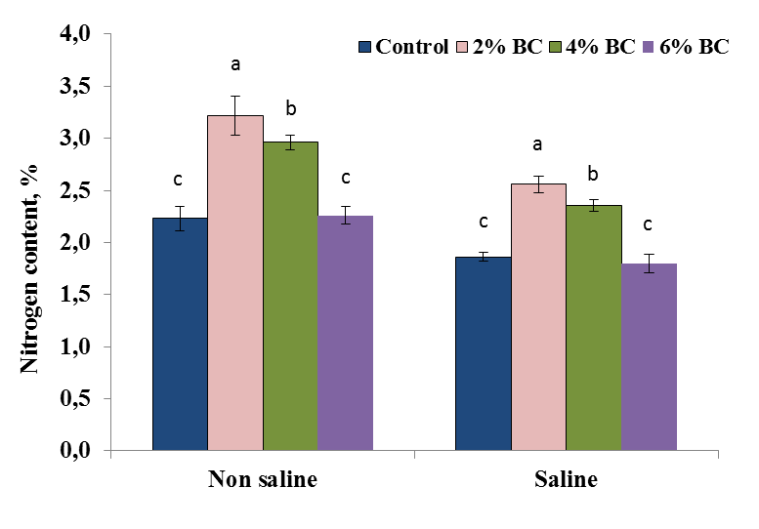
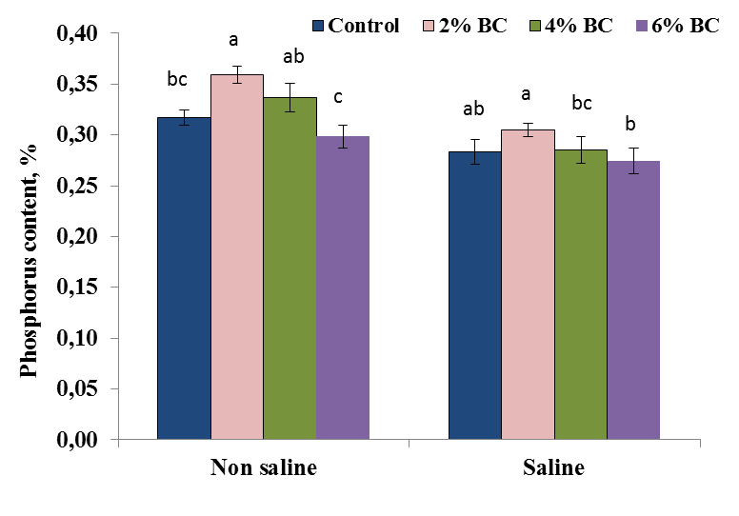
Concentrations (%) nitrogen, and phosphorus in licorice plant tissue grown after application of biochar under non-saline and saline soil condition.
Nitrogen content %
Phosphorus content %

Slide 15
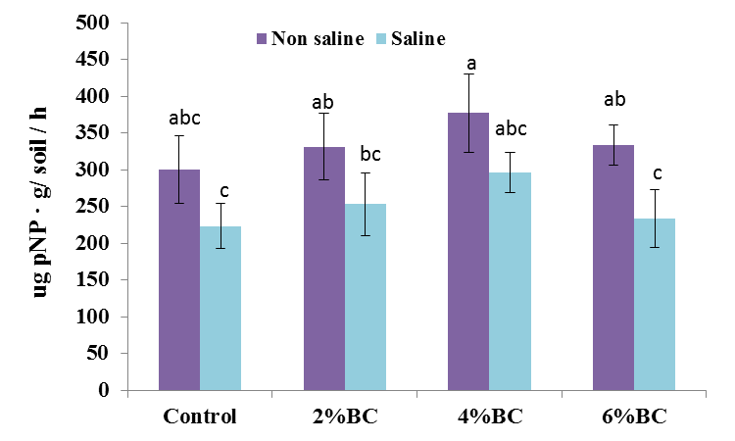
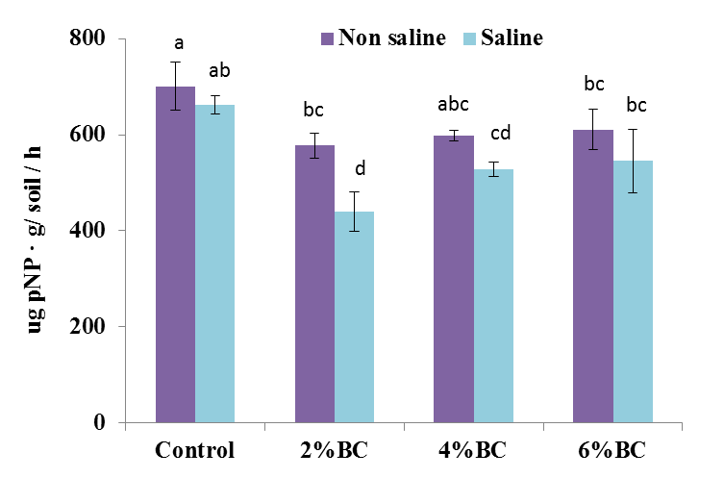
Effect of biochar amendment on soil acidic and alcalic phosphomonoesterase activity under non-saline and saline soil conditions
Acidic phosphomonoestrase
Alcalic phosphomonoestrase
Notes:
as evidence shows that they are correlated to P stress and plant growth. For example, when there is a signal indicating P deﬁciency in the soil, acid phosphatase secretion from plant roots is increased to enhance the solubilization and remobiliza- tion of phosphate, thus inﬂuencing the ability of the plant to cope with P-stressed conditions

Slide 16
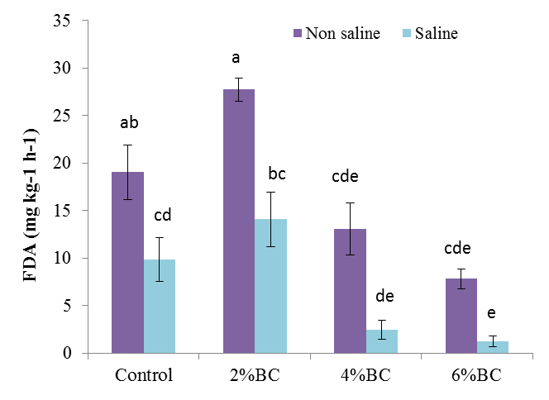
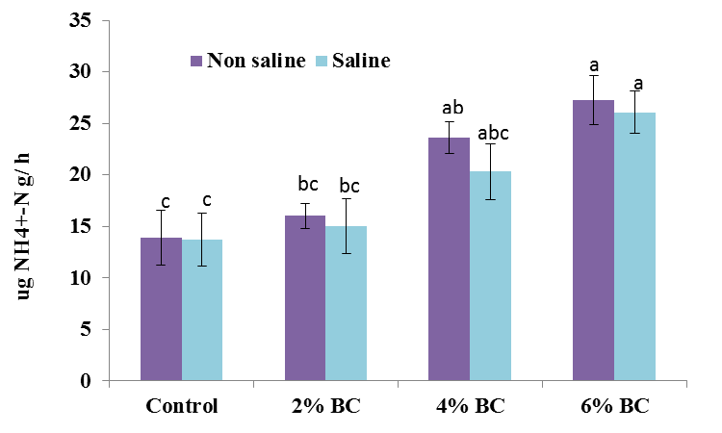
Effect of biochar amendment on FDA hydrolase and protease activity under non-saline and saline soil conditions
FDA activity
Protease

Slide 17

Conclusion
The results of our study revealed synergistic effects of biochar amendments on plant growth, nutrient uptake, and soil enzyme activities involved in cycling of C, N and P in a sandy loam soil under non-saline and saline conditions.
A low biochar concentration (2%) in the soil had a more significant effect on plant shoot and root growth, root architecture, and soil enzyme activities as compared to 4 and 6% biochar additions under both non-saline and saline soil conditions.
This finding underpins the notion of an elaborate relationship between biochar concentration and enhanced plant growth, root system architecture, nutrient acquisition, symbiotic performance and soil biological properties.
Notes:
These studies showed

Slide 18
ACKNOWLEDGEMENT
Leibniz Centre for Agricultural Landscape Research (ZALF), Field Research Station
THANKS
Prof. Sonoko Dorothea Kimura, Dr. Stephan Wirth, Dr. Ma Hua and Dr. Zohreh Zoghi for their support
FUNDING
Alexander von Humboldt Foundation

