Slide 1
Genetic Modification in KNAT7 for increasing saccharification in poplars
Prof. C.P. Joshi,
Chairperson, biological sciences,
Michigan Technological University
IECPS-2020

Slide 2
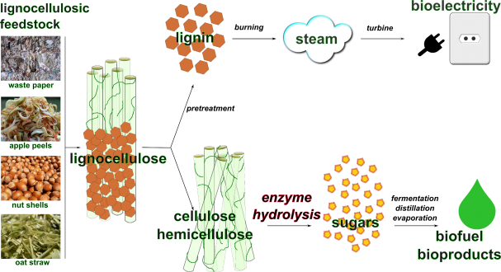
Why improving Saccharification is necessary?
SACCHARIFICATION
Adapted from Genozymes, semantic software lab, Concordia university, Montreal, Canada

Slide 3
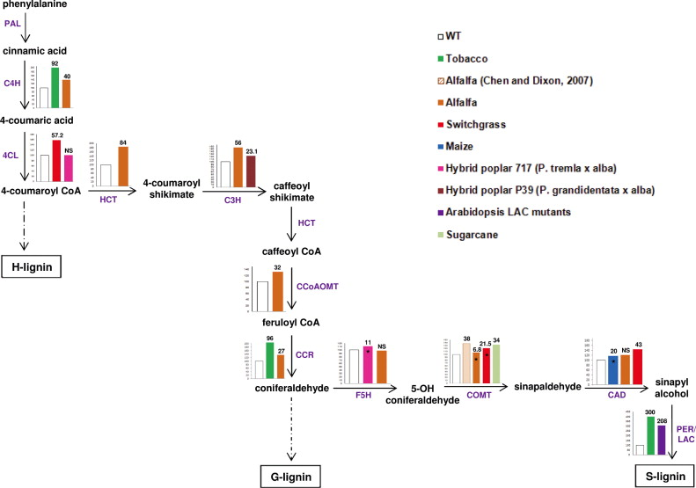
Lignin pathway genes manipulated for saccharification
Lac/Per
Lac/Per
Nookaraju, A., Pandey, S. K., Bae, H. J., & Joshi, C. P. (2013). Designing cell walls for improved bioenergy production. Molecular plant, 6(1), 8-10.

Slide 4
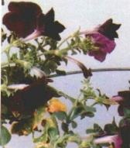
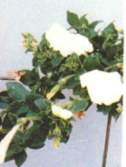

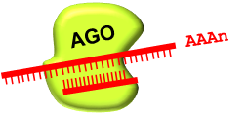
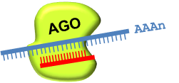
Why Heterologous Studies in Poplar : Co-suppression
The phenomenon, in which both the introduced gene and the endogenous gene are silenced, called as “Co-suppression”
Purple flowers
White flowers
Co-suppressed transgenic
Co-suppression
Sense RNA
PRO
ORF
Sense construct
siRNA produced
mRNA
PRO
ORF
Gene silencing
Endogenous gene
De Paoli, E., Dorantes-Acosta, A., Zhai, J., Accerbi, M., Jeong, D.-H., Park, S., Meyers, B.C., Jorgensen, R.A., and Green, P.J. (2009). Distinct extremely abundant siRNAs associated with cosuppression in petunia. RNA 15: 1965–1970.

Slide 5
Research Objectives
Overexpressing Poplar KNAT7 and silencing KNAT7 using antisense construct in Hybrid Poplar using tissue specific promoter DX15. Heterologous expression of Arabidopsis KNAT7 in Hybrid Poplar species driven under DX15 promoter

Slide 6
6 constructs transformed in Poplar
OE : DX15pBI101-PtKNAT7
Downregulation : DX15pBI101-AS-PtKNAT7
OE : DX15pBI101-AtKNAT7
(OE-Over-expression; AS- Antisense; At-Arabidopsis thaliana; Pt- Populus
trichocarpa; pBI101- binary vector, plasmid)

Slide 7
Research Approach
RNA isolation and cDNA synthesis : Inflorescence or stem, specifically second internode portion, of the plants were collected
Gene amplification and Cloning: Lac2 ( 1.7kb) , Lac4 (1.6 kb) and PRX52 (1 kb), AtKNAT7 (876Bp) in pMINIT vector (2525 BP)
Sub-cloning : Binary vector pBI101-DX15 promoter- 12 KB
Sequencing : Confirmed all clones in pBI101:DX15
Poplar transformation using Agrobacterium infiltration methods
Expression studies- Real-time PCR.
Biochemical- Total Laccase and Peroxidase activity.
Histochemical studies.
Wood properties- Lignin analysis and Saccharification.
Phenotypic measurements every week until day of harvest.

Slide 8
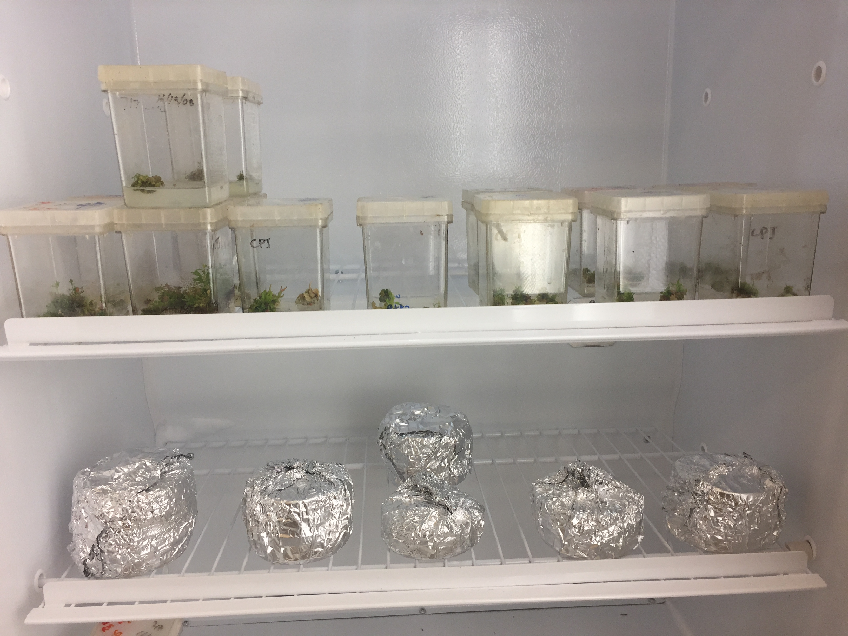
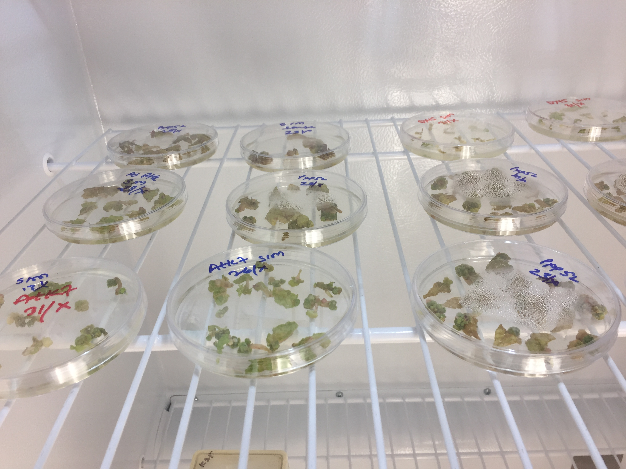
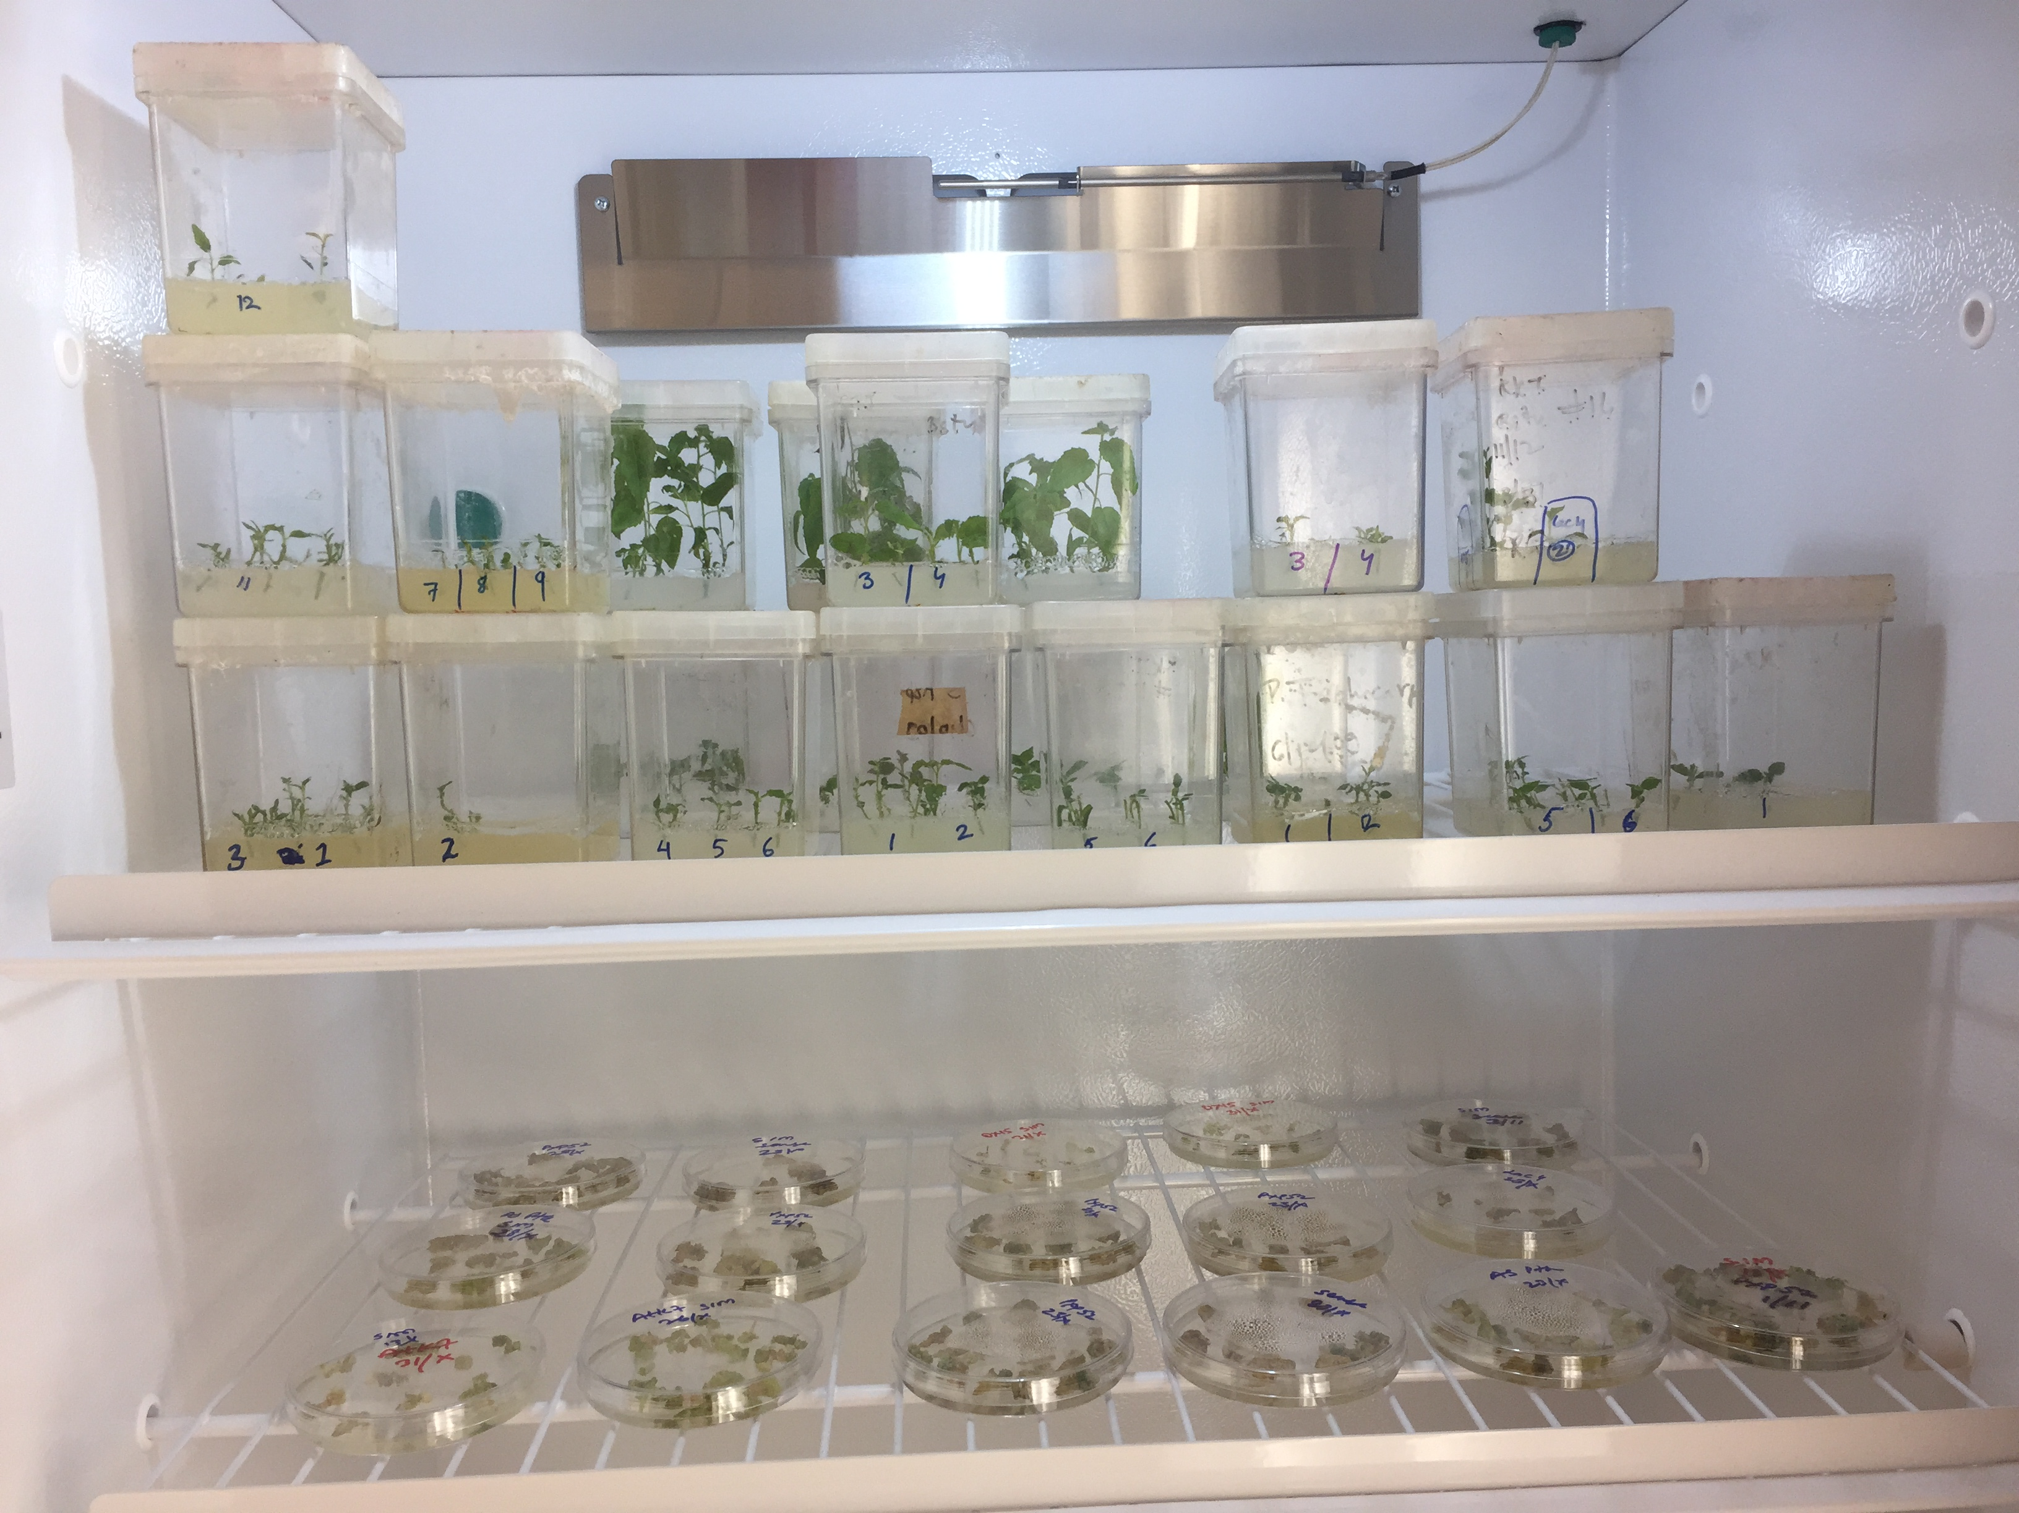
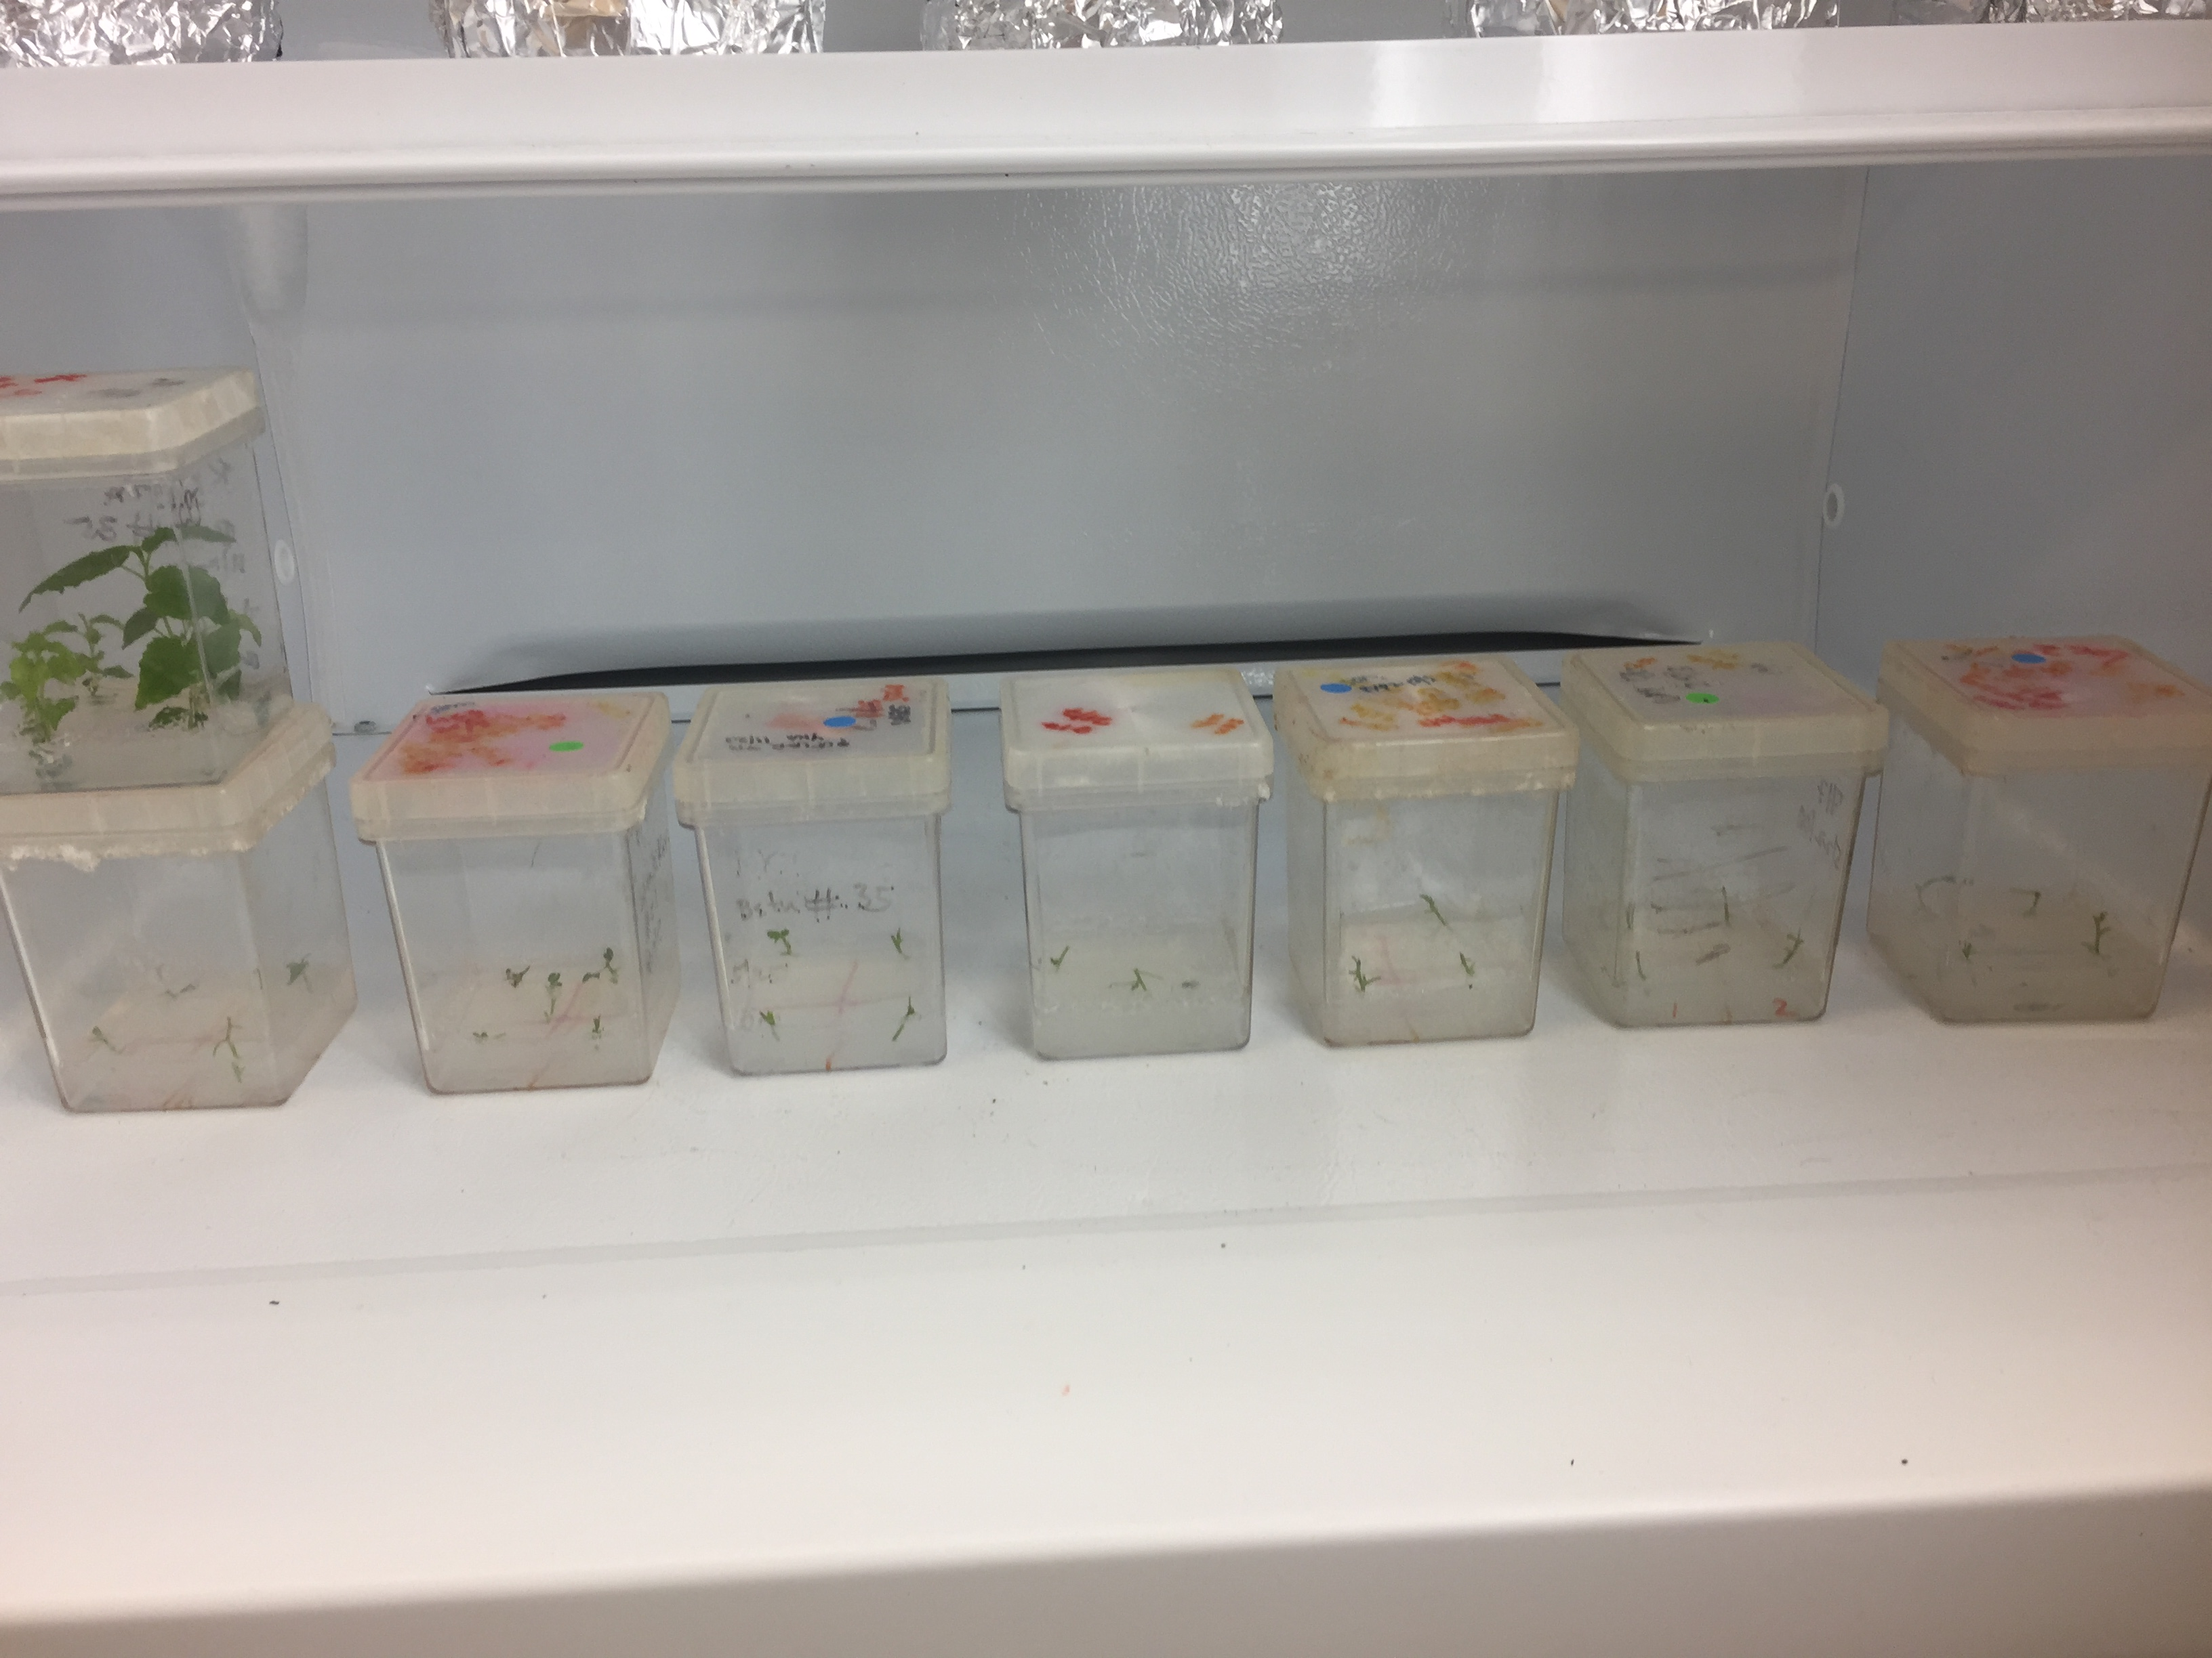
Different stages of tissue culture
CIM
SIM
SEM
RIM

Slide 9
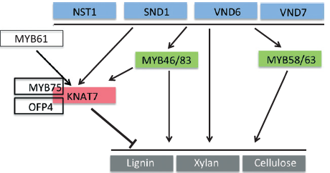
Transcriptional control of SCW

Slide 10
Transcription factors : KNAT7 mediated SCW regulation
TALE Family: Well conserved .
Class I KNOX and Class II KNOX.
KNAT7, Class II KNOX, role is debatable and still unclear.
Negatively regulate the secondary cell wall formation in Arabidopsis (Li et al., 2012).
Positively regulate the secondary cell formation (Zhong et al., 2008)

Slide 11
Research on KNAT7
Li et al . 2011 – KNAT7 is a negative regulator of secondary cell wall formation and functionally conserved in Populus.
In Arabidopsis, Knat7 mutant line showed irx phenotypes.
Increased cell wall thickness in fibers.
Lignin content was increased.
Secondary cell wall genes were up-regulated.
Overexpression lines- thinner inter-fascicular fiber cell walls.
Pandey et at., 2016- Positive regulator in tobacco.

Slide 12
Results : KNAT7 Expression studies in poplar by Real time PCR

Slide 13
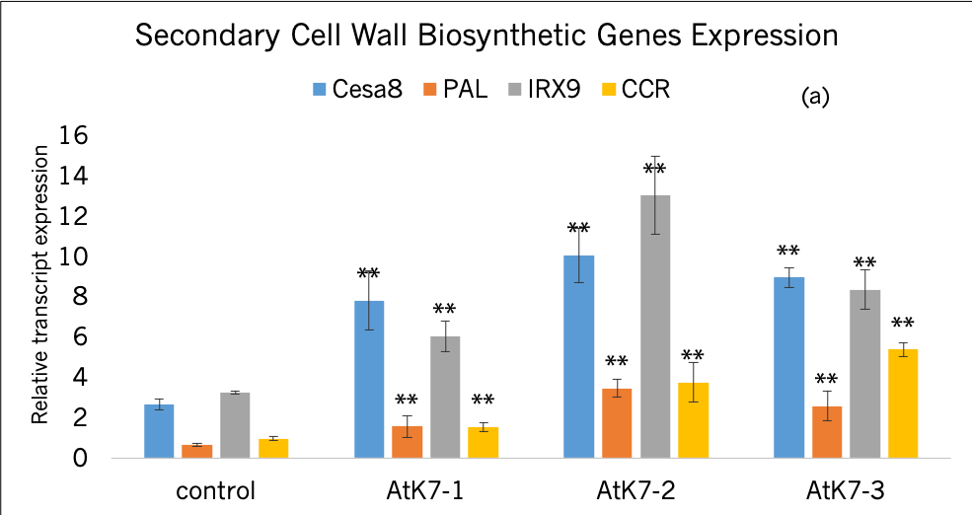
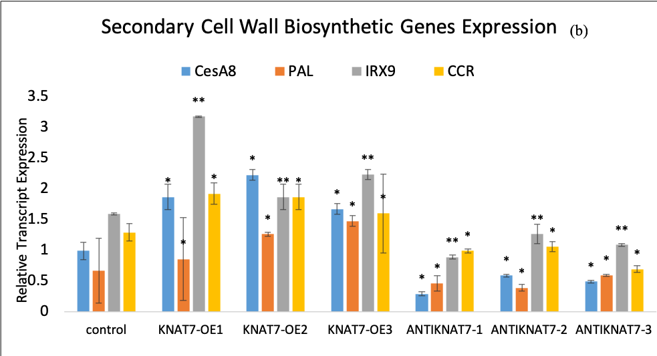
How KNAT7 in poplar affects SCW biosynthetic genes
Results:
In case of OE-AtKNAT7 and OE-PtKNAT7, SCW genes were up-regulated
and in AS-PtKNAT7, SCW genes were down-regulated

Slide 14
Growth measurements of OE-PtKNAT7 and AS-PtKNAT7 transgenic lines
(b)
(a)
(c)

Slide 15
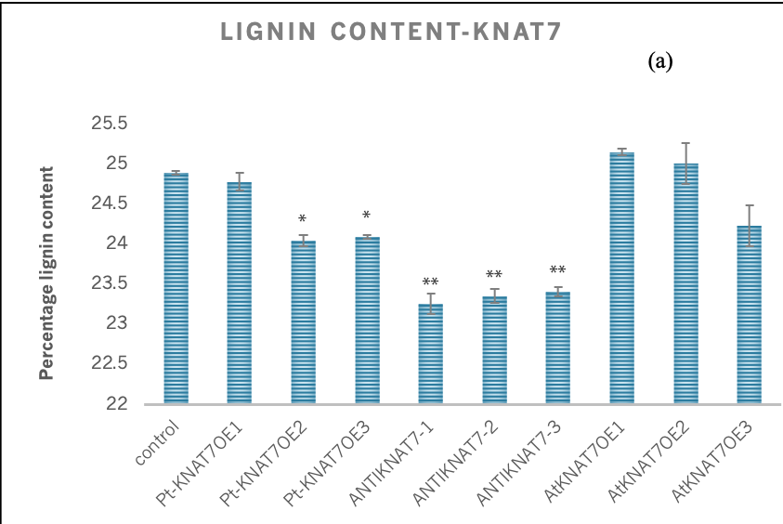
Lignin Analysis by PyMBMS
Result:
Lignin content
4% decrease in lignin content was observed for OE-PtKNAT7 and no change for OE-AtKNAT7.
6% decrease in lignin content in case of AS-PtKNAT7,
S/G ratio
5-7% increase for OE-PtKNAT7 and 8-12% increase in AS-PtKNAT7
7% increase in OE-AtKNAT7.

Slide 16
Saccharification Assay- KNAT7 transgenic lines in poplar
Result: Increase in Saccharification efficiency was observed
OE-PtKNAT7 : 21-26%
AS-PtKNAT7 : 60-66%
OE-AtKNAT7 : 32-43%

Slide 17
Conclusions
Genetic modification of Laccases and Peroxidases under tissue specific promoter is an important strategy for saccharification.
Alteration in KNAT7 results in the increase in saccharification efficiency.
We conclude that tissue specific genetic modification under DX15 utility promoter did not produce any growth abnormality in the transgenic lines of poplar.

Slide 18
Future research directions
Protein-protein interactions between the MYB-KNAT7 family can provide insights about their role in secondary cell wall regulation
EMSA or chip to chip studies can further provide us information about the promoter binding sites of the KNAT7 Transcription factor in the SCW biosynthesis genes
Functional genomics studies on Laccase and Peroxidase gene families can clarify roles on how these enzymes control lignification in secondary cell wall

Slide 19
Thank You

