Slide 1


Approach to optimization of FRAP methodology for studies based on selected monoterpenes
Karolina Wojtunik-Kulesza
karolina.wojtunik@umlub.pl
Medical University of Lublin

Slide 2
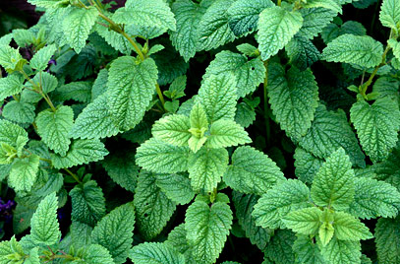
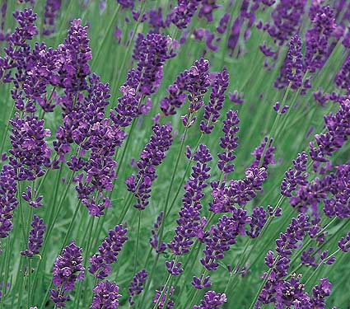
A few words about monoterpenes…
Natural substances which are one of the main components of essential oils
No precise biochemical characterization
Diversified structure of compounds
γ-Terpinene
Citral
Linalool
α -Pinene

Slide 3
Multifactorial character of Alzheimer’s disease
Alzheimer
Cholinergic hypothesis
β-amyloid hypothesis
Tau protein hypothesis
Oxidative stress
Metal ion influence

Slide 4
The influence of Fe³⁺ on AD
Harmful impact within human organism resulting from:
responsibility for the aggregation of hyperphosphorylated tau
neurofibrillary tangles
oxidation process

Slide 5
The aim of studies: determination of ability of selected monoterpenes to reduce Fe³⁺ and optimization FRAP method

Slide 6
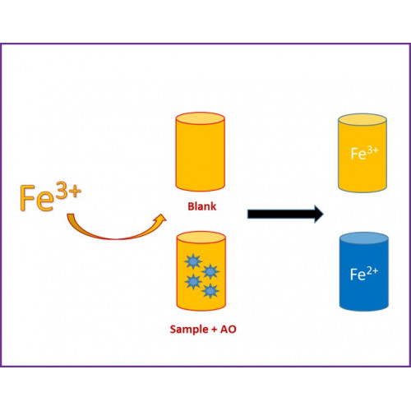
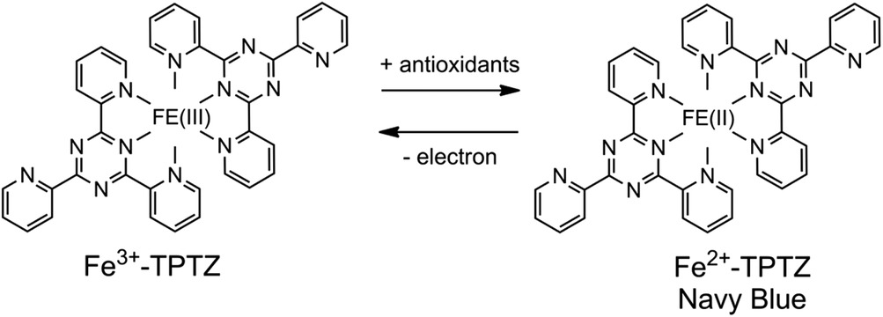

FRAP (ferric reducing antioxidant power) assay
[Fe³⁺-(2,4,6-Tris(2-pirydyl)-s-triazine)₂]³⁺ $\underset{→}{reductor/antioxidant}$ [Fe²⁺-(2,4,6-Tris(2-pirydyl)-s-triazine)₂]²⁺
colorless intensively blue-colored complex

Slide 7
Assay
Basic : 0.3M acetate buffer (pH 3.6) + 0.01M TPTZ in 0.04M HCl + 0.02M FeCl₃ × 6H₂O (10:1:1 v/v/v) + studied compound
Modifications:
Terpene – methanol mixture
Replacement of methanol (to terpenes dissolution) with other solvents (chloroform, ethyl acetate, or 2-butanone)
Addition of Tween 20 (below CMC)
FRAP – TLC

Slide 8
Results

Slide 9
Assay
Basic : 0.3M acetate buffer (pH 3.6) + 0.01M TPTZ in 0.04M HCl + 0.02M FeCl₃ × 6H₂O (10:1:1 v/v/v) + studied compound
Modifications:
Terpene – methanol mixture
Replacement of methanol (to terpenes dissolution) with other solvents (chloroform, ethyl acetate, or 2-butanone)
Addition of Tween 20 (below CMC)
FRAP – TLC

Slide 11
Assay
Basic : 0.3M acetate buffer (pH 3.6) + 0.01M TPTZ in 0.04M HCl + 0.02M FeCl₃ × 6H₂O (10:1:1 v/v/v) + studied compound
Modifications:
Terpene – methanol mixture
Replacement of methanol (to terpenes dissolution) with other solvents (chloroform, ethyl acetate, or 2-butanone)
Addition of Tween 20 (below CMC)
FRAP – TLC

Slide 13
FRAP-TLC

Slide 14
The most active monoterpenes

Slide 15
Conclusions
the most promising optimization for FRAP assay among those proposed was augmentation with surfactant
Despite the solution not showing a spectacular impact on antioxidant activity improvement, the obtained results were more reliable and reproducible
the compounds could be considered as possible anti-neurodegenerative agents

Slide 16
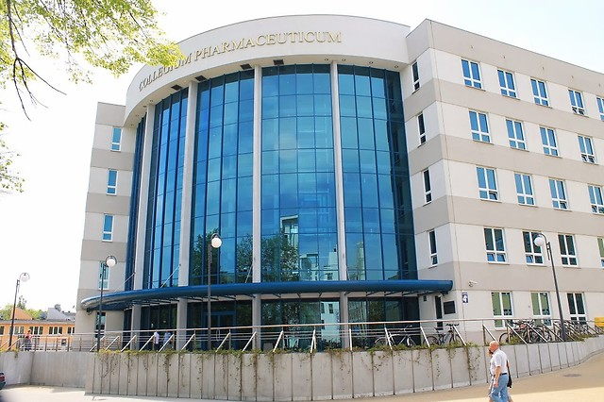


Thank you for your attention

