Slide 1
The 3rd International Electronic Conference on Environmental Research and Public Health —Public Health Issues in the Context of the COVID-19 Pandemic
Session: Public Health Statistics and Risk Assessment
EVALUATING LEGIONELLA ON LONG-DISTANCE PUBLIC TRANSPORTS: MONITORING DATA AND QUANTITATIVE MICROBIAL RISK ASSESSMENT
Ileana Federigi *,
Osvalda De Giglio, Giusy Diella, Francesco Triggiano, Marco Verani, Lorenzo Cioni, Maria Teresa Montagna, Annalaura Carducci
* Hygiene and Environmental Virology Laboratory
Department of Biology – University of Pisa
ileana.federigi@biologia.unipi.it

Slide 2
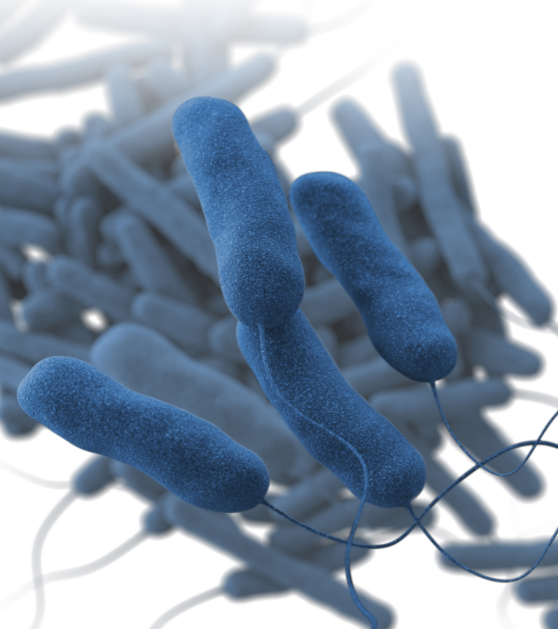
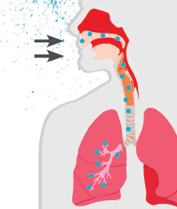
BACKGROUND: Legionella ecology and pathogenicity
Species of the genus Legionella are Gram-negative, non-spore-forming, rod-shaped, aerobic bacteria.
Legionella bacteria naturally reside in many freshwater and soil environments, such as lakes, streams, and sediments.
Source: CDC
Legionella can grow in high amount in the biofilm, which typically forms on wet engineered surfaces of human-made water systems.
Inhalation of airborne small droplets containing Legionella is the commonest mode of transmission.
Legionella is responsible for lung infection, causing also very serious types of pneumonia (the so-called Legionnaires disease).
Source: CDC

Slide 3
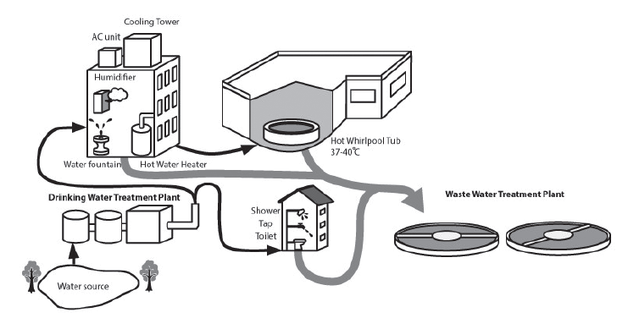
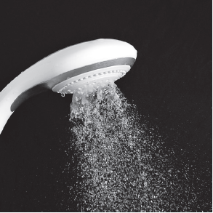
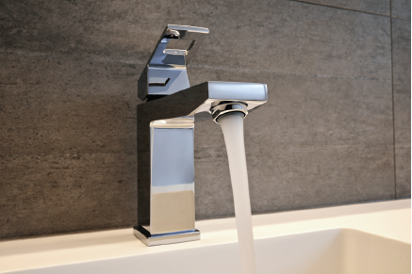
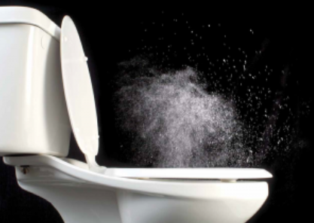
BACKGROUND: Legionella as premise plumbing pathogen
Drinking water systems represent one of the main sources of Legionella, where the outlets of premise plumbing are the sites for aerosolization.
Source: National Academies of Sciences, Engineering, and Medicine 2020
Showerheads
Sink faucets
Toilette

Slide 4
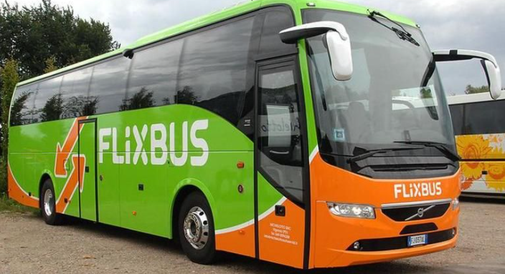
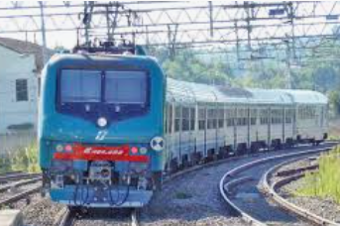
BACKGROUND: Management of Legionella in plumbing systems
To avoid Legionella outbreaks through plumbing systems, guidelines for water management are applied worldwide, which include:
Periodical monitoring of water samples for Legionella;
Treatment strategies (i.e., disinfection) according to Legionella levels in water samples.
Such guidelines are intended for water building systems of specific settings, namely:
Tourist accommodations (i.e., hotels and cruise ships);
Healthcare facilities.
However, also long-distance public transportations are equipped with water distribution systems, but environmental surveillance is rarely addressed and Legionella risk has never yet been considered.

Slide 5
AIM OF THE STUDY
This study joined environmental monitoring and health risk assessment:
Monitoring of Legionella in water collected from sinks on Italian passenger trains carried out in a 6-year period;
Quantifying risk of infection from single use of a sink, through the Quantitative Microbial Risk Assessment (QMRA) framework.

Slide 6
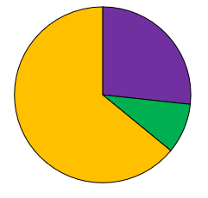
Pathogen identification
The surveillance study (398 samples) showed 217 positive samples for Legionella.
Among positive samples, more than 60% were Legionella pneumophila serogroup 1.
Legionella pneumophila serogroups 2-14
27%
Legionella pneumophila serogroup 1
64%
9%
Mixed Legionella pneumophila serogroup 1 and serogroups 2-14
Legionella pneumophila serogroup 1 has been chosen as the index pathogen since the epidemiological data reported that it is the predominant serogroup in clinical isolates, accounting for approximately 85% of the cases confirmed by culture worldwide (Yu et al., 2002; Fontana et al., 2014; Beaute, 2017).

Slide 7
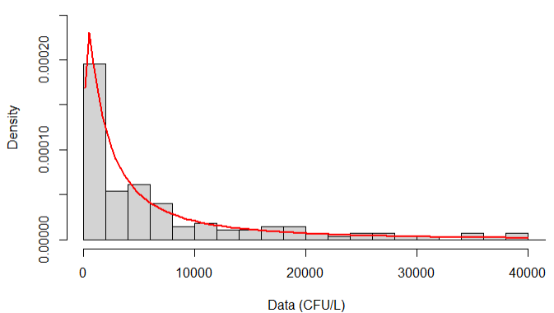
×
Exposure Assessment
The inhaled dose has been calculated using:
Monitoring data for L. pn.sg1 level in water (C_{water});
Literature data on the aerosolization ratio (PC), percentage of aerosol in the respirable range (F₁₋₈), and inhalation rate (IR);
Assumption of 0.5 to 1.5 min of exposure time (ET).
L. pn. sg1 concentration in water
Inhalation rate
Exposure time
Median = 4.1 x 10³ CFU/L
IQR = 1.0 x 10³ CFU/L – 1.1 x 10⁴ CFU/L
Density
Density
Density
L. pn.sg1 (CFU/L)
m³/min
min

Slide 8
Dose-response assessment and risk characterization
The dose-response equation has been derived from the literature and it is widely used in QMRA for Legionella pneumophila in various settings (with
r = 0.06).
P _{inf} = 1 − e ^{− dose * r}
Then, infection risk was computed using Monte Carlo analysis, in which each input parameter was let varying according to its probability distribution function (L. pneumophila concentration in water, inhalation rate, exposure time).
The final result was 10.000 random estimates of the infection risk, so to capture the variability of the input parameters.

Slide 9
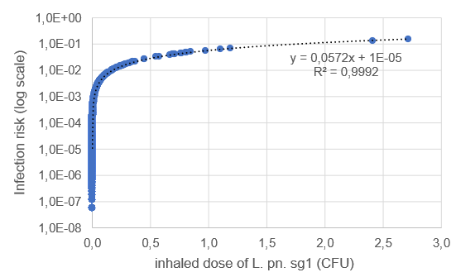
Infection risk for the considered expoure scenario
Although the bacterial concentration in water was relatively high, only a little quantity of Legionella was aerosolized by the sinks, resulting in no more than 3 CFU during a single-use (inhaled dose).
Such inhaled dose was responsible for a median infection risk of approximately 2 infection/10⁶ exposures (IQR = 2 infection/10⁷ exposures - 3 infection/10⁵ exposures).

Slide 10
Final remarks
This study points out the importance of an environmental monitoring also on long-distance public transportations whose piped water systems are rarely considered as sources of Legionella.
The monitoring data have been used to calculate the infection risk from inhalation of L. pn. sg1 using the methodology of QMRA applied to sink exposure scenarios.
This sound approach to risk assessment will allow further developments in the perspective of protecting public health, such as:
Estimation of the infection risk corresponding to Legionella thresholds in water, commonly used for Legionella control in water systems;
Calculation of the possible cumulative effect of sink exposure with toilette flushing, that has not been considered in the present model;
Effect of decontamination measure (i.e., chlorine disinfection) in reducing the probability of infection.

Slide 11
THANK YOUR KIND ATTENTION!!
https://www.vectorstock.com/

