Slide 1
The clinical potential of point-of-care quantitative SpectroChip coupled with lateral flow immunoassay in COVID-19 pandemic
I-Jen Wang
¹Department of Pediatrics, Taipei Hospital, Ministry of Health and Welfare

Slide 2
INTRODUCTION

Slide 3
COVID-19 PANDEMIC

Slide 4
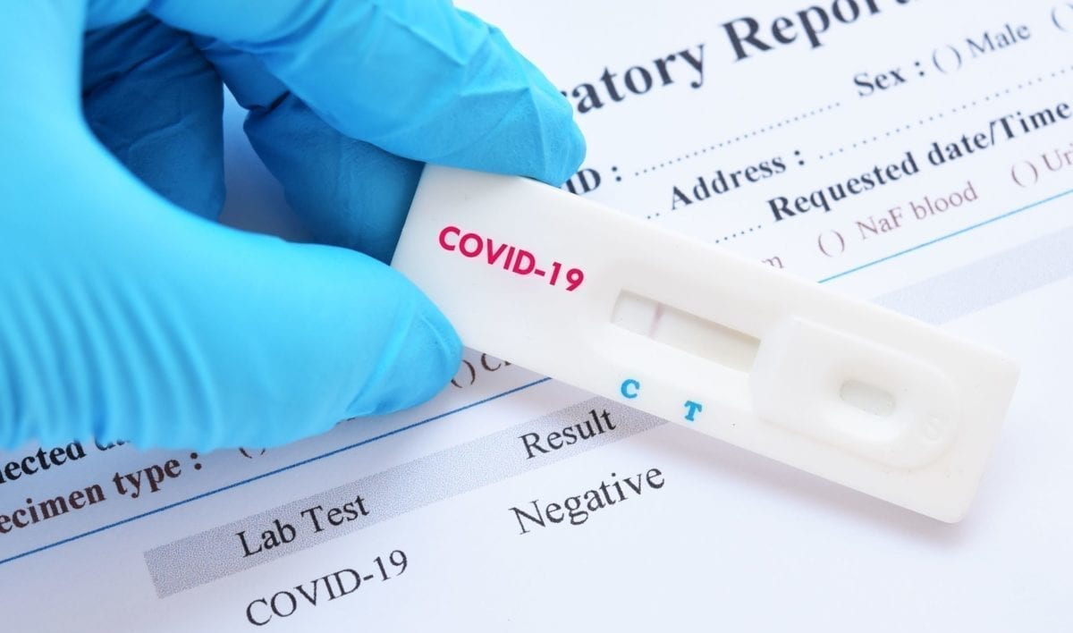
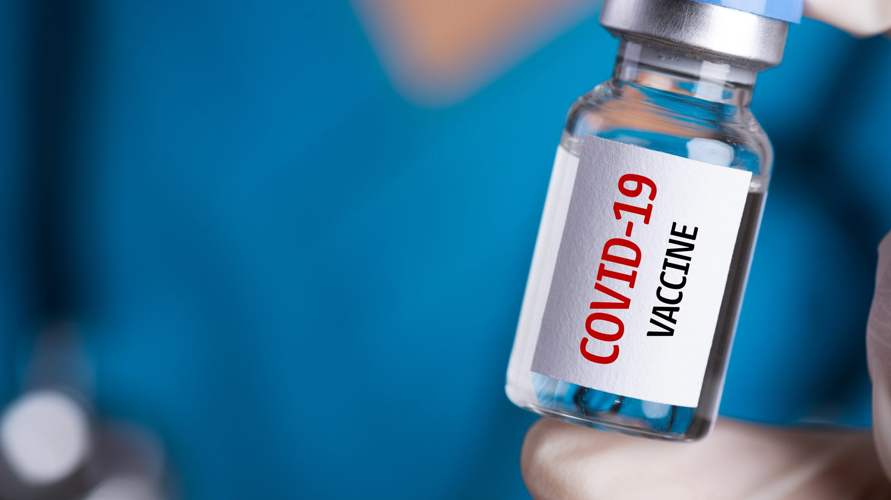

Slide 5
AIM
COVID-19 is the current grand global public health challenge.
To development of rapid quantitative detection of antibodies.

Slide 6
METHODS

Slide 7
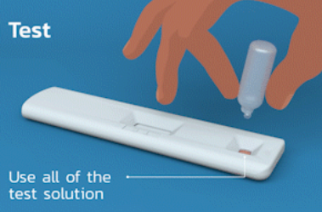
Subjects
Suspected COVID-19
(n=111)
Quickly produce results
March to May 2020 in a hospital
Notes:
Recruiting 111 participants of suspected COVID-19.
Infection from March to May 2020 in a single hospital.
Quickly produce results in 6 minutes.

Slide 8
RESULTS

Slide 9
RESULTS
Table1. Essential demographic characteristics of participants
 | Confirmed, PCR(+) | Suspected, PCR(-)
Characteristics | (N=12) | (N=99) | P-value
Age (mean ± SD) | 28.00±11.68 | 37.17±19.59 | 0.116
Male | 6 (50.0%) | 49 (49.5%) | 0.974
Symptom
Fever | 6 (50.0%) | 55 (55.6%) | 0.765
Cough | 4 (33.3%) | 43 (43.4%) | 0.504
Sore throat | 4 (33.3%) | 18 (18.2%) | 0.214
Diarrhea | 1 (8.3%) | 13 (13.1%) | 0.636

Slide 10
CONCLUSION

Slide 11
CONCLUSION
The COVID-19 IgM / IgG antibody test kit qualitatively detects the presence of IgG and IgM antibodies together or separately
The human immune system produces first antibodies “IgM” that have an immediate strength binding to the coronavirus. the IgG antibodies have a high binding affinity towards the virus, resulting in higher efficiency when fighting the virus.
This new platform's extraordinary detection ability demonstrated clinical potential.

Slide 12
To fight this pandemic, it becomes quite significant to conduct rigorous and quick testing.

