Slide 1
Trends in COVID-19 School Related Inquiries Using 311 NYC Open Data
The 3rd International Electronic Conference on Environmental Research and Public Health —Public Health Issues in the Context of the COVID-19 Pandemic
Adriana Eugene, MS; Wil Lieberman-Cribbin, MPH; Naomi Alpert, MS and Emanuela Taioli, MD, PhD

Slide 2
Introduction
March 11, 2020: WHO declares COVID-19 a pandemic
March 12, 2020: NYS declares a state of emergency, schools and non-essential businesses closed
Points of concern for NYC residents:
Re-opening timeline
Learning options for children
Tools and technology for remote learning
Childcare options
Access to school meals
NYC 311 Call Center is a resource for residents to file complaints and seek information from NYC government agencies.
Hypothesis
Due to the COVID-19 concerns, school related calls to 311 have increased compared to previous years.
Call volume increases following official announcements, as people are seeking more information.

Slide 3
Methods
All calls from July 7-November 22 in 2018, 2019, and 2020 were downloaded from the NYC 311 Call Center, in the time period after NYC entered Phase 3 of its reopening plan (July 6 to July 19).
Calls were categorized as related to “School”, “Access”, “Transportation”, “ Hospital and Ambulance”, “Food”, and “Unemployment”, based on presence of these key words in the call description.
χ2 tests were performed to compare the relative frequency of each call type over time, overall and among school-related calls.
Calls specifically tagged as “COVID-19 and Schools” were tallied per day and quantified on a timeline of COVID-19 related announcements.

Slide 4
Results
Frequency and Percent Change of NYC 311 Call Center Inquiry Types Over Time
 | 2018 (n(%)) | 2019 (n(%)) | 2020 (n(%)) | % Change 2018-2020
Access | 4,798 (0.2) | 6,861 (0.3) | 8,928 (0.5) | 150%
Food | 28,595 (1.2) | 30,333 (1.5) | 62,875 (3.3) | 175%
Hospital | 8,627 (0.36) | 8,381 (0.42) | 7,111 (0.37) | 3%
School | 32,836 (1.4) | 30,626 (1.5) | 45,602 (2.4) | 71%
Transportation | 6,795 (0.3) | 29,975 (1.5) | 16,930 (0.9) | 200%
Unemployment | 1,590 (0.1) | 1,923 (0.1) | 11,236 (0.6) | 500%
Other | 2,338,046 (96.6) | 1,909,751 (94.6) | 1,777,569 (92.1) | -5%
Total | 2,421,287 | 2,017,850 | 1,930,251

Slide 5
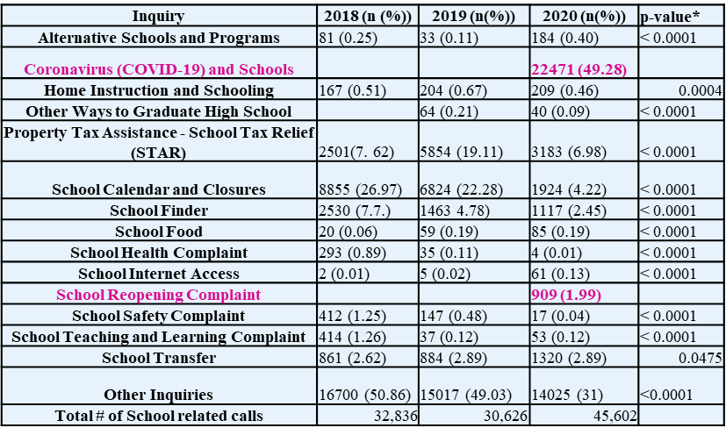
Frequency of School-Related 311 Call Center Inquiries Over Time

Slide 7
Discussion
There have been increases over time in multiple areas that may indicate increased concerns and difficulties due to COVID-19.
The increase in school-related calls could indicate that parents/guardians of school aged children may be struggling to adapt to remote learning and the quick changes in protocol that have occurred during the pandemic.
COVID-19 and school related calls to 311 peak around major announcements related to school closure/openings and policy changes, indicating that people may have outstanding concerns.
A needs assessment would help optimally allocate resources and effectively implement policy changes by determining which school districts have highest need in terms of remote learning (e.g. access to tablets) and social (e.g. dependence on school lunch for meals) resources.

Slide 8
Conclusions
NYC residents have relied on the 311 call center as a source of information on learning options, school health and safety, and additional resources for students during the COVID-19 pandemic.
Information regarding school systems and resources for remote learning during the pandemic need to be communicated to the general public in an accurate and timely manner to prevent confusion and give residents the ability to plan for changes.

Slide 9
Acknowledgements Emanuela Taioli, MD, PhD Naomi Alpert, MS Wil Lieberman-Cribbin, MPH
Financial Disclosure: No funding was received for this work.
Conflicts of Interest: The authors have indicated that they have no potential conflicts of interest to disclose
Data availability statement: 311 Data is available to download at: https://data.cityofnewyork.us/City-Government/311-Call-Center-Inquiry/wewp-mm3p

