Slide 1
Water global health benefit: the water footprint of the dietary patterns and the acceptability of a 100% plant-based diet the 3rd International Electronic Conference on Environmental Research and Public Health — Public Health Issues in the Context of the COVID-19 Pandemic, Section: Environmental Exposures and Health
Virginia Vettori, PhD Student; Chiara Lorini, Researcher, Dr; Bianca Bronzi, MSc;
& Guglielmo Bonaccorsi, MD, Professor
affiliated at Department of Health Sciences, University of Florence

Slide 2
Water as human right
Water is indispensable for leading a life in human dignity but is not endless
Actual global water crisis of Anthropocene
The spread of Covid-19 is closely linked to water and sanitation

Slide 3
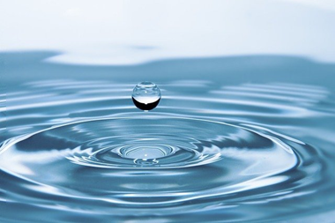
Human & environmental health
Global food production is among the largest drivers of global environmental change by contributing to climate change, biodiversity loss, fresh water use […] (Willet et al., 2019)
Willett et al. (2019). Food in the Anthropocene: the EAT-Lancet Commission on healthy diets from
sustainable food systems. Lancet, 393, 447–492.

Slide 4
Aims of the research
Basing on the relationship between human & environmental health,
we focus two goals
to assess water impact of five diets through water footprint calculation: Western diet, flexitarian diet, Mediterranean diet, diet for athletes & vegan diet
to assess the level of acceptability of the diet that showed the lowest water consumption

Slide 5
Methods
dietary pattern elaboration
daily food plan for each diet selected
ideal subject (aged 30 – 59; estimated caloric expenditure, 2.200 kcal; mean weight, 69 kg)
water footprint calculation
Water Footprint calculation (m³/year) through the Water Footprint Network
Manual calculation (l/capita/day) tabulated values
acceptability assessment
17-item validated questionnaire translated and adapted into Italian context
N = 126 adults (mean age, 26 years old; females, 62.7%)

Slide 6
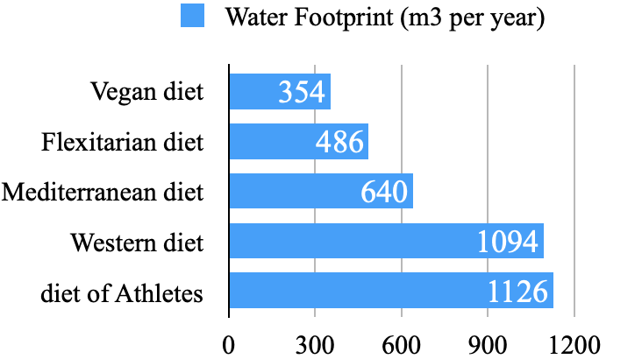
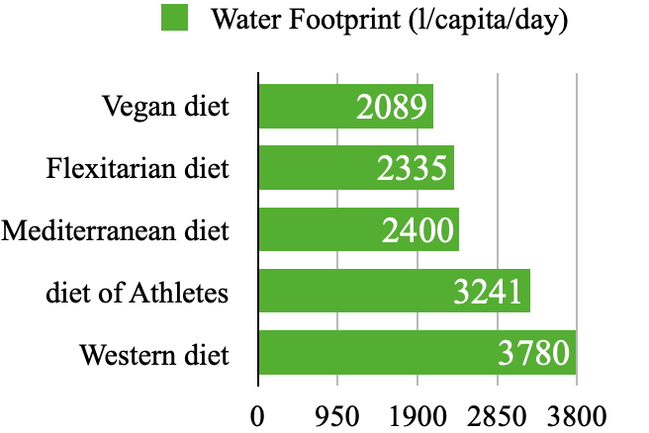
Results I - Water Footprint
Estimated water consumption of 100% plant-based diet is 740 m³ per year or 1.691 liters per capita per day

Slide 7
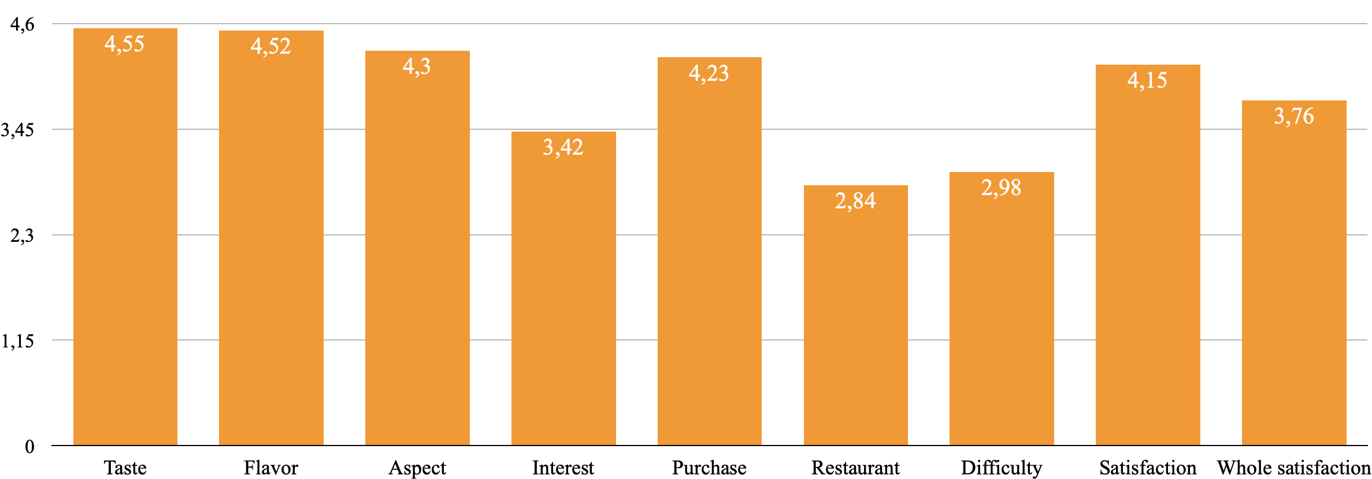
Results II – Level of acceptability
The level of acceptability of vegan diet is intermediate level (mean score, 3.86)

Slide 8
Take home messages
Adopting a plant-based diet or close to it favors reducing water consumption, so that could help to protect human health and planet balance
Western diet and diet for athletes seem to have the highest water consumption among widespread dietary patterns
The level of acceptability of a 100% plant-based diet by people should be considered before promoting this dietetic pattern
Thank you
email: virginia.vettori@unifi.it

